Slide 1
FSG SIGNS · CAPABILITIES
Your Brand on Every Building
Sign programs for one storefront, new locations or a national rebrand.
FACILITY SOLUTIONS GROUP · FSG SIGNS
Notes:
Tailor this title for the client: their brand, their site count, their deadline. Example: Your New Name on Every Kitchen.

Slide 2
WHY THIS MATTERS
Every site, one standard
Same letters, same color, same placement, coast to coast
The Brand Moved. The Buildings Follow.
A fixed window
Surveyed, built, removed and installed on your schedule
Live operations
Sites that cannot stop for a sign change
A new name, a merger or a new location only lands when every building matches. Your signs are where customers, crews and partners see your brand first.
One accountable vendor
Survey to sign-off, end to end
Notes:
Set the stakes in the client's terms: site count, deadline, why the brand is changing.

Slide 3
THE APPROACH
One Team, Survey to Sign‑Off
Design, fabrication, permitting, removal and install under one contract, backed by FSG's national electrical footprint.
Notes:
The big idea: one accountable team from survey to sign-off.

Slide 4
HOW IT WORKS
Four Phases, One Accountable Partner
PHASE 1
Site surveys
Every site photographed and measured. Mounting surface, structure and power confirmed before anything is built.
PHASE 2
Fabrication
Channel letters, cabinets and panels built to your brand standard. Install kits and mounting hardware included.
PHASE 3
Packaging & freight
Letter sets and kits crated for the road. Freight estimated per site, actuals approved by you.
PHASE 4
Removal & installation
Old signage removed and disposed of. New signs installed where your standard and the survey say.
Notes:
If the client sent a scope of work, relabel these phases to match it.

Slide 5
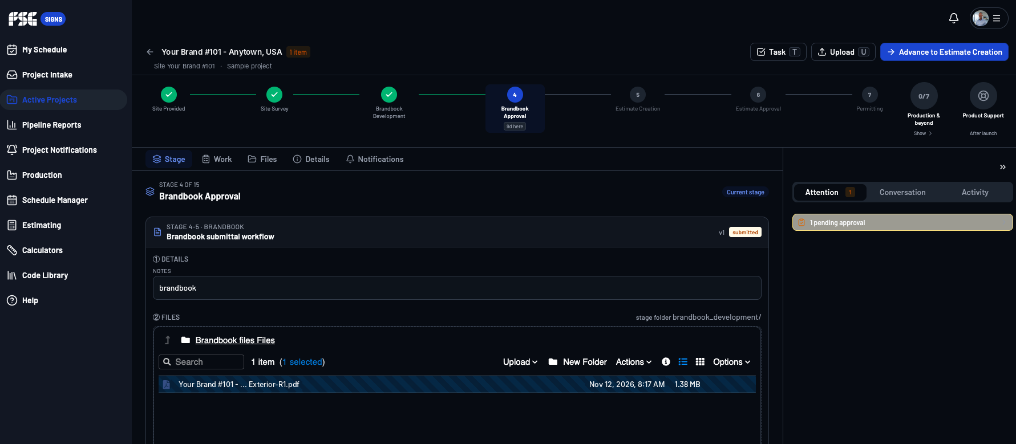
THE FSG SIGNS APP · SAMPLE VIEW
Every Site, Tracked Live
Each of your sites runs as its own project, moving through the same 15-stage workflow.
One stage tracker per site
Where every site stands, at a glance
Versioned submittals
Drawings, approvals and files in one place
Nothing advances without approval
Pending approvals flagged until cleared
Notes:
Sample view of the FSG Signs app. Each site is its own project record.

Slide 6
FLOW DEMO · YOUR PROJECT IN THE APP
Every Step You Asked For, Tracked
1
2
3
4
5
6
7
8
9
Site Provided
Site Survey
Brandbook Development
Brandbook Approval
Estimate Creation
Estimate Approval
Permitting
Production & Beyond
Product Support
STAGE 1 · YOUR SITE LIST
Site Provided
Each site set up as its own project with a work order, site contact and priority rank.
WHAT'S TRACKED
Address, contact, priority, work order
Stored on the record for every site.
PROGRESS
Step 1 of 9
Next: Site Survey
Auto-advances every 3 seconds in Slide Show · click any stage to jump
Notes:
Site Provided (Your site list). Each site set up as its own project with a work order, site contact and priority rank. What the app tracks: Address, contact, priority, work order.

Slide 7
FLOW DEMO · YOUR PROJECT IN THE APP
Every Step You Asked For, Tracked
1
2
3
4
5
6
7
8
9
Site Provided
Site Survey
Brandbook Development
Brandbook Approval
Estimate Creation
Estimate Approval
Permitting
Production & Beyond
Product Support
STAGE 2 · PHASE 1
Site Survey
Bucket-truck visit: mounting surface, structure, corner measurements, existing-sign inventory.
WHAT'S TRACKED
Photos, measurements, extra branding flagged
Stored on the record for every site.
PROGRESS
Step 2 of 9
Next: Brandbook Development
Auto-advances every 3 seconds in Slide Show · click any stage to jump
Notes:
Site Survey (Phase 1). Bucket-truck visit: mounting surface, structure, corner measurements, existing-sign inventory. What the app tracks: Photos, measurements, extra branding flagged.

Slide 8
FLOW DEMO · YOUR PROJECT IN THE APP
Every Step You Asked For, Tracked
1
2
3
4
5
6
7
8
9
Site Provided
Site Survey
Brandbook Development
Brandbook Approval
Estimate Creation
Estimate Approval
Permitting
Production & Beyond
Product Support
STAGE 3 · DESIGN
Brandbook Development
Site-specific sign drawings from your brand standards, colors and survey measurements.
WHAT'S TRACKED
Drawing package in the site folder
Stored on the record for every site.
PROGRESS
Step 3 of 9
Next: Brandbook Approval
Auto-advances every 3 seconds in Slide Show · click any stage to jump
Notes:
Brandbook Development (Design). Site-specific sign drawings from your brand standards, colors and survey measurements. What the app tracks: Drawing package in the site folder.

Slide 9
FLOW DEMO · YOUR PROJECT IN THE APP
Every Step You Asked For, Tracked
1
2
3
4
5
6
7
8
9
Site Provided
Site Survey
Brandbook Development
Brandbook Approval
Estimate Creation
Estimate Approval
Permitting
Production & Beyond
Product Support
STAGE 4 · YOUR SIGN-OFF
Brandbook Approval
Drawings submitted to your team for approval before anything is priced or built.
WHAT'S TRACKED
Versioned submittals, pending approvals
Stored on the record for every site.
PROGRESS
Step 4 of 9
Next: Estimate Creation
Auto-advances every 3 seconds in Slide Show · click any stage to jump
Notes:
Brandbook Approval (Your sign-off). Drawings submitted to your team for approval before anything is priced or built. What the app tracks: Versioned submittals, pending approvals.

Slide 10
FLOW DEMO · YOUR PROJECT IN THE APP
Every Step You Asked For, Tracked
1
2
3
4
5
6
7
8
9
Site Provided
Site Survey
Brandbook Development
Brandbook Approval
Estimate Creation
Estimate Approval
Permitting
Production & Beyond
Product Support
STAGE 5 · YOUR COST TEMPLATE
Estimate Creation
Per-site pricing built on your five-line cost template.
WHAT'S TRACKED
Estimate tied to the approved drawings
Stored on the record for every site.
PROGRESS
Step 5 of 9
Next: Estimate Approval
Auto-advances every 3 seconds in Slide Show · click any stage to jump
Notes:
Estimate Creation (Your cost template). Per-site pricing built on your five-line cost template. What the app tracks: Estimate tied to the approved drawings.

Slide 11
FLOW DEMO · YOUR PROJECT IN THE APP
Every Step You Asked For, Tracked
1
2
3
4
5
6
7
8
9
Site Provided
Site Survey
Brandbook Development
Brandbook Approval
Estimate Creation
Estimate Approval
Permitting
Production & Beyond
Product Support
STAGE 6 · YOUR SIGN-OFF
Estimate Approval
You approve each site's price. Out-of-scope items come as change orders first.
WHAT'S TRACKED
Approval and change orders logged
Stored on the record for every site.
PROGRESS
Step 6 of 9
Next: Permitting
Auto-advances every 3 seconds in Slide Show · click any stage to jump
Notes:
Estimate Approval (Your sign-off). You approve each site's price. Out-of-scope items come as change orders first. What the app tracks: Approval and change orders logged.

Slide 12
FLOW DEMO · YOUR PROJECT IN THE APP
Every Step You Asked For, Tracked
1
2
3
4
5
6
7
8
9
Site Provided
Site Survey
Brandbook Development
Brandbook Approval
Estimate Creation
Estimate Approval
Permitting
Production & Beyond
Product Support
STAGE 7 · PERMITS
Permitting
Permits pulled and filed; local, landlord and airport criteria tracked per site.
WHAT'S TRACKED
Permit status and documents
Stored on the record for every site.
PROGRESS
Step 7 of 9
Next: Production & Beyond
Auto-advances every 3 seconds in Slide Show · click any stage to jump
Notes:
Permitting (Permits). Permits pulled and filed; local, landlord and airport criteria tracked per site. What the app tracks: Permit status and documents.

Slide 13
FLOW DEMO · YOUR PROJECT IN THE APP
Every Step You Asked For, Tracked
1
2
3
4
5
6
7
8
9
Site Provided
Site Survey
Brandbook Development
Brandbook Approval
Estimate Creation
Estimate Approval
Permitting
Production & Beyond
Product Support
STAGE 8 · PHASES 2 – 4
Production & Beyond
Fabrication, packaging and freight, removal of old signage, install of new letters.
WHAT'S TRACKED
Seven production steps, site by site
Stored on the record for every site.
PROGRESS
Step 8 of 9
Next: Product Support
Auto-advances every 3 seconds in Slide Show · click any stage to jump
Notes:
Production & Beyond (Phases 2 – 4). Fabrication, packaging and freight, removal of old signage, install of new letters. What the app tracks: Seven production steps, site by site.

Slide 14
FLOW DEMO · YOUR PROJECT IN THE APP
Every Step You Asked For, Tracked
1
2
3
4
5
6
7
8
9
Site Provided
Site Survey
Brandbook Development
Brandbook Approval
Estimate Creation
Estimate Approval
Permitting
Production & Beyond
Product Support
STAGE 9 · AFTER LAUNCH
Product Support
Warranty and service on every sign after install.
WHAT'S TRACKED
Service history stays with the site
Stored on the record for every site.
PROGRESS
Step 9 of 9
Live for the life of the sign
Auto-advances every 3 seconds in Slide Show · click any stage to jump
Notes:
Product Support (After launch). Warranty and service on every sign after install. What the app tracks: Service history stays with the site.

Slide 15
UL-certified channel letters
Built to code, exterior-durable, weather-resistant
FABRICATION
Built in Our Own Shop
Your brand color, matched
Your Pantone standard on every set
Your choice of illumination
Non-lit, face-lit LED or reverse-lit
Raceway or flush mount
Chosen per wall from survey findings
Your letters come out of FSG's 95,000 sq ft fabrication facility in San Antonio, Texas. Design, build and quality control stay in one place, so every site matches.
10-year lifetime warranty on LEDs
Illumination covered for a decade
5-year sign parts & labor warranty
Parts and labor covered for five years
Notes:
In-house fabrication in San Antonio. Warranty: 10-year lifetime on LEDs, 5-year sign parts and labor.

Slide 16
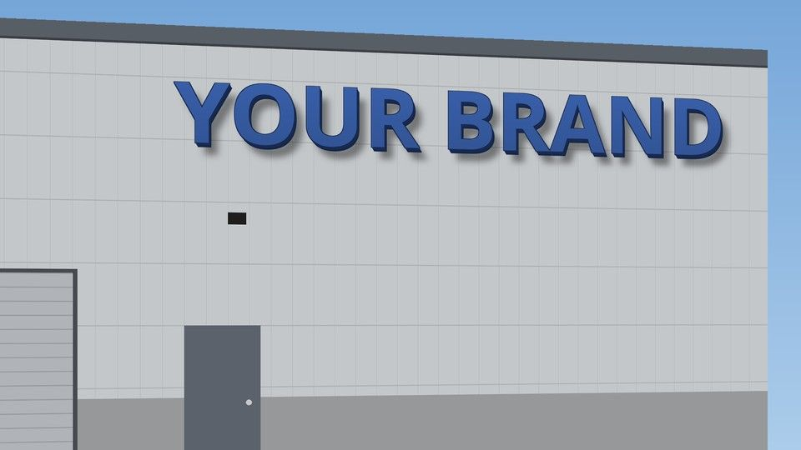


CONCEPT RENDERING · CHANNEL LETTERS
Three Ways to Light Your Brand
NON-LIT
Painted brand-color faces
No power needed at the sign. Reads clearly by day.
FACE-LIT LED
Lit through the face
Your brand color glows after dark.
REVERSE-LIT
Halo on the wall
Solid faces, soft white halo behind each letter.
Illustrative concept. Final size, mounting and illumination confirmed by site survey.
Notes:
Ask which lighting the client wants; it changes the letter build, the power at the wall and the price.

Slide 17
INSTALLATION
2,000+ affiliated installers
Coverage for every market on your list
Crews Wherever You Have a Site
43+ FSG locations, 3,500+ employees
National electrical company behind the sign team
Licensed electricians on staff
Power at the sign handled by the same team
Self-performed crews with our own trucks and cranes, plus a vetted installer network for every market on your list.
One project manager
Single point of contact for every site and every crew
Notes:
National reach: self-performed crews plus 2,000+ affiliated installers.

Slide 18
PROPOSED PHASING
Wave 1: your top priorities
Your highest-priority sites first
Highest-Priority Sites First
Regional waves
Remaining sites batched by geography, in priority order
New facilities
Timed with each general contractor's schedule
Your priority ranking sets the order. Regional grouping after the first wave keeps travel cost down and crews moving.
On your timeline
Schedule set jointly with your team
Notes:
Ask whether the client wants strict priority order or regional batches.

Slide 19
PROVEN AT SCALE
Brands That Rebranded With FSG
NATIONAL ROLLOUT
Wesco
Anixter-to-Wesco rebrand: site surveys, drawings, removal and new channel letters, monuments and wayfinding.
NEW-STORE ROLLOUT
H-E-B
Complete store sign packages: site plan, elevations with code-allowed sign area, every sign through client approval.
NATIONAL ROLLOUT
Duluth Trading Company
Turnkey signage nationwide: design, permitting, fabrication and installation from one provider.
MULTI-UNIT
Applebee's
Restaurant signage delivered across the country.
Notes:
Wesco and H-E-B lead. Their drawings live in the gated hub deck; confirm permission before showing them to a client.

Slide 20
ONE PARTNER
Signs
Channel letters, monuments, wayfinding, ADA, repair and maintenance
More Than Signs
Lighting & Electric
Interior and exterior LED, electrical service and construction
ECM Projects & Roll-outs
Solar, EV Charging and Large ECM Projects with measurable savings
Signs are often the first step. The same team handles the electrical, lighting, energy and building technology behind them.
Building Automation Systems (BAS) & Technology
Controls and building technology for your facilities
Facility Solutions Group · Since 1982
Notes:
Signs open the door to the broader FSG relationship.

Slide 21
NEXT STEP
Let's Start With the Surveys
Send us your site list and our survey crews start at your top‑priority sites.
FACILITY SOLUTIONS GROUP · FSG SIGNS
Notes:
The first domino: get the site list so surveys can start.

