Slide 1

PayBack
Arnav Agarwal
Orr Epstein
Huy Luong
Hohyun Jeon
William Macfarlane
Chase Mamatey
Timothy Milne
Ryan Murphy
Viquoc Quan

Slide 2

Features Implemented
User Interface
More navigation of GUI
Android
Developed activities for UI functionality
Developed classes for object management (accounts/transactions)
Backend
Set up MySQL database on dedicated server and established connection
Created php scripts to run queries and authentication
Updated database to allow auto-incrementation
Hohyun Jeon

Slide 3
Project Status
Basic UI
Sprint 2
Sprint 3
Final Product
Sprint 1
Full UI
Basic Android
Backend Database
Aesthetics
Database querying
Class/object implementation
Encryption (forwarded)
Optimization
Full Application
Implementation of all features
Final testing
Additional Features
Application sub-functions
Encryption
Hohyun Jeon

Slide 4
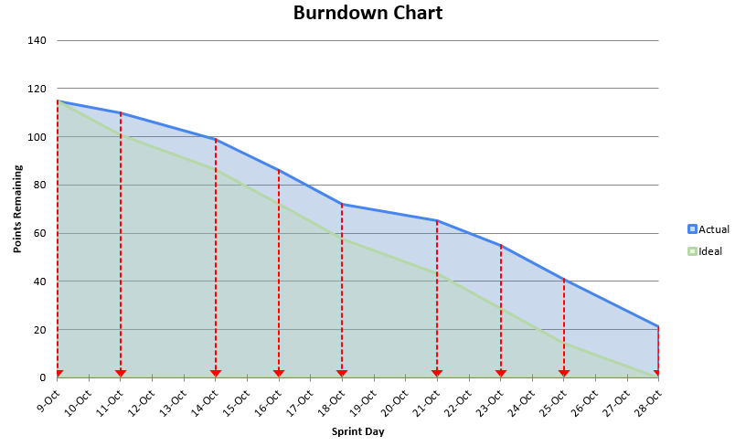
Scrum Documentation
Hohyun Jeon

Slide 5
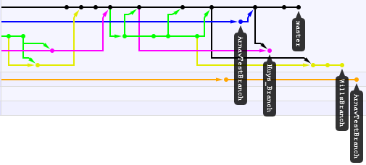
GitHub Repository
Viquoc Quan

Slide 6

Demonstration
Viquoc Quan

Slide 7
Risk Analysis
Description | Probability | Severity | Mitigation
Cannot connect to the server | Medium | High | Restart and reestablish server connection
Cannot pass data through application | Low | High | Carefully comb through code to detect and fix any errors
Cannot record information in database | Medium | High | Examine the code which transmits data and fix any errors
Cannot operate app on real mobile device | Low | Medium | Test as many compatible devices as possible; find and fix any errors in code
Arnav Agarwal

Slide 8
Load Balance
Member | Load
Arnav Agarwal | Core Android programming
Orr Epstein | Application testing and Android
Huy Luong | Core Android programming
Hohyun Jeon | PHP/MySQL and server implementation
Will Macfarlance | Core Android programming
Chase Mamatey | Server-side implementation
Tim Milne | Git and Core Android programming
Ryan Murphy | PHP/MySQL and server implementation
Viquoc Quan | User Interface Design and Coding
Arnav Agarwal

Slide 9
Sprint Retrospective
What went right
Tasks are clearly delegated
Continued effective communication
Performed plenty of research
What went wrong
Delegation of SCRUM points
What to improve on
Putting in more hours on a regular basis
Frontend-Backend communication
Arnav Agarwal

