Slide 1
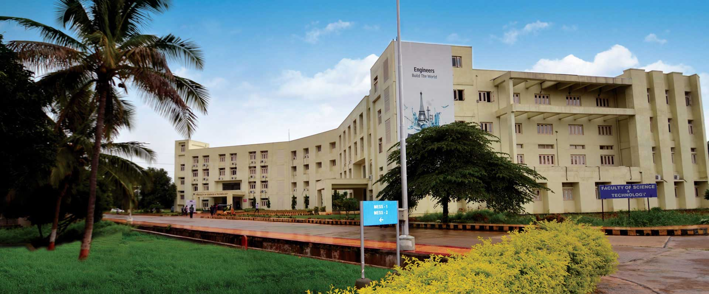
SEMINAR 3 OF 3
Diagnostic Failure Analysis: Why the Raw KG Score Fails, and What Five Rounds of Rejected Fixes Taught Us
Part 3: Research Integrity & the Stopping Rule
Department of Computer Science
Brahmaji Katragadda
ICFAI (IFHE), Hyderabad

Slide 2




Why This Level of Rigor
This project already had one integrity crisis — before any of Seminars 1–2
What was found
How it was resolved
Every headline number computed before this audit — including two decisive earlier experiments — ran against a hand-authored, fully synthetic 120-sample fixture, not the real Mohler et al. (2011) benchmark the paper cites.
Verified against the real dataset on HuggingFace (nkazi/MohlerASAG, CC-BY-4.0) — a completely different format and content, no ambiguity. Every result in this project was then rebuilt on the real data.
The dataset loader's own docstring said so:
Retracted, not deleted
“a sample subset for testing (embedded)” / “synthetic generation for evaluation pipeline testing.”
Fabricated sections are kept in the paper, clearly labeled “Retracted,” for the experimental-design record — not silently removed.

Slide 3
Method: Inductive Failure-Mode Analysis
1
2
3
4
Sample worst cases
No predetermined taxonomy
Root-cause, not just describe
Validate offline against real data
60 samples selected by |kg_score − human_score|, roughly the top 5%.
Categories emerge from reading the cases — not fit to a preset list.
Trace each pattern back to the exact line of code responsible.
Every fix re-run against the real, unchanged extraction outputs.
“Why do apparently similar cases succeed?” matters as much as “why do bad cases fail?”

Slide 4

FIXED & MERGED
Finding 1 — Tokenization Bug
The bug
Scope & Fix
Question text tokenized via .split() — no punctuation stripped.
106 / 1,262
samples affected (8.4%)
"What is a queue?"
token → "queue?"
never matches KG text → "queue"
4
questions, all “What is a <concept>?”
Result: false OUT_OF_KG_DOMAIN flag, regardless of extraction quality.
On the 106 affected samples: MAE improves 65.1% (3.96 → 1.38) — now beating C_LLM on those samples. Regression-validated: exactly 106/106 flips, 0 unexpected side effects.

Slide 5
DIAGNOSED ONLY
Findings 2 & 3 — Two Unfixed Defects
Finding 2
Finding 3
relationship_accuracy zeroed by design
concept_coverage is self-referentially vacuous
Correct answers that structurally can't express a relationship (single-concept facts, comparative questions) score the same as a keyword dump.
Production never supplies external ground truth, so coverage compares the student's concepts against... the student's own concepts. Trivially 1.0.
21.3%
of samples affected;
73.2% of those are
human-graded correct
35.0%
of samples show
trivial coverage = 1.0,
right or wrong

Slide 6
Five Rounds, Six Rejected Repairs
Every candidate tested against pre-committed criteria, before the experiment ran

Slide 7

The Stopping Rule
After four distinct forms of the same intervention class (binary include/exclude of a scoring dimension with weight renormalization) all failed, this is evidence against the mechanism — not just miscalibrated parameters.
Closed with respect to the tested intervention classes
A narrower, more defensible claim than declaring the problem permanently unsolvable. A differently-structured intervention remains an open question this investigation did not address.
None of this changes the deployed grade — production already discards the raw KG-formula score for the Verifier (w = 1.0). This affects only the standalone ablation metric.

Slide 8

Dataset Provenance Audit
Mohler 2011
nkazi/MohlerASAG (HuggingFace, CC-BY-4.0)
Verified
DigiKlausur
Character-for-character match vs. GitHub source
Verified
Kaggle ASAG
Acquisition path could not be reconstructed
Unverified
“Unverified” is not “fake.” No positive evidence of fabrication was found — only an absence of evidence of authenticity. Those are different claims, kept separate.

Slide 9

Reproducibility as a First-Class Artifact
350+
0
5
automated claim checks
unexplained mismatches
rounds of external review
Every reported number is independently recomputed from cached predictions — not trusted from a prior run's printed output.
Two findings — an ensemble-blend result, and the Finding-3 exclude-and-renormalize fix — were retracted the same day they failed their own validation.

Slide 10

Negative results are still results. This project's work says: here are two genuine implementation and design problems, and straightforward repairs did not improve the aggregate system.
The point was never that every proposed fix failed. It's that the investigation established, through a disciplined and reproducible process, which intuitively appealing interventions did not hold up under empirical validation.

Slide 11

Conclusion
A small, real, response-level-fragile improvement over an identical-model LLM baseline — driven by the Verifier, not KG-grounding.
Self-consistency ensembling: a real response-level gain whose question-level robustness collapses under a fair control — on every dataset it was checked against.
Two diagnosed, unfixed scoring defects and a disciplined, evidence-based stopping rule after five rejected repairs.
A dataset provenance audit that distinguishes Verified from Unverified from Invalid — and applies the same bar regardless of which direction a result points.
Thank you — Questions & Discussion

