Slide 1
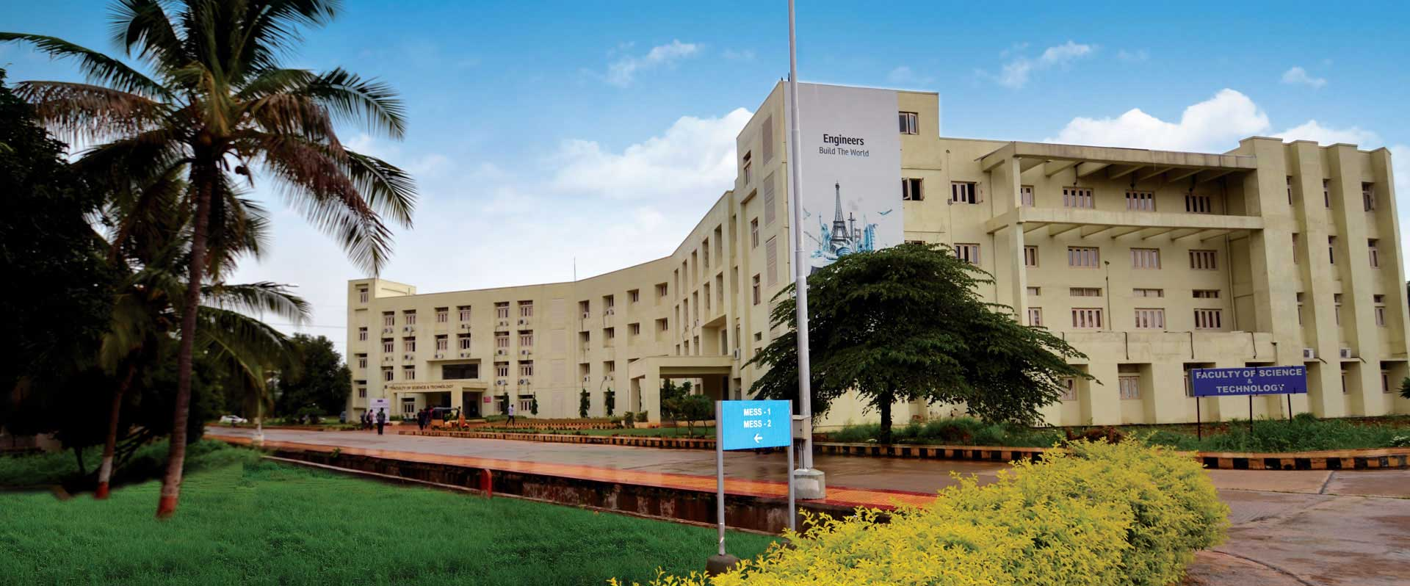
ConceptGrade: A Knowledge-Graph-Driven Framework for Concept-Aware Automated Short Answer Grading
Part 1: Architecture & System Design
DAC Committee Dr. Sandeep kumar Panda
Dr. P. Pavan Kumar Dr. Kongara Srinivasa Rao
Katragadda Brahmaji

Slide 2



The Problem
Grading short-answer questions at scale
1
Slow & inconsistent
Manual grading of CS short-answers doesn't scale to large classes, and delays feedback to students.
ConceptGrade's Premise
Treat grading as a knowledge-graph matching task: convert each free-text answer into a typed concept graph, and compare it against an expert domain graph.
2
Score without explanation
Prior lexical, embedding, and LLM zero-shot graders output a number — not which concepts were understood.
This yields an explicit, inspectable record of what a student did and didn't demonstrate — not just a score.
3
No record of misconceptions
A grade alone can't tell an instructor whether a student confused LIFO with FIFO, or never engaged with the concept.

Slide 3

What Prior Approaches Miss
Lexical / LSA
(Mohler & Mihalcea)
Dependency Graphs
(Mohler et al. 2011)
LLM Zero-Shot
(C_LLM baseline)
r = 0.493
r = 0.518
Competitive
Surface overlap only — no concept structure
Mohler & Mihalcea, EACL 2009 [1]
Structural alignment, still no explicit KG
Mohler et al., ACL 2011 [2]
No explicit conceptual record kept
Our own baseline
ConceptGrade extends concept-map assessment — where students draw node-link diagrams graded against an expert map — to free-text answers, by inferring an equivalent graph automatically via LLM extraction.
r = Pearson correlation between the automated score and a human grader’s score (0 = no relationship, 1 = perfect agreement). All sources above were checked directly against their original publications — full citations on the References slide.

Slide 4
System Architecture
Five layers, question + student answer in → score + explanation out
01
02
03
04
05
Concept
Extraction
KG
Comparison
Cognitive
Depth
Misconception
Detection
Score Synthesis
+ Verifier
LLM (gemini-2.5-flash), 3× self-consistency
Deterministic, LLM-free matching
Bloom's (L1–L6) + SOLO (L1–L5)
16-entry validated taxonomy
Blend → LLM Verifier, w = 1.0
Question + Student Answer
Score + Explanation
WORKED EXAMPLE — ONE REAL ANSWER THROUGH ALL FIVE LAYERS
A student answer stating a stack uses “FIFO order” moves through all five layers: Layer 1 extracts 8 concepts, including the stated FIFO claim • Layer 2 finds the ordering relationship incorrect • Layer 4 flags a critical LIFO/FIFO misconception • Layer 5 returns a final score of 0.75 / 5 — lower than the 1.00 / 5 a plain LLM gave the same answer, unaided by any of the above.

Slide 5
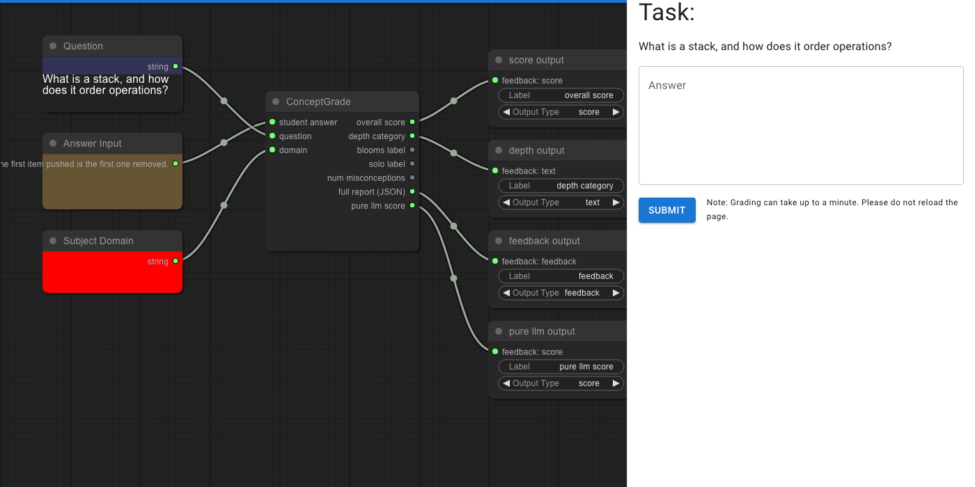
The Live Application
This node-graph editor is the real, running NodeGrade platform — not a mockup

Slide 6
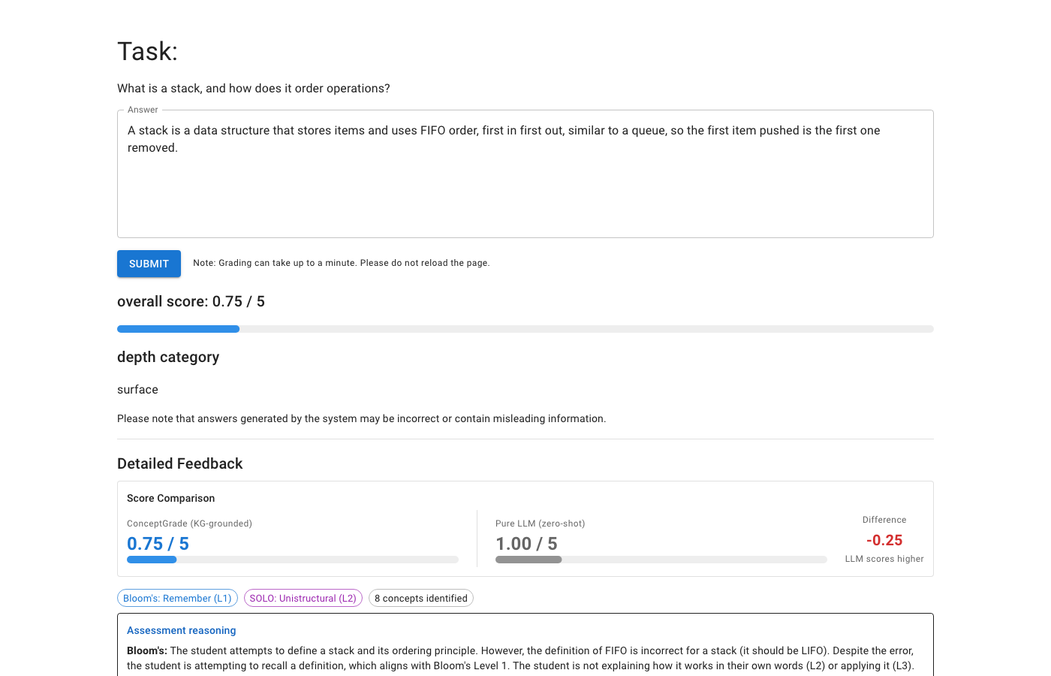
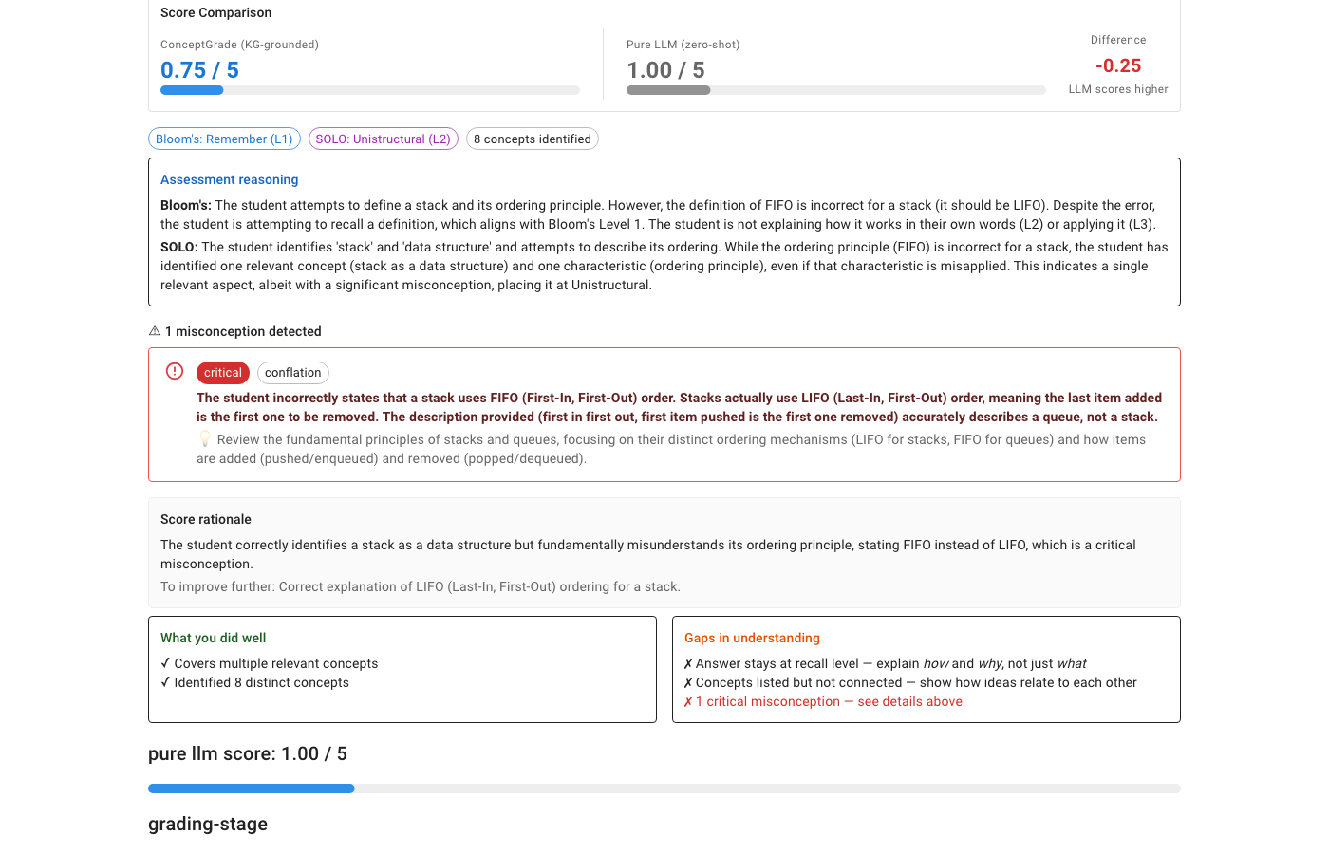
Live Example — A Real Graded Answer
Submitted live to the running system: “A stack is a data structure that uses FIFO order...”

Slide 7

Layer 1 — Concept Extraction
An LLM receives the question and student answer and returns a typed student concept graph Gₛ = (Vₛ, Eₛ), run with 3× self-consistency (majority-vote, min_votes = 2/3) to reduce single-call extraction noise.
Question-focused ontology matching
A keyword matcher builds a focused ~10–20-concept ontology subset for the LLM prompt, instead of always supplying the full 101-concept KG.
Concepts below confidence τ = 0.70 are filtered; surface forms resolve to canonical KG identifiers via alias lookup.
Notation note: Gₛ = (Vₛ, Eₛ) is standard graph notation — G is a graph, V is its set of concepts (nodes), E is its set of relationships between concepts (edges). The subscript s marks this as the student’s graph, compared in Layer 2 against the expert’s graph, Gₑ.

Slide 8
Layer 2 — Knowledge Graph Comparison
A deterministic, LLM-free graph matcher — no model calls, fully reproducible
coverage
accuracy
integration
|Vₛ ∩ Vₑ| / |Vₑ|
|correct edges| / |Eₛ|
|connected nodes| / |Vₛ|
Fraction of expert-graph concepts the student mentioned
Fraction of stated relationships that are correct
How structurally connected the student's graph is
Plus interpretable diagnostics: missing concepts, incorrect relationships, and per-answer feedback points surfaced directly to the student.
Notation note: |X| means “the count of X”; ∩ means “the overlap between two sets.” So |Vₛ ∩ Vₑ| / |Vₑ| reads as: the concepts the student and the expert both have, divided by the total number of expert concepts.

Slide 9


Layers 3 & 4 — Depth & Misconceptions
Layer 3: Cognitive Depth
Layer 4: Misconception Detection
A hybrid classifier jointly assigns:
A 16-entry validated error taxonomy is checked against every response.
• Bloom's level (1–6): Remember → Create
• SOLO level (1–5): structural complexity of the response
DS-STACK-01
Confuses LIFO with FIFO ordering
depth = 0.55·blooms_norm + 0.45·solo_norm
SOLO has received far less attention than Bloom's in automated CS assessment — ConceptGrade applies both jointly.
Each entry carries a severity level and a remediation hint surfaced directly to the student — not just “wrong.”
Notation note: “_norm” means the raw Bloom’s/SOLO level converted onto a 0–1 scale first, so the two different scales (1–6 and 1–5) can be combined fairly in one weighted average.
Bloom’s (1–6): Remember → Understand → Apply → Analyze → Evaluate → Create — what kind of thinking the answer shows.
SOLO (1–5): Prestructural → Unistructural → Multistructural → Relational → Extended Abstract — how structurally connected the answer is.

Slide 10

Layer 5 — Score Synthesis & Verification
knowledge = 0.45·cov + 0.35·acc + 0.20·int
s_kg = (0.60·knowledge + 0.40·depth) × (1 − p_misc)
final = (1 − w)·s_kg + w·verified
w = 1.0 (deployed)
An LLM Verifier independently reviews the raw answer alongside the KG evidence and produces the final grade.
At the deployed weight, the Verifier's judgment drives the score — KG evidence is prompt context, not an arithmetic anchor. Is that an accident of tuning? Seminar 2 answers this with cross-validation.
Notation note: cov/acc/int are the Layer 2 scores; depth is the Layer 3 score; p_misc is a penalty from Layer 4’s misconceptions; w controls how much weight the Verifier gets versus the formula above it. Every term is a number between 0 and 1.

Slide 11
The Expert Domain Knowledge Graph
Data Structures domain — frozen before evaluation began
101
138
8
concepts
typed relationships
semantic types
Three design rules:
Pedagogical coverage — every concept in a standard intro course
Canonical identifiers — unique ID plus alias surface forms
Typed relationships — semantically labeled directed edges
THE EIGHT SEMANTIC TYPES, WITH EXAMPLES
Data Structure (27)
array, linked_list, binary_tree
Abstract Concept (25)
recursion, iteration, data_structure
Algorithm (19)
tree_traversal, inorder, preorder
Property (10)
lifo, fifo, stack_overflow
Operation (9)
push, pop, enqueue
Complexity Class (7)
O(1), O(log n), time_complexity
Design Pattern (3)
chaining, divide_and_conquer
Prog. Construct (1)
pointer

Slide 12
What the Student Actually Sees
Not just a score — a structured, actionable explanation
Matched / missing concepts
“You mentioned stack and lifo, but missed push_operation and pop_operation.”
Incorrect relationships
“Stack uses FIFO is incorrect.”
Bloom's / SOLO level with justification
Cognitive depth, not just correctness
Misconception + remediation hint
“DS-STACK-01: A stack uses LIFO, not FIFO. Review the push/pop mechanism.”
The KG and misconception taxonomy carry this information cost at authoring time — not inference time.

Slide 13
Platform & Engineering Stack
Analysis Pipeline
Python — runs ConceptGrade scoring, TRM computation, and statistical analysis scripts.
Backend
NestJS (TypeScript) — serves the dataset, manages event logs, and handles API calls to the analysis pipeline.
Frontend
React + Vite (TypeScript) — the interactive dashboard shown in the live demo (Slide 5).
Deployment Platform
The live application on Slide 5 runs this exact stack — not a mockup or a separate demo build.
Event Logging: every interaction is logged to JSONL with millisecond timestamps. FERPA-compliant — student answer text is never stored; only a one-way FNV-1a hash is kept, for deduplication only.

Slide 14
Scope & Limitations
Single model family
Every LLM call uses gemini-2.5-flash. No cross-model validation yet.
Single-author KG & taxonomy
101 concepts, 16 misconceptions, one research group. Machine-IRR pilot: κ = 0.54 (moderate) — a lower-bound self-estimate, not external validation.
Domain specificity
The expert KG covers Data Structures only. Cross-domain evaluation on other CS areas is future work.
These are disclosed up front — not discovered by a reader. Seminar 3 covers a deeper class of limitation found during the project's own audit.

Slide 15
References
Sources for the correlation figures cited on Slide 3
[1] M. Mohler and R. Mihalcea, “Text-to-text semantic similarity for automatic short answer grading,” Proc. 12th Conf. European Chapter ACL (EACL), Athens, Greece, 2009, pp. 567–575.
→ Source of r = 0.493, Lexical / LSA box, Slide 3
[2] M. Mohler, R. Bunescu, and R. Mihalcea, “Learning to grade short answer questions using semantic similarity measures and dependency graph alignments,” Proc. 49th Ann. Meeting ACL, Portland, OR, USA, 2011, pp. 752–762.
→ Source of r = 0.518, Dependency Graphs box, Slide 3
[3] J. Devlin, M.-W. Chang, K. Lee, and K. Toutanova, “BERT: Pre-training of deep bidirectional transformers for language understanding,” Proc. 2019 Conf. NAACL-HLT, Minneapolis, MN, USA, 2019, pp. 4171–4186.
→ Foundational transformer model underlying the BERT box, Slide 3
[4] C. Sung, T. I. Dhamecha, S. Saha, T. Ma, V. Reddy, and R. Arora, “Pre-training BERT on domain resources for short answer grading,” Proc. 2019 Conf. EMNLP-IJCNLP, Hong Kong, China, 2019, pp. 6071–6075.
→ Reports an F1 gain on SemEval, not a Mohler r — corrects an earlier, unverifiable citation here

