Slide 1
How to start with Containers
Robert McCaleb

Slide 2
Docker Engine
Docker CE
  CLI Linux and Windows are the same
  Docker Engine, Docker Registry, Swarm (Orchestration)
Windows Native (EE)
  W/HyperV Linux and Windows
  W/O HyperV Windows only
Docker EE
  Engine, Docker Trusted Reg, UCP (Swarm)

Slide 3
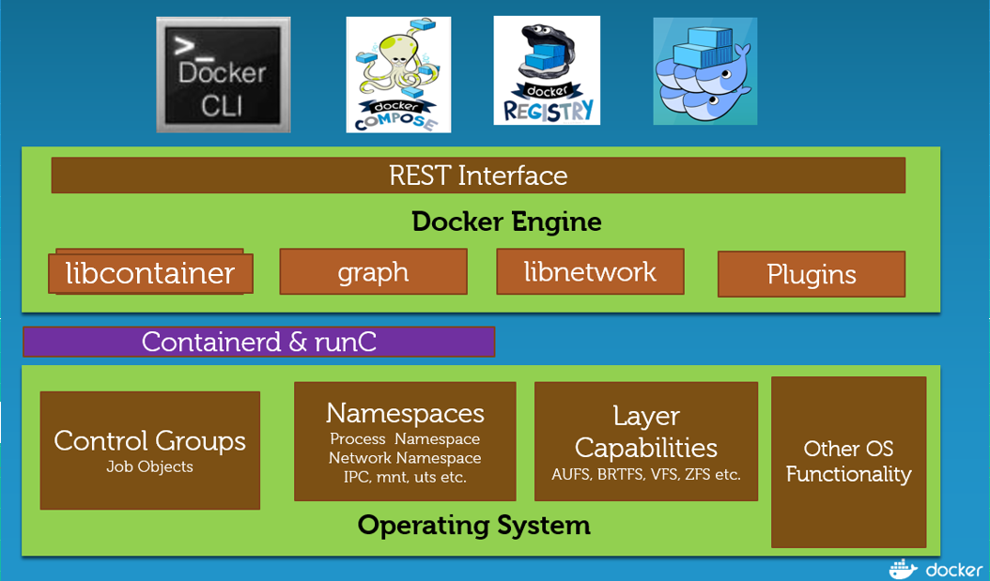
Docker CE on Linux
CE Engine
Docker Compose
Docker Swarm
Docker Registry (container)
http://collabnix.com/a-comparative-study-of-docker-engine-on-windows-server-vs-linux-platform/

Slide 4
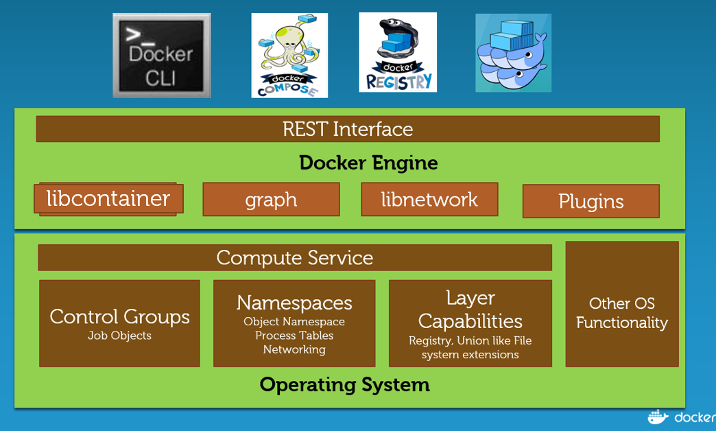
Docker CE on Windows
CE Engine
Docker Compose
Docker Swarm
Docker Registry (container)

Slide 5
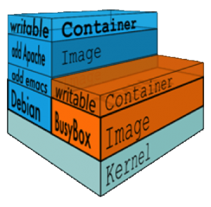
Containers are ephemeral (kind of)
Docker calls this combination of read-only layers with a read-write layer on top a Union File System.

