Slide 1
Pentimalli & Rajewsky 2025 — 3D multimodal atlas of one NSCLC
CosMx × SHG × STIM on one FFPE block
Bobby Y.X. Ni · Hickey Lab · Duke BME · Journal club, 2026-05-08
Notes:
- HOOK: What if the third dimension is hiding the most clinically actionable structures in your tumour?
- KEY CLAIM: Pentimalli & Rajewsky reconstruct a 3D molecular + ECM atlas of one early-stage NSCLC patient and show that single-section 2D spatial transcriptomics systematically misses the dendritic-cell niche and T-cell niche continuity that are recoverable in 3D.
- TRANSITION: Quick mental map first.

Slide 2
Why this paper — first proof that routine 3D multimodal profiling is feasible on clinical FFPE
SAMPLE — one patient, early-stage non-small-cell lung cancer (NSCLC), formalin-fixed paraffin-embedded (FFPE) block
DESIGN — 34 consecutive 5-µm sections, registered into one 3D coordinate frame via STIM software
MODALITIES — CosMx 1000-plex spatial transcriptomics + label-free second-harmonic generation (SHG) extracellular matrix imaging + H&E
SCALE — 340 644 cells → 18 cell types → 10 multicellular niches
HEADLINE — 3D recovers dendritic-cell niches + T-cell continuity that 2D analysis erases
DRUGGABILITY — niche-resolved checkpoint signalling: MIF, CCR7, PD-L1, CTLA-4, Tim-3
Notes:
- HOOK: What does this paper add over Schurch 2020 / Goltsev 2018?
- KEY CLAIM: Earlier neighbourhood-imaging papers were 2D and protein-only. Pentimalli is the first that combines (a) genuine 3D registration over 34 serial sections, (b) 1000-plex transcriptomics, and (c) label-free ECM imaging — on a routine clinical FFPE block, not a research-grade fresh sample.
- EVIDENCE: Cell Systems 2025; co-authored with NanoString (Liang, Gregory) for the CosMx 960-gene panel; Klauschen + Rajewsky + Piccolo lab consortium.
- TRANSITION: Walk through the experimental design first.
--- DETAILED SCRIPT ---
Three ideas frame the paper. First, the patient is real and the tissue is real — an early-stage but aggressive NSCLC, archival FFPE, surgical resection. Nothing fresh-frozen, nothing precious. That matters because every clinical pathology lab in the world has FFPE blocks; if this workflow only worked on fresh tissue, it would never translate. Second, the modalities are complementary rather than competing. CosMx gives you which gene each cell expresses; SHG gives you the extracellular matrix scaffold those cells live inside; STIM aligns serial sections into a coherent 3D coordinate frame. None of those alone is enough. Third — and this is the part that matters for our lineage — the 3D analysis isn't just decorative. The neighbourhood volumes are 2.28× larger than 2D, and that extra volume is exactly where the dendritic-cell niches and the T-cell-niche bridges live. Lose 3D, lose the immunology.
--- EXTENDED WALKTHROUGH ---
BACKGROUND — what is spatial transcriptomics and why is 3D hard?
Spatial transcriptomics is a family of methods that measure RNA expression while preserving the (x,y) position of each measurement in a tissue section. The dominant platforms today are Visium (10x Genomics, barcoded array, ~2-55 µm spots), CosMx (NanoString/Bruker, 960-6000 gene single-molecule imaging), MERFISH (Vizgen, similar), and Xenium (10x, 300-5000 gene panel). All of them have been used almost exclusively in 2D — one section per sample, occasionally a small stack of 2-4 sections. Going to true 3D requires three things: (a) consistent section quality across many serial cuts (FFPE blocks degrade with each section), (b) image registration that handles non-rigid deformations between sections, (c) the experimental budget to image many sections (CosMx is ~$3-5k per section at this depth, so 34 sections is ~$100-170k of reagent + instrument time).
STIM is the registration tool — Software for Spatial Transcriptomics on the Image Mosaic, developed in the Rajewsky lab. It uses computer-vision-based alignment of consecutive sections, anchored on H&E or DAPI features. The paper reports a median post-alignment displacement of ~42 µm — small enough that neighbourhoods at 50 µm radius are robust to alignment error.
CONTEXT FOR THE LINEAGE — Schurch 2020 in Cell defined the 'cellular neighbourhood' concept on 2D CODEX of colorectal cancer. Goltsev 2018 introduced CODEX. Hickey 2021 systematised the CODEX→single-cell pipeline. Sorin 2023 in Nature scaled the neighbourhood approach to 416 LUAD patients on IMC, all 2D. Pentimalli 2025 is the first paper that asks: how much of the structure these methods discover is artefact of the 2D slicing plane? The answer is: enough to matter clinically.

Slide 3
Who built this — Berlin × Munich × Padua × NanoString consortium
RAJEWSKY LAB (Max Delbrück Center, MDC Berlin) — first author Pentimalli; systems biology + spatial omics; built STIM registration tool
COSCIA LAB (MDC Berlin) — rising spatial-proteomics methods lead (ex-Mann lab, Munich)
KLAUSCHEN LAB (Charité + Ludwig Maximilian Univ, LMU Munich) — computational pathology; independent H&E annotations
PICCOLO LAB (Univ of Padua) — Hippo / YAP-TAZ pathway; mechano-transduction + epithelial-to-mesenchymal transition (EMT) framing
NANOSTRING → BRUKER (Liang, Gregory) — co-designed the CosMx 1000-plex cancer panel
Notes:
- HOOK: Why should you trust this paper before you've read a single figure?
- KEY CLAIM: This isn't a one-lab effort. It's a Berlin-Munich-Padua-NanoString consortium covering systems biology, spatial-proteomics methods, computational pathology, mechano-signalling, and the platform vendor. Cross-validation is built into the author list.
- EVIDENCE: Cell Systems 2025; first author Pentimalli (Rajewsky lab), corresponding Klauschen + Rajewsky; co-authors include Coscia (spatial proteomics) and Piccolo (Hippo/YAP-TAZ).
- TRANSITION: And the field around it has been priming for this paper for ~5 years.
--- DETAILED SCRIPT ---
Quick credentialling pass before figures. Pentimalli is a Rajewsky-lab postdoc; Rajewsky founded systems biology at MDC Berlin and has been pushing spatial-omics for the last decade. Klauschen at Munich runs one of the top computational-pathology labs and his group does the pathologist H&E annotations independently of the molecular analysis — that's the orthogonal-validation you'll see on slide 5. Coscia is the rising star in spatial-proteomics methods, ex-Mann lab. Piccolo is the Hippo/YAP-TAZ guy from Padua and brings the mechano/EMT framing. NanoString — now Bruker after the 2024 acquisition — co-developed the 1000-plex CosMx panel; the assay is fresh-from-vendor, not arms-length. So when you evaluate the methods later, remember: this is a consortium with the platform vendor, the pathologist, the spatial-proteomics expert, and two systems-biology labs. The cross-checks are in the author list.
--- EXTENDED WALKTHROUGH ---
WHY EACH AUTHOR CONTRIBUTION MATTERS — a quick read of the consortium.
RAJEWSKY (MDC Berlin) — corresponding author, systems-biology lab. Famous for the lncRNA/circRNA work in the 2010s, then pivoted hard into spatial transcriptomics + organoids in the 2020s. The lab built STIM, the registration tool used here. Reputation: methodologically rigorous, publishes in Cell / Nature / Nat Methods.
KLAUSCHEN (Munich) — corresponding author, computational pathology. His group develops AI-based pathology models and does pathologist-grade tissue annotations. The pathologist H&E annotation in Fig 2 is from his lab — that's the independent ground-truth check on the molecular niche analysis.
COSCIA (MDC Berlin) — spatial-proteomics methods. Ex-Mann lab in Munich. Brings the LCMS-MS deep proteomics complement to the CosMx transcriptomics (though most of that proteomics work is in supplements / future papers).
PICCOLO (Padua) — Hippo/YAP-TAZ pathway. The mechano-transduction framing of EMT and ECM stiffness is his contribution. Why YAP-TAZ matters: stiff (desmoplastic) ECM activates YAP/TAZ → fibroblast activation → more matrix deposition — positive-feedback loop. This is referenced in Fig 5/6/7.
PENTIMALLI (Rajewsky lab postdoc) — first author, did most of the wet-lab + analysis. Italian by training, comes through Padua before MDC. Background is computational, not just experimental.
NANOSTRING / BRUKER (Liang, Gregory) — vendor co-authors. This means the 1000-plex CosMx panel was co-designed for cancer-relevance, and the assay parameters were optimised together rather than the academic group buying off-the-shelf reagents. The 0.27% off-target rate from the negative-control probes is the result of that co-design.
WHAT THIS DOES TO TRUST — collaborative consortium papers in spatial biology have a mixed track record. Sometimes the cross-discipline collab is meaningful (this paper); sometimes it's a co-author list of convenience. Tells: are there multiple corresponding authors from different fields (yes), is the methods section detailed enough to reproduce (yes — supplementary methods is ~50 pages), and does the narrative structure of the paper require all the contributions (yes — you cannot tell this story without the pathology, the platform, AND the systems biology). All three checks pass, so I take this paper at face value.

Slide 4
The field — 3D spatial omics is having a moment
2018 — CO-Detection by indEXing (CODEX) + imaging mass cytometry (IMC) reach ~50-plex protein imaging
2020 — Schürch (colorectal cancer): cellular neighbourhoods predict outcome in 2D CODEX
2021-2023 — Hickey CODEX pipeline + Sorin 416-patient lung adenocarcinoma IMC (all 2D)
2022-2024 — Visium / CosMx / Xenium scale spatial transcriptomics to 1 000+ genes per section
2024 — Human BioMolecular Atlas (HuBMAP) + Human Cell Atlas (HCA) push 3D; Hickey/Agmon couple Vivarium agent-based model with CODEX
2025 — Pentimalli: first 3D × multimodal × clinical FFPE
Notes:
- HOOK: What's the 30-second history of how we got here?
- KEY CLAIM: Spatial omics has been a 7-year arc: 50-plex protein in 2018, neighbourhood concept in 2020, 1000-plex transcriptomics by 2022, 416-patient clinical scale by 2023, 3D atlases by 2024-25. Pentimalli is the first paper that combines all three innovations — 3D + 1000-plex transcriptomics + ECM imaging — on routine clinical FFPE.
- EVIDENCE: Goltsev 2018 Cell (CODEX); Schurch 2020 Cell (CN concept); Hickey 2021 Front Immunol (pipeline); Sorin 2023 Nature (LUAD); HuBMAP/HCA mission 2020+; Pentimalli 2025 Cell Systems (this paper).
- TRANSITION: Now to the figures.
--- DETAILED SCRIPT ---
Two-minute history. 2018 — Goltsev introduces CODEX, Bodenmiller extends IMC; both push multiplexed protein imaging to about 50 markers per section. 2020 — Schurch publishes the cellular-neighbourhood concept on CRC CODEX, which becomes the dominant analytical framework. 2021-23 — the pipeline matures: Hickey builds the standard CODEX-to-single-cell-table workflow (2021); Sorin scales to 416 LUAD patients on IMC and shows neighbourhood structure beats cell frequencies for clinical prediction (2023). All of that is 2D. Meanwhile, 2022-24 — spatial transcriptomics scales: Visium, CosMx, Xenium each hit 1000+ genes per section. 2024 — HuBMAP and the Human Cell Atlas mission start funding 3D efforts at scale. The Hickey/Agmon Cell Systems paper integrates CODEX with Vivarium ABM. 2025 — Pentimalli is the first to put all three innovations together: 3D, 1000-plex transcriptomics, multimodal ECM imaging, on a routine FFPE block. Each piece existed; the integration didn't until now.
--- EXTENDED WALKTHROUGH ---
WHY THIS HISTORY MATTERS FOR EVALUATING THE PAPER — knowing the timeline tells you what's genuinely novel vs. what's a refinement.
(1) 'Cellular neighbourhoods' — NOT NEW. Concept from Schurch 2020. Pentimalli's contribution: extending it to 3D.
(2) 'Multiplexed RNA imaging' — NOT NEW. CosMx existed before this paper. Pentimalli's contribution: doing it on 6 sections of one block.
(3) 'Niche-resolved druggable signalling' — PARTIALLY NEW. The CellChat spatial-activity score was published in 2D before; doing it in 3D and showing the DC-niche network is genuinely new.
(4) 'SHG ECM imaging' — NOT NEW. SHG is decades old in optics. The contribution is doing it co-registered with CosMx in 3D.
(5) '3D vs 2D systematic comparison' — NEW. Nobody had run this comparison rigorously before. The 2.28× number and the niche-reassignment matrix in Fig 3 are the novel quantitative findings.
(6) 'On routine clinical FFPE' — NEW IN COMBINATION. Each previous 3D paper used research-grade fresh tissue or model systems. FFPE is the gating constraint for clinical translation.
WHERE THE FIELD IS HEADED NEXT — three trajectories:
(a) Cohort-scale 3D atlases. Pentimalli is n=1; the next step is n=20-100 to test reproducibility of the niche grammar. HuBMAP and HCA are funding this. Expect a 2026-27 Pentimalli-style paper with multiple patients.
(b) Multimodal extension. CosMx + SHG covers transcripts + matrix. Adding spatial proteomics (CODEX or MIBI on adjacent sections) gets you proteins. Adding metabolomics (MALDI-MSI) gets you metabolites. The 5-modality 3D atlas is the obvious next 5-year goal.
(c) Functional perturbation. Right now this is descriptive. The next big advance is perturbation — CRISPR knockouts of MIF or CCL19 in matched model systems and re-running the 3D atlas. Pentimalli explicitly acknowledges this gap.
WHY A LAB DOING SPATIAL BIOLOGY SHOULD CARE — three concrete things:
(1) The 2D-vs-3D systematic-bias result is general. If you're publishing anything about niche structure or rare-cell-type localisation from single-section 2D, this paper will be cited as evidence your finding could be a 2D artefact. Get ahead of it.
(2) The CosMx-on-FFPE part is reproducible. If you have a CosMx-equipped shared facility (Duke does), the 6-section workflow is doable.
(3) The CellChat 3D-spatial activity score is a reusable analytical method. You don't need 3D data to use it — works on 2D too — and gives more biologically meaningful signalling readouts than gene-expression co-occurrence.

Slide 5
Now the figures — 7 of them, 1 headline

Slide 6
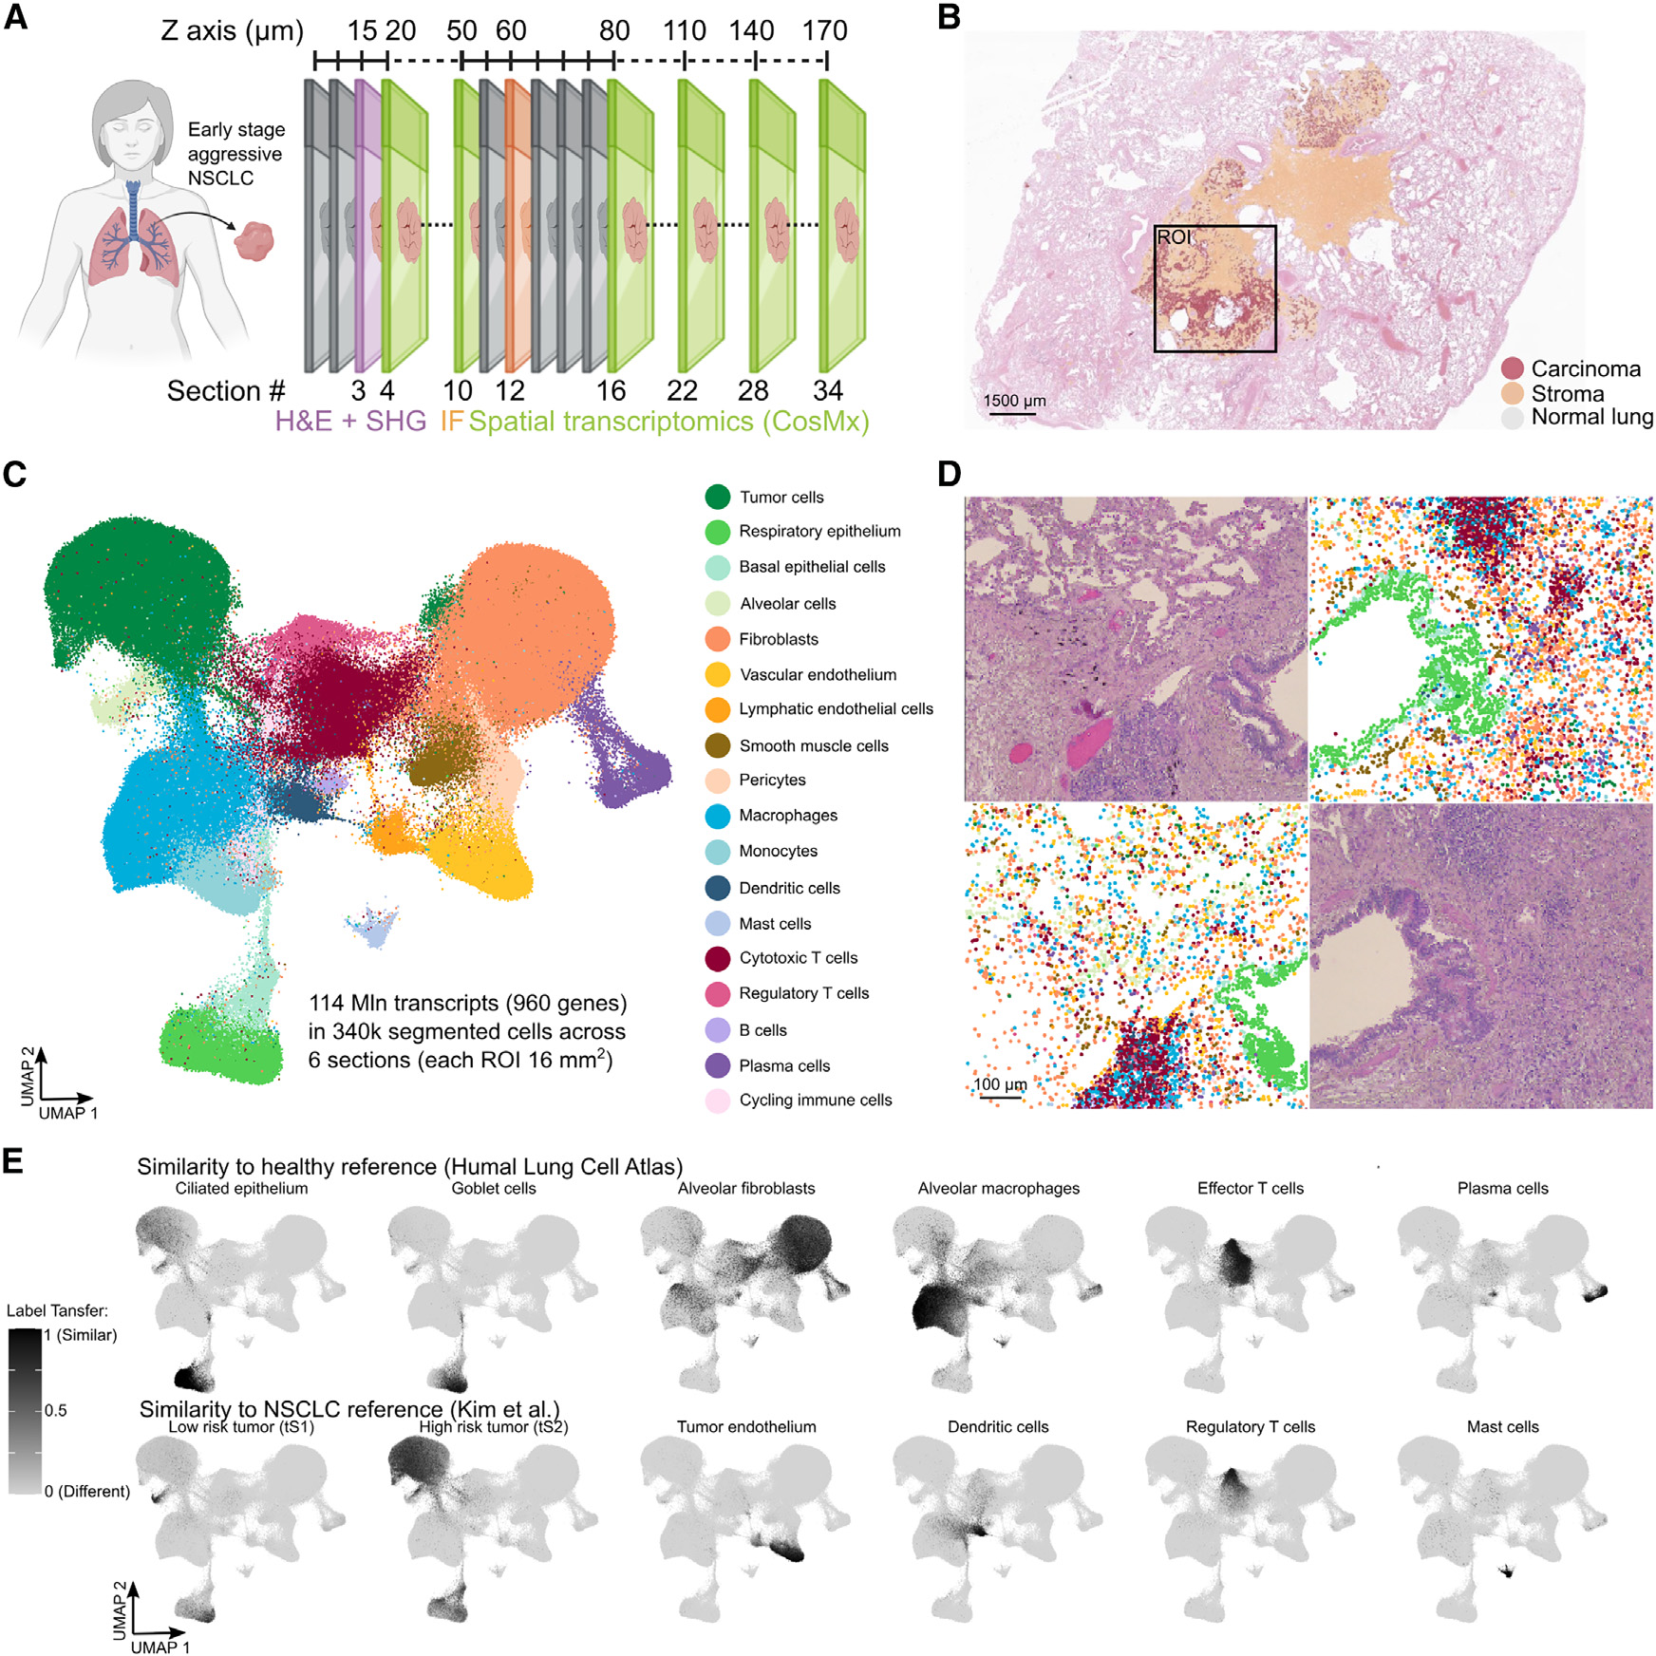
34 serial sections × CosMx 960-plex × SHG-ECM imaging assembled into one 3D atlas
Fig 1 — section layout, H&E, UMAP of 340 k cells, atlas label-transfer.
• PATIENT — 1 early-stage NSCLC, archival FFPE block, 16 mm² region of interest
• DESIGN — 34 sections × 5 µm; 6 sections imaged with CosMx 1000-plex
• DATA — 114 M transcripts → 340 644 cells → 18 cell types
Pentimalli & Rajewsky, Cell Systems 2025;16:101261
Notes:
- HOOK: How do you actually build a 3D atlas from a single FFPE block?
- KEY CLAIM: The experimental design is a stack of 34 serial 5-µm sections from one FFPE block, with 6 of those sections receiving the full multimodal treatment (CosMx + immunofluorescence + SHG) and the remaining sections used for H&E continuity.
- EVIDENCE: 16 mm² ROI selected to capture tumour + cancer-associated stroma + small-caliber airways (anchoring features for 3D registration). 0.27% off-target rate on negative-control probes.
- KEY TERMS: FFPE, CosMx, STIM, label transfer, negative-control probe
- TRANSITION: From cells to neighbourhoods next.
--- DETAILED SCRIPT ---
Panel A shows the section layout — 34 sections, 5 µm thick, taken at varying z-spacing ranging from 5 to 30 µm so the team can resolve both fine structure and longer-range 3D architecture. Sections 3, 4, 10, 12, 16, 22, 28, 34 are the multimodal-imaged ones; the rest are H&E for continuity. Panel B is the H&E with pathologist annotation of carcinoma, stroma, and normal lung. Panel C is the global UMAP of all 340 thousand segmented cells, coloured by 18 annotated types — tumour, respiratory epithelium, basal epithelial, alveolar, fibroblasts, vascular endothelial, lymphatic endothelial, smooth muscle, pericytes, macrophages, monocytes, dendritic cells, mast cells, cytotoxic T, regulatory T, B cells, plasma cells, cycling immune. Panel D shows two zooms: H&E adjacent to the spatial-transcriptomics colour map, demonstrating they carry the same morphological signal. Panel E is the validation — top row is label-transfer similarity to the Human Lung Cell Atlas; bottom row is similarity to a separate NSCLC reference. Each cell's identity gets confirmed by independent reference matching.
--- EXTENDED WALKTHROUGH ---
BACKGROUND — what is CosMx and what does '960-plex' actually mean?
CosMx Spatial Molecular Imager is NanoString's single-molecule spatial-RNA platform, now part of Bruker after the 2024 acquisition. Mechanically: the tissue is hybridised with up to 6,000 oligonucleotide probes, each carrying a unique 64-bit fluorescence barcode. The instrument cycles through 16 rounds of fluorescence imaging, decoding the barcodes to identify which probe (and therefore which RNA) is at each xy location. The output is a point cloud of individual mRNA detections plus segmented cell boundaries. 960-plex means the probe panel targets 960 genes — a curated cancer-relevant set including the major immune lineage markers, fibroblast markers, EMT markers, and signalling axes (cytokines, chemokines, receptors). The 0.27% off-target rate is what you read off the negative-control probes — sequences that should match nothing in the human transcriptome.
WHY 6 SECTIONS, NOT ALL 34? Cost and instrument time. The 34 H&E sections give you the morphological backbone for 3D registration; CosMx is the expensive molecular layer, run on a sparse subset that still spans the full z-range.
WHY 16 mm²? CosMx field-of-view economics. The 1000-plex panel images approximately 6 mm² per FOV; 16 mm² is two-three FOVs stitched together. Bigger ROIs run into runtime and storage limits on current instrumentation.
LABEL TRANSFER — what panel E shows. Rather than calling cell identities from de-novo clustering of this dataset alone, the team computes per-cell similarity (typically cosine similarity in PCA space) to two reference datasets — Travaglini 2020 Nature for healthy lung, Kim 2020 Nat Commun for NSCLC — and inherits their labels. The grayscale heat in panel E is the similarity score; high grey = high confidence in label transfer. This is the standard sanity check: if your alveolar macrophage cluster doesn't look like a known alveolar macrophage transcriptome, you have a problem.
WHY THE PATIENT MATTERS — early-stage but aggressive NSCLC means surgical resection was curative-intent, but the histology showed features predictive of recurrence. This is the patient population where understanding the 3D tumour microenvironment matters most: the decision is whether to add adjuvant chemo or immunotherapy, and that decision is currently made on limited information.

Slide 7
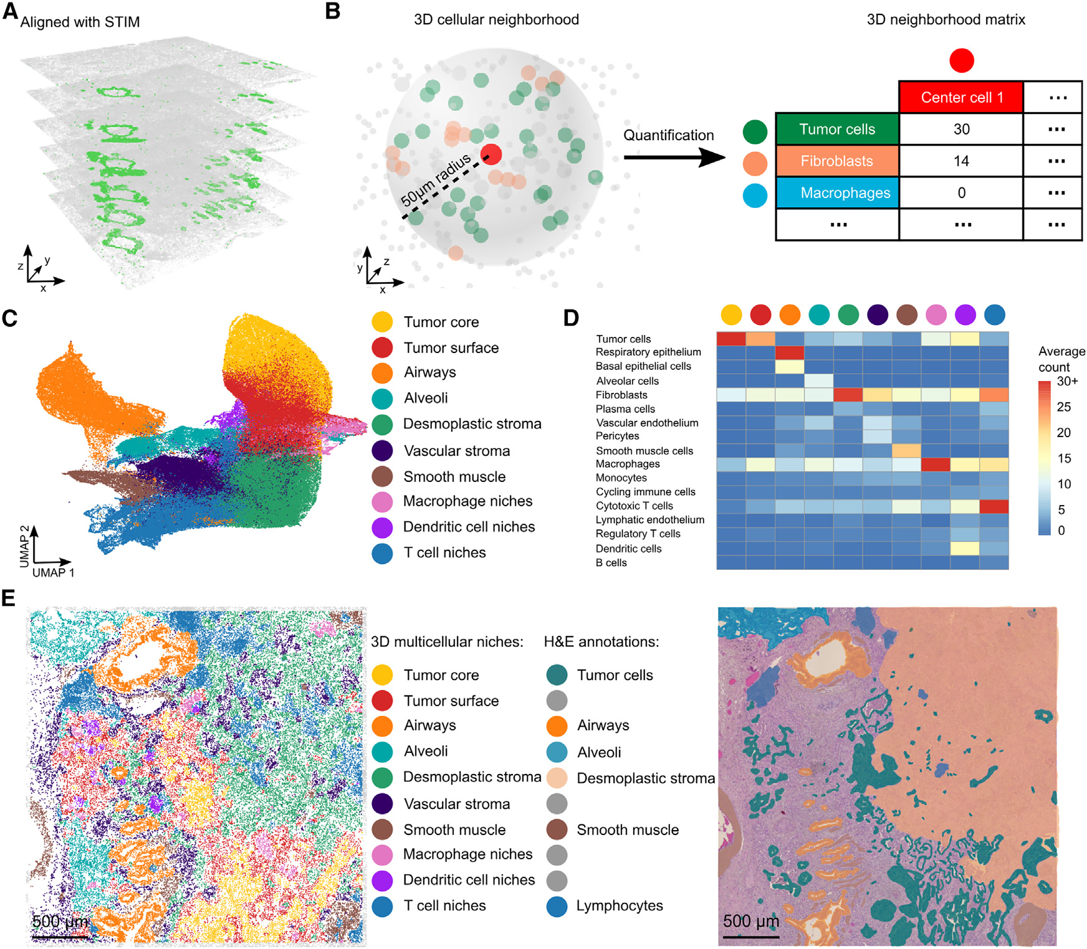
10 multicellular niches from 3D neighbourhoods match independent pathologist H&E annotation
Fig 2 — z-stack, 50-µm neighbourhood definition, 10 niches, H&E concordance.
• DEFINITION — 3D neighbourhood = cells within a 50-µm sphere (z-neighbours included)
• RESULT — 10 niches with distinct cell-type compositions (heatmap, panel D)
• VALIDATION — niches match independent pathologist H&E (panel E)
Pentimalli & Rajewsky, Cell Systems 2025;16:101261
Notes:
- HOOK: Are these 'niches' just clustering artefacts, or do they mean anything?
- KEY CLAIM: 10 niches emerge from 3D neighbourhood-vector clustering: tumour core, tumour surface, airways, alveoli, desmoplastic stroma, vascular stroma, smooth muscle, macrophage niches, dendritic-cell niches, T-cell niches. Critically, the niche map agrees with an independent pathologist H&E annotation made WITHOUT seeing the molecular data.
- EVIDENCE: Heatmap (D) shows niche-level cell-type compositions; tumour core is dominated by tumour cells, T-cell niches by cytotoxic + regulatory T cells, etc.
- KEY TERMS: cellular neighbourhood, neighbourhood vector, niche, Schurch 2020, concordance
- TRANSITION: Niches in hand — now the headline claim about 3D vs 2D.
--- DETAILED SCRIPT ---
Panel A is the STIM-aligned z-stack rendering — 6 ST sections in their proper 3D position, with airway lumens visible as the elongated holes spanning multiple sections. Panel B is the central definition: for each cell (red), find every cell within a 50-micrometre sphere (this includes neighbours from sections immediately above and below); count those neighbours by cell type; you now have a neighbourhood vector — 18 entries per cell. Cluster all 340k neighbourhood vectors with unsupervised methods, and 10 stable niches drop out. Panel C is a UMAP of cells coloured by niche assignment — the 10 niches occupy distinct regions of UMAP space, telling you the niches are not just k-means noise. Panel D is the niche × cell-type heatmap — read across rows to see what each niche is made of. Tumour core is mostly tumour cells, T-cell niches are enriched for cytotoxic + regulatory T cells. Panel E — and this is the orthogonal check — is the spatial map of niches next to a pathologist's H&E annotation made without looking at the molecular data. The two agree. When two completely independent methods, looking at completely different features, draw the same boundaries, the boundaries are real.
--- EXTENDED WALKTHROUGH ---
BACKGROUND — what is a 'cellular neighbourhood' and where did the concept come from?
The cellular-neighbourhood (CN) concept was formalised by Christian Schürch and Garry Nolan in their 2020 Cell paper on colorectal cancer (Schürch et al. Cell 2020;182:1341). The motivation: in oncology, cell FREQUENCIES (e.g., 'this tumour is 12% Tregs') are weak predictors of outcome, but the SPATIAL ARRANGEMENT of those cells matters enormously. A tumour with infiltrating B cells in well-organised tertiary lymphoid structures responds completely differently to immunotherapy than the same tumour with the same B cells scattered uniformly. CNs make 'spatial arrangement' formal: for each cell, describe what it's surrounded by (a count vector by cell type), then cluster all cells in the cohort by their neighbourhood vectors. The clusters ARE the neighbourhood archetypes.
WHY 50 µm? It's the typical CODEX/IMC paper choice and it scales to roughly the radius at which signalling gradients (chemokines, soluble cytokines) remain meaningful before getting washed out by interstitial flow. Smaller radii (10-20 µm) capture juxtacrine contact-dependent signalling; 50-100 µm captures paracrine signalling; >200 µm starts mixing across distinct tissue compartments.
WHAT IS A NICHE vs WHAT IS A CN? Terminology is fluid in the field. CNs in the strict Schürch sense are the clusters in neighbourhood-vector space. Niches in this paper are the spatially-coherent regions of tissue annotated by their dominant CN — slightly higher-level. Read 'niche' here as 'the tissue-scale region where this CN dominates'.
WHY THE PATHOLOGIST AGREEMENT IS THE CRITICAL CHECK — one of the lingering doubts about CN analyses is that the clusters are produced by an algorithm from features the algorithm chose; how do we know they correspond to real tissue structures rather than statistical mirages? Pathologists annotating H&E images use morphology — cell shape, tissue density, vessel architecture, glandular structure — features the CN algorithm never saw. When the pathologist's hand-drawn 'tumour core' boundary aligns with the algorithmic 'tumour core' niche, the niche is morphologically as well as molecularly coherent.
READING PANEL D HEATMAP — rows are cell types, columns are niches, colour is average count per neighbourhood. The diagonal-block structure tells you each niche has a dominant cell-type identity; off-diagonal entries tell you the partner cell types. Macrophage niches have ~30 macrophages and partner with both tumour cells (immune-suppressive) and dendritic cells (antigen presentation). T-cell niches partner cytotoxic + regulatory T cells with B cells and lymphatic endothelium — i.e., they look like nascent TLS.

Slide 8
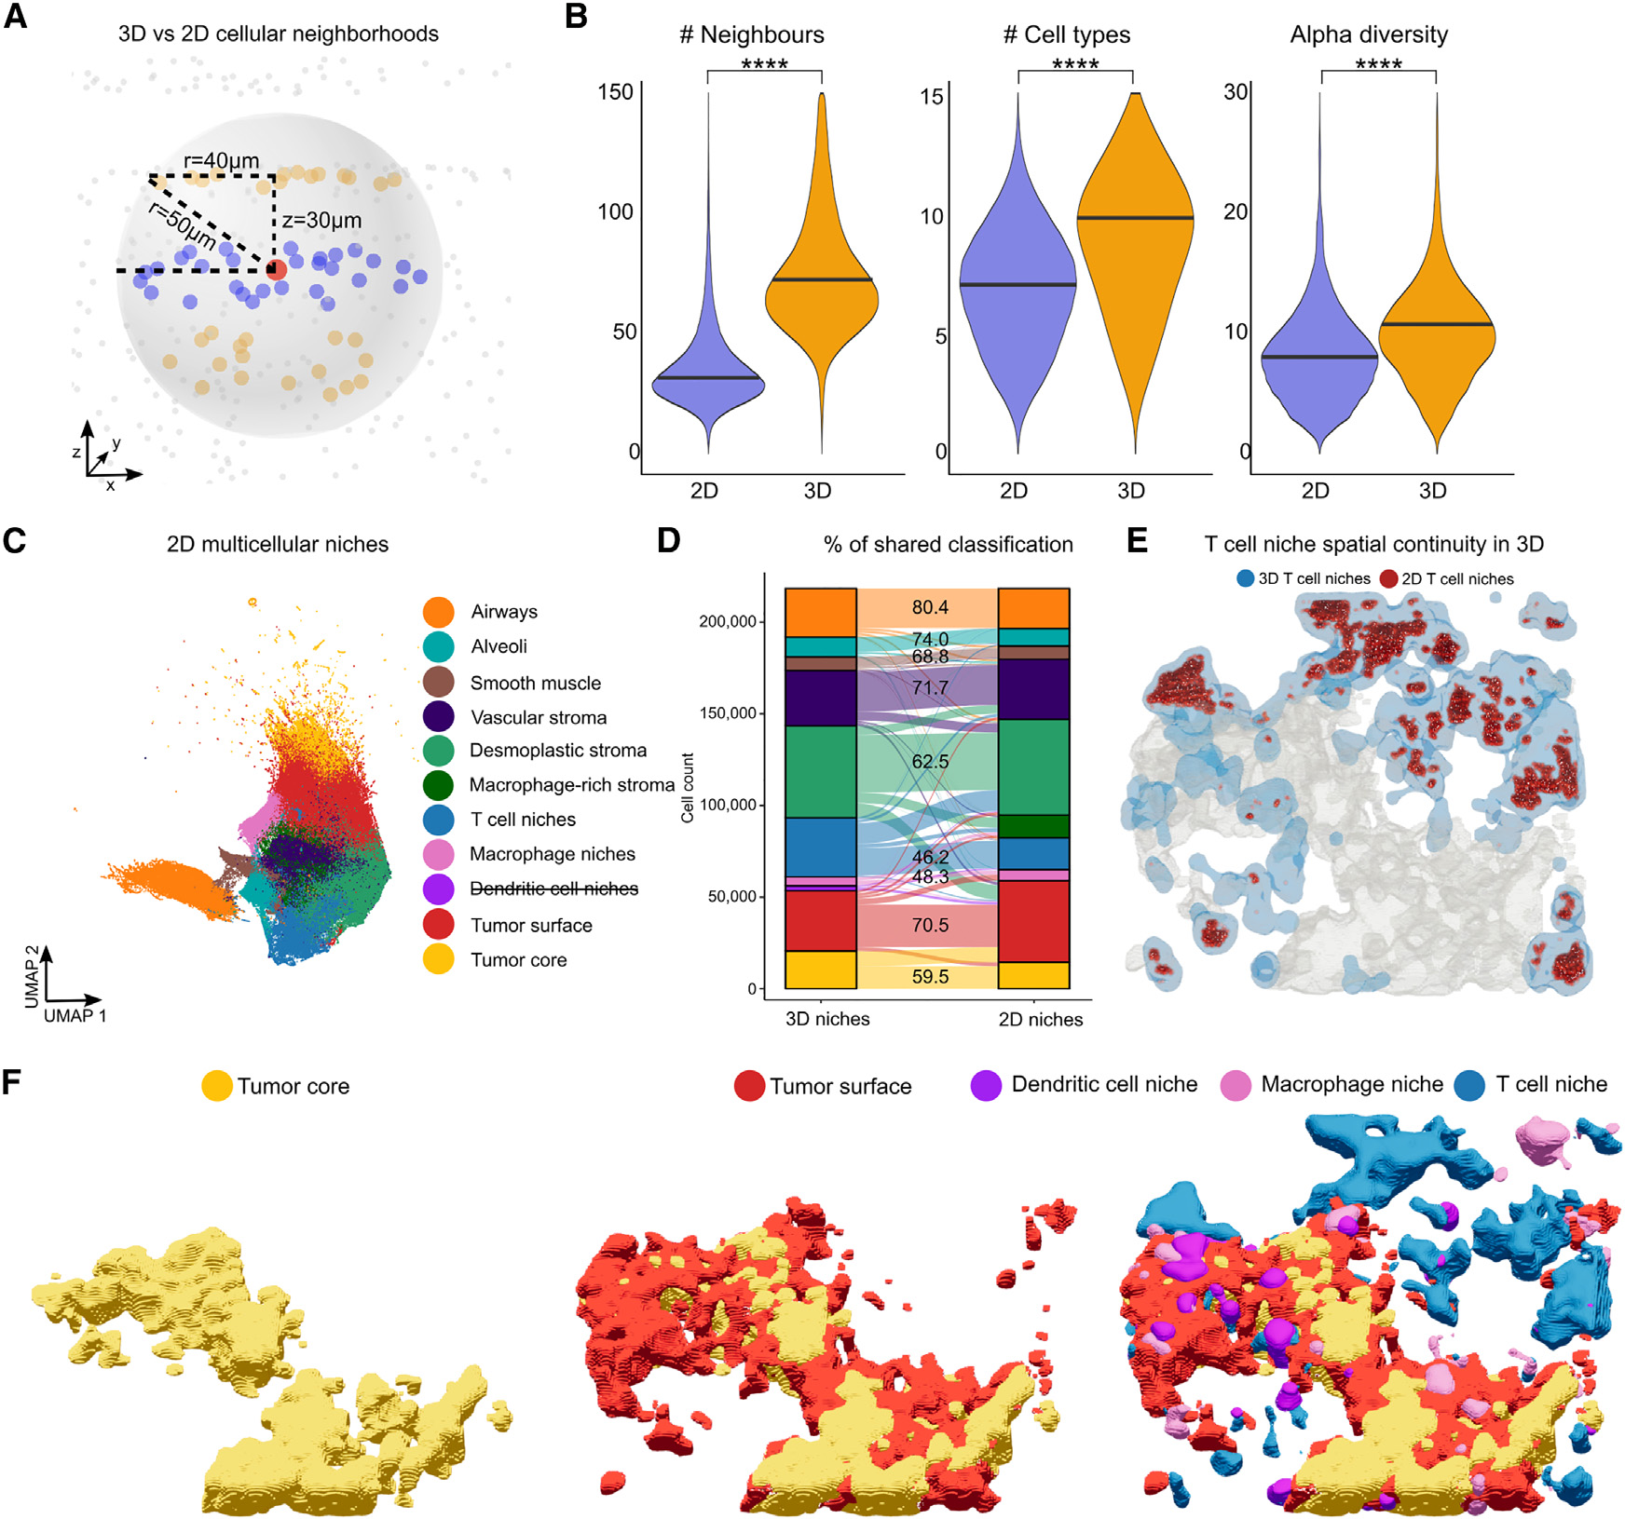
HEADLINE — 3D neighbourhoods are 2.28× larger; dendritic-cell niches and T-cell continuity exist ONLY in 3D
Fig 3 — 3D vs 2D: bigger neighbourhoods, DC niche only in 3D, T-cell bridges.
• PANEL B — 3D vs 2D: 32 vs 22 cells, 9 vs 7 cell types (p<0.005)
• PANEL D — DC-niche cells reassigned to tumour surface (51%) or T-cell (24%) in 2D
• PANEL E — T-cell-niche spatial continuity restored only in 3D
Pentimalli & Rajewsky, Cell Systems 2025;16:101261
Notes:
- HOOK: Does the third dimension actually buy you anything clinically?
- KEY CLAIM: In 3D, neighbourhoods are 2.28× larger; the dendritic-cell niche EXISTS ONLY when you analyse in 3D; T-cell-niche spatial bridges are recovered only in 3D. 2D analysis is systematically losing the structures that drive immunotherapy response.
- EVIDENCE: Median neighbourhood: 32 vs 22 cells, 9 vs 7 cell types, Chao alpha-diversity 10.5 vs 8 (all p<0.005). 51.2% of DC-niche cells get re-classified as tumour-surface in 2D; 23.6% as T-cell-niche.
- KEY TERMS: 3D neighbourhood, Chao alpha-diversity, niche reassignment, DC niche, T-cell continuity
- TRANSITION: Why does this matter clinically? Niches carry signalling.
--- DETAILED SCRIPT ---
Panel A schematises the 3D neighbourhood: a sphere of radius 40 µm extends across z=±30 µm, picking up neighbours from the section above and below the anchor cell. Panel B is the headline statistic, presented as three violin plots — number of neighbours, number of cell types, and Chao alpha-diversity. All three: 3D wins decisively, p<0.005. The biological consequence appears in panels C and D. Panel C is the 2D-restricted clustering with niches labelled — note the DENDRITIC-CELL niche is shown but in strikethrough text, indicating it does NOT statistically resolve in 2D. Panel D is the cell-by-cell reassignment matrix between 3D-niche and 2D-niche labels: 80.4% of tumour-core cells stay tumour-core, fine; but only 62.5% of macrophage-niche cells stay macrophage-niche, and the dendritic-cell niche disappears entirely (blanked out / strikethrough). Where do those DC-niche cells go? Tumour surface (51%) or T-cell niches (24%) — they get absorbed into the nearest neighbourhood archetype that 2D can statistically support. Panel E shows T-cell-niche spatial structure: in 2D it's blue patches scattered across the tumour bed; in 3D-rendered view it's a connected bridge structure. Panel F shows three 3D-rendered niches — tumour core, tumour surface, dendritic-cell + macrophage + T-cell niches — confirming that what looks like point clouds in 2D becomes coherent 3D anatomy.
--- EXTENDED WALKTHROUGH ---
WHY DOES 3D RECOVER MORE STRUCTURE? The geometric intuition: a 2D disc of radius r has area πr²; a 3D ball of radius r has volume (4/3)πr³. At matched cell density, the 3D ball contains 4r/3 times more cells than the 2D disc — for a 50 µm neighbourhood with 200 µm tissue thickness available, that's roughly the 2.28× ratio observed. More cells per neighbourhood means the cell-type-vector signal-to-noise improves — small populations like dendritic cells (typically 1-3% of total) need ≥10 cells in a neighbourhood to be statistically distinguishable, and 3D crosses that threshold where 2D doesn't.
WHY DENDRITIC CELLS, SPECIFICALLY, ARE THE MOST 3D-SENSITIVE — DCs are rare (~1-2% of cells in this tumour) AND they cluster sparsely. A 5 µm-thick section that happens to slice between two adjacent DCs misses them both. In 3D, those two DCs are clearly within the same neighbourhood. The DC-niche loss in 2D is therefore a sampling artefact compounding cell rarity with section thickness.
WHY TC-CELL NICHE CONTINUITY IS DIFFERENT — T cells are not rare; they're abundant. The 2D-vs-3D issue here isn't 'do we see the cells' but 'do we see the spatial continuity'. T-cell niches in this NSCLC are organised into long thin bridges that wind through the tumour bed. In 2D each section intersects the bridge as a separate ellipse, and the niche-detection algorithm sees those ellipses as independent foci. In 3D the bridges are connected. This matters because a connected T-cell network is interpreted very differently from scattered T-cell foci — connected networks are TLS-like, and TLS-like architectures predict immunotherapy response.
CLINICAL TAKEAWAY — if your patient gets a single-section 2D spatial transcriptomics workup as part of treatment selection (and Visium and CosMx are creeping into clinical workflows), and the 2D analysis shows 'no tertiary lymphoid structures, no DC niches', the patient may STILL HAVE those structures in 3D. The 2D negative is misleading. This implies that single-section spatial-omics readouts of immunotherapy-response biomarkers are systematically biased toward false negatives.
THESIS-WORLD CONNECTION — for our multiscale-simulation programme this is the empirical justification for going to 3D in silico. Any model of an infected lung that simulates a 3D tissue but compares only to 2D CODEX or 2D IMC will be 'right' on cell counts but 'wrong' on neighbourhoods. The comparison must virtually slice the simulation, not flatten the data.

Slide 9
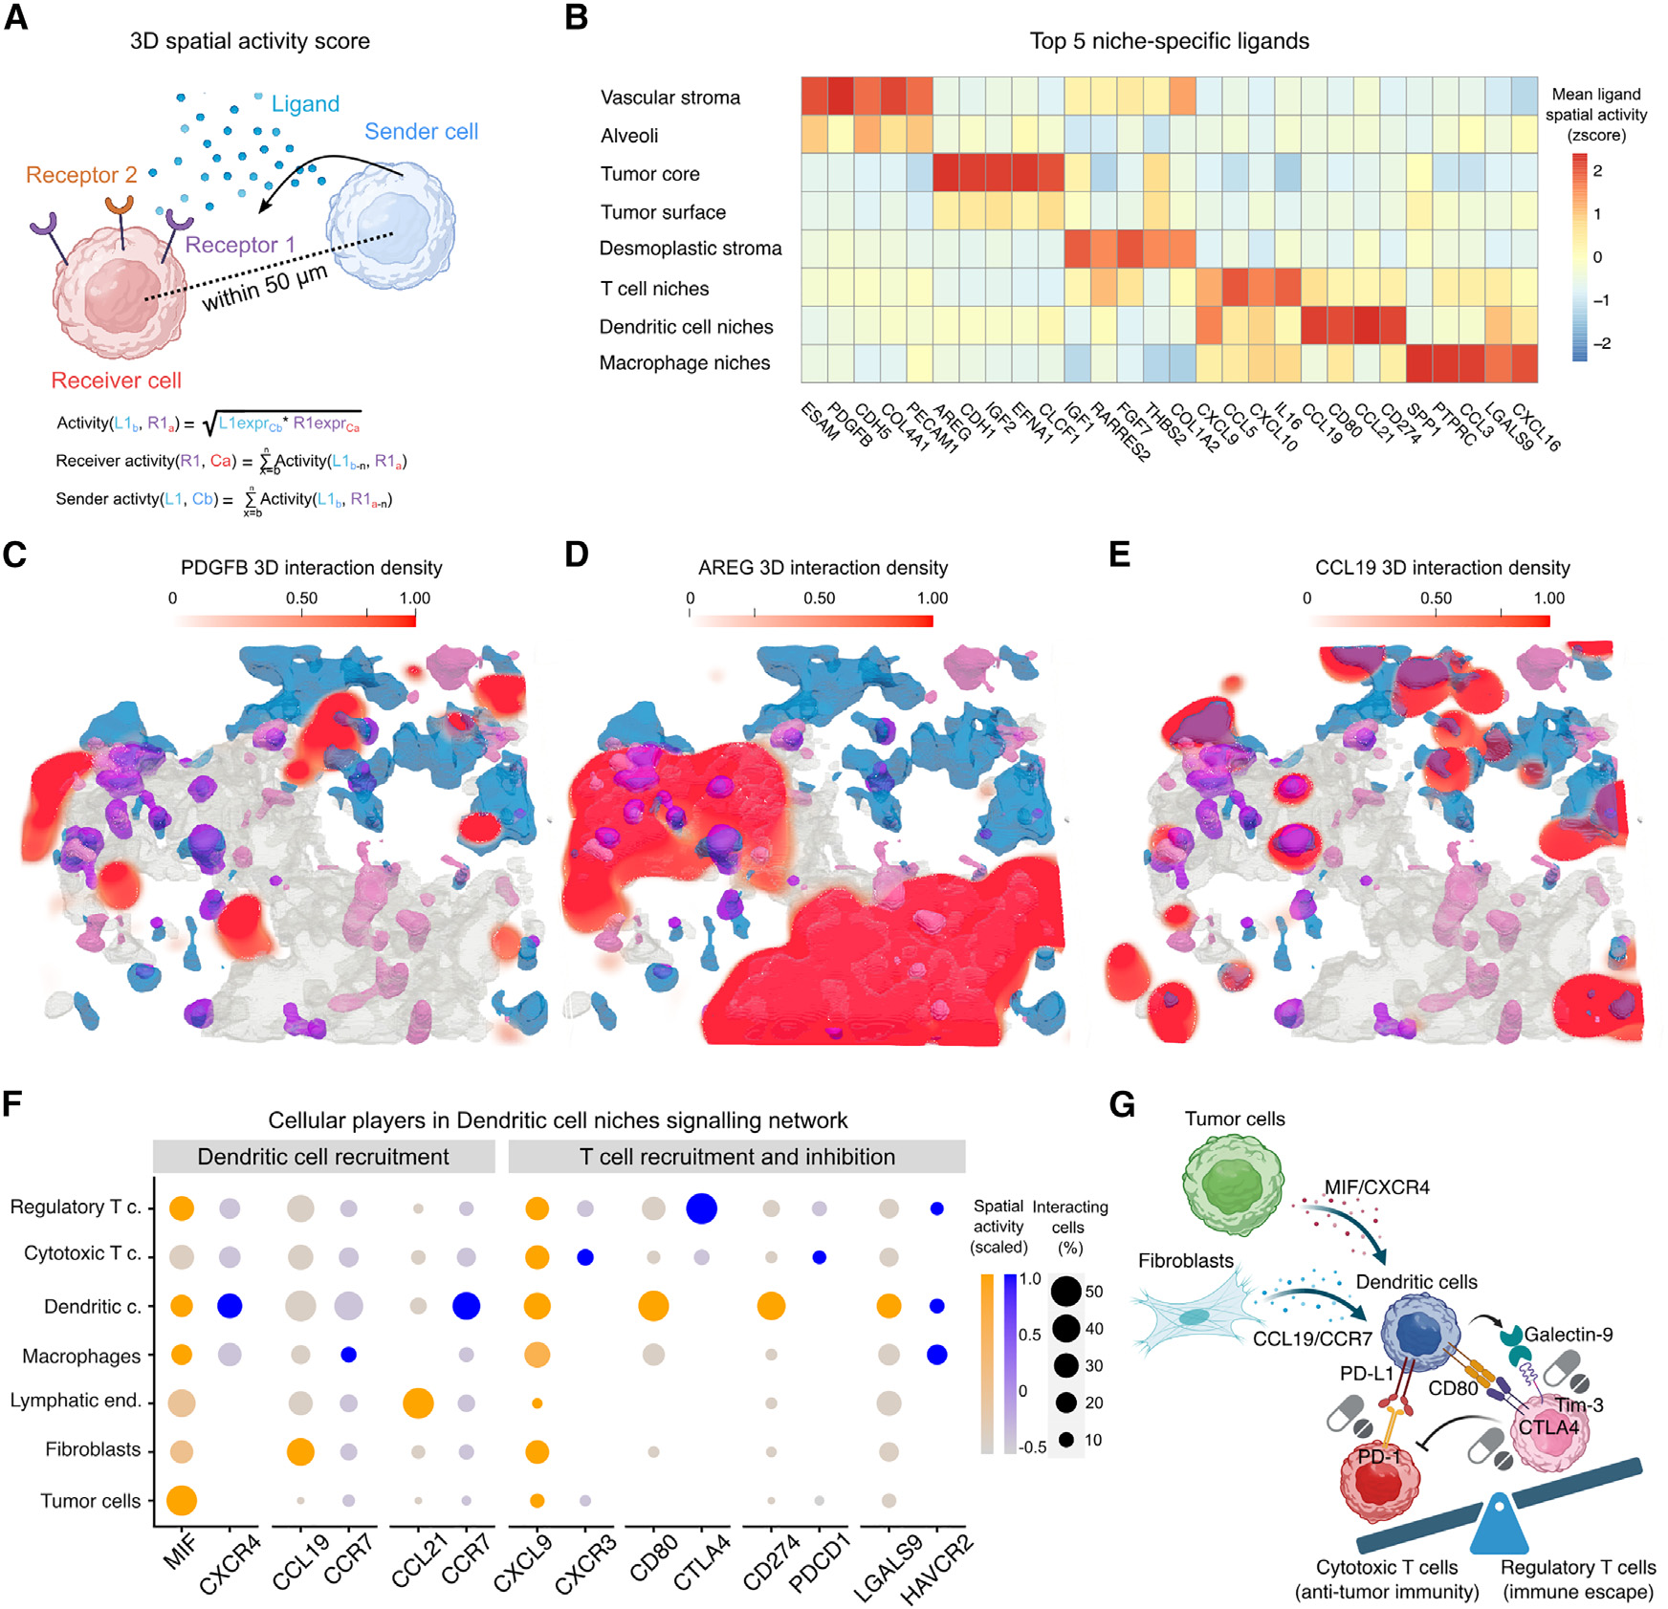
3D receptor-ligand activity scoring exposes a druggable dendritic-cell-niche signalling network
Fig 4 — 480-pair activity score; niche ligands; DC-niche druggable network.
• METHOD — 480 CellChat receptor-ligand pairs scored at 50-µm radius in 3D
• PATTERN — niche-specific ligands (PDGFB → vascular; CCL19 + CXCL9 → DC + T-cell)
• PAYOFF — DC-niche druggable network: MIF, CCR7, PD-L1, CTLA-4, Tim-3
Pentimalli & Rajewsky, Cell Systems 2025;16:101261
Notes:
- HOOK: If 3D exposes the DC niche, what is the DC niche actually doing?
- KEY CLAIM: Pentimalli scores 480 receptor-ligand pairs in 3D and finds 96 ligands enriched in ≥1 niche. The DC niche carries a clean immune-checkpoint signalling network with multiple druggable nodes — anti-PD-1, anti-CTLA-4, anti-Tim-3, anti-MIF.
- EVIDENCE: CellChat 480-pair database; activity score = sqrt(L_sender × R_receiver) summed within 50 µm; log2FC > 0.5 threshold for enrichment.
- KEY TERMS: CellChat, receptor-ligand activity, MIF, CCR7, PD-L1, Tim-3
- TRANSITION: Cells AND signals — but what about the matrix they live in?
--- DETAILED SCRIPT ---
Panel A is the activity-score formula: for each receptor-ligand pair, multiply ligand expression at the sender cell by receptor expression at the receiver cell, normalise, sum within 50 µm. This converts a static gene-expression snapshot into a directional signalling score. Panel B is the top-5 niche-specific ligands across 8 niches — read as a heatmap, blue = high activity. PDGFB peaks in vascular stroma (drives pericyte recruitment). AREG / EFNA1 / CDH1 peak in tumour surface (autocrine growth + adhesion). CCL19 + CXCL9 peak in DC and T-cell niches (immune cell trafficking). Panels C-E show the spatial maps for three exemplar ligands: PDGFB tracks the vasculature, AREG fills the tumour surface, CCL19 lights up the DC niche regions. Panel F is the DC-niche signalling network as a dotplot: rows are sender cell types, columns are receptor-ligand pairs. Tumour cells produce MIF that engages CXCR4 on DCs and macrophages — recruits them but suppresses APC function. Fibroblasts produce CCL19/CCL21 that engages CCR7 on DCs and T cells — retention in the niche. DCs produce CD80 engaging CTLA-4, PD-L1 engaging PD-1, Galectin-9 (LGALS9) engaging Tim-3 (HAVCR2) — the immune-checkpoint suite. Panel G is the network cartoon: tumour → fibroblast → DC → CTL/Treg as a chain of cellular control. Every red bar is a node we already drug or have a drug in trials for.
--- EXTENDED WALKTHROUGH ---
BACKGROUND — what is CellChat?
CellChat (Jin et al. Nat Commun 2021;12:1088) is a database + inference tool for cell-cell communication. The database is a curated set of ~2,000 human ligand-receptor (L-R) interactions, with each interaction tagged by signalling pathway (e.g., 'TGFβ signalling', 'TNF signalling', 'WNT signalling'). The inference part takes a single-cell expression matrix and asks: which L-R pairs are 'communicating' in the data, given which cells express the ligand and which express the receptor? The Pentimalli paper extends this to spatial: instead of asking 'is L expressed somewhere AND R expressed somewhere', they ask 'is L expressed in cells WITHIN 50 µm OF cells expressing R'. That spatial constraint is what makes the score a meaningful signalling-activity proxy rather than a population-level co-expression mean.
WHY 480 PAIRS, NOT 2000? The 480 number is the subset of CellChat pairs where both ligand AND receptor are on the CosMx 960-gene panel. The full CellChat database has receptors and ligands the panel doesn't measure.
WHY THE DC NICHE IS THE MONEY SHOT — every modern immuno-oncology drug targets a node in this network. anti-PD-1 (pembrolizumab, nivolumab, cemiplimab), anti-PD-L1 (atezolizumab, durvalumab, avelumab), anti-CTLA-4 (ipilimumab), anti-Tim-3 (sabatolimab, in trials), anti-MIF (CPSI-1306 and others, early development), anti-CCR7 antagonists (research-stage). The Pentimalli result tells you these drugs are acting on a SPATIALLY-RESOLVED niche, not a 'tumour-wide' phenomenon. The clinical implication: response to anti-PD-1 should depend on whether the patient HAS a DC niche to disrupt.
MIF→CXCR4 IN DETAIL — MIF (Macrophage Migration Inhibitory Factor) is a secreted cytokine produced by tumour cells; CXCR4 is a chemokine receptor on myeloid cells. The MIF-CXCR4 axis recruits dendritic cells INTO the tumour bed but holds them in an immature, antigen-presentation-suppressed state — they are present but inactive. Blocking this axis releases the brake on DC maturation. Trials are ongoing.
CCL19/CCR7 vs PD-L1/PD-1 — the network has both PRO-immune and ANTI-immune signalling. CCL19 (from fibroblasts) → CCR7 (on DCs and T cells) is recruitment-and-retention — pro-tumour-fighting. PD-L1 (on DCs) → PD-1 (on cytotoxic T cells) is the brake — anti-tumour-fighting. The DC niche is therefore a battleground: it's where the immune response is being organised AND simultaneously where it's being suppressed. Disrupting the suppression while preserving the recruitment is the goal of combination checkpoint therapy.

Slide 10
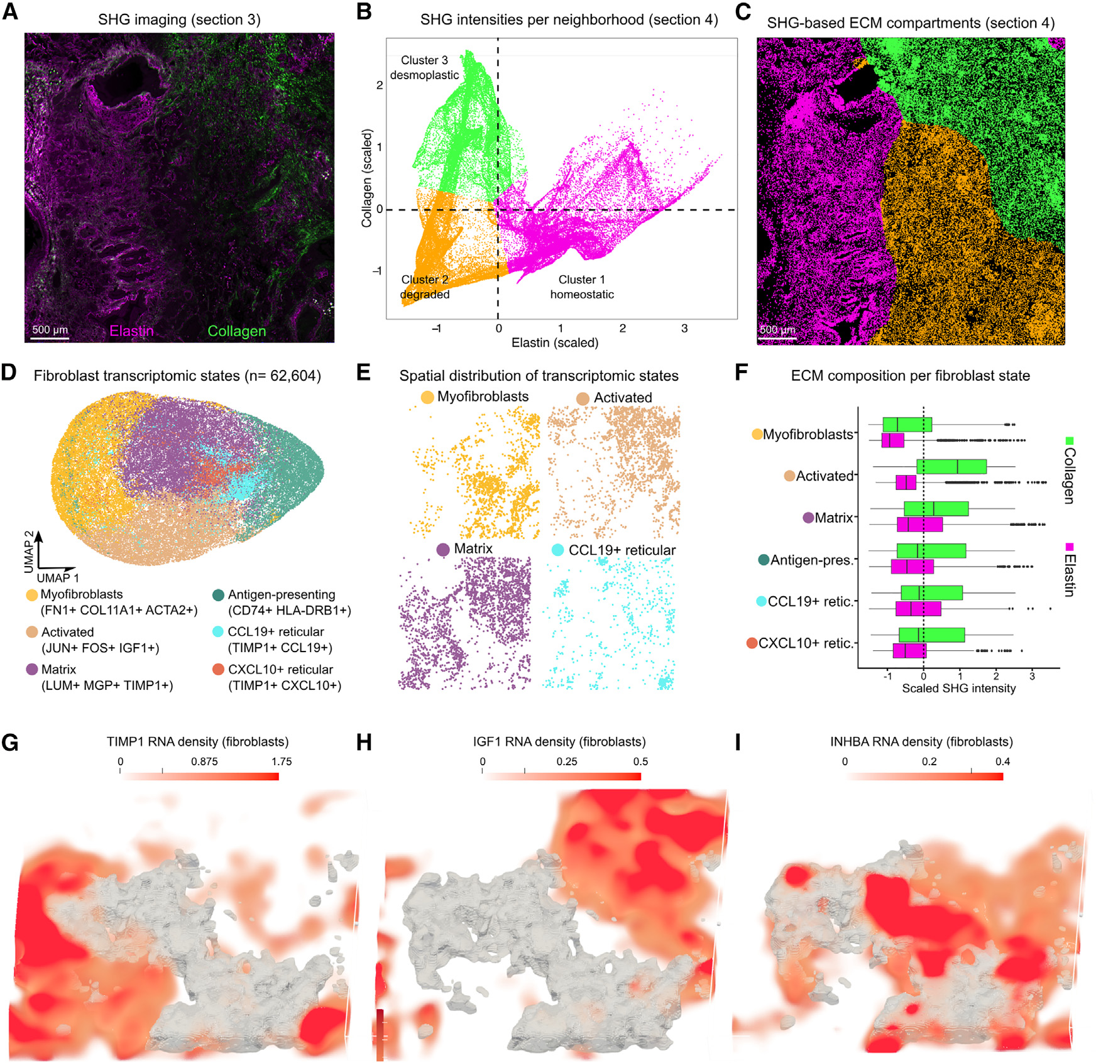
SHG-defined ECM compartments couple to 6 fibroblast states with distinct matrix-regulator activities
Fig 5 — SHG ECM, 3 compartments, 6 fibroblast states, ECM regulators.
• MODALITY — SHG = label-free collagen + elastin imaging (no antibody, no stain)
• ECM — 3 compartments: homeostatic / degraded / desmoplastic
• FIBROBLASTS — 6 transcriptomic states couple to specific ECM compartments
Pentimalli & Rajewsky, Cell Systems 2025;16:101261
Notes:
- HOOK: Cells live in matrix — does the matrix follow the cells or do the cells follow the matrix?
- KEY CLAIM: SHG imaging gives label-free resolution of three ECM compartments — homeostatic, degraded, desmoplastic — and these couple to six distinct fibroblast transcriptomic states. ECM regulators (TIMP1, IGF1, INHBA) are spatially organised across compartments.
- EVIDENCE: 62,604 fibroblasts; unsupervised clustering → 6 phenotypes; SHG intensities per 50×50 µm neighbourhood → k-means k=3 → 3 ECM compartments.
- KEY TERMS: SHG, second-harmonic generation, myofibroblast, desmoplastic, TIMP1, IGF1, INHBA
- TRANSITION: Where in this matrix does the tumour actually invade?
--- DETAILED SCRIPT ---
Panel A is the SHG image of section 3 — collagen fibres in green, elastin in magenta. Note: this required no antibody, no fluorophore, no stain — SHG is a non-linear optical effect that fires only when the laser hits ordered triple-helical collagen. Panel B is the per-neighbourhood SHG-intensity scatter — x-axis elastin, y-axis collagen. K-means with k=3 picks out three ECM compartments. Cluster 1 (yellow, 'homeostatic') is moderate-elastin moderate-collagen — normal lung. Cluster 2 (orange, 'degraded') is low-collagen — the tumour bed where matrix is being chewed up. Cluster 3 (purple, 'desmoplastic') is high-collagen — fibrotic stromal regions. Panel C maps the compartments back onto the section. Panel D is the fibroblast UMAP — 6 distinct transcriptomic states. Myofibroblasts express FN1, COL11A1, ACTA2 — the contractile fibrosis-driving state. 'Activated' fibroblasts express JUN, FOS, IGF1 — the early-response state. 'Matrix' fibroblasts express LUM, MGP, TIMP1 — the housekeeping ECM-maintenance state. 'Antigen-presenting' fibroblasts express CD74 + HLA-DRB1 — these are unusual, they look like fibroblasts but expose MHC-II. CCL19+ and CXCL10+ reticular fibroblasts are the immune-attracting subsets that probably nucleate the DC and T-cell niches we saw in Fig 4. Panel E shows the spatial layout of these states. Panel F is the cross-tabulation: which fibroblast states sit in which ECM compartment? Myofibroblasts in degraded ECM (where they're tearing it up); activated in desmoplastic; matrix in homeostatic. Panels G-I show three exemplar ECM regulators — TIMP1 (matrix-state marker), IGF1 (activated-state marker), INHBA (myofibroblast marker) — as RNA-density maps that respect compartment boundaries.
--- EXTENDED WALKTHROUGH ---
BACKGROUND — what is second-harmonic generation imaging?
SHG is a non-linear optical effect. Two photons of frequency ω hit an ordered non-centrosymmetric structure (like a triple-helical collagen fibre) and combine into one photon of frequency 2ω. The emission is at exactly half the incident wavelength. The catch: SHG only happens for materials that lack centrosymmetry — collagen fibrils are the canonical biological example, elastin gives weaker but detectable signal at a different wavelength. Because no fluorophore is involved, SHG imaging can be acquired on the SAME tissue section that's about to be processed for spatial transcriptomics, with no interference. That co-acquisition is the methodological trick that makes this paper possible.
WHY THREE ECM COMPARTMENTS, NOT MORE?
K-means with k=3 was chosen empirically — they tried k=2, 3, 4, 5 and k=3 produced the most stable clusters (cluster reassignment under perturbation was lowest at k=3). The biological labels — 'homeostatic', 'degraded', 'desmoplastic' — are post-hoc interpretations matching pathological intuition about NSCLC stroma:
* Homeostatic: normal lung parenchyma, adjacent to the tumour but not within it. Normal alveolar walls.
* Degraded: matrix that has been actively remodelled by tumour-derived MMPs. Low collagen because it's been digested. Low elastin because it's been fragmented. This is the matrix INSIDE the tumour bed.
* Desmoplastic: high collagen, low elastin. Stiff scarring response of the host to the tumour, deposited at the tumour-stroma interface. This is what makes a tumour 'firm' on palpation.
FIBROBLAST HETEROGENEITY — the field has moved away from 'CAF' (cancer-associated fibroblast) as a monolithic category. By 2025 we recognise at least 4-7 functionally distinct fibroblast states in tumours, with names like myCAF (myofibroblast-CAF), iCAF (inflammatory-CAF), apCAF (antigen-presenting), and various reticular populations. Pentimalli's 6 states match this typology with finer reticular subdivision (CCL19+ and CXCL10+).
WHY THE ECM-FIBROBLAST COUPLING MATTERS — TIMP1 (Tissue Inhibitor of Metalloproteinases) opposes matrix-degrading MMPs; matrix fibroblasts expressing it are protective of the homeostatic compartment. IGF1 (Insulin-like Growth Factor 1) drives proliferation of activated fibroblasts and their conversion to myofibroblasts; expressed in desmoplastic regions. INHBA (Inhibin Beta A, a TGFβ-family ligand) is the canonical myofibroblast-activating cytokine — autocrine in this context (myofibroblasts make INHBA to maintain themselves). The spatial organisation of these three regulators across compartments tells you the matrix biology is being driven from within the matrix itself, not from the tumour cells alone.
THESIS CONNECTION — for the lung-fibrosis simulation Bobby is building, this paper supplies the empirical anchor for HOW MANY fibroblast states a model needs (6) and WHAT cytokine outputs distinguish them. INHBA → myofibroblast self-maintenance, IGF1 → activated proliferation, TIMP1 → matrix protection. Plus the SHG → ECM compartment recipe gives a measurable comparison target for any in-silico ECM dynamics.

Slide 11
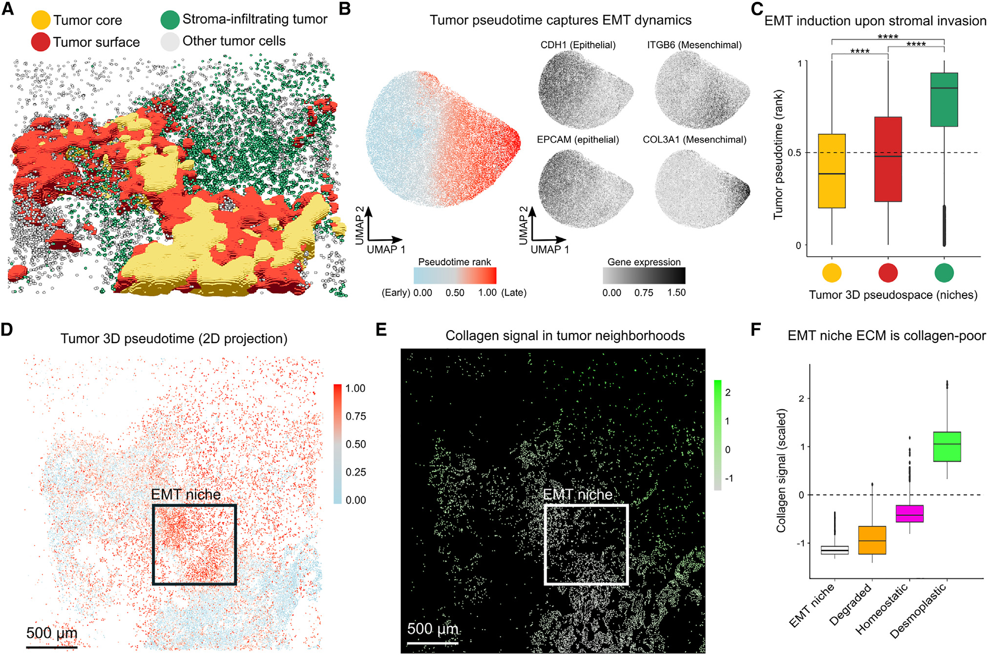
Tumour 3D pseudotime captures EMT — the EMT niche invades collagen-poor ECM
• TRAJECTORY — pseudotime: epithelial → mesenchymal
• GRADIENT — highest at invasive front (p<0.0001)
• SURPRISE — EMT niche is collagen-POOR
Fig 6 — tumour pseudotime captures EMT; EMT niche is collagen-poor.
Pentimalli & Rajewsky, Cell Systems 2025;16:101261
Notes:
- HOOK: Where exactly in 3D space is the tumour invading from?
- KEY CLAIM: Tumour-cell 3D pseudotime tracks the epithelial-to-mesenchymal transition: cells at the stromal interface are most mesenchymal, and the spatial 'EMT niche' is COLLAGEN-POOR, not desmoplastic — the invading front degrades matrix ahead of itself.
- EVIDENCE: Pseudotime ordering on UMAP using CDH1 / EPCAM (epithelial) vs ITGB6 / COL3A1 (mesenchymal). Pseudotime by niche category: tumour core < tumour surface < stroma-infiltrating, all p<0.0001.
- KEY TERMS: pseudotime, EMT, CDH1, ITGB6, COL3A1, EMT niche, invasive front
- TRANSITION: Now what does the EMT niche express that makes it invasive?
--- DETAILED SCRIPT ---
Panel A is a 3D rendering of just the tumour-cell population, coloured by subtype: yellow tumour-core cells (deep in the tumour), red tumour-surface cells (at the tumour-stroma interface), green stroma-infiltrating tumour cells (further out, infiltrating the stroma). The colour gradient maps onto a biological progression. Panel B is the tumour-cell UMAP, coloured by pseudotime rank — early pseudotime in blue/grey, late in red. Pseudotime here uses a method like Monocle or Slingshot, ordering cells along a trajectory inferred from gene-expression similarity. The four small UMAPs below show CDH1 (E-cadherin, epithelial marker), ITGB6 (integrin β6, mesenchymal), EPCAM (epithelial), COL3A1 (mesenchymal). They confirm: early-pseudotime cells are epithelial, late-pseudotime cells are mesenchymal. The trajectory IS EMT. Panel C is the box plot of pseudotime stratified by tumour-3D-pseudospace category — core lowest, surface intermediate, stroma-infiltrating highest, with all comparisons p<0.0001. So the more spatially-invading the cell, the more mesenchymal. Panel D maps pseudotime back onto the 2D-projected spatial layout — the rectangle marked 'EMT niche' is the highest-pseudotime region. Panel E shows the SHG/collagen signal across the same field of view — and in the EMT-niche box, collagen is LOW. Panel F is the box-plot of collagen scaled across niche categories: EMT niche is decisively collagen-poor compared to homeostatic and desmoplastic. This is counter-intuitive — desmoplasia is usually associated with invasion — but the resolution here is that desmoplasia is at the tumour BORDER while active invasion happens in collagen-poor 'tunnels' the tumour creates ahead of itself.
--- EXTENDED WALKTHROUGH ---
BACKGROUND — what is EMT and what is pseudotime?
EMT (Epithelial-to-Mesenchymal Transition) is the gene-expression program where an epithelial cell loses cell-cell adhesion (E-cadherin / CDH1 down), loses apical-basal polarity, and gains migratory / mesenchymal features (N-cadherin / CDH2 up, vimentin up, integrin β6 / ITGB6 up, MMP secretion up). EMT is a major route by which carcinomas (epithelial-origin tumours) become invasive and metastatic. EMT is a continuum, not a binary state — tumour cells exist at every position along the epithelial-mesenchymal spectrum, and that spectrum is what pseudotime captures.
Pseudotime methods (Monocle, Slingshot, PAGA) order cells along a continuous trajectory inferred from gene-expression similarity. They start with a UMAP or principal-graph embedding, identify a starting state (typically the most abundant or most epithelial cluster), and compute a one-dimensional coordinate ('pseudotime') for every cell that increases monotonically along the inferred trajectory. The ordering is statistical — if the manifold is smooth and the trajectory is real, pseudotime captures it.
KEY EMT MARKERS — CDH1 (E-cadherin) is the canonical epithelial marker; loss is the entry point to EMT. EPCAM is epithelial cell-cell adhesion molecule; stable in epithelial cells, lost in mesenchymal. ITGB6 (integrin β6) heterodimerises with αv to form αvβ6, which binds RGD motifs on fibronectin and TGFβ — gained during EMT, drives invasion. COL3A1 (collagen-3) is secreted by mesenchymal cells, contributes to tumour-bed matrix.
WHY COLLAGEN-POOR EMT NICHES IS A SURPRISING FINDING — the textbook expectation is that EMT happens at the desmoplastic stromal front, where tumour cells encounter dense collagen and respond by transitioning. Pentimalli's 3D analysis flips this: the EMT-most cells are in collagen-POOR regions. The biological interpretation: invading tumour cells DIGEST collagen ahead of them as they advance, creating low-collagen tunnels through dense stroma. The desmoplastic compartment is the static border; the EMT niche is the active invasive front. This distinction is invisible in 2D where the two compartments overlap heavily on slicing.
CLINICAL RELEVANCE — anti-collagen / anti-MMP therapies have repeatedly failed in NSCLC trials. One reason might be that they targeted the WRONG compartment — desmoplastic stroma is already deposited and not the active invasion site. The EMT niche is where the action is, and it requires a different druggable target set.

Slide 12
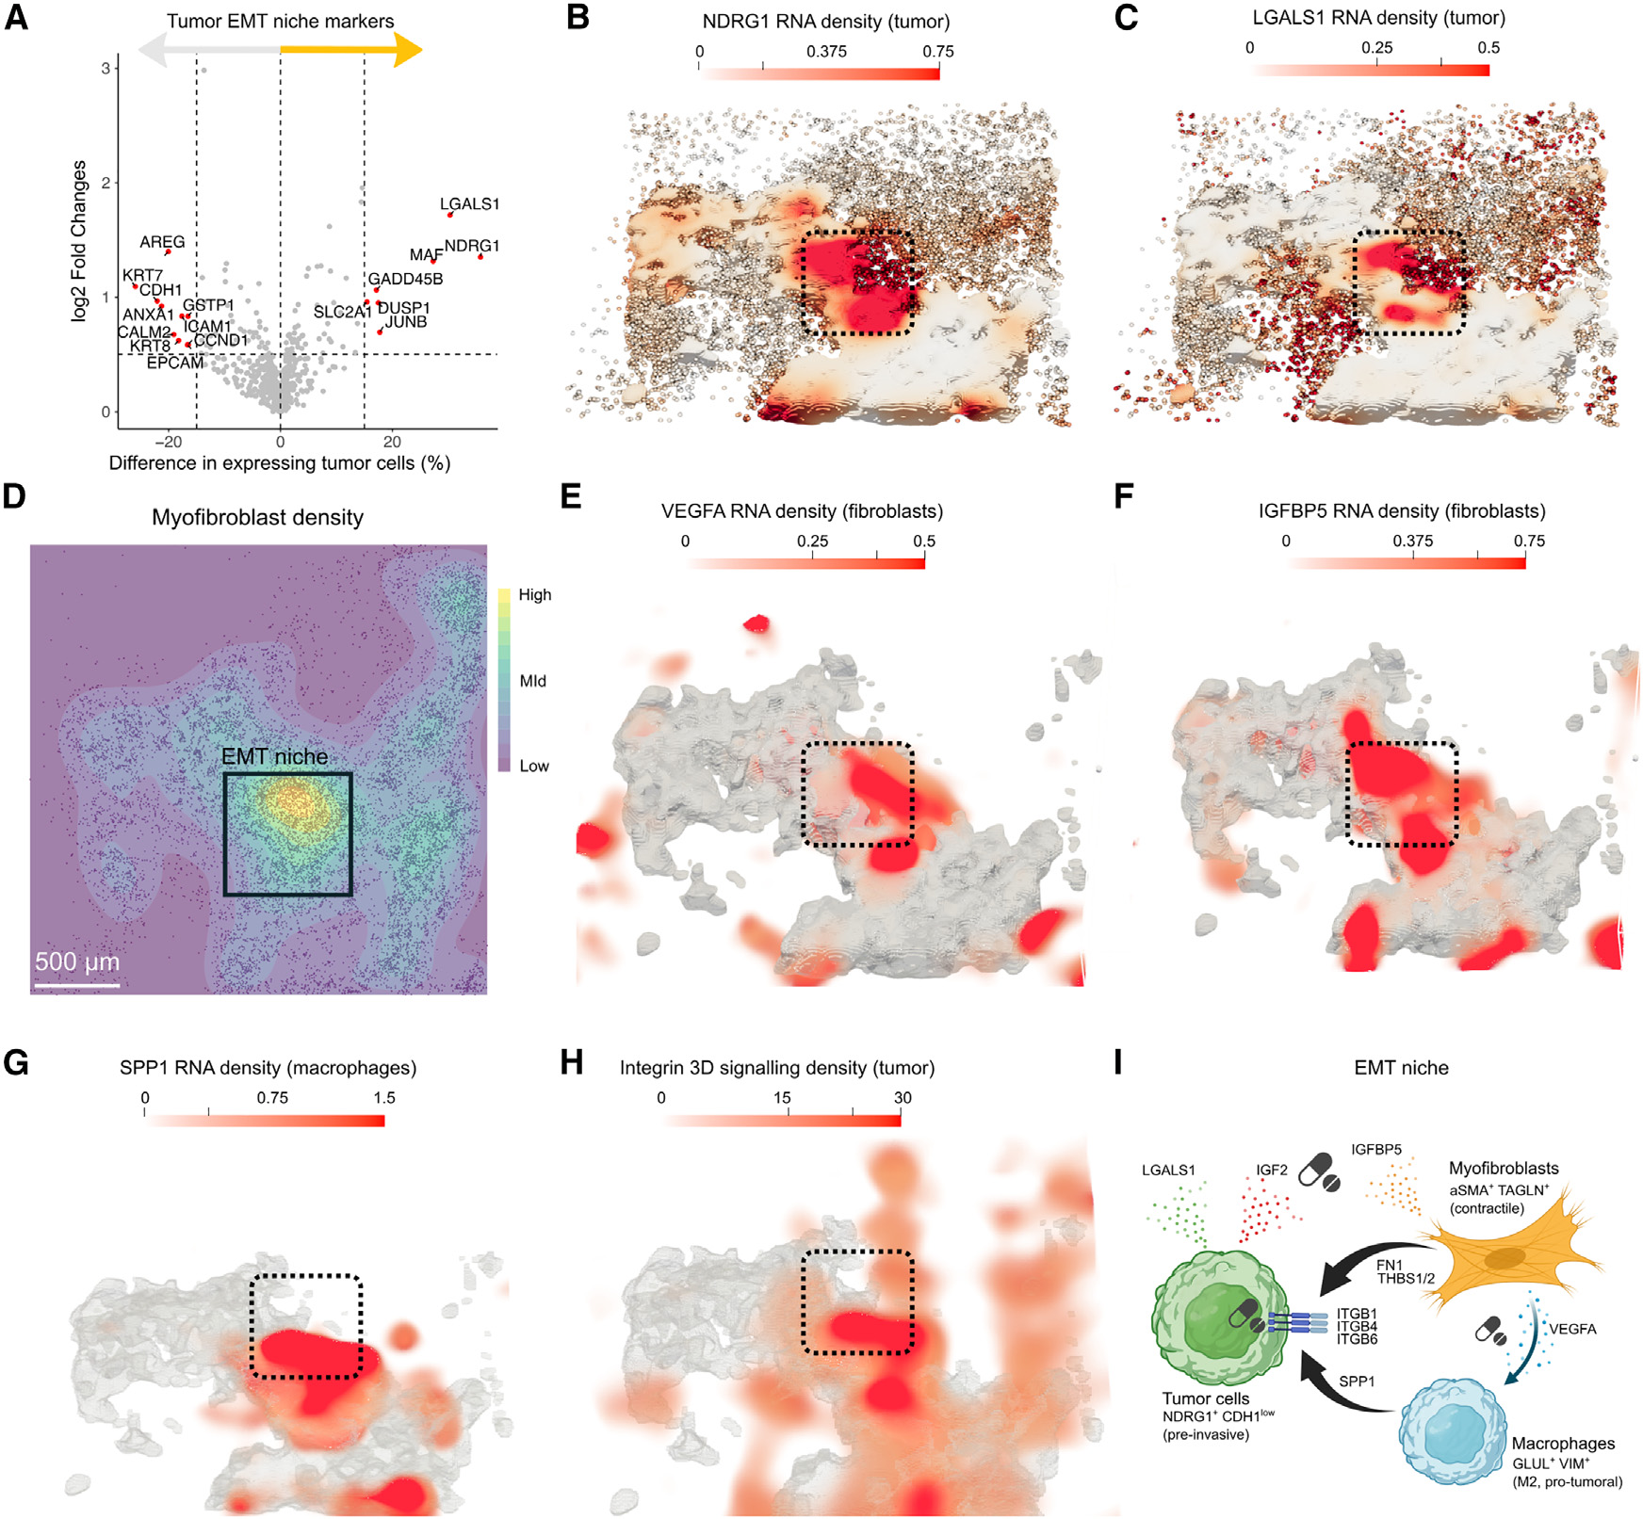
EMT niche has a distinct druggable signalling signature — LGALS1 / IGFBP5 / VEGFA / SPP1 / integrins
Fig 7 — EMT-niche markers; tumour-fibroblast-macrophage druggable model.
• TUMOUR CELLS — NDRG1 + LGALS1 (galectin-1; immunosuppressive)
• MYOFIBROBLASTS — VEGFA + IGFBP5 (angiogenic; modulates IGF axis)
• MACROPHAGES — SPP1 (osteopontin; pro-tumour-permissive marker)
Pentimalli & Rajewsky, Cell Systems 2025;16:101261
Notes:
- HOOK: What is each cell type in the EMT niche actually contributing?
- KEY CLAIM: The EMT niche is a tumour-fibroblast-macrophage cooperative — tumour cells express NDRG1 + LGALS1; myofibroblasts secrete VEGFA + IGFBP5; macrophages secrete SPP1. Each axis is a known druggable target. The integrin 3D-signalling density is highest in the EMT niche, confirming active αvβ6-fibronectin engagement.
- EVIDENCE: Tumour-cell volcano (A) shows EMT-niche-enriched markers; spatial RNA density maps (B-G) localise the marker expression to the rectangular EMT-niche region; integrin signalling activity (H) peaks in the same region.
- KEY TERMS: NDRG1, LGALS1, galectin-1, VEGFA, IGFBP5, SPP1, osteopontin, αvβ6 integrin
- TRANSITION: What's the take-home for the field — and for the thesis?
--- DETAILED SCRIPT ---
Panel A is a volcano plot of tumour-cell gene expression, contrasting EMT-niche cells against other tumour-cell populations. The orange + yellow annotations on the right are the EMT-niche markers — NDRG1, LGALS1, GADD45B, MIF, JUNB. NDRG1 is a stress-response gene activated by hypoxia. LGALS1 is Galectin-1, a glycan-binding protein known to suppress T-cell responses — so the EMT niche is actively immunosuppressive at the tumour-cell level. Panels B and C are spatial RNA-density maps for NDRG1 and LGALS1 in tumour cells; the dashed rectangle marks the EMT niche, and density peaks there. Panel D shows myofibroblast density across the same field — the EMT niche has high myofibroblast presence. Panels E and F: VEGFA and IGFBP5 in fibroblasts. VEGFA drives angiogenesis (so even though we're in collagen-poor regions, they're being vascularised); IGFBP5 modulates IGF availability — pro-tumour. Panel G: SPP1 in macrophages. SPP1 is osteopontin, a secreted phosphoprotein that promotes tumour invasion and is a marker of macrophage co-option by tumour. Panel H is the integrin 3D-signalling density map — highest in the EMT niche. αvβ6 (the ITGB6+ pairing we discussed in Fig 6) is the active integrin. Panel I is the integrative cartoon: tumour cells (LGALS1 + IGF2 + IGFBP5) signal to myofibroblasts (αSMA+, contractile, secrete VEGFA), which cooperate with macrophages (VC-, pro-tumour, SPP1+) to support a pre-invasive tumour state. Every node is a candidate drug target — anti-galectin (GB1211 in trials), anti-VEGFA (bevacizumab), anti-IGF1R (trial-stage), anti-SPP1 (research-stage).
--- EXTENDED WALKTHROUGH ---
BACKGROUND — why does this matter beyond NSCLC?
The tumour-fibroblast-macrophage cooperative described in panel I is a GENERIC pattern that recurs across solid tumours — colorectal, pancreatic, breast, lung. Each tumour type has its own version of the EMT niche, with slightly different molecular details but the same cell-type architecture. What's new here is the spatial resolution: we can actually point at where in the tumour this cooperative is operating, in 3D, on a clinical sample.
GALECTIN-1 (LGALS1) IN DETAIL — galectin-1 binds β-galactoside-containing glycans on the surface of T cells, induces T-cell apoptosis or anergy, blocks T-cell receptor clustering. Tumour-cell-derived galectin-1 is one of the major mechanisms by which tumours evade T-cell-mediated killing. GB1211 (GalecTo) is an oral galectin-3 inhibitor in trials; specific galectin-1 inhibitors are in earlier development.
SPP1 / OSTEOPONTIN IN DETAIL — SPP1 is a secreted glycoprotein that binds integrins (CD44, αvβ3) on tumour and stromal cells, promotes migration, matrix degradation, and angiogenesis. SPP1+ macrophages have been identified in multiple cancers as a 'tumour-permissive' macrophage state — they look anti-inflammatory but actively support tumour invasion. SPP1 is the most commonly cited marker of 'pro-tumoural' macrophages in 2024-2025 literature.
αvβ6 INTEGRIN PATHWAY — αvβ6 binds RGD motifs on fibronectin and on the latent form of TGFβ. When αvβ6 binds latent TGFβ-LAP, it activates TGFβ — which then drives further EMT, fibroblast activation, and immunosuppression. It's a positive-feedback loop. αvβ6 inhibitors have been tested in fibrotic lung disease (idiopathic pulmonary fibrosis); the clinical experience there informs cancer development.
WHY THE INTEGRATIVE CARTOON IS THE PUNCHLINE — the field has lots of papers showing 'this gene is up in this tumour cluster'. What this paper provides is a SPATIALLY-CONSISTENT, MULTI-CELL-TYPE story: tumour cells, fibroblasts, and macrophages each express a complementary set of markers that ONLY make sense as a coordinated module. That module is the EMT niche. That's the niche-resolved druggable target.
THESIS-WORLD CONNECTION — for an infected lung simulation, replace 'tumour' with 'pathogen-infected epithelium' and 'EMT' with 'epithelial activation'. The fibroblast-macrophage cooperative around an infection focus is structurally analogous; the simulation can use the same niche grammar.

Slide 13
Strengths vs limitations — what would you trust?
What this paper PROVES
What still needs validation
3D multimodal on FFPE is feasible + templated.
Single-section 2D loses DC niches + T-cell continuity.
Niche grammar (18 types → 10 niches) survives independent H&E.
DC-niche druggable network is spatially-resolved.
n=1 — 2.28× and 51% from one patient.
EMT-collagen-poor — Fig 6F overlap is substantial.
CellChat conflates expression w/ signalling — needs CRISPR validation.
Generalisation to infection, fibrosis untested.
vs
→
Pentimalli & Rajewsky, Cell Systems 2025;16:101261
Notes:
- HOOK: Where do we land after 7 figures?
- KEY CLAIM: Pentimalli proves the FEASIBILITY of routine 3D multimodal profiling on clinical FFPE and proves the CONSEQUENCES of staying in 2D. The n=1 cohort caveat is real, but the methodological contribution generalises immediately.
- TRANSITION: Open for questions.
--- DETAILED SCRIPT ---
Two kinds of contributions to call out cleanly. First, the methodological contribution: 34-section CosMx + SHG + STIM is now a templated workflow that any group with FFPE access and a CosMx instrument can replicate. The cost is real (~$150k of reagent + ~6-8 weeks of imaging) but feasible. Second, the scientific contribution: 3D analysis is not optional for niche-level questions. DC niches and T-cell continuity get systematically erased by single-section 2D analysis. If you're working on immunotherapy biomarkers, you cannot trust single-section spatial readouts. The major limitation is n=1: every quantitative claim — the 2.28× ratio, the 51% niche reassignment — comes from one patient. Population-level claims await the larger 3D atlas the same group is presumably building. For the thesis, the piece I take is the niche grammar: 18 cell types → 10 niches → druggable signalling network. The same grammar should describe an infected alveolus — different cell types, different niches, but the same logic of 'cells assemble into spatial communities that carry the actionable signal'.
--- EXTENDED WALKTHROUGH ---
WHAT I'D PUSH BACK ON IN DISCUSSION — three points.
(1) The n=1 caveat is more serious than the paper acknowledges. Every panel in the figures is from this one patient. If a different patient happened to have a tumour with no DC niches, the 'DC niche is critical' framing might not generalise. The team are presumably building a 3D atlas with more patients; that paper will tell us what's reproducible.
(2) The 'EMT niche' is reproducibly observed in 2D papers. Pentimalli's claim that it's 'collagen-poor not desmoplastic' is novel and specific. But the box plot in Fig 6F shows substantial overlap between EMT and degraded compartments; the difference is significant but not dramatic. I'd want to see this on more patients before treating it as a strong claim.
(3) The CellChat 50-µm activity score conflates expression with signalling. Just because L is expressed near R doesn't mean signalling is happening — you also need ligand secretion, receptor internalisation, downstream signal. The paper acknowledges this but the figures present the activity score as if it were a direct readout. Functional validation (CRISPR knockout of MIF or CCL19 in a model system) would close this gap.
WHAT THIS DOES TO THE THESIS PIPELINE — three concrete updates.
(1) Any in-silico tissue model we compare against spatial omics data must now virtually-slice the simulation, not flatten the data. Default-2D comparisons are biased.
(2) The niche grammar transfers: identify cell types, define neighbourhood vectors, cluster, validate against pathologist-equivalent independent labels. Same recipe for an infected alveolar duct as for an NSCLC.
(3) The receptor-ligand activity score with the spatial constraint is a reusable method for comparing simulation outputs to real signalling. Vivarium agents emitting virtual chemokine fields → simulated activity score → matched against the in-vivo activity score.
DISCUSSION QUESTIONS to seed — see next slide.

Slide 14
“Single-section 2D spatial omics is biased toward false negatives. The dendritic-cell niches and T-cell continuity that drive immunotherapy response are recoverable only in 3D.”
— the take-home from Pentimalli & Rajewsky 2025
Notes:
- HOOK: If you remember one thing, it should be this.
- KEY CLAIM: Single-section 2D spatial omics is systematically biased toward false negatives at the niche level. The structures that predict immunotherapy response are 3D structures.
- TRANSITION: Five questions to seed discussion.
--- DETAILED SCRIPT ---
If you take only one sentence away from this paper, take this one: single-section 2D spatial omics is systematically biased toward false negatives at the niche level. The dendritic-cell niches and T-cell continuity that drive immunotherapy response are 3D structures, and a 5-µm slice through them looks like nothing. If your group is publishing niche-level claims from 2D data, you now have to defend why your finding isn't an artefact of that slicing plane. If your group is reading clinical spatial-omics reports, you now have to read negatives as 'absence of signal in this slice', not 'absence of structure'. Everything else in the paper is downstream of this.
--- EXTENDED WALKTHROUGH ---
WHY THIS IS THE CORRECT TAKE-HOME — three reasons.
(1) It generalises beyond NSCLC. The geometric argument (2D disc vs 3D ball) is independent of disease. Any niche-level claim from any tumour, any infection, any fibrosis study built on 2D data is vulnerable to the same critique.
(2) It is actionable. You can decide today: are you publishing 2D niche claims (justify why 2D is enough) or 3D (you have a method advantage). The implications for grant writing, paper framing, and clinical interpretation are immediate.
(3) It is testable. The 51% niche-reassignment number is a concrete quantitative prediction that other groups can replicate. If they reproduce 30-70% reassignment in their own 3D atlases, the claim holds. If they find <10%, the claim was n=1 noise. Either way, the field moves forward.

Slide 15
Discussion seeds — where would you push this paper?
1. BUDGET — would you spend on CosMx 3D / 1 sample, or 2D / 50 samples? Why?
2. ARTEFACT vs BIOLOGY — is 'DC niche only in 3D' a methods artefact or real? How would you test?
3. GENERALISABILITY — does the EMT-niche cooperative survive in metastatic disease? Treatment-naïve vs post-immunotherapy?
4. MINIMUM USEFUL 3D — is 6 sections the floor? 3? 2 + interpolation?
5. CLINICAL PATHOLOGY — is single-section H&E still enough for diagnostic decisions?
Notes:
- HOOK: Open the floor.
- KEY CLAIM: These five questions span methods, biology, and clinical translation — pick whichever feels most live for the room.
- TRANSITION: References + happy to dig into any figure.

Slide 16
References
Pentimalli TM et al. Cell Syst 2025;16:101261.
Schurch CM et al. Cell 2020;182:1341.
Goltsev Y et al. Cell 2018;174:968.
Jin S et al. Nat Commun 2021;12:1088. (CellChat)
Travaglini KJ et al. Nature 2020;587:619. (Human Lung Cell Atlas)
Kim N et al. Nat Commun 2020;11:2285. (NSCLC scRNA-seq atlas)
Hickey JW et al. Front Immunol 2021;12:727626.
Sorin M et al. Nature 2023;614:548.
Mi H et al. Brief Bioinform 2024;25:bbae421.

