Slide 1
vaultlab — slide-deck demo
Generated from a Python plan dict
Replace with your name
Notes:
- HOOK: Open with the system pitch: research-paper-driven decks.
- KEY CLAIM: Every slide is data + speaker notes, not just a layout.
- TRANSITION: Outline first.

Slide 2
What this deck shows
Adaptive layout dispatch based on figure aspect + bullet count
Three-tier speaker notes (mental_map + script + walkthrough)
Audit-driven quality gates (overflow / overlap / off-slide)
Argument-graph + practice-script sidecars per deck
Notes:
- HOOK: Quick map of what's coming.
- KEY CLAIM: Four content slides + one references slide demonstrate the core layouts.
- TRANSITION: Next: a figure slide that picks its layout from the image aspect.

Slide 3
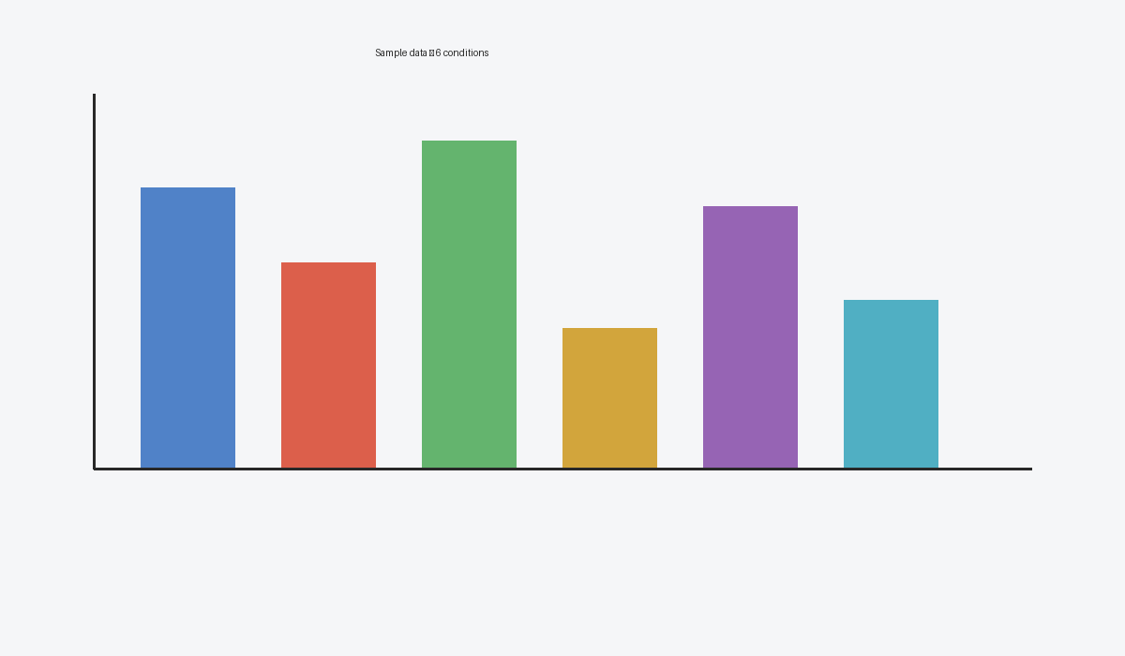
Auto-layout adapts to figure aspect ratio
• Wide-aspect figures get the top-caption-bottom-right layout
• Square figures default to side-caption (caption in right gutter)
• Tall-aspect figures use figure-above-bullets
• All preserve aspect ratio — figure never stretched
Six placeholder bars; aspect 1.71 → routed to figure_top_caption_br.
vaultlab demo (placeholder data) | 2026
Notes:
- HOOK: How does layout adapt?
- KEY CLAIM: The dispatcher reads image aspect + bullet count and picks one of 6 layouts.
- EVIDENCE: See vaultlab.slides.deck._auto_pick_figure_layout for the rule table.
- KEY TERMS: aspect ratio, auto-layout, layout dispatcher
- TRANSITION: Quote slides give the deck an emotional beat.
--- DETAILED SCRIPT ---
vaultlab decides slide layout dynamically. For each figure slide, the dispatcher reads three signals: the figure's aspect ratio, the number of bullets you provided, and (optionally) the content density of the figure. From those signals it picks one of six layouts: figure-only (no bullets, centered hero), figure-with-side-caption (square + bullets, caption + citation in right gutter), figure-above-bullets (extreme aspect), figure-top-caption-BR (wide-flat with caption tucked bottom-right), figure-with-bullets (default), or two-figure-compare. The goal is to give every figure as much canvas as possible without crowding text.

Slide 4
“If you can't show your data, you can't tell your story.”
— Folk wisdom in slide design

Slide 5
References
Replace these with your own citations.
Each line becomes one entry on the references slide.
vaultlab auto-switches to a 2-column layout when references > 7.

