Slide 1
Maximizing the Spread of Influence through a Social Network
Authors: David Kempe, Jon Kleinberg, Éva Tardos
KDD 2003
Adapted from author’s slide at: http://www.cs.washington.edu/affiliates/meetings/talks04/kempe.pdf

Slide 2
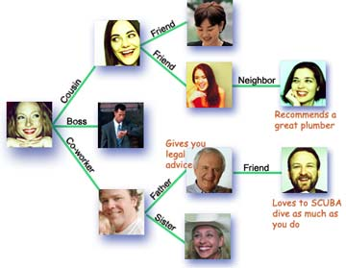
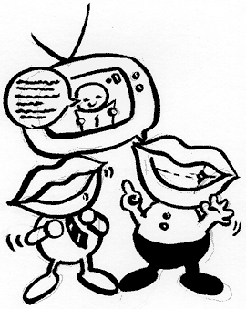
Social Network and Spread of Influence
Social network plays a fundamental role as a medium for the spread of INFLUENCE among its members
  Opinions, ideas, information, innovation…
Direct Marketing takes the “word-of-mouth” effects to significantly increase profits (Gmail, Tupperware popularization, Microsoft Origami …)

Slide 3
Example
Inactive Node
0.1
0.9
0.2
0.4
0.6
Active Node
0.3
0.2
0.2
Threshold
X
Influence
0.1
0.4
U
0.5
0.6
0.6
0.4
0.2
0.5
0.5
0.3
Stop!
0.2
w
0.5
r
0.2
0.5
0.6

