Slide 1




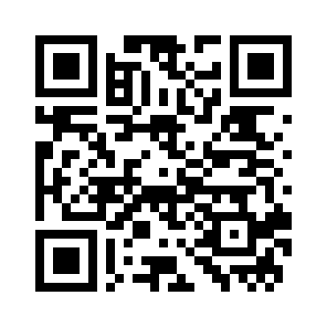
Make coding a
STEM superpower
A 5-week practical
Python programme
An inclusive, low-pressure way for
STEM students to start coding.
Code with confidence
Become independent learners
Expand career options
Explore CodeCamp
Scan for programme details
codecamp-kcl.pages.dev
Notes:
Content and visual identity adapted from 20260709 CodeCamp ICEA Faculty Pitch.pptx. Landing page: https://codecamp-kcl.pages.dev. Finished trim size, no bleed. Text is editable. Original computer artwork and QR code are replaceable images.

