Slide 1




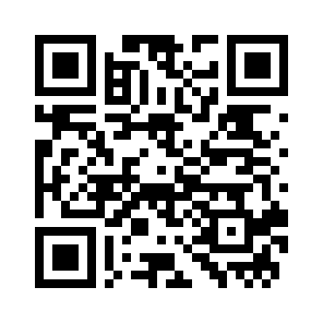

What is CodeCamp?
CodeCamp is a free 5-week practical Python programme
designed to help STEM students build confidence in
coding from scratch.
You will learn Python fundamentals, explore real STEM
data and build and share a simple project.
Who is it for?
STEM / NMES students
Complete beginners especially welcome
Anyone who wants a low-pressure start to coding
Where do I sign up?
Scan the QR code or visit
codecamp-kcl.pages.dev
to register your interest.
Register your interest
Same curiosity.
Brighter futures.
Notes:
Adapted from the user-supplied design reference. All text and panel boxes are editable. Decorative illustrations are cropped image assets. QR code links to https://codecamp-kcl.pages.dev. A5 portrait, 148 x 210 mm.

