Slide 1




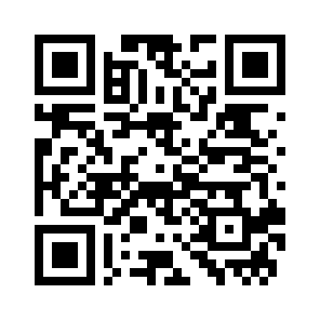
Make coding a
STEM superpower
A 5-week practical
Python programme
An inclusive, low-pressure way
for STEM students to start coding.
Explore CodeCamp
Scan for details
codecamp-kcl.pages.dev
Notes:
Content and visual identity adapted from 20260709 CodeCamp ICEA Faculty Pitch.pptx. Landing page: https://codecamp-kcl.pages.dev. Finished trim size, no bleed. Text is editable. Original computer artwork and QR code are replaceable images.

Slide 2
CODECAMP
What you’ll learn
WEEKS 1-3
Python fundamentals
Core programming concepts,
functions, data structures,
debugging and good coding habits.
WEEK 4
Data analysis
Clean, analyse and visualise
real STEM datasets with Python.
WEEK 5
Build & share
Use GitHub and simple deployment
tools to publish and share
a working Python project.
Code with confidence
Build skills to learn new tools
and expand your career options.
Notes:
Content and visual identity adapted from 20260709 CodeCamp ICEA Faculty Pitch.pptx. Landing page: https://codecamp-kcl.pages.dev. Finished trim size, no bleed. Text is editable. Original computer artwork and QR code are replaceable images.

