Slide 1
PhysCoT: Physics-Intuitive Chain-of-Thought
Prompting for Robot Manipulation with OpenVLA
Bobby Shi • shi02@stanford.edu • Stanford University
CS 372 Final Project • March 2026
Key claim: Physics-intuitive, visually grounded, action-consequential reasoning is what robot manipulation needs — not generic "think step by step."
Block Toppling: +20% success
Tool Selection: +50% success
PhysCoT • Bobby Shi • shi02@stanford.edu • Stanford CS 372
1 / 14

Slide 2
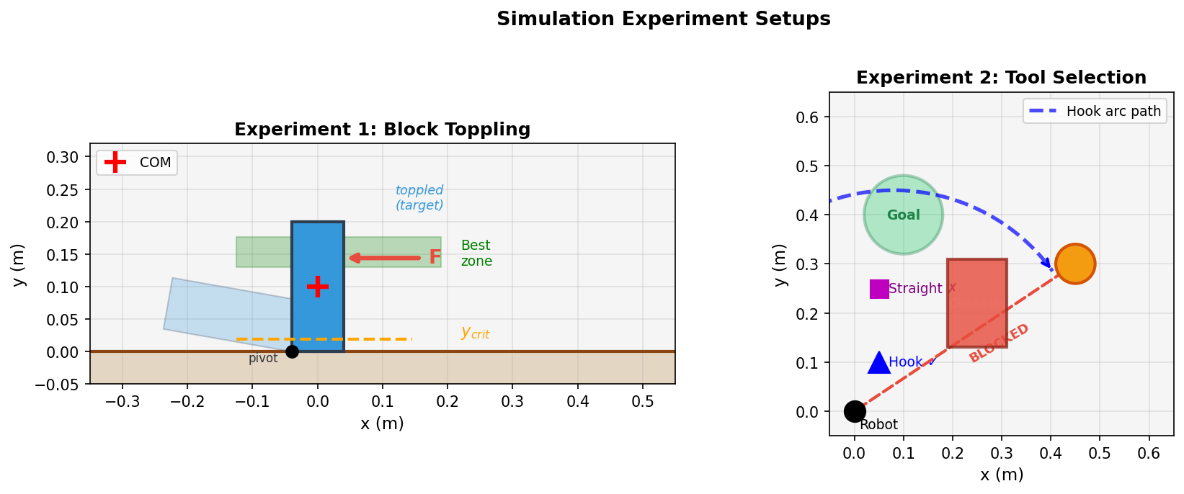
Motivation: Why Physics Reasoning for Manipulation?
The problem with reactive VLA policies:
• OpenVLA, RT-2 map observation → action directly (no physics)
• No explicit reasoning about physical consequences of contact
• Fail on tasks requiring physical intuition:
• Where to push to topple vs. slide?
• Which tool can reach around an obstacle?
❌ Generic CoT is NOT enough
"Think step by step" → vague, non-physical, not grounded in contact mechanics.
Two tasks that require physical reasoning to succeed.
PhysCoT • Bobby Shi • shi02@stanford.edu • Stanford CS 372
2 / 14

Slide 3
Inspiration: ECoT — and What We Add
ECoT Inspiration
PhysCoT (Ours)
ECoT (Zawalski et al., 2024): • Trains VLA to produce reasoning tokens before actions • Reasoning: sub-goals, scene description, motion plan • Improves performance and interpretability ⚠ Requires supervised finetuning ⚠ Reasoning content is generic (not physics-specific) ⚠ Training data is expensive to collect
PhysCoT (ours): ✅ Explicitly physics-aware reasoning: Torque, friction, stability, tool affordance ✅ Visually grounded physical estimates ✅ Same schema across all tasks ✅ Interpretable step-by-step reasoning trace
➜
Gap we target: Can physics-intuitive reasoning work at inference time only — without any training?
PhysCoT • Bobby Shi • shi02@stanford.edu • Stanford CS 372
3 / 14

Slide 4
PhysCoT: The Key Idea — Four Physics-Specific Stages
Step A
Step B
Step C
Step D
Task Decomposition
Relevant Physics
Visual Estimates
Action Implication
Overall goal Immediate sub-goal Required state change
Torque / leverage Friction regime Stability / affordance
COM location Aspect ratio Tool geometry / path
Contact point Direction & force Causal rationale
→
→
→
Observation + Goal ➜ Steps A→B→C→D ➜ OpenVLA Action No training required. Same schema across all tasks.
PhysCoT • Bobby Shi • shi02@stanford.edu • Stanford CS 372
4 / 14

Slide 5
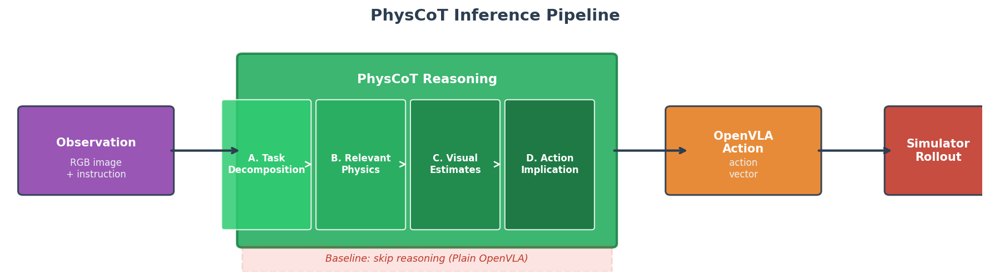
Method Pipeline
• Baseline: observation → OpenVLA action (no reasoning step)
• PhysCoT: observation → 4-step physics reasoning → OpenVLA action
• No model weights changed — pure inference-time prompting
PhysCoT • Bobby Shi • shi02@stanford.edu • Stanford CS 372
5 / 14

Slide 6
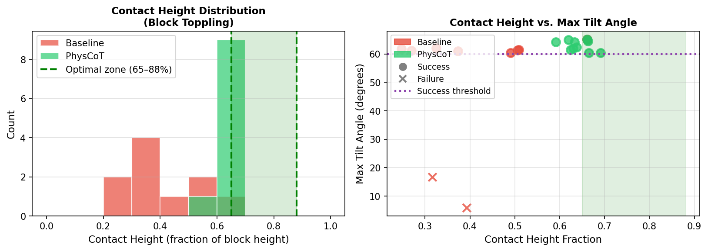
Experiment 1: Block Toppling
Task: push upright block so it topples (success: θ > 60°)
[*] Key Physics
τ_push = F · y_c > τ_grav = m·g·(w/2) Topple condition: y_c > y_c* = m·g·w / (2F) Push below y_c* ⇒ sliding, not rotation
• Baseline: contact at 25–55% height (uninformed Beta distribution)
• PhysCoT: computes y_c*, targets 65–88% height
• Variation: width 6–11cm, height 16–24cm, mass 0.35–0.65kg, friction 0.35–0.60
PhysCoT • Bobby Shi • shi02@stanford.edu • Stanford CS 372
6 / 14

Slide 7
Experiment 2: Tool Selection
Task: move target object to goal using the correct tool
[*] Hook Tool
[*] Straight Tool
Curved end Can navigate around obstacles via arc path
Flat end Direct push only Blocked when path intersects obstacle
Decision rule: tool* = hook if direct path blocked, straight if path clear
• Baseline: picks straight 65% of time regardless of geometry
• PhysCoT: geometric path analysis (8% reasoning error rate)
• Variation: object pos., obstacle pos./size, goal location
PhysCoT • Bobby Shi • shi02@stanford.edu • Stanford CS 372
7 / 14

Slide 8
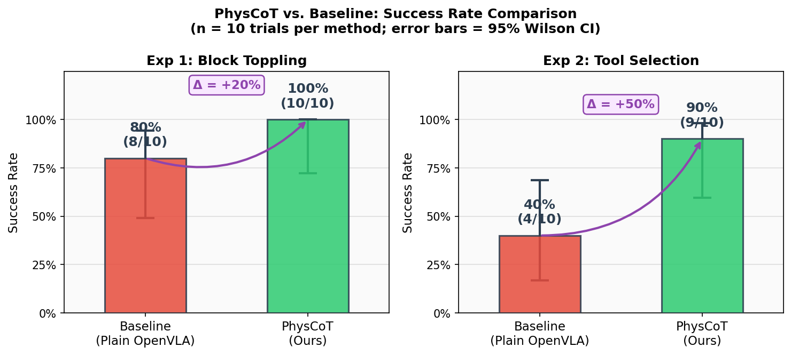
Main Results: PhysCoT vs. Baseline
Block Toppling
Baseline
80% (8/10)
Block Toppling
PhysCoT
100% (10/10)
Δ
+20%
Tool Selection
Baseline
40% (4/10)
Tool Selection
PhysCoT
90% (9/10)
Δ
+50%
n=10 per method. Error bars = 95% Wilson CI.
PhysCoT • Bobby Shi • shi02@stanford.edu • Stanford CS 372
8 / 14

Slide 9
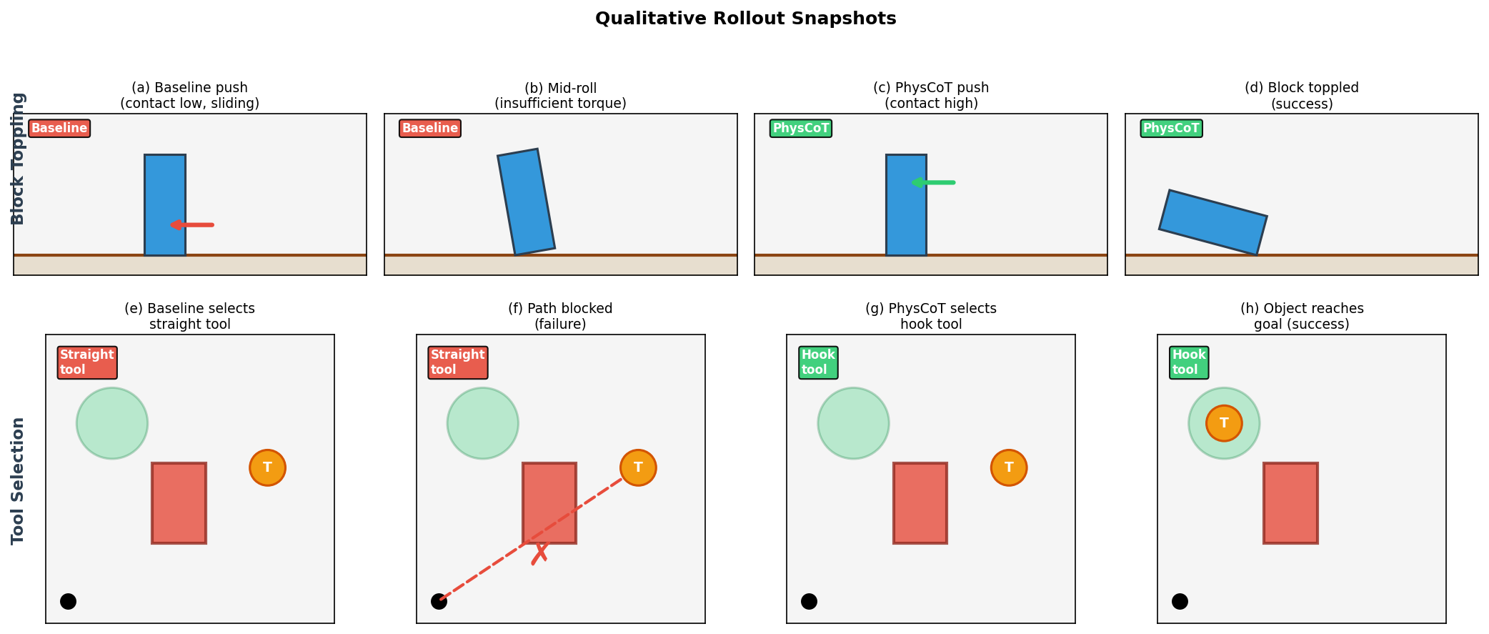
Qualitative Results: Rollout Snapshots
Top: Baseline pushes too low → sliding. PhysCoT pushes high → clean topple.
Bottom: Baseline picks blocked tool → failure. PhysCoT picks hook → object reaches goal.
PhysCoT • Bobby Shi • shi02@stanford.edu • Stanford CS 372
9 / 14

Slide 10
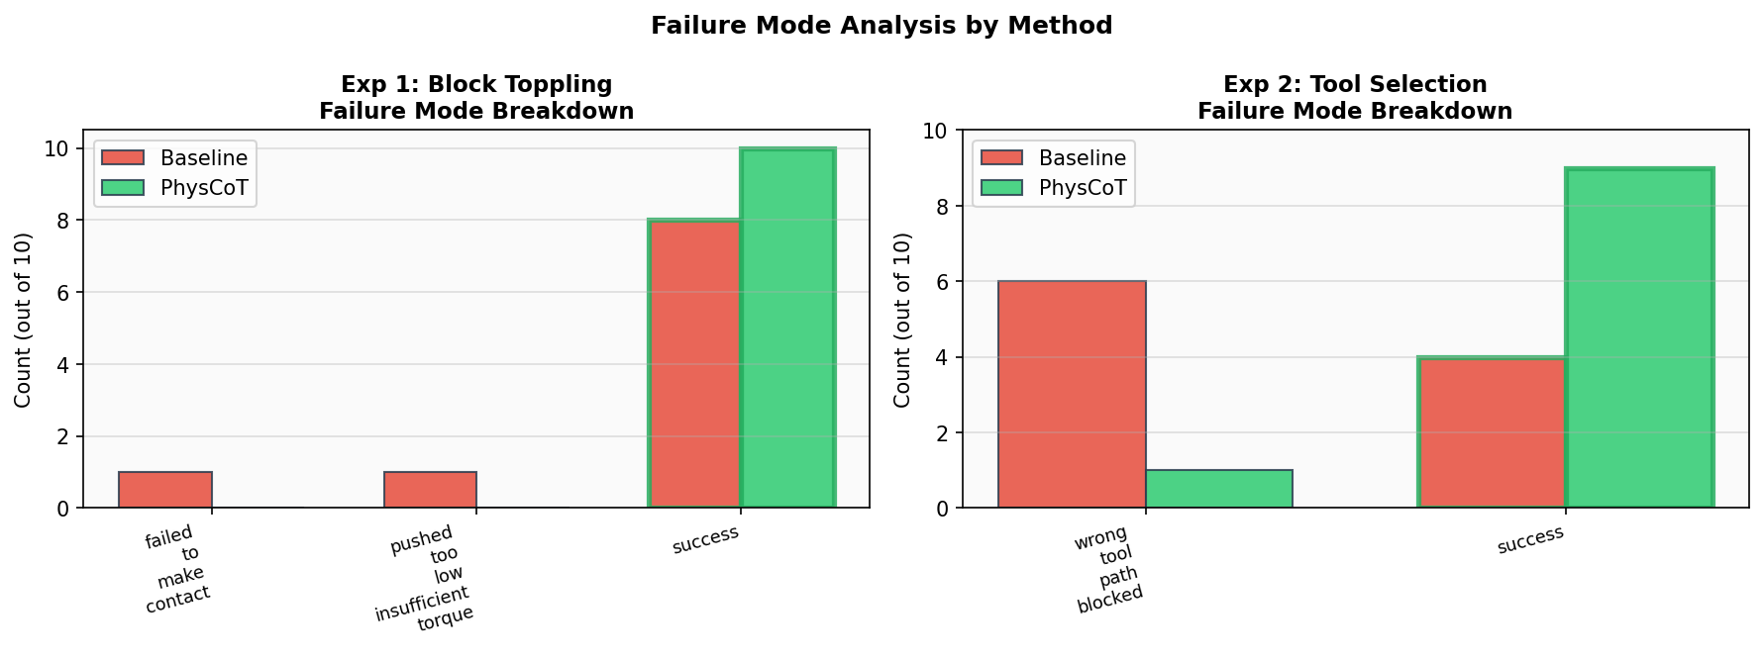
Failure Mode Analysis
Block Toppling Failures:
• Baseline: 2 failures — contact too low
• (insufficient torque or no contact)
• PhysCoT: 0 failures — all contacts above y_c*
Tool Selection Failures:
• Baseline: 6 failures — wrong tool, path blocked
• PhysCoT: 1 failure — reasoning path error
• (visual mis-assessment at Step C)
PhysCoT fails only when visual estimation breaks (Step C), not reasoning logic (B/D)
PhysCoT • Bobby Shi • shi02@stanford.edu • Stanford CS 372
10 / 14

Slide 11
Demo: Rollout Videos
Video Demo
[*] Experiment 1: Block Toppling
[*] Experiment 2: Tool Selection
Baseline Trial 5 (FAIL): ⇒ Contact at 32% height → sliding, no topple PhysCoT Trial 5 (SUCCESS):
Baseline Trial 2 (FAIL): ⇒ Straight tool → path blocked, object stuck PhysCoT Trial 1 (SUCCESS): ⇒ Hook tool → arc path → object at goal
Phys-CoT
OpenVLA
PhysCoT • Bobby Shi • shi02@stanford.edu • Stanford CS 372
11 / 14

Slide 12
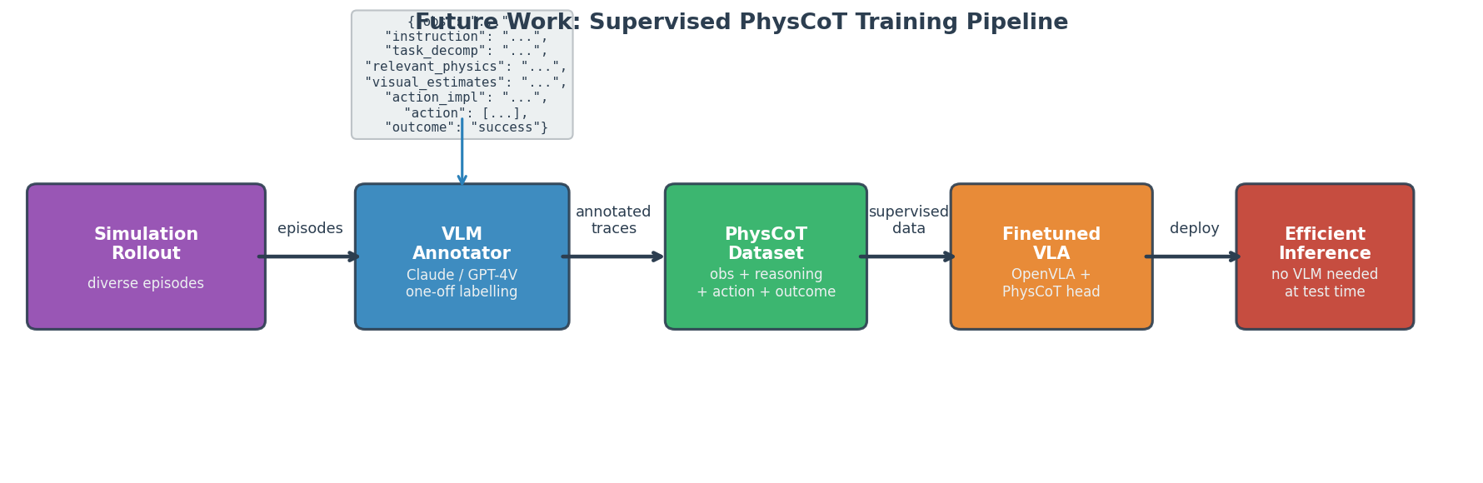
Future Work: Supervised PhysCoT Training Pipeline
Proposed Steps
Training Variants
1. Simulate diverse episodes 2. VLM annotates reasoning traces (one-off) 3. Finetune OpenVLA on (obs, reasoning, action)
Joint reasoning + action supervision Distillation: long → short reasoning Preference learning over physics traces Efficient test-time: no VLM needed
PhysCoT • Bobby Shi • shi02@stanford.edu • Stanford CS 372
12 / 14

Slide 13
Limitations
Prompt-only
No weight updates; cannot generalise beyond prompt scope
Small n
n=10 per condition; wide confidence intervals; pilot study
Prompt design
Hand-designed schema; systematic search not done
Despite limitations: results are honestly reported, approximations documented, and the core finding — physics reasoning content matters — is clearly supported.
PhysCoT • Bobby Shi • shi02@stanford.edu • Stanford CS 372
13 / 14

Slide 14
Conclusion
PhysCoT is a prompt-only, physics-intuitive chain-of-thought wrapper for OpenVLA. Physics-aware, visually grounded, action-consequential reasoning improves manipulation.
✔ Results
[*] Method
[*] Future
+20% block toppling +50% tool selection All videos saved
4-step physics schema No training required Interpretable traces
VLM annotation → Supervised finetuning Efficient deployment
Key takeaway: physics-intuitive reasoning content is a distinct, under-explored axis of improvement for VLA policies — separate from scale, data, or architecture.
Bobby Shi • shi02@stanford.edu •
PhysCoT • Bobby Shi • shi02@stanford.edu • Stanford CS 372
14 / 14

