Slide 1
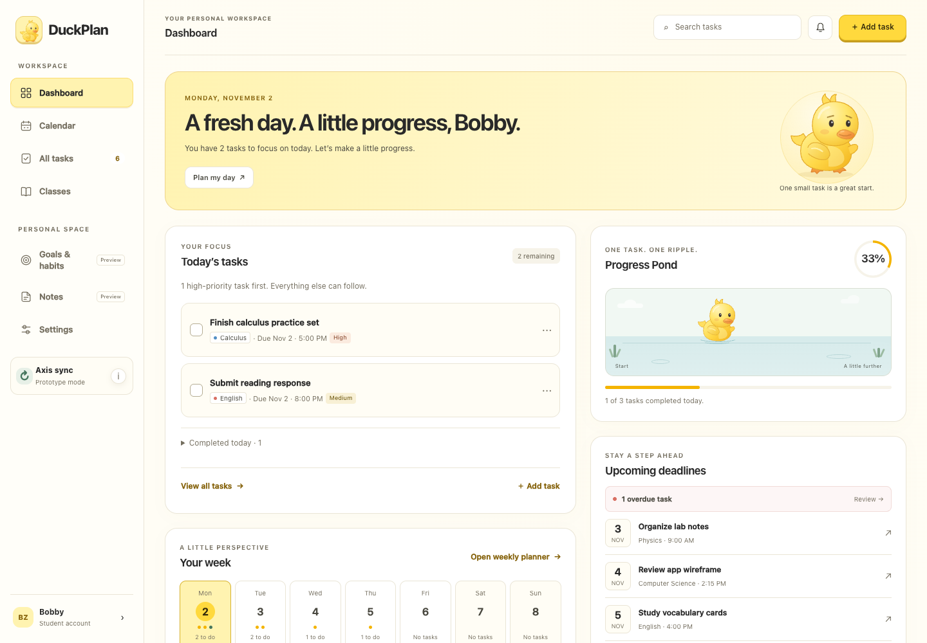
DuckPlan
UI/UX redesign · Priya
A warmer, more expressive digital planner.
Frontend design, layout, accessibility, and microinteractions.
Group project · Michael, Bobby & Priya
DUCKPLAN · FRONTEND UI/UX
01
Notes:
Introduce this as the frontend UI/UX contribution to the existing DuckPlan group project. The application was improved in place; it was not rebuilt and backend functionality was preserved.

Slide 2
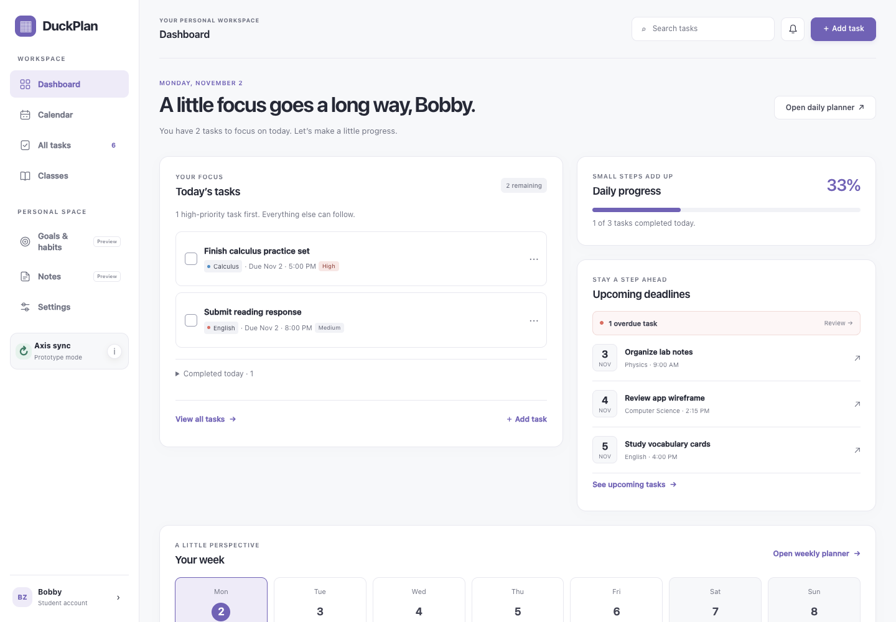
Before → After
Same dashboard, same 1440 × 1000 viewport
Before this iteration: a restrained lavender interface.
After: cream surfaces, yellow accents, a signature duck, and Progress Pond.
DUCKPLAN · FRONTEND UI/UX
02
Notes:
These screenshots were captured before and after the yellow redesign using the existing demo data and the same desktop viewport. The before image shows the previous frontend iteration, not the very first version of the project.

Slide 3
A dashboard with a clear purpose
Today’s work, visible progress, and a week at a glance
Today’s tasks, ordered by priority.
Upcoming deadlines and overdue reminders.
Daily progress and a compact weekly overview.
DUCKPLAN · FRONTEND UI/UX
03
Notes:
Show that the playful visual layer still serves planning. Task cards, deadlines, calendar links, progress, and the weekly summary use the existing task data rather than invented statistics.

Slide 4
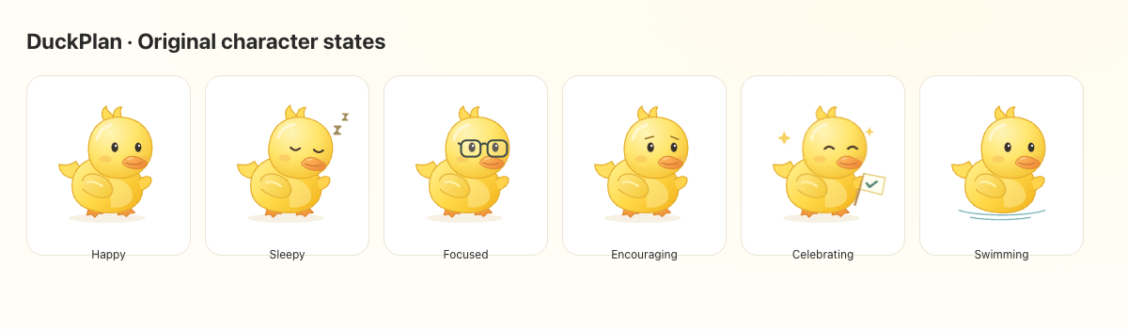
One original character. Six expressions.
Reusable SVG illustration, without a large animation library
Happy · Sleepy · Focused
Encouraging · Celebrating · Swimming
Shared artwork across welcome, progress, editor, and empty states.
DUCKPLAN · FRONTEND UI/UX
04
Notes:
Explain the original shaded SVG duck with expressive eyes, glasses, orange feet and beak, and a celebration flag. States adapt to task progress and evening planning. This image is an illustration-state study, not a data dashboard.

Slide 5
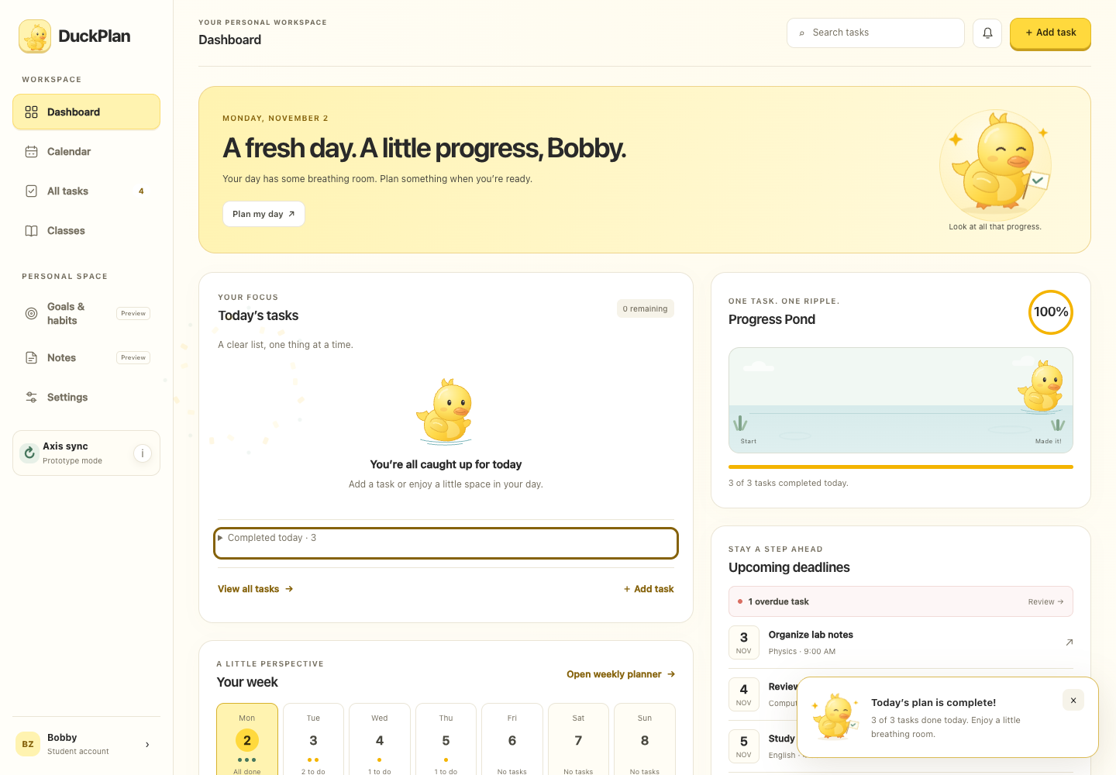
Make progress feel satisfying
Brief, nonblocking feedback tied to real task completion
A happy duck, a gentle card response, and golden particles.
Progress Pond moves with today’s completion percentage.
Finishing today’s plan shows a dismissible celebration.
DUCKPLAN · FRONTEND UI/UX
05
Notes:
Describe the completion sequence: checkbox toggle, existing data update, then visual feedback. The celebration reflects today’s plan, not every task in the account. Undoing completion removes stale congratulations. Motion can be disabled and system reduced-motion settings are respected.

Slide 6
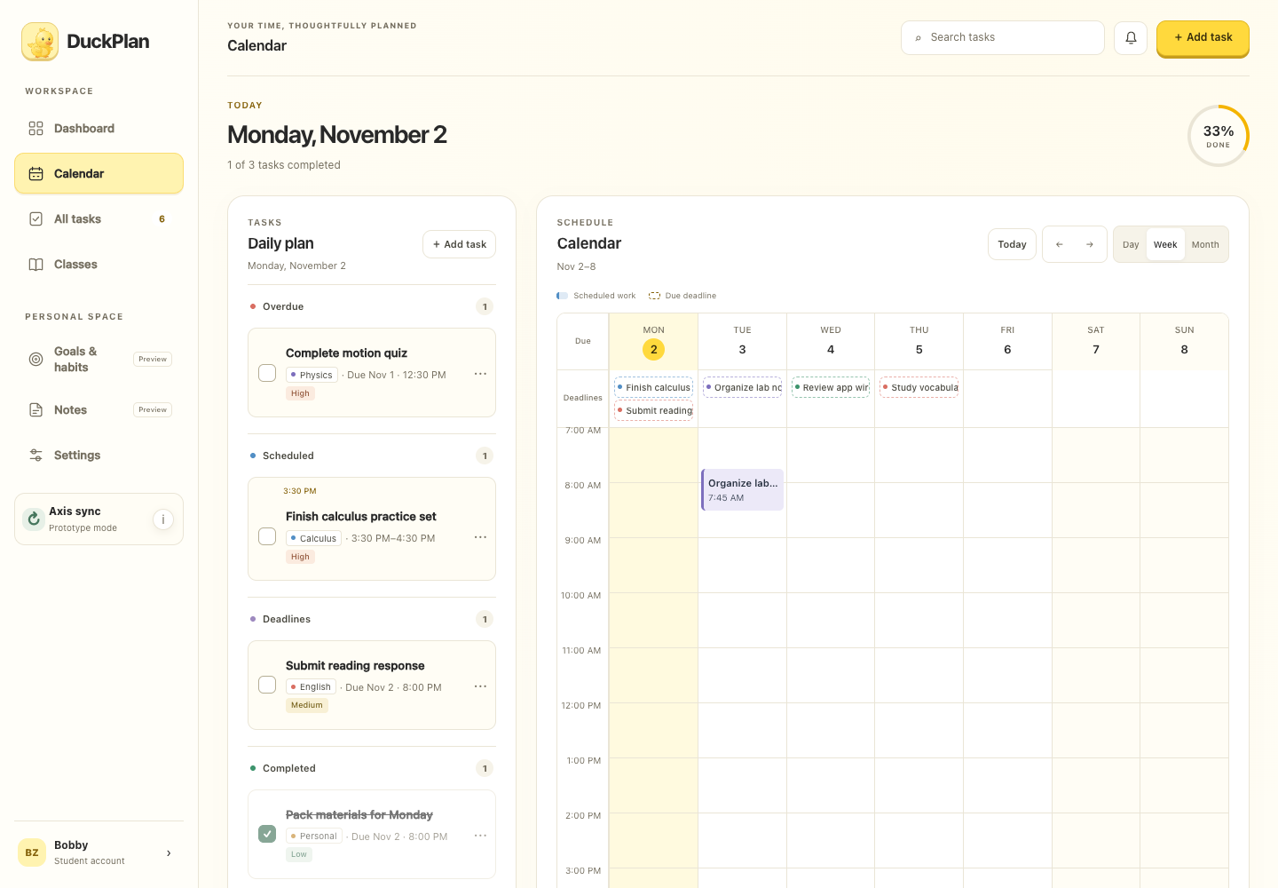
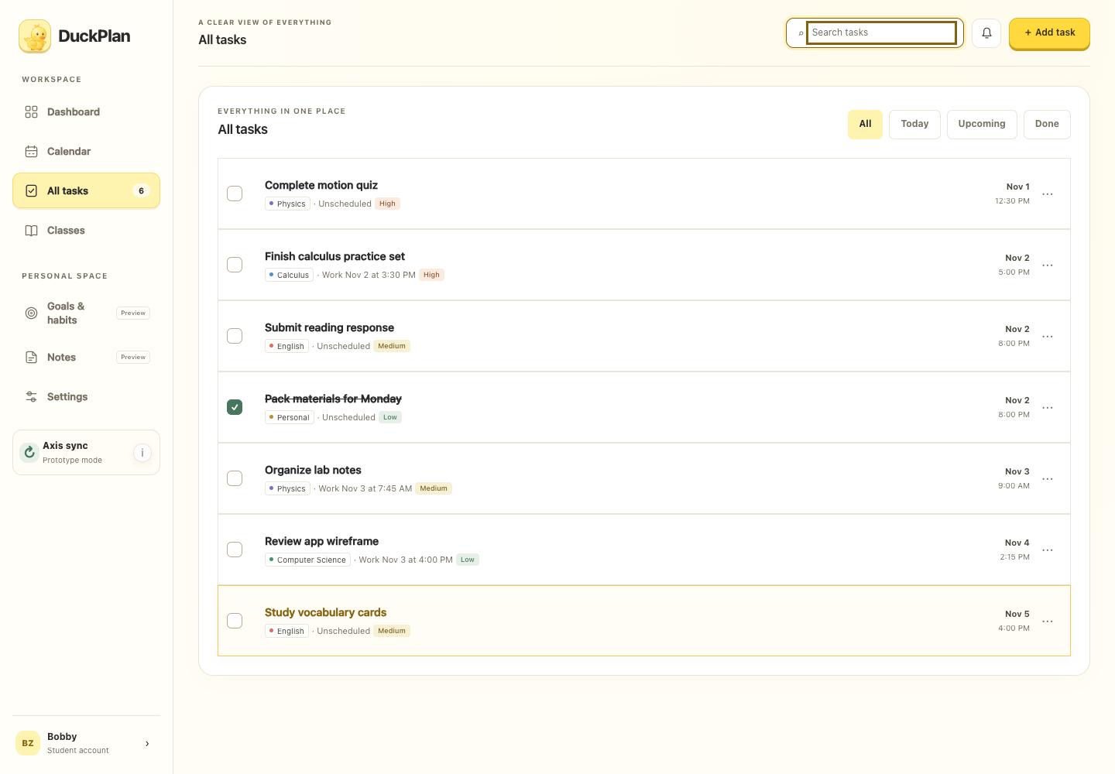
Keep the planner useful
Existing calendar and task features, with a cohesive visual system
Daily, weekly, and monthly calendars remain available.
Task editing, priorities, categories, search, and filters are preserved.
DUCKPLAN · FRONTEND UI/UX
06
Notes:
The two screenshots show the weekly calendar and task organization. The redesign changes presentation and interaction feedback while preserving existing task and scheduling behavior.

Slide 7
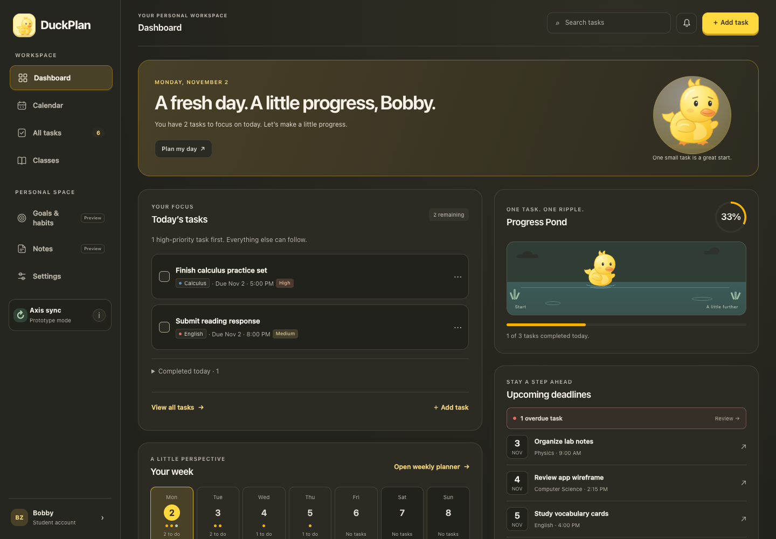
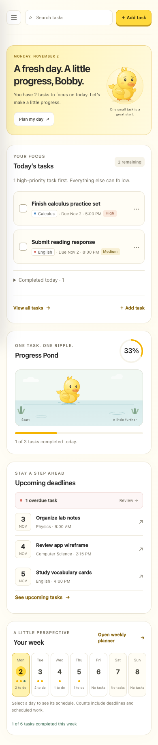
Designed for different screens and preferences
Responsive layouts, dark mode, and accessible interactions
Checked from 320 to 1440 pixels.
Visible keyboard focus and focus preservation after completion.
Reduced motion and a persistent mascot-motion setting.
DUCKPLAN · FRONTEND UI/UX
07
Notes:
Show dark mode and the full mobile layout. Wide calendar grids scroll inside their panels. Explain that the character remains visible when motion is disabled; progress values and status messages continue to update.

Slide 8
My contribution & verification
A frontend-only redesign that respects team collaboration
Built reusable mascot, theme, and interaction components.
Preserved planner data, backend behavior, and existing team work.
17 existing tests passed, plus Chrome interaction and responsive checks.
Goals & Habits and Notes remain labeled previews requiring future integration.
DUCKPLAN · FRONTEND UI/UX
08
Notes:
Name the main new files: duck-mascot.js, duck-interactions.js, duck-theme.css, and the duck favicon. index.html and planner-ui.js connect the UI. The existing task model and persistence routines were preserved. Work remains on feature/duckplan-ui and was not committed, pushed, merged, or deployed.

