Slide 1
INTRODUCTION TO SALVIA
Ye WU
M&E Maya

Slide 2
Introduction
SALVIA
Shading and Lighting Visualization Architecture
Related projects
MESA
Muli3D
SwiftShader

Slide 3
Agenda
Pipeline of SALVIA
Cooperation of stages
Implementation of rasterizer
Sampling algorithm
Includes Anisotropic Filtering
Design of Shader System
SIMD simulation for derivative computation
High performance binary interface between host and shader
Project management( Candidate )

Slide 4
SECTION I: Graphics Pipeline
Pipeline stages
Input Assembler
Vertex Shader
Rasterizer
Pixel Shader
Output Merger
Blend shader
Resources
Surface / Texture
Linear Buffer
Why not support GS/TS/HS right now?

Slide 5
Input Assembler
Input
Index buffer
Vertex buffer
Primitive Type
Point / Line / Triangle
List / Strip
Output
Point List
Ensure that it is rasterized
Customized sampler
Zane Li: Adaptive Shadow Map
Line List
Diamond rule
Triangle List

Slide 6
Rasterizer
Rasterizer Algorithms
Hardware
Sweep
SALVIA
Scan line
Subdivision ( Larrabee )

Slide 7
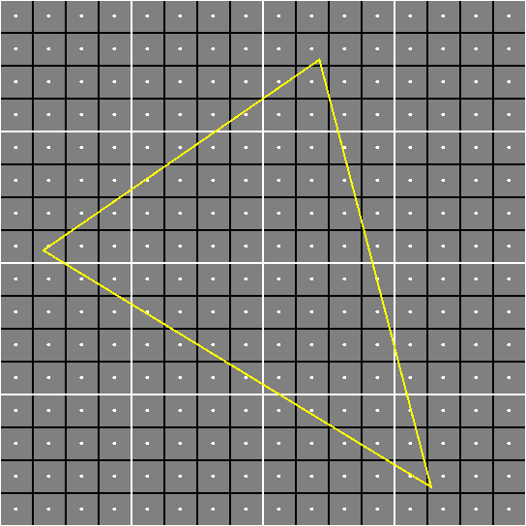
Triangle to rasterized

Slide 8
Scanline
Steps
Split triangle to top-bottom parts
Rasterize top part and bottom part
Demo

Slide 9
Sweep
Bigger-grain size than scanline
Demo

Slide 10
Subdivision
Larrabee used
Easy to vectorized
Demo

Slide 11
Output Merger
Functionalities
Alpha test/blend
Scissors
Stencil buffer
Z rejection
AA Buffer Resolve

Slide 12
Output Merger
Fixed
Programmable
Blend/Blending shader

Slide 13
Output Merger
Design of output merger
Naive solution
void blend(
PIXEL_STRUCT* px,
float4* color[TARGET_COUNT],
float& z,
uint32_t& stencil,
SISSOR sissor
)
{
// blah blah blah ...
}

Slide 14
Output Merger
Pros.
Simplify the implementation of back-end
Less instructions than fixed pipeline
Probability for early rejection
Cons.
AA buffer couldn’t be resolved by shader
Additional function call
Little slower than optimized fixed pipeline

Slide 15
Output Merger
TODO
Put blending shader with pixel shader together
Less function call and data access
Optimized with data access locally
Work with Early Rejected Test
Early Z, Early Stencil, Early …

Slide 16
Cooperation with Stages
Push Model
Pull Model
draw_triangles()
ASYNC
for tri in assemble( ib, vb, prim_type )
ASYNC
tri_buf.push( tri )
ASYNC
while( tri_buf.not_empty() )
ASYNC
verts = proc_v( vs, tri_buf.pop().verts )
proc_vbuf.push( verts )
ASYNC
while( proc_vbuf.not_empty() )
ASYNC
pixels = rasterize( proc_vbuf.pop() )
pxbuf.push( pixels )
ASYNC
while( proc_vbuf.not_empty() )
ASYNC
pixels = rasterize( proc_vbuf.pop() )
pxbuf.push( pixels );
ASYNC{
while( pxbuf.not_empty() )
ASYNC{
px = proc_px( ps, pxbuf.pop() )
blend( bs, px, bufs );
draw_triangles()
assemble_input()
for tri in assemble(ib, vb, prim_type)
ASYNC
verts = proc_v ( vs, tri.verts )
add_to_rasterizer( verts )
ASYNC
rasterize()
for px in rast
ASYNC
proc_px( ps, px )
blend( bs, px, bufs )

Slide 17
Cooperation with Stages
 | Push | Pull
Implementation | Recursive call | Message queue
Synchronization | Sync | Async
Advantage | Simple Easy to control | High parallel Easy to implement asynchronous API
Disadvantage | Unbalanced workload | Complexity Unlimited memory footprint

Slide 18
1D Buffers
Vertex buffer
Index buffer
std::vector
Constant buffer
Raw bytes
Interpreted by compiler

Slide 19
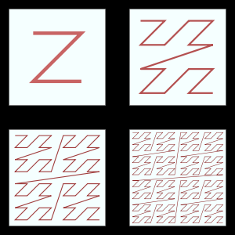
Texture
Storage
Linear
2D Array
Tile based
Morton Code

Slide 20
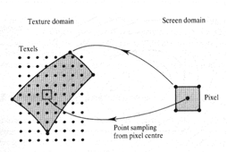
Sampler
Sample type
Linear
Bilinear
Trilinear (Mipmap)
Anisotropic
Sample in math
Adaptive
EWA
Hack method

Slide 21
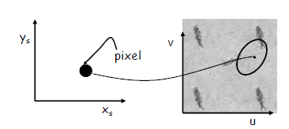
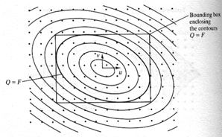
Sampler
EWA Algorithm
Hardware Hack
Sample distributed on gradient direction
Long axis of ellipse

Slide 22
END OF SECTION
Graphics Pipeline
Any questions ?

Slide 23
SECTION II: Shader System
Architecture
Motivation
Design
Implementation
Compiler
Host and Runtime

Slide 24
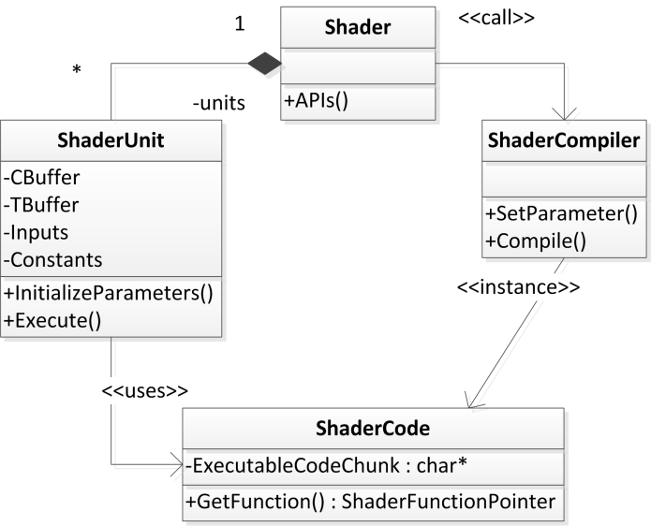
Architecture

Slide 25
Motivation
Candidates
Precompiled shader
C Callback
Injected DLL
OO Styled: Inheritance and Polymorphic
3rd Party compiler: Lua, LuaJIT, TinyC, etc.
Just-In-Time based shader
WHY WE NEED CUSTOMIZED COMPILER

Slide 26
Motivation
Derivative
ddx, ddy
Analytic solution
Could not process sample based data
E.g. texture.
Interpolation-based derivative
Differential solution
Continuation/precision on 1/2-order
Performance
No code is fastest code

Slide 27
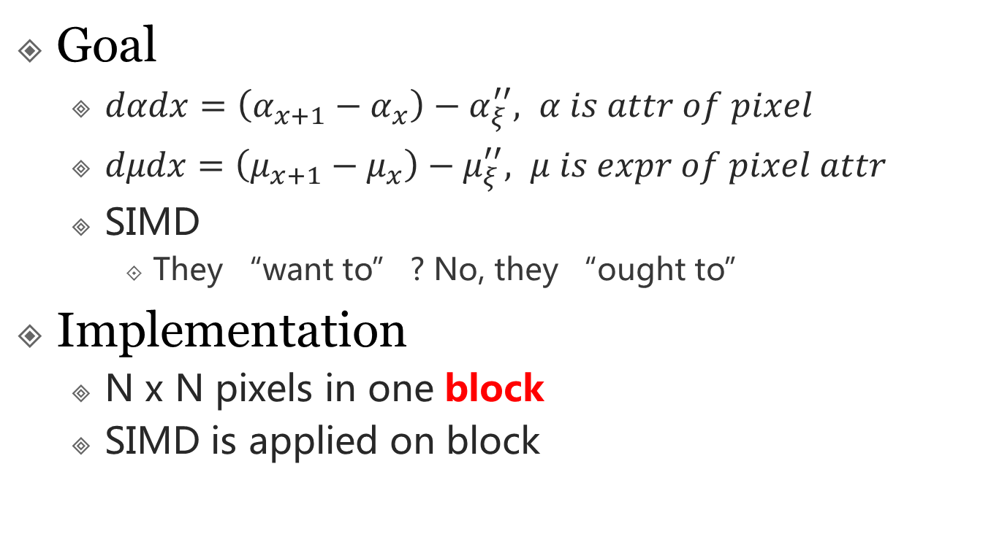
Design for derivative
Goal
$dαdx=\left(α_{x+1}−α_{x}\right)−α_{ξ}^{′′}, α is attr of pixel$
$dμdx=\left(μ_{x+1}−μ_{x}\right)−μ_{ξ}^{′′}, μ is expr of pixel attr$
SIMD
They “want to” ? No, they “ought to”
Implementation
N x N pixels in one block
SIMD is applied on block

Slide 28
Design for derivative
Pixel block
HW
4x4 pixels per block in general
SALVIA
2x2 pixels per block in SSE version
4x4 pixels per block in AVX version( in future )
N*N pixels per block in scalar (Tune-based in future)

Slide 29
Design for derivative
Problems met
Undefined partial derivation
Sequence execution
Branch execution
Undefined and defined case
Fake branch
Dispatched by uniform
Fixed for-loop is “sequence”
Artifacts
The edge of geometry
One pixel triangle
template <typename T>
T ddx( T& addr );
void max( float a, float b ){
float c = b;
// ddx c is defined
if( a > b ){
c = a;
// ddx c is undefined
}
// ddx c is defined
return c;
}

Slide 30
Design for derivative
Hardware solution
DX9.0c and earlier
No stack, all registers
Unused register has default value
Difference between registers

Slide 31
Design for derivative
SALVIA Solution
Interlace intrinsic
SIMD Acceleration on Interlaced code
Pros.
Simple
Easy to acceleration
Cons.
Waste computation and bandwidth on tiny triangle

Slide 32

Design for derivative
Alternative solution
Route for every block pattern
Pattern size is $2^{n∙n}$
EXPLODED with block size increasing
Separate full tile case and partially tile case
SIMD instruction on full tile
Scalar instruction on partially tile

Slide 33
Design for Binary Interface
The workflow of shader execution
Binary Interface of Shader
SQUEEZE
TUG
Two achievements
Less memory access operation
Higher locality

Slide 34
Design for Binary Interface
Sample code
Vertex Shader Code
float4x4 wvpMat;
struct VS_INPUT{
float4 pos: SV_Position;
float4 tex: SV_Texcoord0;
};
struct VS_OUTPUT{
float4 pos: SV_Position;
float4 tex: SV_Texcoord0;
};
float4 world_pos( float4 p ){
return mul(p, wvpMat);
}
VS_OUTPUT vs_main(VS_INPUT in){
VS_OUTPUT o;
o.pos = world_pos(in.pos);
o.tex = in.tex;
return o;
}

Slide 35
Design for Binary Interface
Naive Idea
As same as shared library(DLL)
Global is global
Function is function
Same signature
Local is local
Pros.
Nothing but easy to do
Cons.
Not be re-entrant
Many data copy

Slide 36
Design for Binary Interface
Work further
All data is passed as arguments
Pros.
Need a code generator for memory layout change
Re-entrant
Cons.
Need a back end of compiler
Still lots of data transfer

Slide 37
Design for Binary Interface
SALVIA solution
Repackage data referred by shader
Optimized for locality
Avoid unnecessary data copy

Slide 38
Design for Binary Interface
Semantic
Protocol
Data storage
Stream, buffer, etc.
Dataflow direction
Input / Output
Storage
As Stream
From external buffer
VB/IB/FB
As Buffer
“Register” buffer
From internal buffer
Generated by fixed pipeline
Specially storage

Slide 39
Design for Binary Interface
Uniform
Optimizing when byte code emitting
Static branch
Optimized by graphics driver
Uniform in SALVIA Shading Language
Problem
Compilation is slow
Solution
Treat constant as “Input & Buffer Attribiute“
Keep branch
Branch predication on CPU

Slide 40
Design for Binary Interface
Final parameter layout
Same semantic , different effect in input/output and different shader
Buffer in : struct*
InstanceID : float
Constants : variant types
Buffer out : struct*
…
Stream in: struct*
float3* : POS
float4*: TEX0
…
float2* : TEXN
Stream out : struct*
float4* : POS

Slide 41
Design for Binary Interface
How host and shader cooperation
Layout is computed by shader compiler
Memory are allocated by host
Data fetching and setting by host
Some shader related code is generated by compiler
Attribute interpolating
Generated semantic value
Less memory bandwidth
Final goal
ALL IS JUST IN TIME !

Slide 42
Design for Binary Interface
float4x4 wvpMat;
struct VS_INPUT{
float4 pos: SV_Position;
float4 tex: SV_Texcoord0;
};
struct VS_OUTPUT{
float4 pos: SV_Position;
float4 tex: SV_Texcoord0;
};
float4 world_pos( float4 p ){
return mul(p, wvpMat);
}
VS_OUTPUT vs_main(VS_INPUT in){
VS_OUTPUT o;
o.pos = world_pos(in.pos);
o.tex = in.tex;
return o;
}
All design together
Implementation

Slide 43
Design for Binary Interface
Shader generated code
struct STR_IN{ float4 *pos, * coord; };
struct STR_OUT{ float4 *pos, * coord; };
struct BUF_IN{ float4x4 wvpMat; };
struct BUF_OUT{};
void vs_main(
STR_IN* si, STR_OUT* so,
BUF_IN* bi, BUF_OUT* bo
){
*so->pos = mul( *si->pos, bi->wvpMat );
*so->coord = *si->coord; // Maybe optimized in future
}

Slide 44
Design for Binary Interface
execute_vs( vert_cache, streams, outputs ){
stream_in si[ thread_count ];
buffer_in bi[ thread_count ];
stream_out so[ thread_count ];
buffer_out bo[ thread_count ];
threaded_executor executors[ thread_count ];
for_each( i in [0, executors.length) ){
bi[i]->set_constant();
bi[i]->calculate_builtin_semantics();
si[i]->set_by_streams();
bo->generated_by_vert_cache( vert_cache, i );
so->generated_by_vert_cache( vert_cache, i );
for( tri in tri_bucket[i] ){
ASYNC_INVOKE( executor[i], tri );
}
}
outputs.combine_with( so, bo );
}
theaded_executor( si, so, bi, bo, triangle_info ){
si->fill_with_triangle( triangle_info );
bi->fill_with_triangle( triangle_info );
shader->execute( si, so, bi, bo );
}
Host code
Every thread has a input data structure
Constant copied to buffer when thread initialized
Data per call copied to buffer before shader was called

Slide 45
END OF SECTION
Shader System
Any questions ?

Slide 46
Snapshots

Slide 47
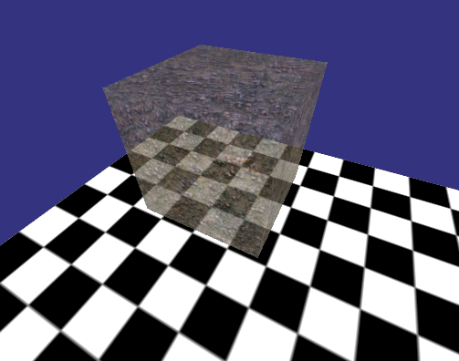
Texturing and color blending
Notes:
Here are two scenes for testing SALVIA’s performance and exhibiting its features.

Slide 48
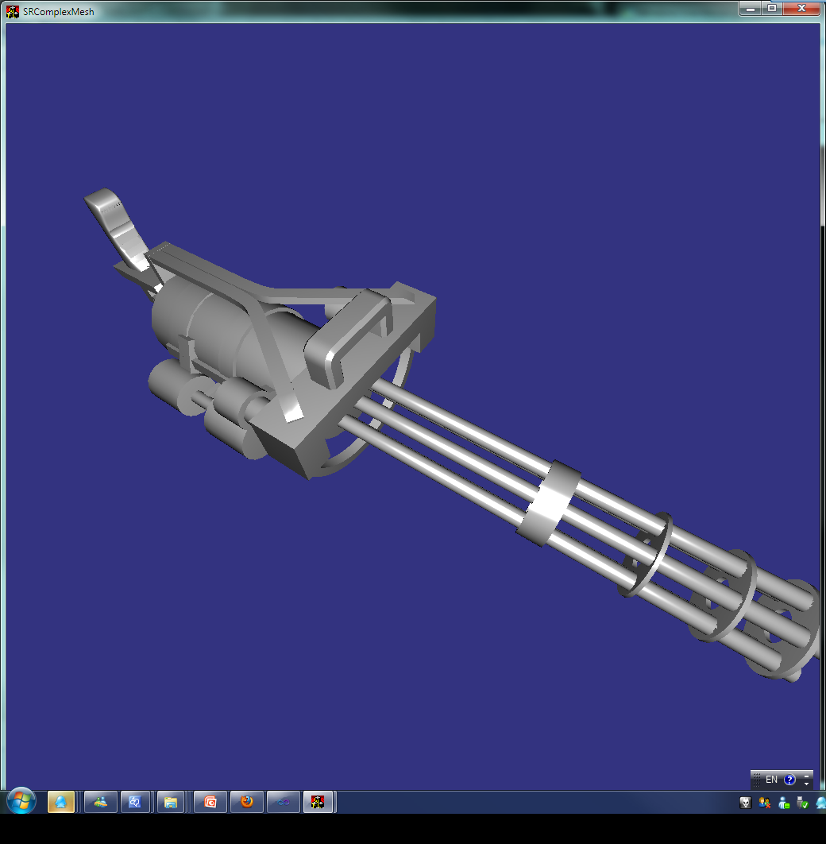
Complex mesh with per pixel lighting

Slide 49
Q & A

Slide 50
THANK YOU !

