Slide 1
Neural Network Coprocessor
106062113 鄭柏文

Slide 2
Objective
Accelerate NN inference computation with hardware coprocessor
Use pcpi coprocessor interface to implement a coprocessor and hook it on to the picorv processor.
NN is used to recognize hand written digits
Also, keep the accuracy of the classifier as high as the software implementation.

Slide 3
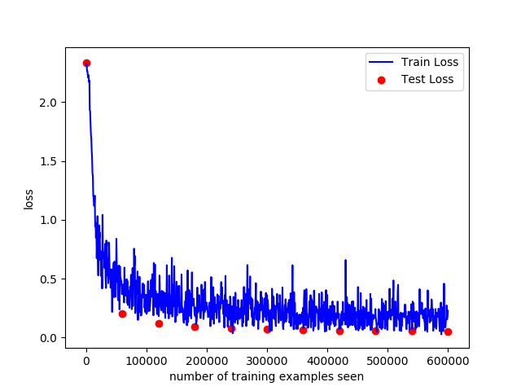
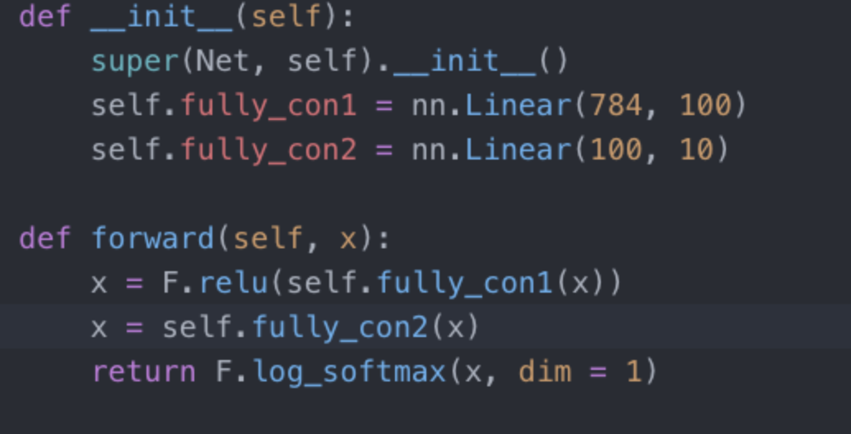
1. Train our model using pytorch
The original model is of 784-784-10 architecture.
However, for convenience and performance of the hardware(will be mentioned later) I changed to model to 784-100-10. This change doesn’t sacrifice the performance of the classifier too much, still achieve 98% validation accuracy.

Slide 4
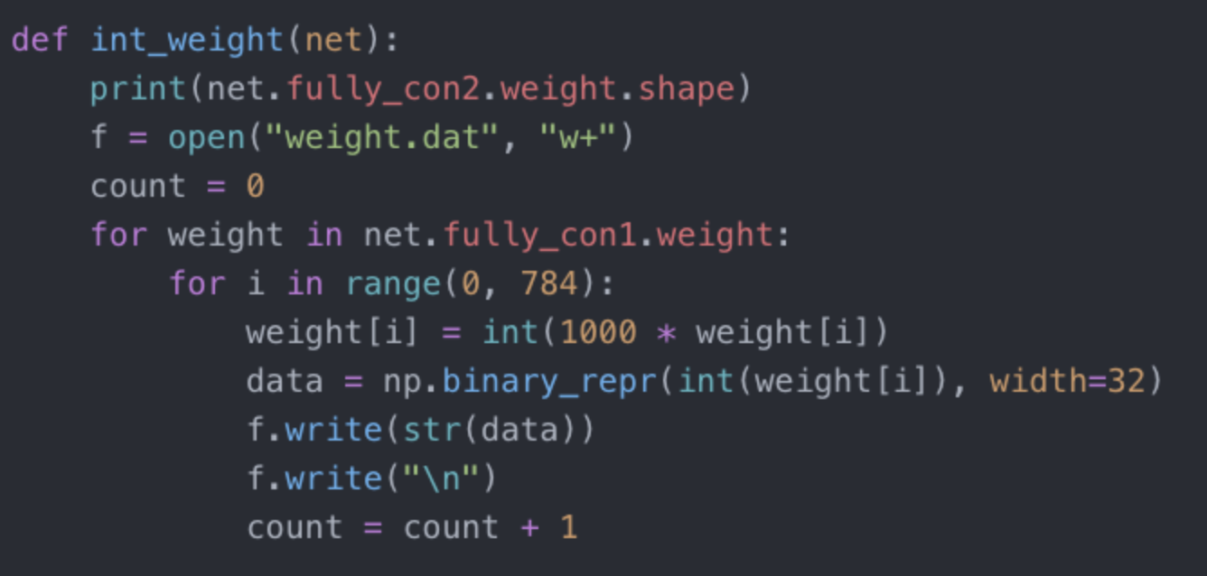
1. Train our model using python- net weight
To Implement the hardware design, I change the floating point weight in python to integer using the following function and write weight into bit file.

Slide 5
1. Cont.
After turning the weight into integer, the accuracy of the model still achieve 98%.
Also we read the image of the mnist data set and write it into a bit file.

Slide 6
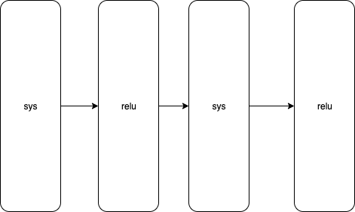
2.Hardware Architecture
Use systolic array to compute the intermediate weight of each layer and pass it through the relu activation function.
When the final layer output the result, select the maximum one the be the answer.

Slide 7
2.cont.
However, systolic array requires all and image input every cycle,.but the memory of the picorv can only read out one data every two cycle!
My solution (brutal and naïve) read weight and image from the memory and store them in register file in the module to feed data every cycle to the array.

Slide 8
3. Evaluation
Time: takes 79400 * 2 cyc to read weight
Takes 784 * 2 cyc to read image
Takes 884 cyc for first layer
Takes 110 for second layer
Excluding reading cycs, only need 2562 cycle to compute an inference

