Slide 1

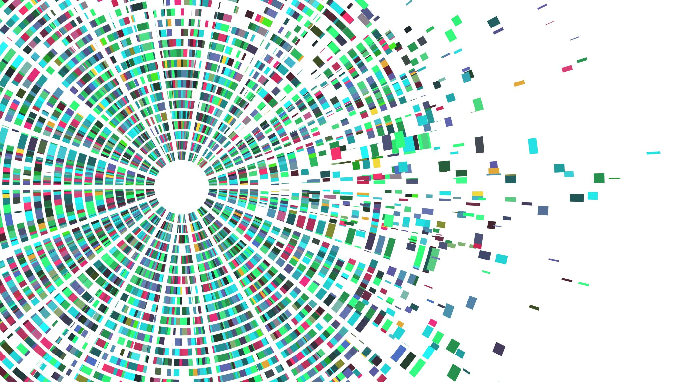
Capstone Check-In - Part 1
Bob Ding – GA DSI 720

Slide 2
1. Restaurant Recommendation
Data will be collected from:
Yelp
Reddit
Google
Convert the data to csv file
My stretch goals include:
To build a recommendation system that will recommend users a few choices based the word they type in.
My observations will be _posts_ from _the previous reviewers__ and my target will be
_a few restaurant names__.

Slide 3
2. Patent Classification
Data will be collected from:
https://www.patentsview.org/download/
https://developer.uspto.gov/
My stretch goals include:
To build a system to detect if patent can be approved or not during application
Or to build a system to detect if patent would like to be appealed or challenged after published.
My observations will be _text _ from _the previous _-patents__ and my target will be
_approved or not , challenged or not___

Slide 4
3. Baking / Cooking Recipes
Data will be collected from:
http://www.odditysoftware.com/free_lists.html
Or any other place from internet.
My stretch goals include:
Use unsupervised learning to look at existing recipes, figure out the rules, and to make something new.

