Slide 1
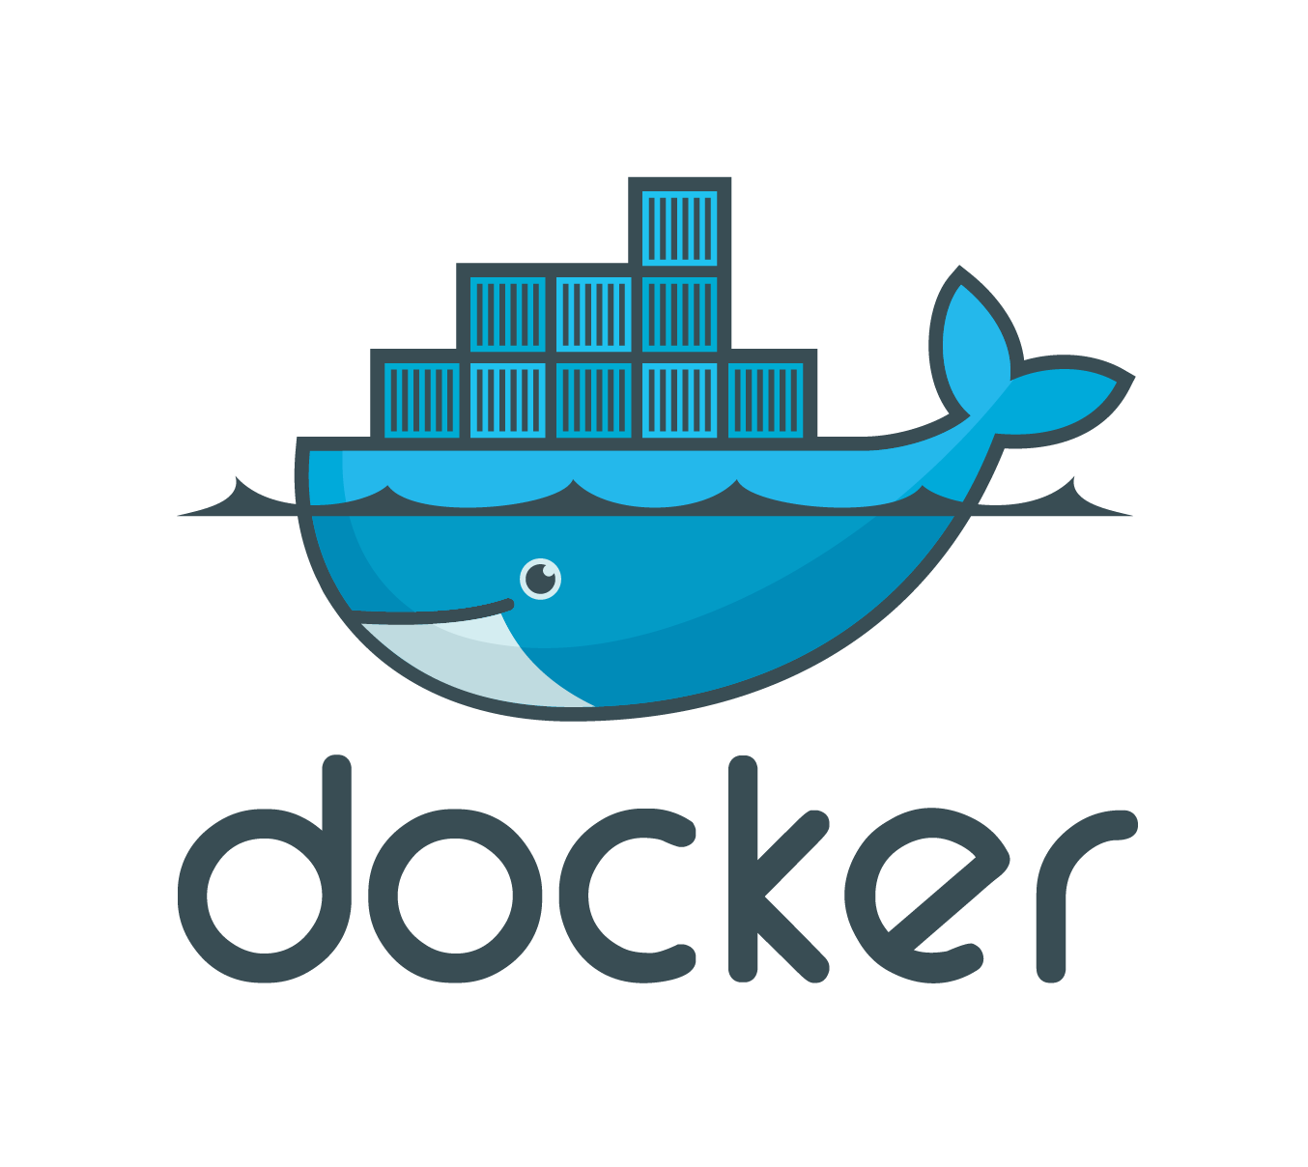
Milan Web Dev
Bobby Cooper
github.com/bcoop713

Slide 2
The Problem
Deploying code is too time consuming
Developing with multiple machines and devs causes the “Huh. well, it works on my machine”
Local dev environment can become bloated (I'm looking at you php)

Slide 3
So, What is Docker?
“Docker is an open platform for developers and sysadmins to build, ship, and run distributed applications. Consisting of Docker Engine, a portable, lightweight runtime and packaging tool, and Docker Hub, a cloud service for sharing applications and automating workflows...”

Slide 4
So, what really is Docker?
It's basically some software that lets you run your code in a portable tiny box
You can then send your code off to a fellow developer or the production server, and be confident that it will run the same as when you developed it

Slide 5
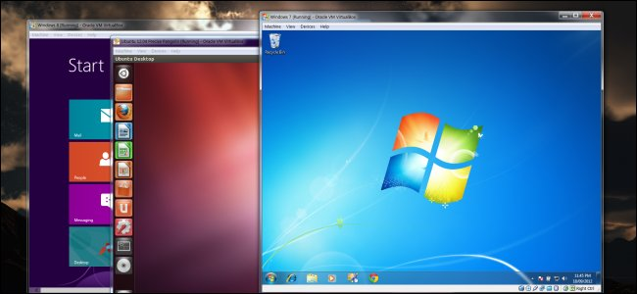
But VM's!
VM's are massive.
Slow
Shouldn't be used in production

Slide 6
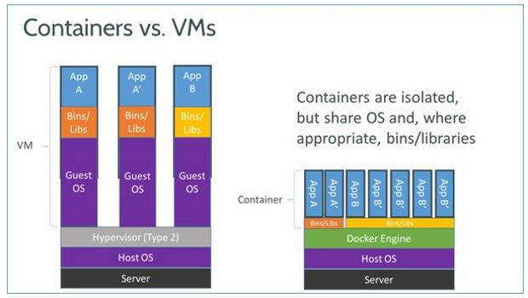
VMs vs Docker Containers

Slide 7
Containerize everything!
Front-end (nginx/apache, php...)
Back-end API (python, ruby, C#...)
Database
Redis
Ship them to production on one server, then break them off as demand requires to other servers without rewriting any code

Slide 8
How do I get rolling with docker?
Once docker is installed, all you need is to run
docker run ubuntu /bin/echo hello world
This tells docker to spin up a ubuntu image, and then run the /bin/echo hello world command in it

Slide 9
Docker Images
All containers run from an image
Images come from one of two places
  Docker Image Repository (github-ish thing)
  Make them yourself with a dockerfile

Slide 10
Sample Apache Dockerfile
FROM ubuntu:12.04
MAINTAINER Kimbro Staken version: 0.1
RUN apt-get update && apt-get install -y apache2 && apt-get clean && rm -rf /var/lib/apt/lists/*
ENV APACHE_RUN_USER www-data
ENV APACHE_RUN_GROUP www-data
ENV APACHE_LOG_DIR /var/log/apache2
EXPOSE 80
CMD ["/usr/sbin/apache2", "-D", "FOREGROUND"]

Slide 11
Fig to the rescue
Docker containers can get complicated
Especially when getting multiple containers to talk to each other
Fig manages docker containers and links them together
Fig is so awesome, docker bought them

Slide 12
Fig File
web:
build: .
command: php -S 0.0.0.0:8000 -t /code
ports:
- "8000:8000"
links:
- db
volumes:
- .:/code
db:
image: orchardup/mysql
environment:
MYSQL_DATABASE: wordpress

Slide 13
Useful Links
Fig – www.fig.sh
Docker – www.Docker.io
Live Demo source – www.github.com/bcoop713/docker-presentation

