Slide 1

VotePulse: Predicting Electoral Trends via Social Media Sentiment
Presenter: [Bobga-Herman Gwanvoma]
Institution: [Bellevue University]
Date: [June 01, 2025]

Slide 2
Abstract
Summary of project purpose: Analyzing campaign finance and sentiment for electoral prediction
Three models: Logistic Regression, Random Forest, XGBoost
Data from FEC, Census, Pew
R used for analysis; Sentiment modeling planned in Phase 3

Slide 3

Business Problem
Traditional polling: costly, slow, biased
Social media: real-time political opinion
Need for dynamic modeling approach

Slide 4
Background & Literature
Twitter shown effective for political sentiment (Tumasjan et al., 2010)
Bot/misinformation risks (Bessi & Ferrara, 2016)
VotePulse focuses first on structured, verified data

Slide 5
Data Sources
Federal Election Commission: receipts, disbursements, party
U.S. Census Bureau: demographics
Pew Research Dataset: structure reference for future sentiment integration

Slide 6
Data Cleaning
Used `readr`, `tidyverse`, `readxl` in R
Converted currency columns to numeric
Removed missing values using `na.omit()`
Encoded party as factor; created `high_funding` label

Slide 7
Modeling Overview
Goal: Predict high-funding candidates
Models used:
- Logistic Regression
- Random Forest
- XGBoost

Slide 8
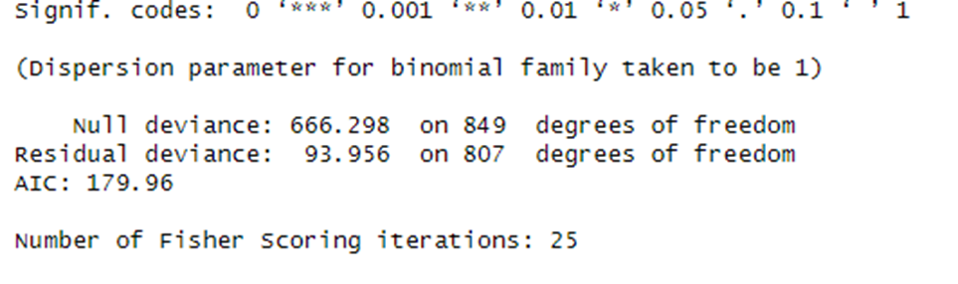
Logistic Regression Results
Binary classification using `glm()`
Strong predictors: party, cash-on-hand
Easy interpretability

Slide 9
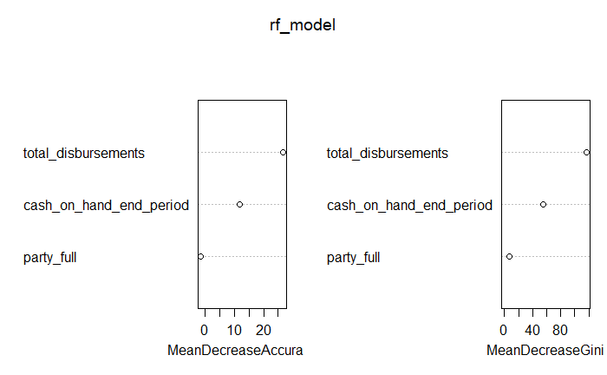
Random Forest Results
Used `randomForest()` with 100 trees
Strong predictor: total disbursements
Robust performance

Slide 10
XGBoost Results
Used `xgboost` with one-hot encoding
Best performance among models
Feature impact validated

Slide 11
Implementation Plan
Phase 1
Data acquisition and prep (FEC + Census) - Week 1
Phase 2
Modeling (Logistic, RF, XGBoost) - Week 2–3
Phase 3
Sentiment integration, reporting - Week 4

Slide 12
Ethical Considerations
No PII collected
Bias auditing planned
Misinformation/bot filtering in sentiment phase
Full transparency via open documentation

Slide 13
Future Uses
Expand to voter turnout prediction
Include Twitter, Reddit via APIs
Add VADER, BERT sentiment features
Build live dashboards for campaigns

Slide 14
Audience Questions - Highlights
Why structured data first?
Can model scale to state elections?
How to define high funding?
What’s the best performing model?

Slide 15
Answers
Structured data from the Federal Election Commission is reliable, clean, and directly linked to candidate performance. Using it first provides a stable foundation before introducing noisier unstructured social media data.
Yes, if similar financial and sentiment data are available. The model is scalable and modular, so local adaptations are feasible with domain-specific data.
High funding is defined as candidates whose total receipts exceed the median value in the dataset.
Among the three models tested, XGBoost outperformed logistic regression and random forest in classifying candidates as high- or low-funding based on financial features.

Slide 16
Conclusion
Strong predictors identified from financial data
XGBoost best-performing model
Framework ready for sentiment integration
Scalable for real-world political strategy

Slide 17
References
Bessi & Ferrara (2016). Social bots and 2016 U.S. election. First Monday
Tumasjan et al. (2010). Predicting elections with Twitter. ICWSM
Pew Research (2024). U.S.-Germany Dataset
U.S. Census (2024). Government Time Series
FEC (2024). Candidate Reports

