Slide 1

Predicting Housing Prices Based on Real Estate Features
A Machine Learning Approach
Presented by: Bobga-Herman Gwanvoma
Date: February 28, 2025

Slide 2

Accurate housing price prediction is crucial for homebuyers, sellers, and investors.
This study leverages machine learning to analyze real estate features and predict property values.

Slide 3
Key Questions:
What factors most influence housing prices?
How accurately can we predict housing prices?
Which machine learning model performs best?

Slide 4
- Dataset: Ames Housing Dataset with 80+ attributes.
- Key Features Considered:
- GrLivArea (Above-ground living space)
- OverallQual (Construction quality)
- Neighborhood (Geographical location)
- GarageCars (Number of garages)
- YearBuilt (Year of construction)
- Data Preprocessing Steps:
- Handling missing values
- Log transformation for SalePrice
- One-hot encoding categorical variables
- Standardization of numerical features

Slide 5
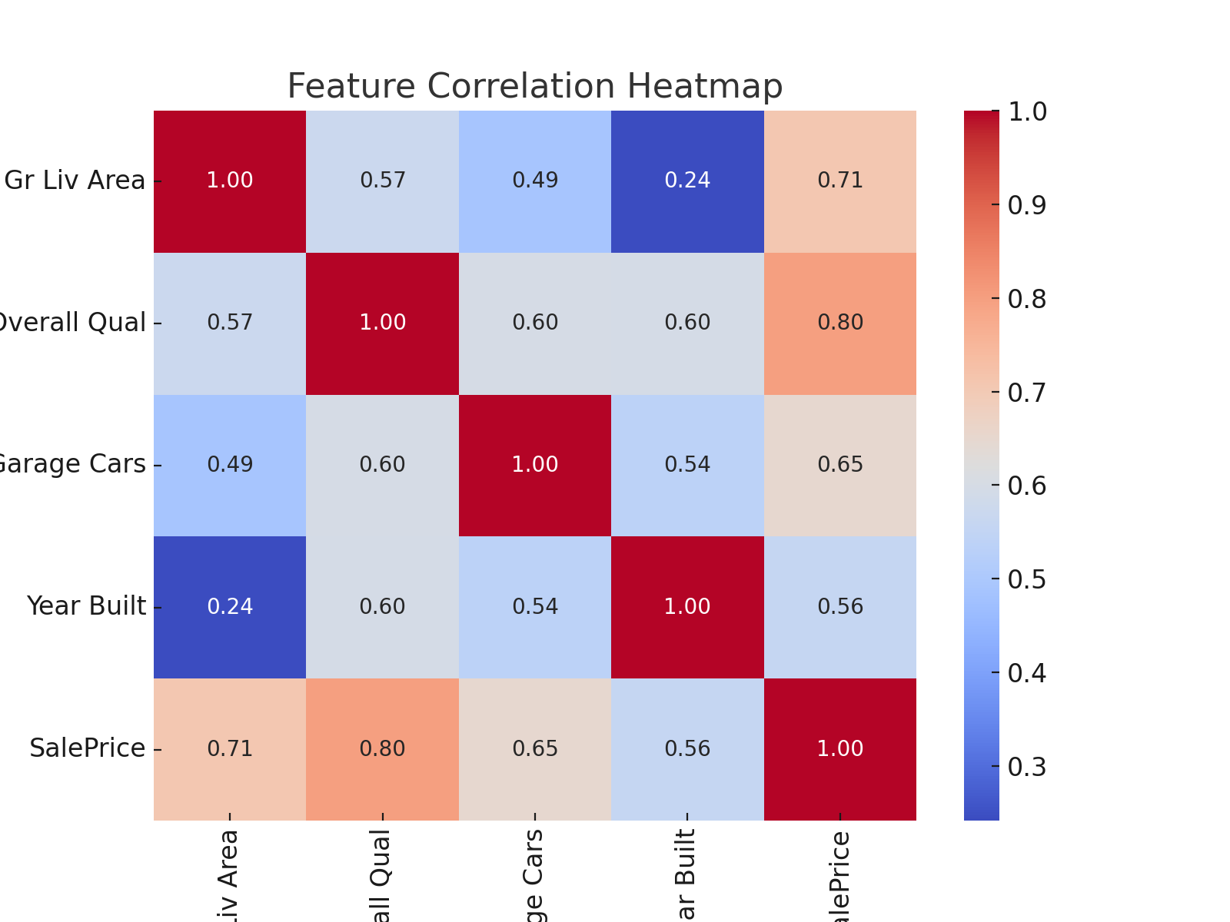
Feature Correlation Heatmap
This heatmap illustrates the correlation between key housing features.
A strong positive correlation exists between living area, overall quality, and SalePrice.

Slide 6

- Best Performing Model: Gradient Boosting (XGBoost)
- R² Score: 0.91 (Explains 91% of price variance)
- RMSE: 0.12
- MAE: 0.08
- Other Models:
- Random Forest performed well but slightly less accurate.
- Decision Tree had the weakest performance due to overfitting.

Slide 7
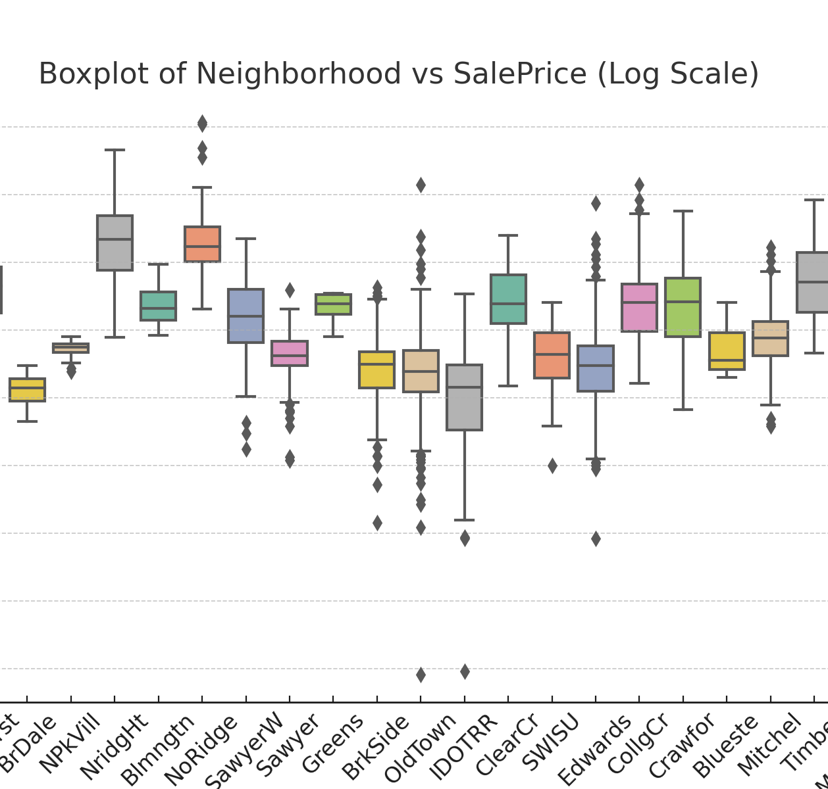
Neighborhood vs SalePrice
This boxplot shows that housing prices vary significantly by neighborhood.
Affluent areas like NoRidge and StoneBr have consistently higher median home prices.

Slide 8
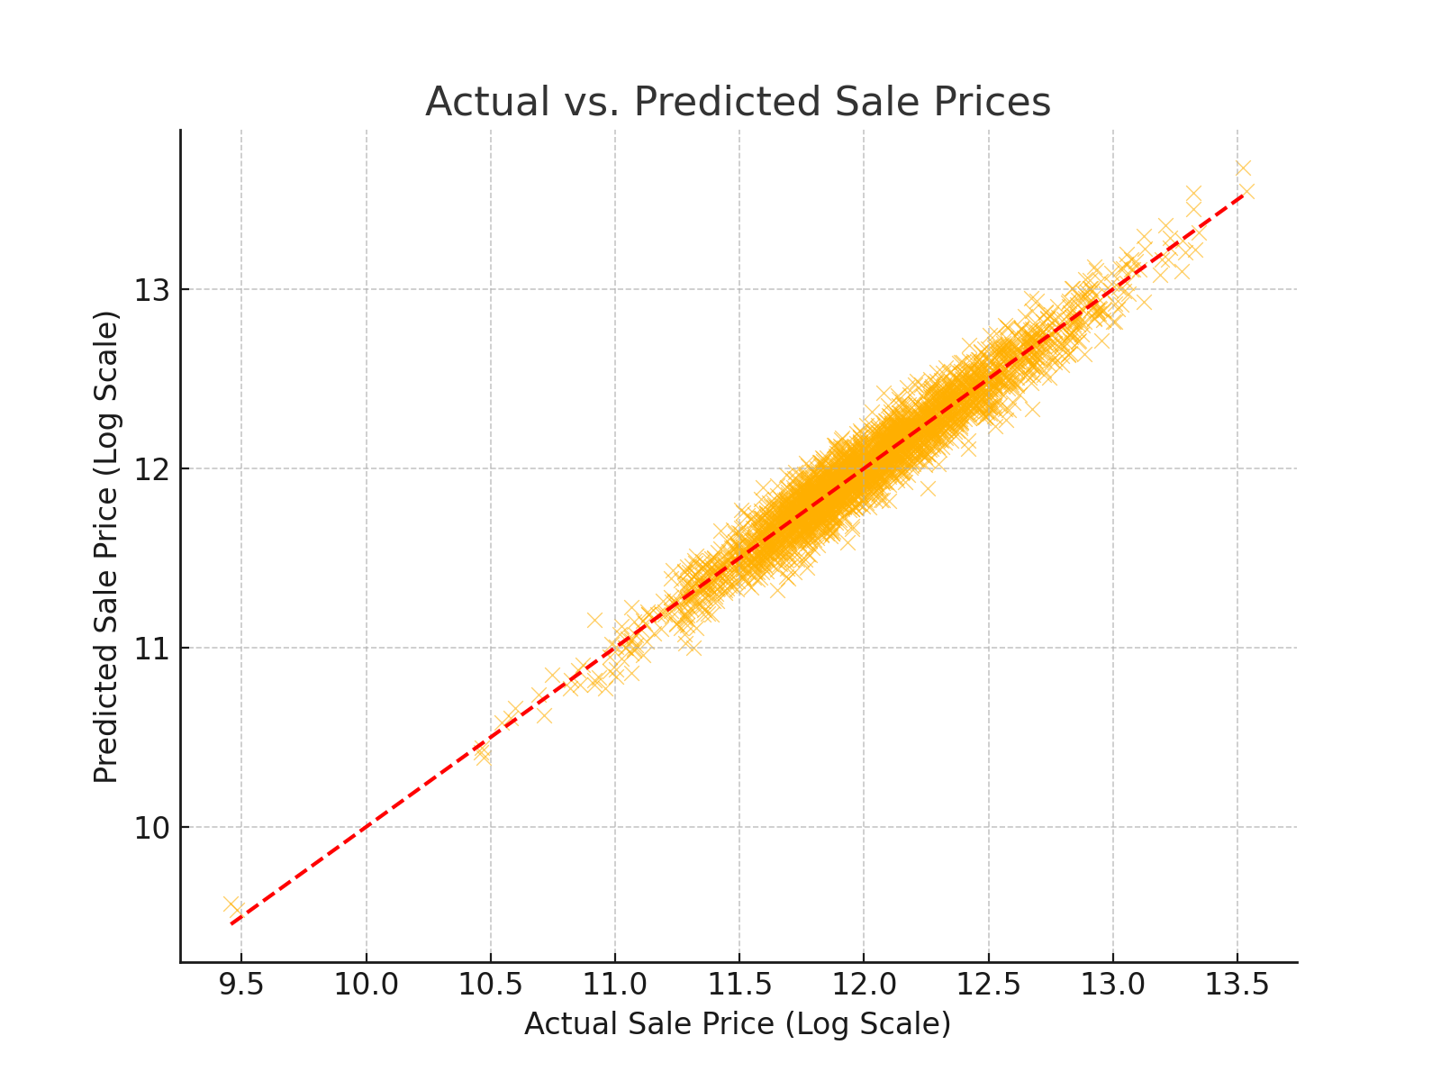
Actual vs. Predicted Sale Prices
This scatterplot compares predicted vs actual prices.
The strong alignment along the diagonal indicates that the model performs well in price estimation.

Slide 9

For Homebuyers: Prioritize home size, quality, and location over lot size.
For Real Estate Agents: Emphasize high-quality upgrades and neighborhood advantages.
For Investors: Target high-income neighborhoods and focus on property upgrades.

Slide 10

- Short-Term:
- Use XGBoost for real estate price prediction.
- Enhance pricing strategies using feature importance insights.
- Implement automated valuation models for real estate firms.
- Long-Term:
- Incorporate economic indicators (e.g., mortgage rates, employment trends).
- Explore deep learning for improved accuracy.
- Conduct a longitudinal study on housing market trends.
- Consider external macroeconomic factors influencing real estate trends.

Slide 11

Machine learning models, particularly Gradient Boosting, effectively predict housing prices.
Key influencing factors include living space, home quality, and location.
The insights derived can drive data-driven decision-making in real estate.
Future research should integrate external economic factors for more comprehensive analysis.

Slide 12

Open floor for Q&A.

