Slide 1
Childcare Price Analysis
Final Presentation
Bobga-Herman Gwanvoma
DSC 640 – Data Presentation & Visualization
Bellevue University
February 27, 2025

Slide 2
Summary of Analysis
Analyzed national childcare costs dataset
Examined trends, gaps, and inconsistencies
Urban areas and younger children have higher costs

Slide 3
Key Findings
Childcare costs vary significantly by region
Inflationary trends indicate rising costs
Higher unemployment correlates with lower childcare costs

Slide 4
Policy & Economic Implications
High childcare costs impact workforce participation
Disparities in economic accessibility
Need for policy interventions

Slide 5
Data Assumptions
Missing values treated as data gaps
Cost variations assumed to reflect actual differences unless flagged

Slide 6
Mediums Used
Interactive Dashboard (Tableau/Power BI)
Infographic for visual summary
Written report for in-depth analysis

Slide 7
Ethical Considerations
Transparency in data processing
No personally identifiable information (PII) included
Potential misinterpretations addressed with documentation

Slide 8
Lessons Learned
Need for better metadata on flag columns
Earlier engagement with domain experts recommended
Uncovering trends was the most enjoyable aspect

Slide 9
Conclusion
Childcare costs are a major economic factor
Policies should address affordability disparities
Data-driven insights help drive informed decisions

Slide 10
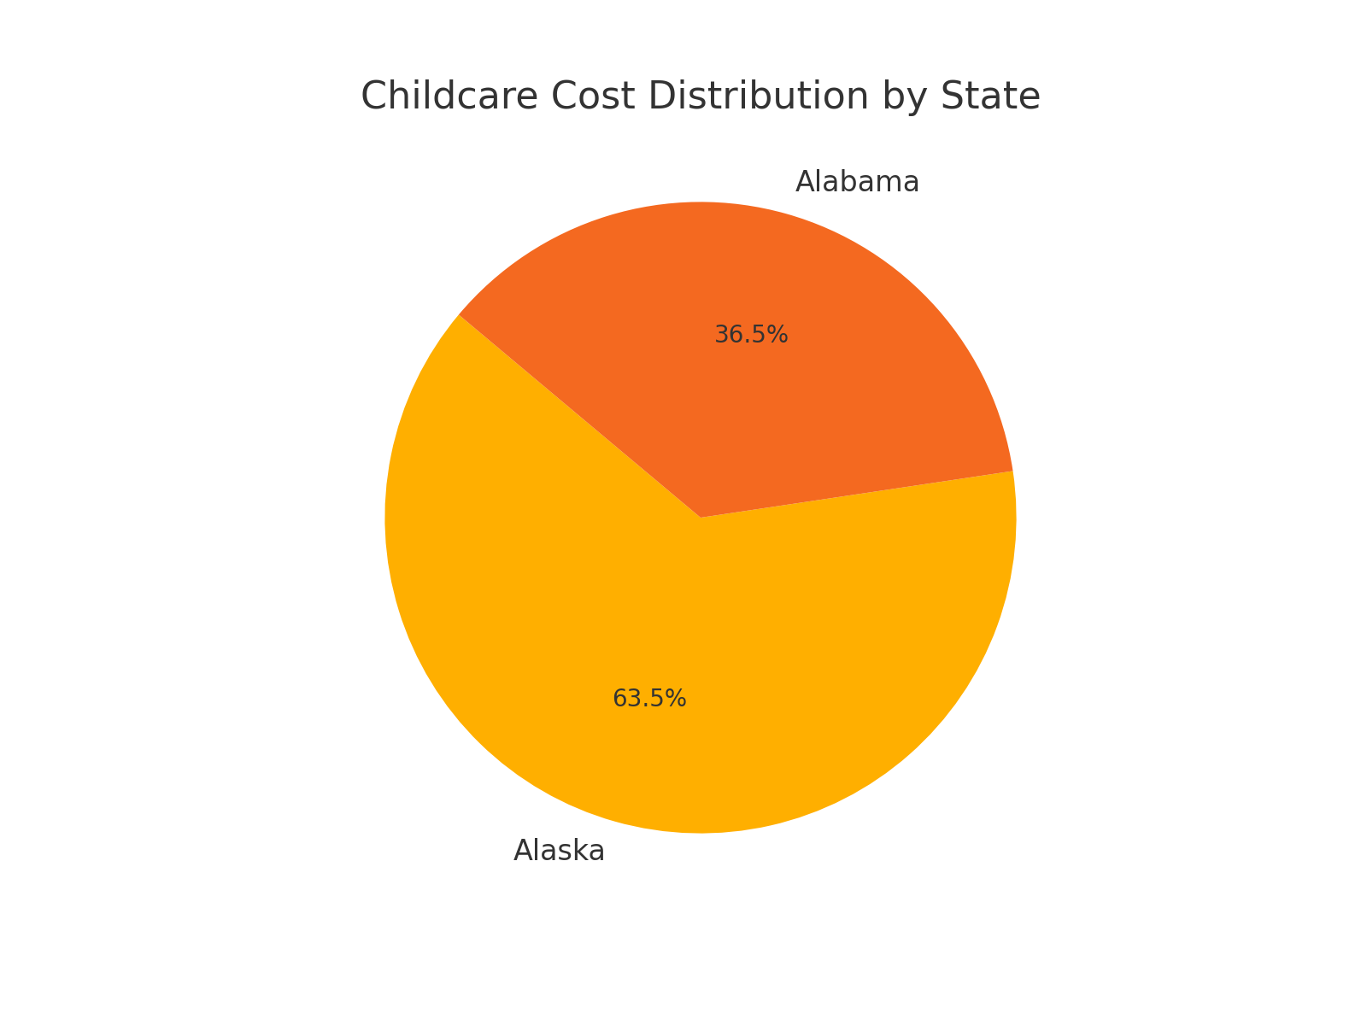
Childcare Cost Distribution by State
This pie chart shows how childcare costs are distributed among the top 10 states. Larger slices indicate states where childcare is more expensive.

Slide 11
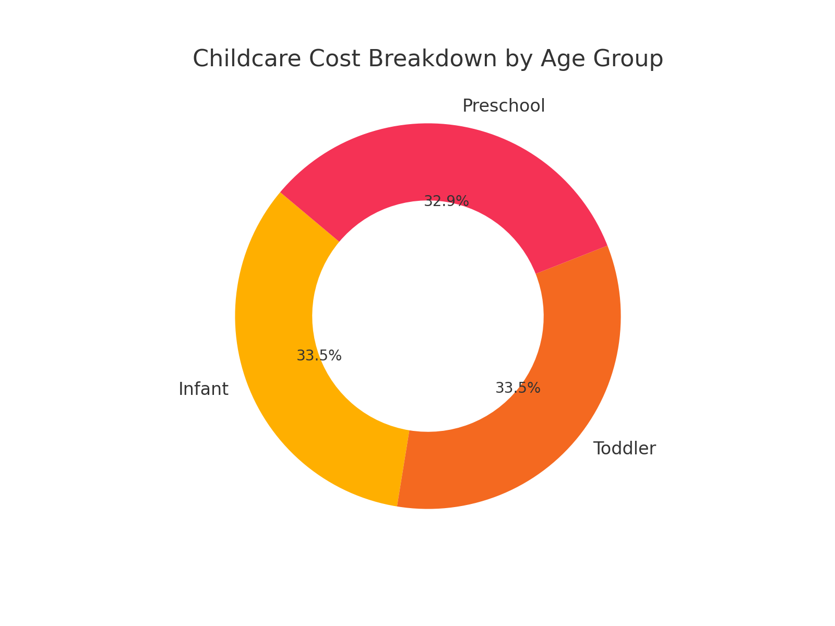
Childcare Cost Breakdown by Age Group
This donut chart presents the average cost distribution across three age groups: Infant, Toddler, and Preschool. Infant care is typically the most expensive.

Slide 12
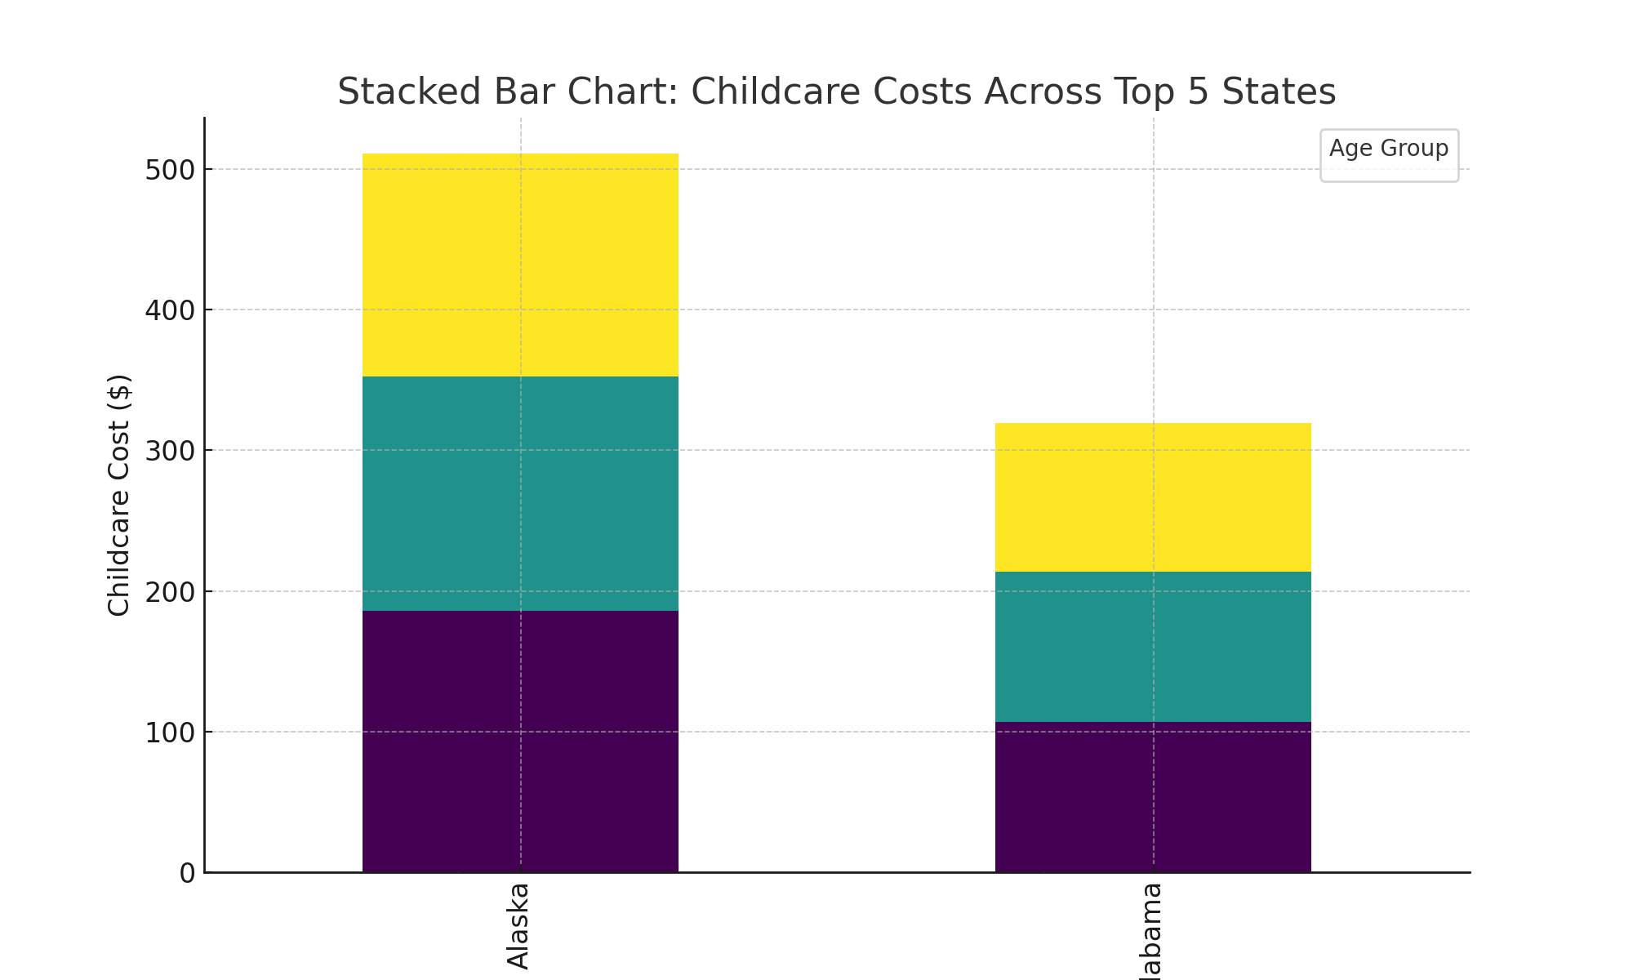
Stacked Bar Chart: Childcare Costs Across Top 5 States
This stacked bar chart compares the average childcare costs for Infants, Toddlers, and Preschoolers in the top 5 states with the highest costs. Each segment represents a different age group.

Slide 13
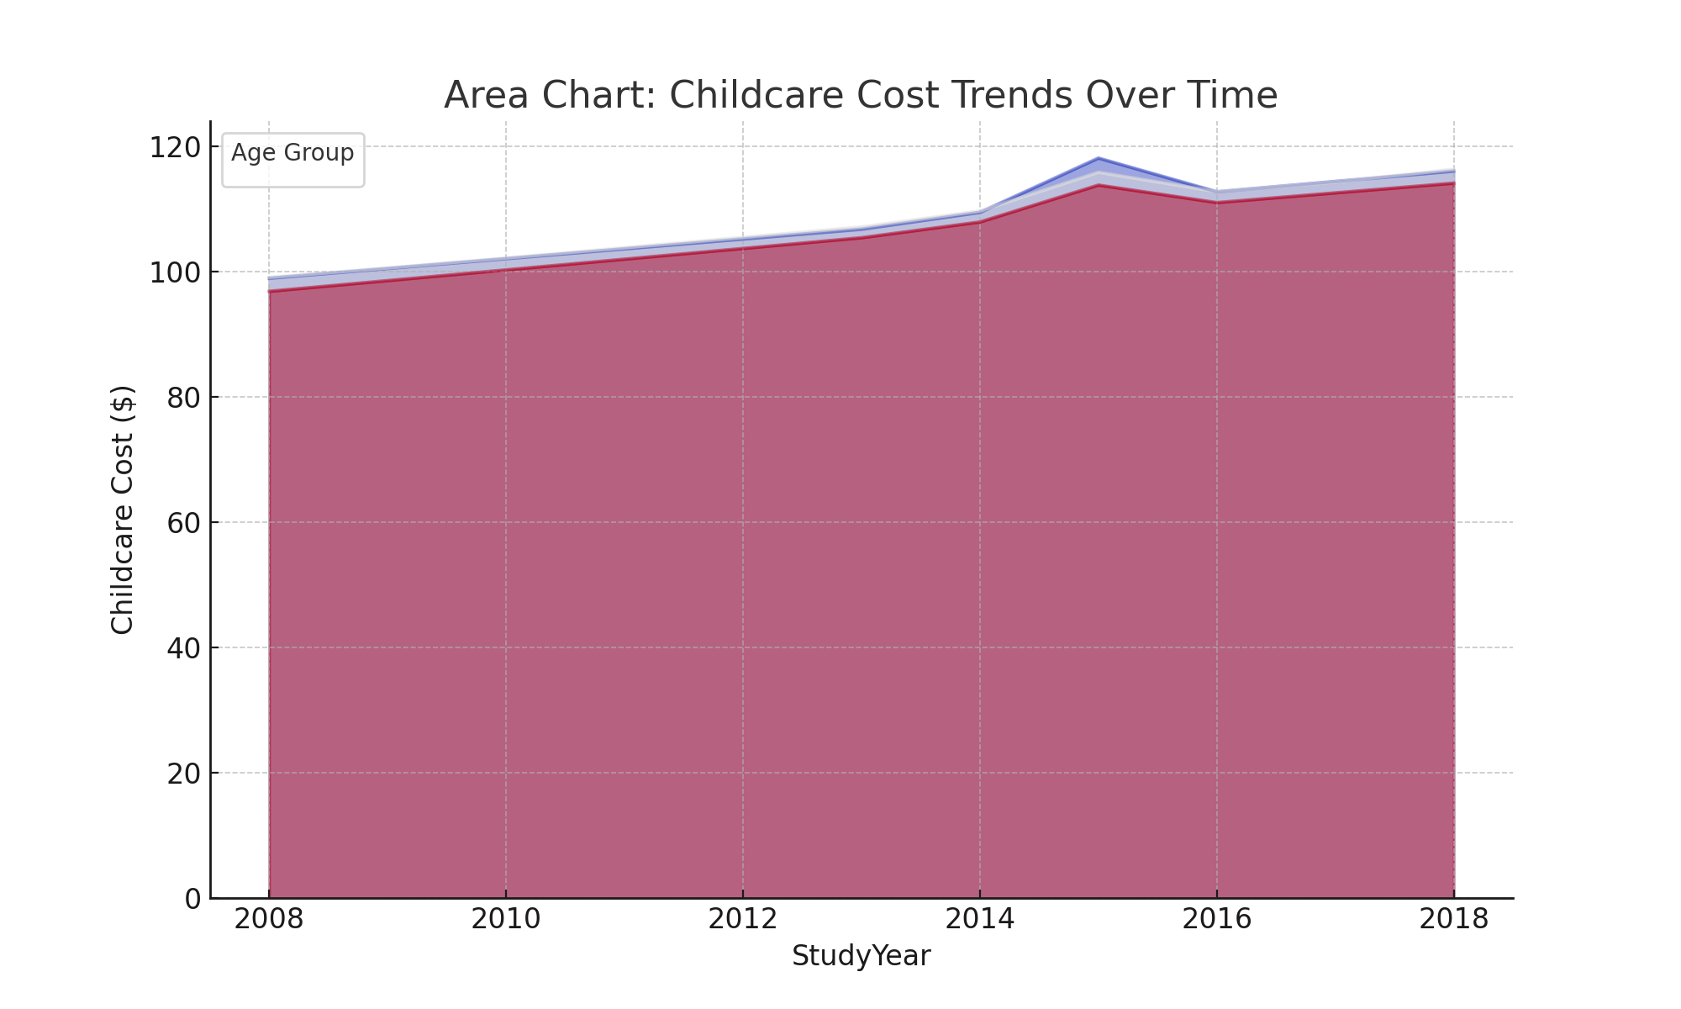
Area Chart: Childcare Cost Trends Over Time
This area chart shows the trend of childcare costs over the years for different age groups. It highlights the increasing cost trend and any fluctuations in pricing.

Slide 14
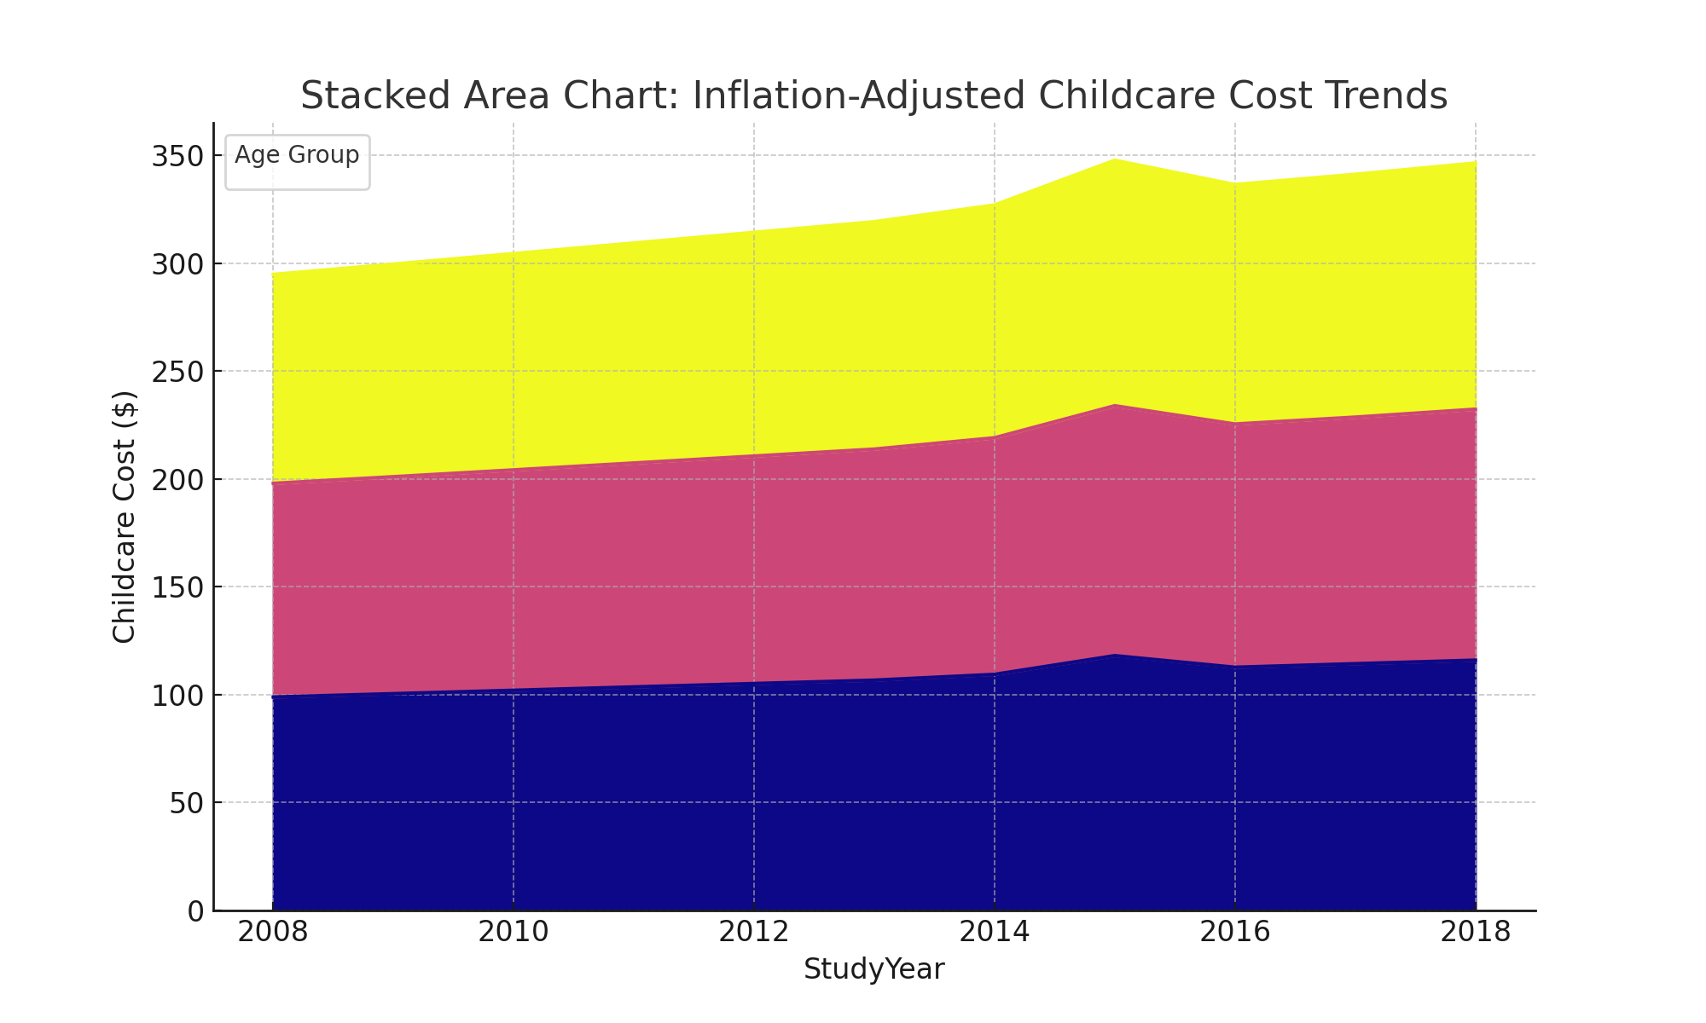
Stacked Area Chart: Inflation-Adjusted Childcare Cost Trends
This stacked area chart represents the total childcare costs over time, adjusted for inflation. The stacking effect allows us to see the cumulative costs and their increase over the years.

Slide 15
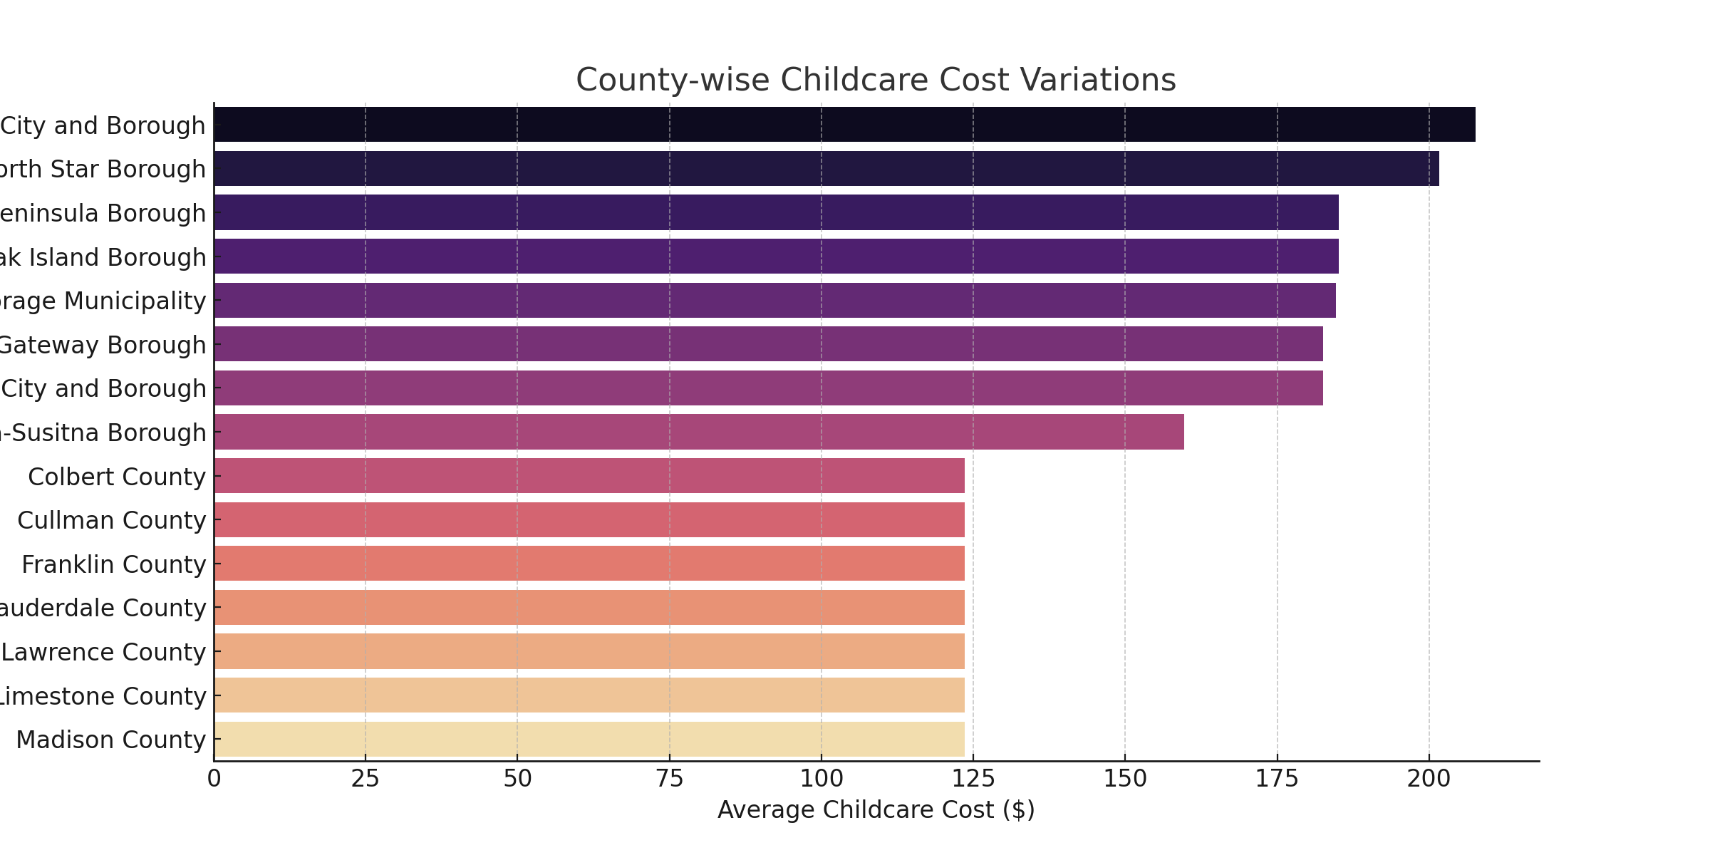
County-wise Childcare Cost Variations (Alternative Tree Map)
This alternative tree map (bar chart) visualizes the variations in childcare costs at the county level. Counties with higher costs appear at the top, indicating regions with the most expensive childcare services.

