Slide 1
Building a Tableau Visualization
Honolulu Data science meetup
November 16, 2017
Bob Hiltner bobhilt@gmail.com github.com/bobhilt

Slide 2
Credits
Gapminder.org (Hans Rosling) – Original creation of dynamic visualization
Super Data Science (Kirill Eremenko) – Adaptation to Tableau

Slide 3
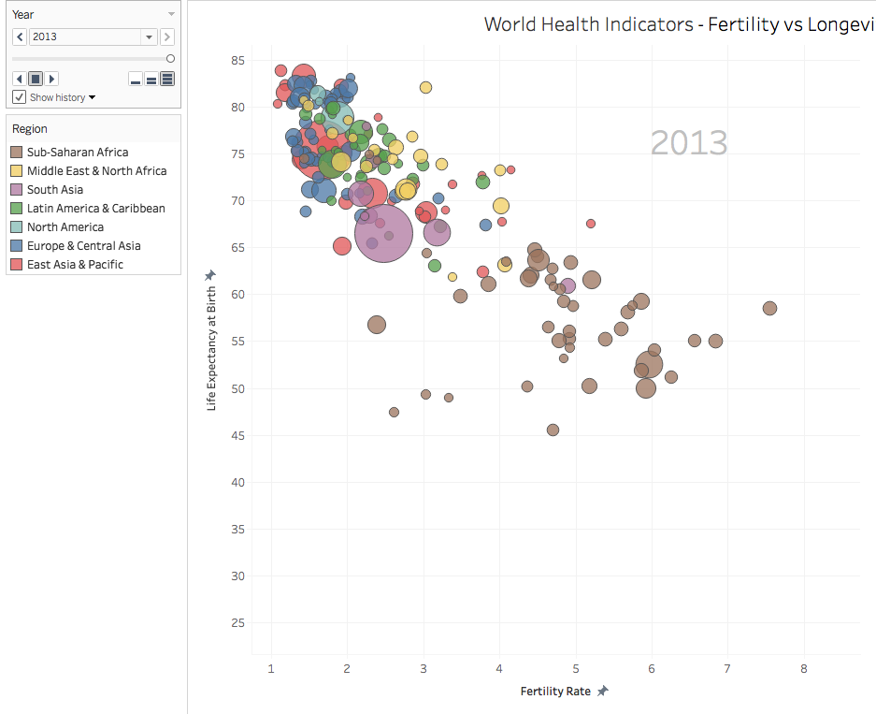
How Does fertility rate relate to life expectancy?
Blending 4 datasets
Relate 5 dimensions in 2-d dashboard
X – Fertility Rate
Y – Life Expectancy at birth
Size – population
Color – Region
Year – animation over pages (optional data History trails)

Slide 4
Data
4 Excel datasets blended
Edit relationships
Primary dataset needs country code (not name!), Year
Secondary datasets link on country code, year (except when n/a)
Fields must be linked
Disaggregate measures (don’t want to sum up life expectancy for each year)

Slide 5
Begin adding data
Rows: Fertility Rate
Columns: Life Expectancy at Birth
Size: Population
Detail: Country Name
Filter: Region, Year

Slide 6
Aesthetic / User-friendly changes
Annotation with page name
Sorting by Region to set z-order (Dimensions only)
Title
Dashboard (Size)
Turn of tooltip commands
Set axis ranges

Slide 7
Animation — changes over time using pages.
Speed
Show History (several options)
Forward/Reverse
Loop

Slide 8
Create Dashboard
Pick your size
Preset list
Customer height, width
Arrange cards
Sort z-order by region (must be dimension, so this is of limited use)

Slide 9
Review
DESIGN TO TELL A STORY!
Data import, pivot
Data Blends. Edit Relationships, Link Fields
Lay out data elements (Data, Filters, Parameters) Tweak Aesthetics, usability
Color, size, font, tooltips, labels
Dashboards
Story (series of dashboards)

Slide 10
Questions and Discussion

