Slide 1
Building a Tableau Visualization
Honolulu Data science meetup
November 16, 2017
Bob Hiltner bobhilt@gmail.com
github.com/bobhilt/tableau-dashboard-demo
https://public.tableau.com/profile/bob.hiltner#!/vizhome/WorldHealthIndicators-HonoluluDataScienceTableauDemo/WorldHealthIndicators1960-2013?publish=yes

Slide 2
Credits
Gapminder.org (Hans Rosling) – Original creation of dynamic visualization
Super Data Science (Kirill Eremenko) – Adaptation to Tableau

Slide 3
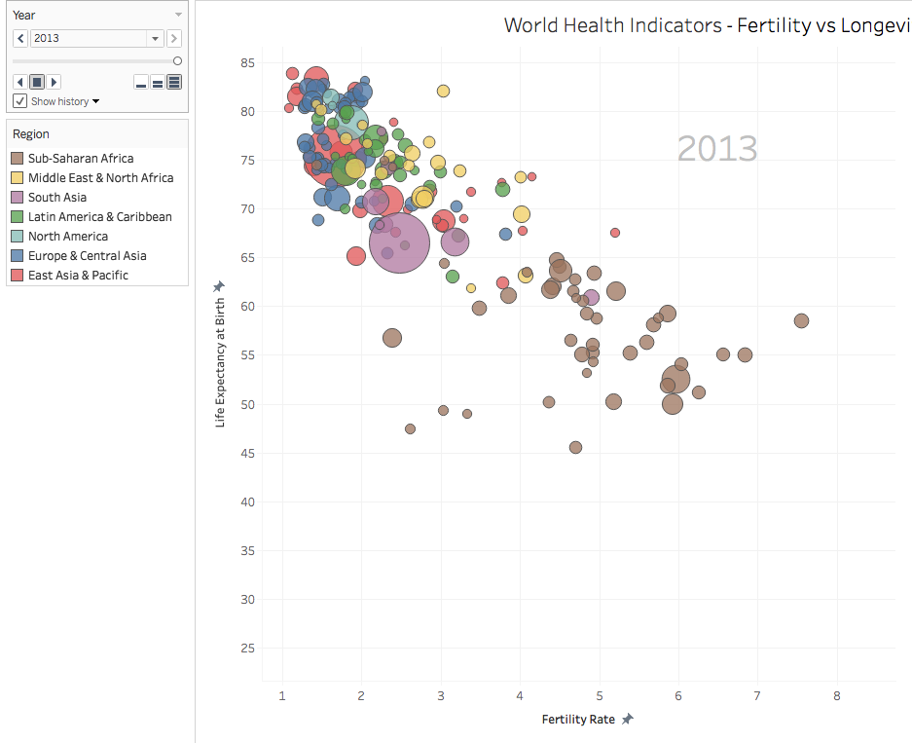
How Does fertility rate relate to life expectancy?
Blending 4 datasets
Relate 5 dimensions in 2-d dashboard!
X – Fertility Rate
Y – Life Expectancy at birth
Size – population
Color – Region
Year – animation over pages (optional data History trails)
Could also use shape for another dimension (doesn’t mean you should)

Slide 4
Data
4 Excel datasets blended
Edit relationships
Primary dataset needs country code (not name!), Year
Secondary datasets link on country code, year (except when n/a)
Fields must be linked!
Disaggregate measures (don’t want to sum up life expectancy for each year)

Slide 5
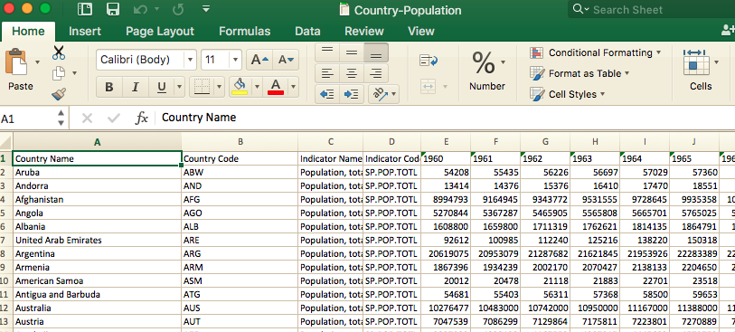
Tabular-Denormalize (pivot) years

Slide 6
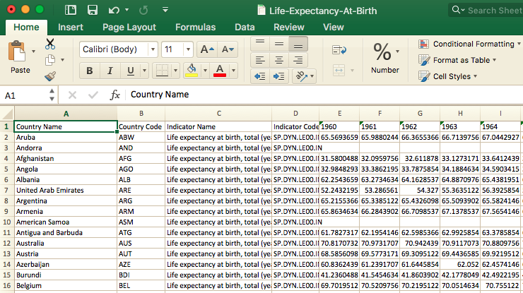

Slide 7
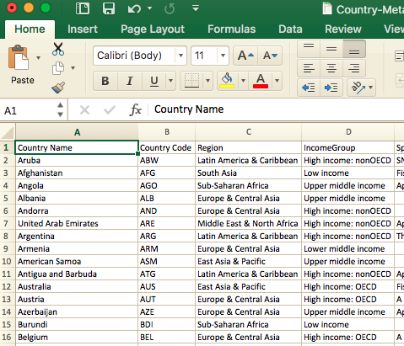
Blend on country code (and year where applicable)

Slide 8
Begin adding data
Rows: Life Expectancy at Birth
Columns: Fertility Rate
Size: Population
Detail: Country Name
Filter: Region, Year

Slide 9
Aesthetic / User-friendly changes
Annotation with page name
Sorting by Region to set z-order (Dimensions only)
Title
Dashboard (Size)
Turn off tooltip commands (Inhibit user from messing up viz)
Set axis ranges – Take advantage of your whole canvas
Tweak Size & border for objects

Slide 10
Animation — changes over time using pages.
Speed Options (3)
Show History (several options)
Forward/Reverse
Loop
Trail format

Slide 11
Create Dashboard
Pick your size
Preset list
Or Customize width, height
Arrange cards for space, logical layout
Sort z-order by region (must be dimension, not measure, so this is of limited use)
Can’t sort based on population, e.g.

Slide 12
Review
DESIGN TO TELL A STORY!
Data import, pivot
Data Blends. Edit Relationships, Link Fields
Lay out data elements (Data, Filters, Parameters) Tweak Aesthetics, usability
Color, size, font, tooltips, labels
Dashboards
Story (series of dashboards)

Slide 13
Questions and Discussion

