Slide 1
All Aboard the Databus!
LinkedIn’s Change Data Capture Pipeline
ACM SOCC 2012
Oct 16th
Databus Team @ LinkedIn
Shirshanka Das
http://www.linkedin.com/in/shirshankadas
@shirshanka

Slide 2
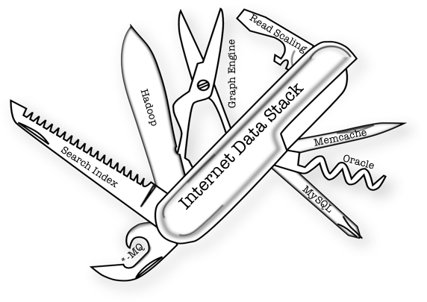
The Consequence of Specialization in Data Systems
Data Flow is essential
Data Consistency is critical !!!

Slide 3
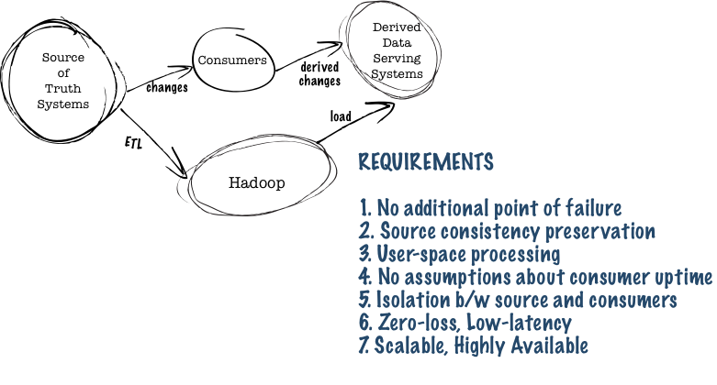
The Timeline Consistent Data Flow problem

Slide 4
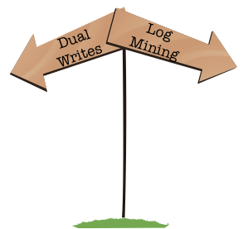
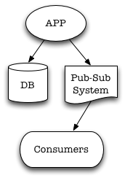
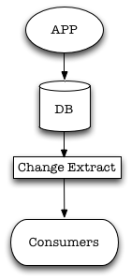


Two Ways
Application code dual writes to database and pub-sub system
Easy on the surface
Consistent?
Extract changes from database commit log
Tough but possible
Consistent!!!

Slide 5
The Result: Databus
Standardization
Standardization
Standardization
Standardization
Standardization
Standardization
Standardization
Standardization
Standardization
Search Index
Graph Index
Read Replicas
Updates
Primary
DB
Data Change Events
Databus

Slide 6
Key Design Decisions : Semantics
Logical clocks attached to the source
Physical offsets are only used for internal transport
Simplifies data portability
Pull model
Restarts are simple
Derived State = f (Source state, Clock)
+ Idempotence = Timeline Consistent!

Slide 7
Key Design Decisions : Systems
Isolate fast consumers from slow consumers
Workload separation between online, catch-up, bootstrap
Isolate sources from consumers
Schema changes
Physical layout changes
Speed mismatch
Schema-aware
Filtering, Projections
Typically network-bound → can burn more CPU

Slide 8
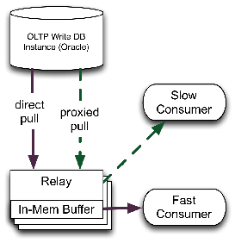
Databus: First attempt (2007)
Issues
Source database pressure caused by slow consumers
Brittle serialization

Slide 9
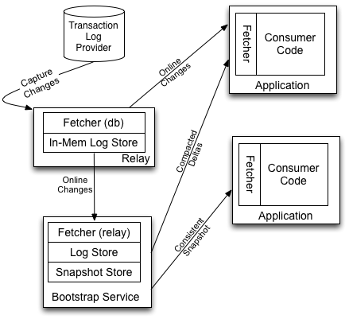
Current Architecture (2011)
Four Logical Components
Fetcher
Fetch from db, relay…
Log Store
Store log snippet
Snapshot Store
Store moving data snapshot
Subscription Client
Orchestrate pull across these

Slide 10

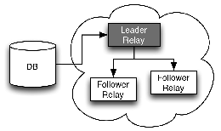
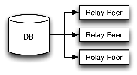
The Relay
Change event buffering (~ 2 – 7 days)
Low latency (10-15 ms)
Filtering, Projection
Hundreds of consumers per relay
Scale-out, High-availability through redundancy
Option 1: Peered Deployment
Option 2: Clustered Deployment

Slide 11
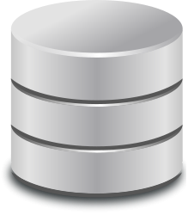
The Bootstrap Service
Catch-all for slow / new consumers
Isolate source OLTP instance from large scans
Log Store + Snapshot Store
Optimizations
Periodic merge
Predicate push-down
Catch-up versus full bootstrap
Guaranteed progress for consumers via chunking
Implementations
Database (MySQL)
Raw Files
Bridges the continuum between stream and batch systems
Notes:
Batch systems can consume the raw snapshots directly.

Slide 12

The Consumer Client Library
Glue between Databus infra and business logic in the consumer
Switches between relay and bootstrap as needed
API
Callback with transactions
Iterators over windows

Slide 13

Fetcher Implementations
Oracle
Trigger-based (see paper for details)
MySQL
Custom-storage-engine based (see paper for details)
In Labs
Alternative implementations for Oracle
OpenReplicator integration for MySQL

Slide 14
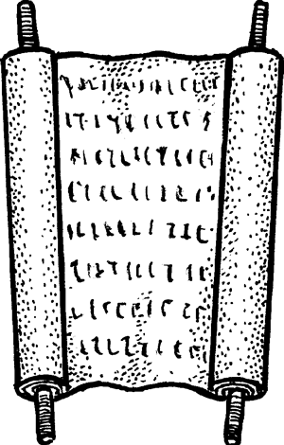
Meta-data Management
Event definition, serialization and transport
Avro
Oracle, MySQL
Table schema generates Avro definition
Schema evolution
Only backwards-compatible changes allowed
Isolation between upgrades on producer and consumer

Slide 15
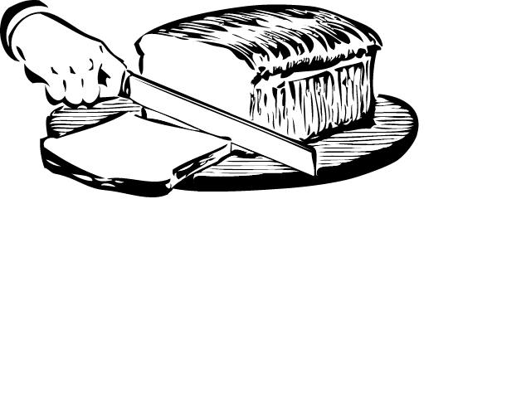
Partitioning the Stream
Server-side filtering
Range, mod, hash
Allows client to control partitioning function
Consumer groups
Distribute partitions evenly across a group
Move partitions to available consumers on failure
Minimize re-processing

Slide 16
Experience in Production: The Good
Source isolation: Bootstrap benefits
Typically, data extracted from sources just once
Bootstrap service routinely used to satisfy new or slow consumers
Common Data Format
Early versions used hand-written Java classes for schema → Too brittle
Java classes also meant many different serializations for versions of the classes
Avro offers ease-of-use flexibility & performance improvements (no re-marshaling)
Rich Subscription Support
Example: Search, Relevance

Slide 17
Experience in Production: The Bad
Oracle Fetcher Performance Bottlenecks
Complex joins
BLOBS and CLOBS
High update rate driven contention on trigger table
Bootstrap: Snapshot store seeding
Consistent snapshot extraction from large sources
Complex joins hurt when trying to create exactly the same results

Slide 18
What’s Next?
Open-source: Q4 2012
Internal replication tier for Espresso
Reduce latency further, scale to thousands of consumers per relay
Poll → Streaming
Investigate alternate Oracle implementations
Externalize joins outside the source
User-defined functions
Eventually-consistent systems

Slide 19
Three Takeaways
Specialization in Data Systems
CDC pipeline is a first class infrastructure citizen up there with your stores and indexes
Bootstrap Service
Isolates the source from abusive scans
Serves both streaming and batch use-cases
Pull and External clock
Makes client application development simple
Fewer things can go wrong inside the pipeline

Slide 20

Questions?

