Slide 1
Databus
LinkedIn’s Timeline Consistent Change Data Capture System
Balaji Varadarajan

Slide 2
LinkedIn by Numbers
161,000,000+ users in March 2012
2 new user registrations per second
9.4 billion page views in Q1 2012
5.3 billion People Searches expected in 2012
102.5 million unique visitors monthly*
2+ million companies with LinkedIn Company Pages
400K domains feature the LinkedIn Share Button
* Based on comScore, Q1 2012

Slide 3
Agenda
Motivation: Typical Use-Cases and Requirements
Architecture
Development With Databus
Capturing Change Events from Oracle and MySQL
Performance Benchmarks
Current and Future Work

Slide 4
Use Cases: Intro
Standardization
Standardization
Standardization
Standardization
Standardization
Standardization
Standardization
Standardization
Standardization
Search Index
Graph Index
Read Replicas
Updates
Primary
DB
Data Change Events
Notes:
What do we mean when we say that Databus is LinkedIn’s data-change propagation system.

Slide 5

Use Case: External Indexes
Description
Full-text and faceted search over profile data
Social graph search
Corporate Portal
Profile
Update
skills
Recruiters
Search
Results
Members
changes
People Search Index
Notes:
A very common use case at LinkdIn is maintaining external indexes over the primary data. Such external indexes may be full-text search index built using LinkedIn’s Zoie and Lucene. Or a faceted search index using LinkedIn’s Bobo or a social graph index.
For example, if you update your linkedin’s pofile with a new skill or a new position, the change is first made persistent in the members database. To maintain the consistency of our real-time people search index, we want to propagate that change quickly so that for example, recruiters are able to find out about your new skill.
Similarly, if you add a new connection, we want the change to be quickly propagated to the social graph index so that our Network Updates Service starts delivering updates from the new members in your social graph.
The main requirements for those uses cases are:
Timeline consistency – i.e. the changes have to be propagated in exactly the commit order and without missing any updates (i.e. guaranteed deliver) so we don’t compromise the integrity of the index, maintaining low latency to maintain the freshness of the index and what we call use-space visibility, i.e. the ability to process those changes in your applications.

Slide 6
Other Use Cases
router
Replication for read scaling with cache maintenance
R
W
R
R
Memrep
Members memcache
Memrep
Members memcache
Members
Memrep
Members memcache
changes
changes
Memrep
View materialization
invalidations
changes
People Search Index
Comps
changes
changes
Groups
Search Feature Extractor
Search Data DB
changes
Conns
Members
changes
Notes:
Other use cases, for which I am not going to talk because of lack of time, include:
Replication to read scaling where replication to a slave database is combined with cache maintenance logic, and
View materialization across multiple data sources

Slide 7
Partitioned Clients
Range Partitioned Consumer ( 0 – 5M)
Members
Range Partitioned Consumer ( 5 – 10M)
8M
4M
6M
2M
Range Based
Mod Partitioned Consumer ( Bucket 0)
Members
Mod Partitioned Consumer ( Bucket 1)
101
100
55
20
Mod Based

Slide 8
Schema Evolution
SCHEMA
{
"name" : "sourceId",
"type" : [ "long", "null" ],
}, {
"name" : "destId",
"type" : [ "long", "null" ],
}, {
}, {
"name" : “active",
"type" : [ “boolean", "null" ],
}
Consumer 1
Connections
{
"name" : “strength",
"type" : [ “int", "null" ],
}}
Field | Type
SourceId | Long
destId | Long
active | Boolean
SCHEMA
{
"name" : "sourceId",
"type" : [ "long", "null" ],
}, {
"name" : "destId",
"type" : [ "long", "null" ],
}, {
}, {
"name" : “active",
"type" : [ “boolean", "null" ],
}}
strength
int
Consumer 2

Slide 9
Long Look-back & Bootstrapping Consumers
Fast Consumer
( lagging DB by 5 mins)
Updates
Members
Slow Consumer
( lagging DB by 0.5 days)
New Consumer
( to bootstrap)

Slide 10
Use Cases: Summary of Requirements
Timeline consistency
Guaranteed delivery
User-space visibility
Low latency
Consumer Scaling
Seamless Long look-back in the change stream
New clients
Slow/lagging clients
Schema versioning and migration
Source Agnostic
Support for different client partitioning schemes
Notes:
We already saw the main requirements directly deriving from the previous use cases.
From LinkedIn’s experience with the initial implementations of Databus, operating such a system at scale requires the ability to support long look back in the change stream without affecting the performance of the primary database. Use cases include initializing state for new clients, re-initializing the state of existing clients because of significant changes, for example, due to grandfathering; slow or lagging consumers because of the complexity of the computation they perform.
Additional requirements that can be inferred are the need for portable serialization of the changes with schema versioning and schema migration. Generally, those external consumers of the changes do not care if the data is store in oracle, mysql or somewhere else. Often the data store and the data users are part of different teams which can move at different speeds. We don’t want any changes to the source data schemas to force migration on the consumer side or even worse, breaking consumers which chose not to migrate immediately.
Finally, because of nature of the complex processing it may be impossible for any single consumer to keep track with the rate of changes. We want to allow such consumers to scale to a large number without affecting the performance and scalability of the source database or the change capture pipeline. Further, different application have different scaling requirements. We need to be able to support different partitioning schemes simultaneously

Slide 11
Agenda
Motivation : Typical Use-Cases and Requirements
Architecture
High-Level Overview
Architecture
Major components
Development with Databus
Capturing Change Events from Oracle and MySQL
Performance Benchmarks
Future Work
Notes:
Next, I am going to describe Databus, LinkedIn’s Data-Change Propagation System. I am going to give high-level overview and describe the architecture

Slide 12
Terminologies
SCN : System Change Number
Monotonically increasing external clock to tag change-sets.
Consistency Window:
Batch of Change events that preserve consistency.

Slide 13
High-Level Overview
LinkedIn’s Change Data Capture System
In use at LinkedIn since 2007 serving 30+ production databases.
Implemented in Java
Open
API: HTTP/TCP
Data Serialization: Avro

Slide 14
Initial Design
Client 1
0
Source clock timer
SCN
DB
Capture
Changes
Broker(Relay)
Client 2
 | In Memory Buffer
70000
…
3 hrs
100000
Broker
102400
Client n
DB
Pros:
Client Scaling
Isolation of DB and “fast” consumers
Cons:
Buffer has limited capacity. Wont be able to support “slow” or bootstrapping consumers.

Slide 15
Approach 1
Source clock timer
SCN
Client 1
0
30000
DB
Capture
Changes
Broker(Relay)
Client 2
10 days
 | In Memory Buffer
70000
…
90000
Log
100000
3 hrs
Broker
Client (slow)
102400
Persistent Log
DB
Pros:
Able to serve “slow” consumer and long look-back queries with a “consistent view”
Cons:
Logs cannot hold infinite change-set. Cannot support “bootstrapping” clients.
Non-Optimal for tables with frequent updates

Slide 16
Approach 2
Source clock timer
SCN
Client 1
0
30000
Infinite
DB
Capture
Changes
Broker(Relay)
Client 2
 | In Memory Buffer
70000
…
80000
Snapshot
3 hrs
100000
Broker
Client (bootstrapping)
102400
DB
Snapshot DB
Pros:
Support bootstrapping clients
Optimal serving of consolidated deltas.
Cons:
1. Cannot get consistent view without locking. Scalability issue.

Slide 17
Hybrid Approach
Source clock timer
SCN
Client 1
0
Snapshot
infinite
30000
Log
Broker(Relay)
Client 2
10 days
 | In Memory Buffer
70000
Broker
…
80000
90000
3 hrs
100000
Client (bootstrapping)
102400
DB
Server
Log Storage
Snapshot Storage
Bootstrap DB

Slide 18
Architecture
Client
DB
Capture
Changes
Relay
On-line
Changes
Databus Client Lib
Consumer 1
Consumer n
 |  |  | Event Win
On-line
Changes
Consolidated
Delta Since T
Bootstrap
Client
Consistent
Snapshot at U
Databus Client Lib
Consumer 1
Consumer n
DB
Features
Data source independence
User-space visibility
Portable change event serialization and versioning
Start consumption from arbitrary point in the change stream
Server-Side Filtering for partitioned clients
Guarantees
Timeline consistency
At-least-once delivery
Durability (by data source)
High-availability and reliability
Low latency
Notes:
What do we mean when we say that Databus is LinkedIn’s data-change propagation system.
On change in the primary stores (e.g. the profiles DB, the connections DB, etc.), the changes are buffered in a broker (the Databus Relay). This can be either through push or pull. The relay can also capture the transactional semantics of updates.
Clients poll (including long polls) for changes in the relay. A special client is the Bootstrap DB which allows long for long look-back queries into the history of changes. If a client falls behind the stream of change events in the relay, it will be automatically redirected the Bootstrap DB which can deliver a compressed delta of the changes since the last event seen by the client. By “compressed” we mean that only the latest change to a row is delivered. An extreme case is when a new machine is add to the client cluster and it needs to *bootstrap* its initial case. In this case, the Bootstrap DB will deliver a consistent snapshot of the data as of some point in time which can later be used to continue consumption from the relay.
Databus provides …
Data source independence
User-space visibility
Portable change event serialization and versioning
Start consumption from arbitrary point in the change stream
The guarantees given by Databus are …

Slide 19
Relay Transient Log: Event Buffer
SCN Index
10 | 30 | 40
Event Buffer
10 | 10 | eop | 20 | 20 | 20 | eop | 30 | eop | 40 | 40 | 40 | 40 | eop
Consistency Window
In Memory Circular Buffer
Mmapped or Direct Memory (Off Heap)
Indexed by SCN
Concurrency and thread safety by Range Locking
Filtering (Range or Mod based) on primary Keys
OpCode | SCN | ….… | CRC |  |  | Change Data
Event Format

Slide 20
Pull Events From Relay: Example
getEventsSince(SCN = 40)
Index Lookup
10 | 30 | 40
Scan, Filter and Stream
Read Lock
10 | 10 | eop | 20 | 20 | 20 | eop | 30 | eop | 40 | 40 | 40 | 40 | eop

Slide 21
Bootstrap Server
SinceSCN | 10
StartSCN | 101
TargetSCN | 103
Relay
 |  |  | Event Win
Client
C | 103
A | 103
Log Store
Key | SCN
A | 100
B | 101
C | 101
Snapshot Store
Key | SCN
A | 100
B | 101
C | 101
C | 103
A | 103
A | 100
C | 103
A | 103
B | 101
A | 103
C | 103
C | 103
A | 103

Slide 22
Client Library
On-line
Changes
Client
Consolidated
Delta Since T
Databus Client Lib
Consumer 1
Consumer n
Consistent
Snapshot at U
Connects relays/bootstrap servers with business logic in consumers
Consumes change events from relays
Automatically bootstraps if necessary
Buffers change events locally
Tracks consumption progress
Provides
Push (callbacks) or pull interface
Flow control
Multi-thread processing
Error retries
Notes:
Flow control (push interface)
Local buffering of change events
Do not starve consumers
Do not overwhelm consumers
Parallelization
Maintain consistency guarantees

Slide 23
Agenda
Motivation : Typical Use-Cases and Requirements
Architecture
Development with Databus
Overview
Code Snippet
Consumer Callback API
Capturing Change Events from Oracle and MySQL
Performance Benchmarks
Future Work
Notes:
Next, I am going to describe Databus, LinkedIn’s Data-Change Propagation System. I am going to give high-level overview and describe the architecture

Slide 24
Development with Databus: Overview
DB
Capture
Changes
Relay
Client
On-line
Changes
Databus Client Lib
Consumer 1
Consumer n
Bootstrap
DB
Databus Consumers
Identify and subscribe to change streams
Implement callback APIs defined by the Client Library
Managed
Service
Databus Service
Database Change Capture : Oracle, MySQL and Espresso support
Change stream schema generation and mgmt
Relay and Bootstrap owned and operated
Provides and supports Databus Client Library
Notes:
- Mention notion

Slide 25
Development with Databus – Client Library
Databus Client
Consumers
Consumers
implement
Databus Client Library
Stream Event Callback
API
Bootstrap Event Callback
API
Client API
onDataEvent(DbusEvent, Decoder)
…
…
register(consumers, sources , filter)
start() ,
shutdown(),
Notes:
Depict Client Library in the slide.

Slide 26
Create a new Databus Consumer : Implement Callbacks
class MyConsumer
extends AbstractDatabusStreamConsumer
{
ConsumerCallbackResult onDataEvent(DbusEvent e,
DbusEventDecoder d){
//use map-like Avro GenericRecord
GenericRecord g = d.getGenericRecord(e, null);
//or use the auto-generated Java class
MyEvent e = d.getTypedValue(e, null,
MyEvent.class);
…
return ConsumerCallbackResult.SUCCESS;
}
}

Slide 27
Create a new Databus Consumer : Start Client
public void main(String[]) {
//configure
DatabusHttpClientImpl.Config clientConfig =
new DatabusHttpClientImpl.Config();
clientConfig.loadFromFile(“mydbus”, “mdbus.props”);
DatabusHttpClientImpl client =
new DatabusHttpClientImpl(clientConfig);
//register callback
MyConsumer callback = new MyConsumer();
client.registerDatabusStreamListener(callback,
null, "com.linkedin.events.member2.MemberProfile”);
//start client library
client.startAndBlock();
}

Slide 28
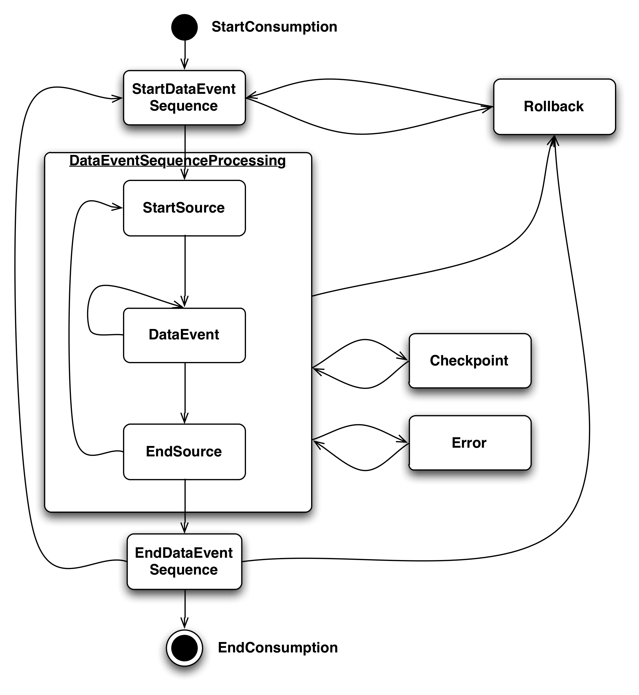
Databus Client Library: Event Callback API
Notes:
onStartConsumption()
-consumer is started (called once)
onStartDataEventSequence(SCN)
Start of an event window.
onStartSource(Source, Schema)
start of a new Databus source in a window
onDataEvent(DbusEvent, Decoder)
- A new data event
onEndSource(Source, Schema)
end of a Databus source in a window
onEndDataEventSequence(SCN)
end of an event window.
onEndConsumption()
Consumer is stopped (called once)
onCheckPoint(SCN)
Databus wants to persist a checkpoint
onError(Throwable)
- on Error encountered by databus client
onRollback(SCN)
rollback to the specified SCN

Slide 29
Agenda
Motivation : Typical Use-Cases and Requirements
Architecture
Development with Databus
Capturing Change Events from Oracle and MySQL
Performance Benchmarks
Future Work
Notes:
Next, I am going to describe Databus, LinkedIn’s Data-Change Propagation System. I am going to give high-level overview and describe the architecture

Slide 30
Capture Changes
Timestamp Based
Trigger Based
DB Change Log Based

Slide 31
Timestamp
Idea
Have timestamp column to track time of insert/update.
Relay can use this column to fetch all changed rows
CONNECTIONS
from_member_id | long
to_member_id | long
is_active | boolean
last_modified | timestamp
select * from Connections where last_modified > :1

Slide 32
Timestamp: Problems
Cannot guarantee timeline consistency
Timestamps marked at update/insert time but not at commit time
Race Conditions could result in missed updates !!
time
tx1
sys timestamp
t1
tx2
sys timestamp
t2
commit
commit

Slide 33
Trigger Based : Oracle
ora_rowscn pseudo column contains internal Oracle clock (SCN) at COMMIT time!
SCN always advances, never goes back!
Cannot be indexed!
To Overcome:
add an indexed column: scn
set default value for scn to “infinity”
after commit ora_rowscn is set
every so often, update Table set scn = ora_rowscn where scn = infinity
CONNECTIONS
from_member_id | long
to_member_id | long
is_active | boolean
scn | Long (indexed)
ora_rowscn | Virtual
select * from T where scn > :1 AND ora_rowscn > :1

Slide 34
Trigger for Multiple tables
trigger on insert/update allocates txn from sequence
and inserts into sy$TxLog with masks for affected tables
CONNECTIONS
from_member_id | long
to_member_id | long
is_active | boolean
Txn | long
Sy$Sources
Table | String
Mask | int
CONNECTIONS Count
Member_id | long
Count | long
is_active | boolean
Txn | long
Sy$TxLog
txn | long
Scn | Long(indexed)
Mask | Int
Ora_rowscn | virtual

Slide 35
Change Capture – An Example in Oracle
sy$sources
Consumers
Source | BitNum
member_account | 1
member_profile | 2
changes since scn > 1200
subscribe:
member_profile
subscribe:
member_account
member_profile
member_account
txn | . . .
95 | George
101 | Robert
txn | . . .
101 | bob@gmail.com
101, 95
95
sy$txlog
txn | scn | ts | mask
101 | 1234 |  | 11
95, 101
101
Relay
95 | 1235 |  | 10
changes since scn > 1200
 |  |  | Event Win

Slide 36
Transaction Log Based
Issues with Trigger based approach
Can miss intermediate changes for rows
More overhead on the DB : Triggers, locks on sy$txlog
Use Transaction log as it already available in most DBs
Problem:
Proprietary format !!
For MySQL, use the standard Storage Engine API to pull bin logs.
Xstreams for Oracle

Slide 37
MySQL : Change Data Capture
Relay
MySQL
Master
MySql replication
MySQL Slave
Storage Engine API
In-Memory Log
MySQL Replication takes care of
bin-log parsing
Protocol between master and slave
Handling restarts
Databus
gets ChangeLog through Storage Engine API and
appends to in-memory log

Slide 38
Agenda
Motivation : Typical Use-Cases and Requirements
Architecture
Capturing Change Events from Oracle and MySQL
Development with Databus
Performance Benchmarks
Future Work
Notes:
Next, I am going to describe Databus, LinkedIn’s Data-Change Propagation System. I am going to give high-level overview and describe the architecture

Slide 39
Experimental Setup
Relays and clients
12 core 2.56GHz Intel Xeon
48GB RAM
SATA Raid 0
Two 1Gbps Ethernet Card
Bootstrap Servers
12 core 2.4GHz Intel Xeon
48GB RAM
800 GB 15K SAS RAID 1+0
Two 1Gbps Ethernet Card

Slide 40
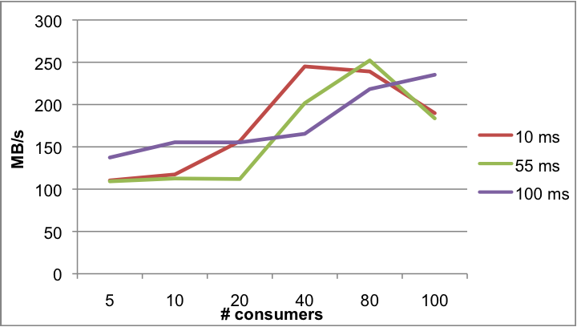
Relay Scalability
Vary Client Pull Interval and number of clients and measure relay bandwidth
Conclusion
We could saturate network without hitting other bottlenecks.
With higher Poll Interval, we could scale to more consumers

Slide 41
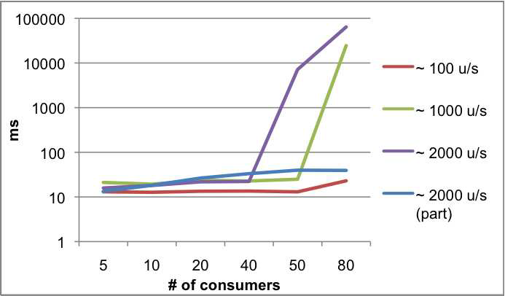
Consumer Latency at varying update rates
Conclusion
Average of 15 msec latency for 100 updates/sec
Server-Side Filtering helped scale consumers at higher update rate at the cost of small overhead

Slide 42
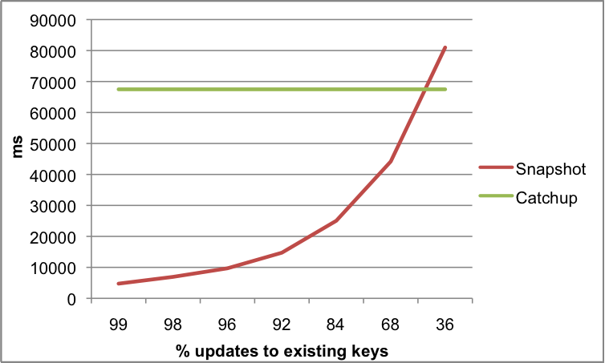
Bootstrap Snapshot vs Log Read
Conclusion
Reading from Snapshot is very efficient when more than 50% of change records are updates/deletes.

Slide 43
Agenda
Motivation : Typical Use-Cases and Requirements
Architecture
Capturing Change Events from Oracle and MySQL
Development with Databus
Performance Benchmarks
Future Work
Notes:
Next, I am going to describe Databus, LinkedIn’s Data-Change Propagation System. I am going to give high-level overview and describe the architecture

Slide 44
Databus Future
Future Work
Events Compression
Relay Chaining for tiered deployments
Streaming relay-to-client protocol
Hadoop Bridge
Relay Clusters with leader election
Automatic Consumer Rebalancing
Open Sourcing in Q3 2012

Slide 45
Questions

Slide 46
Architecture: Illustration
0
Bootstrap Snapshot
Transaction Log Provider
Source clock timer
SCN
Capture changes since 100000
30000
Fetcher (DB)
In-Memory Log
70000
80000
Relay
90000
Bootstrap Log
Pull changes since 90000
100000
Pull changes since Ck
Relay
102400
Fetcher (Relay)
Log Store
SnapShot Store
Source
Fetcher (Client library) | Consumer
Pull changes since Cm
Bootstrap Server
Application

Slide 47
Bootstrap Server:
Generate consistent snapshots and consolidated deltas during continuous updates with long-running queries
Client
Databus Client Lib
Consumer 1
Consumer n
Relay
 |  |  | Event Win
Read
Changes
Bootstrap server
Bootstrap
Log Writer
Read
recent events
Server
Log Storage
Replay
events
Snapshot Storage
Log Applier
Notes:
Bootstrapping is the process of generating initial state of the client consistent as a particular point in the source database.
Catch-up is replaying events to the client that happened after the last successful event processed.

