Slide 1
Presentation Template
LinkedIn Corporate Brand/Visual

Slide 2
Cover Options
Examples

Slide 3

Presentation title goes here
Production Note: Generic cover for all usage. Default title font is Arial 28pt and subtitle is 20pt. Font size maybe adjusted accordingly.
Name Presentation title

Slide 4
Presentation title goes here
Name Presentation title
Production Note: Generic cover for all usage. Default title font is Arial 28pt and subtitle is 20pt. Font size maybe adjusted accordingly.

Slide 5
Presentation title goes here
Production Note: Cover with organization/group name. Please change the team name in the slide master before you use it.
Name Presentation title

Slide 6
Content Slides
Examples

Slide 7
Slide title goes here: Arial 26pt
Body copy default font: Arial 24pt
You may adjust the font size accordingly.
You may NOT use another font.
Production Note: This is a generic content slide for all usage. This has NO team/organization title on the bottom bar.

Slide 8
Slide title goes here: Arial 26pt
Body copy default font: Arial 24pt
You may adjust the font size accordingly
You may NOT use another font.
Production Note: This is a content slide with the team/organization name on the bottom bar. Please change the team name in the slide master.

Slide 9
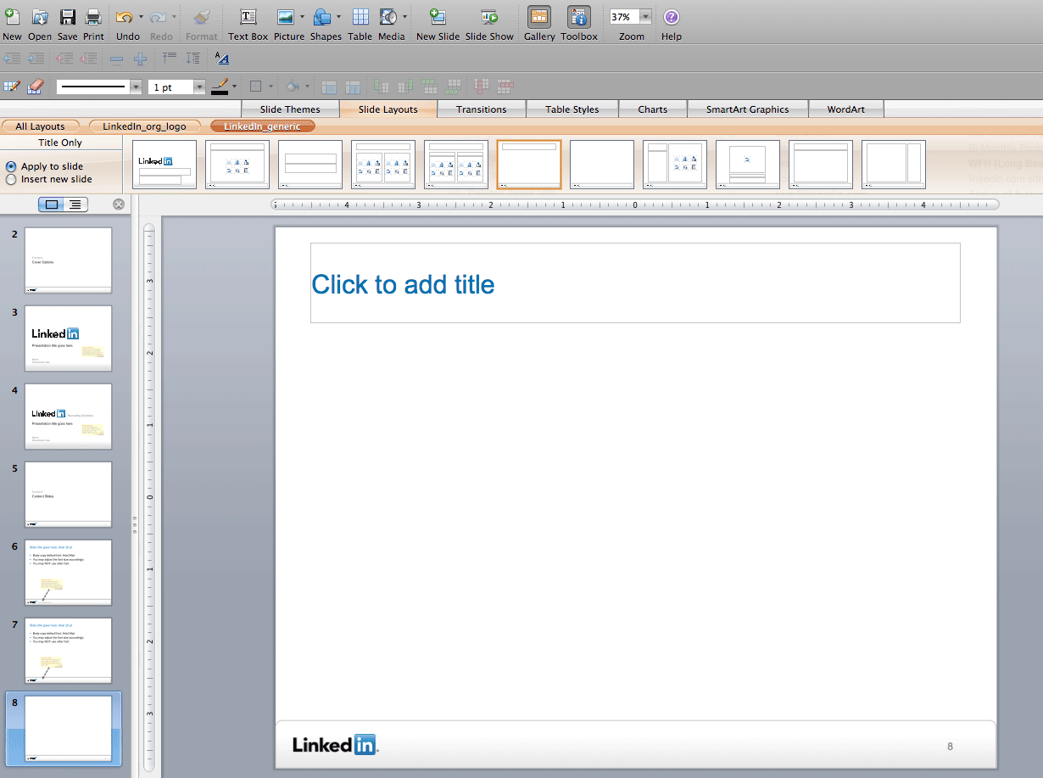
How to choose the right slide layout
Production Note: The “Linkedin_org_logo” layout has the team/organization name on the bottom bar. Please change the team name in the slide master.
Production Note: In the Slide Layouts tab, if you select “Linkedin_generic”, the entire layout will have a plain bottom bar for general usage.

Slide 10
This is a quote/statement slide
Production Note: Quote/statement slide for all usage. Default title font is Arial. Font size maybe adjusted accordingly.

Slide 11

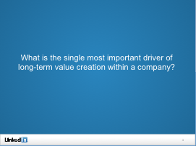
Quote/statement slide
Quote and statement should be short and strong.
Font size should be adjusted according to the amount of text. Average font size is Arial 30pt and aligned center.
This slide should generally not be used with images.
Examples of Quote/statement slide

Slide 12
Production Note: Closing slide for all usage. Do not add any additional content in this slide.

