Slide 1
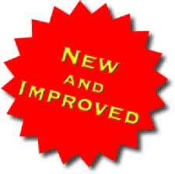
Databus2 Migration
A System for Timeline Consistent Change Data Capture
Balaji Varadarajan , Sunil Nagaraj LinkedIn Tech Talk, 11/16/2011

Slide 2
Overview
Databus V2 System
Why Migrate?
How to Migrate to Databus V2?
Databus V2 Consumer Development
Migration Patterns
Pilots

Slide 3
DatabusV2 System
Client
M
Relays
Consumer 1
Consumer n
Databus2 Client Lib
Subscribe
rows
DB
Events in Memory
DB
events
Sources
events
DatabusV2
Event Stream
Subscribe
Works with V1 instrumentation
Client
events
Databus2 Client Lib
Consumer 1
Consumer n
Snapshot Store
Events in MySQL
Bootstrap Servers

Slide 4
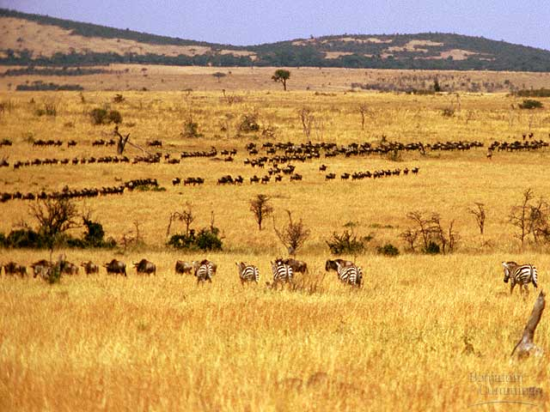
Why Migrate?

Slide 5
Why Migrate?
Supports Common Use-Cases of Databus Consumers
Consumers seamlessly bootstrap
No load on primary Database
Custom bootstrap from warehouse not necessary
Lagging consumers automatically switch to snapshot store
No load on primary Database
No SRE intervention
Schema Evolution of Databus Events
No need to launch new relay if schema of source changes
Databus Events are represented by versioned Avro schemas
Notes:
Team ownership of Databus infrastructure – first step toward Databus-as-a-Service

Slide 6
Why Migrate?
New Ownership Model
Databus2 Event Streams are centrally managed, owned and operated
Relay and Bootstrap Server creation ,deployment and operations
Instrumentation of Primary Database (databusification) for new sources
Databus2 Consumers are provided Databus Client Library and API
Teams will only be responsible for creating and operating the services that are databus consumers
Network branch independence
Notes:
Team ownership of Databus infrastructure – first step toward Databus-as-a-Service

Slide 7
Why Migrate?
Scalability and Operability Features
Databus Consumers support parallelism
Multiple threads of execution of consumer
Server side partitioning support
No need for consumers to filter at client
Cluster of databus client nodes with hot standby
Services can have 1 “master” databus consumer node with n “stand-by” nodes
Notes:
Team ownership of Databus infrastructure – first step toward Databus-as-a-Service

Slide 8
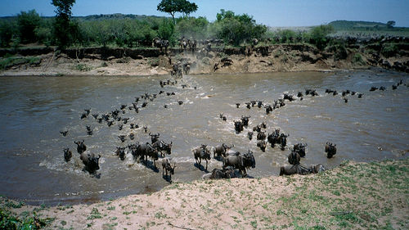
How to Migrate?

Slide 9
How To Migrate – Identify Sources
Identify Sources
Is it a new source?
Does a Databus V1 Relay exist for this source?
If not, fill out request for Databusification and give capacity estimates [link]
Get the Avro schemas for the sources
Databus Team will generate and publish schema package
Notes:
Team ownership of Databus infrastructure – first step toward Databus-as-a-Service

Slide 10
How To Migrate – Databus Consumer Development
has
Consumers
Consumer
Startable
implement
uses
Bootstrap Event Callback
API
HTTP Client API
Stream Event Callback
API
subscribe (consumers, sources,filter)
start() ,startAsync()
shutdown(), awaitShutdown()
onStartConsumption()
onStartDataEventSequence(SCN)onStartSource(Source, Schema)onDataEvent(DbusEvent, Decoder)onCheckPoint(SCN)
onEndSource(Source, Schema)onEndDataEventSequence(SCN).
onEndConsumption()
onError(Throwable)
onRollback(SCN)
configure()
-source URIs
-hot standby clusters
-resource specs
-misc failure/recovery params
Notes:
Depict Client Library in the slide.

Slide 11
How To Migrate – Consumer Development
Migration Options
Convert v2 Databus Events to v1 Event
Requires implementation of fewest v2 callbacks
No rewrite of core application logic , merely implement a wrapper
Cannot leverage consumer parallelism support easily
Develop new processing logic built around v2 API
Requires restructuring of event processing logic
Consumer can be made threadsafe to utilize parallelism
Notes:
Team ownership of Databus infrastructure – first step toward Databus-as-a-Service

Slide 12
How To Migrate – Deployment
Packaging
Dev Environment
One WAR stub (databus2-dev) containing all databus2 WARs provided
Consumers can bring up Databus2 components (relays , bootstrap servers) in dev using the WAR stub
Other Environments
Centrally managed EI, BETA environments for your sources
[wiki link here]
Monitoring
Databus Client Library is integrated with Autometrics
<bean id="databus2ClientSensorFactory" class="com.linkedin.databus.client.DatabusClientSensorFactory" lazy-init="false">
<constructor-arg index="0" ref="sensorRegistry" type="com.linkedin.healthcheck.pub.spring.SensorRegistry" />
<constructor-arg index="1" ref="databus2Client" type="com.linkedin.databus.client.DatabusClientRunnable" />
</bean>
Notes:
Team ownership of Databus infrastructure – first step toward Databus-as-a-Service

Slide 13
Databus Client Library : Closer Look
Databus Client Library
Stream Event Callback
API
Bootstrap Event Callback
API
HTTP Client API
register(consumer, sources,filter)
start() , startAsynchronously()
shutdown() ,awaitShutdown()
onStartConsumption()
onStartDataEventSequence(SCN)onStartSource(Source, Schema)onDataEvent(DbusEvent, Decoder)onCheckPoint(SCN)
onEndSource(Source, Schema)onEndDataEventSequence(SCN).
onEndConsumption()
onError(Throwable)
onRollback(SCN)
configure()
-source URIs
-hot standby clusters
-resource specs, deg of parall
-misc failure/recovery params

Slide 14
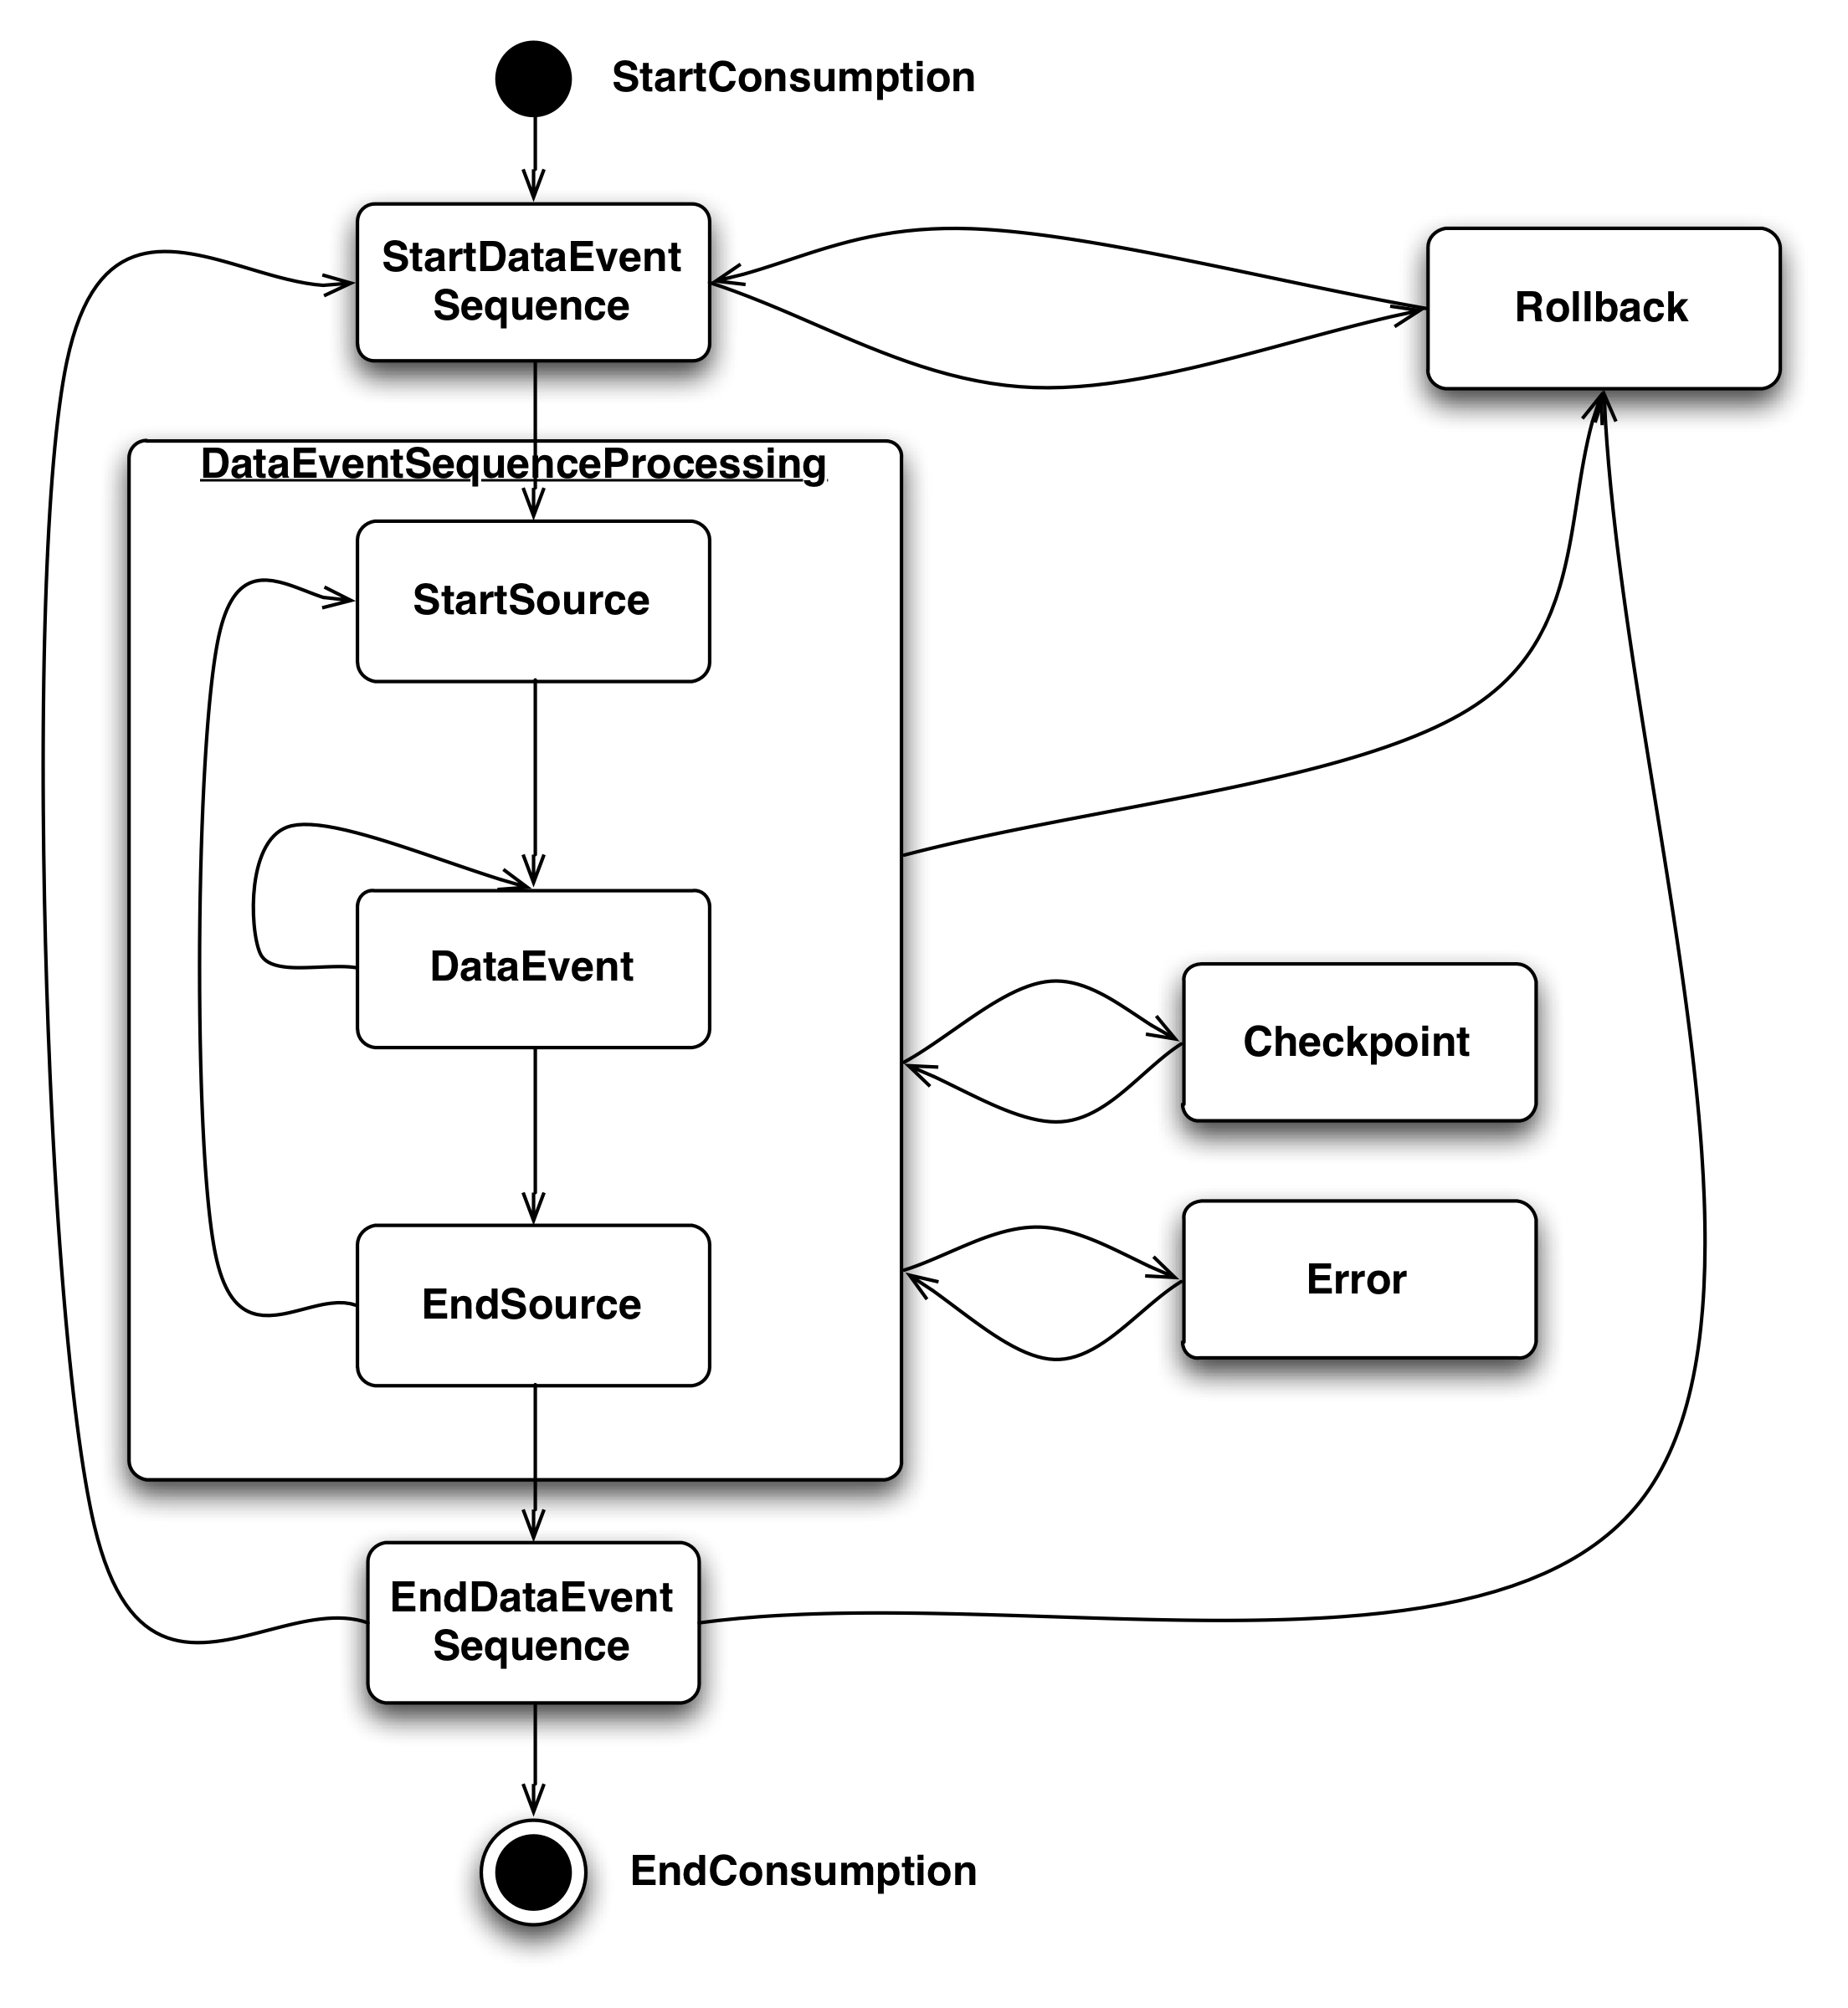
Databus Event Callback API and Execution Model
onStartConsumption()
-consumer is started (called once)
onStartDataEventSequence(SCN)
Start of an event window.
onStartSource(Source, Schema)
start of a new Databus source in a window
onDataEvent(DbusEvent, Decoder)
- A new data event
onCheckPoint(SCN)
Databus wants to persist a checkpoint
onEndSource(Source, Schema)
end of a Databus source in a window
onEndDataEventSequence(SCN)
end of an event window.
onEndConsumption()
Consumer is stopped (called once)
onError(Throwable)
- on Error encountered by databus client
onRollback(SCN)
rollback to the specified SCN
Notes:
-Point out differences in v1 (parts in orange) : onCheckpoint() – useful for saving progress while processing large windows. Esp in bootstrap
-onRollback – explanation- when does this happen – an example.
-onDataEvent – example – how to use the decoder.
-is onStartConsumption called on mastership? –only on mastership – consumers are instantiated – but not invoked callbacks unless they are ‘master’ – in a hot-standby situation

Slide 15
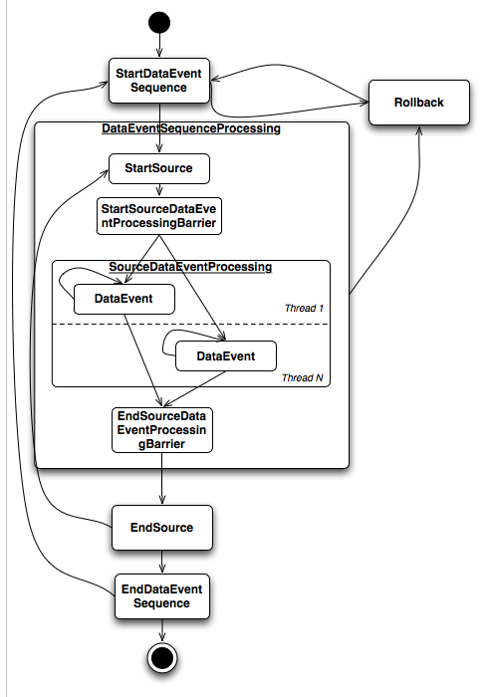
Databus Consumer - Parallelism
Consumer should be thread-safe
Multiple threads of execution of consumer
Degree of parallelism [size of threadpool] specified
Parallelism achieved when processing data events within an event window
onStartSeq,onEndSeq,onStart/onEndSource invoked for all threads
Barrier on onStart and onEndSource for all threads
Notes:
Simple Parallelism -

Slide 16
HTTP Client : Execution Model
register(Consumer, Source)
Subscribe to source and provide pointer to processing logic
register(Consumer,Source,Filters)
Subscribe , but define filters (partition-id) at source
start() , startAsynchronously register
Starts the http client , connects to relevant databus2 event stream
shutdown() , awaitShutdown()
Stops the consumer and client, wait until all processing stops
configure()
checkpoint type : Progress saved on file or centrally in zookeeper
checkpoint freq : For large windows, save progress periodically
optional bootstrap : Don’t rely on bootstrap at all !
hot standby cluster : Part of a “one-active , n-standby” group
consumer parallelism : number of concurrent executions of data event processing

Slide 17
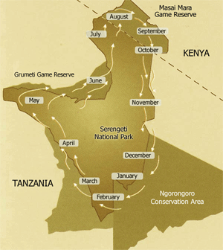
Consumer Migration Patterns

Slide 18
Consumer Migration Patterns – The Big Switch
Stop Databus V1 writes to store/index
Start Databus v2 writes to store/index
No bootstrap required for V2
Reads occur from original store through the switch.
Callers can live with stale data for a while
More risk , less capacity requirements from both application and databus

Slide 19
Consumer Migration Patterns – The V2 Replica
Bootstrap new store using Databus V2
Prove V2 store is equivalent to V1 store
Switch read traffic to V2 store
Disable and decommission V1 store
Less risk, more capacity needs, effort to validate

Slide 20
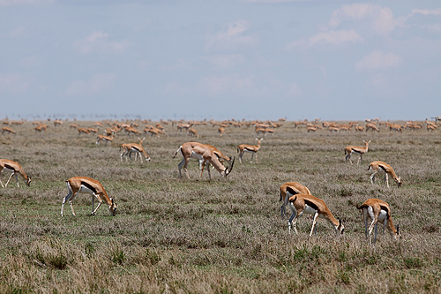
Pilot Program : The early adopters
Liar
Bizfollow

Slide 21
Pilot: LIAR
Sources:
LIAR Job Relay
LIAR Member Relay
Services:
LIAR Job Recommendation (LIAR Job Relay)
LIAR Member Search (LIAR Member Relay)
LIAR App (LIAR Job Relay)
Characteristics:
- Number Of Clients
LIAR Job Recommendation ( 8 )
LIAR Member Search (96)
LIAR Application (11)
- Number Of Rows
LIAR Job Relay (15M rows)
LIAR Member Relay ( 100M rows)
- Row Size
LIAR Job Relay (22 bytes)
LIAR ember Relay (18 bytes)
- Event Rate
LIAR Job Relay ( 1 – 2 eps)
LIAR Member Relay (60 eps)
Features:
Server side Filtering for Liar Member Search and Liar App services
Stream from Latest Window on client falling off for Liar App
Notes:
Need to make this brief.
Should we talk about all the sources and clients?

Slide 22
Server Side Filtering Use Case
Liar Member Search
(Partition 1)
Oracle DB
Liar Member Relay
E1
EV 1
EV 2
EV 31
Liar Member Search
(Partition 2)
E2
E1
E2
E31
E31
…..
EVENTS
EV1 -> Partition 1
EV2 -> Partition 2
EV31 -> Partition 31
Liar Member Search
(Partition 31)

Slide 23
LIAR (Post Databus V2 Migration)
Liar DB
LIAR App
(Mod 0)
Liar Entity
Matches
Job Relay
LIAR App
(Mod 1)
LIAR Job V2 Relay
Job Relay
Liar Job
Info
LIAR V2 Relay
Job Recommendation
Index
Member Search
(Shard 1)
Bootstrap Producer
Bootstrap Server
Index
Liar Member Info
Member Relay
…….
Bootstrap
DB
Member Search
(Shard 32)
Index
Notes:
Unclear.

Slide 24
Pilot : BizFollow Migration
Company-follows
(writes)
reads
company-bizfollow DS
Peak: 1000 events/sec
R
Peak: 10 events/sec
W
Databus V1
Consumer
Vdmt
W
bizfollow
R
Databus V1 Stream
R
Peak: 10 events/sec
Significant number of rows , low update rate
Only one DS instance has an active databus consumer at a given time
100 M Rows
Event Size: 200 bytes
Size: 200 G

Slide 25
Pilot : BizFollow Migration
V2 Event “converted” to v1
“v2 Replica” method chosen
Bootstrap of new store was challenging
Hot standby picks active databus consumer improving fault tolerance
company-bizfollow
-
R
W
Databus V1
Consumer
Databus V2 Consumer
Vdmt
V1
W
DB
R
Databus V1 Stream
R
company-bizfollow
Databus V2 Stream
R
R
Databus V2 Consumer
R
Vdmt
V2
W

Slide 26
Pilot: Bizfollow Databus2 Consumer
public ConsumerCallbackResult onDataEvent(DbusEvent e, DbusEventDecoder eventDecoder) {
//get avro deserialized object representation of changed row
// BizFollow is the type represented by Avro schema [available in a package]
BizFollow event = eventDecoder.getTypedValue(e, (BizFollow)null, BizFollow.class); …….
//object that bridges v1 and v2
BizFollowInfo = new BizFollowInfo(event.id.longValue(), event.memberId, event.companyId,
BizFollowNotifyOptions.fromXml(event.notifyOptions.toString()),
…,
new Date(event.lastModified),
event.txn.longValue());
cacheEvent = new MiCacheDatabusEvent<BizFollowInfo>(e.sequence(), info);
v1Event = new Event<String, MiCacheDatabusEvent<BizFollowInfo>>(
Long.toString(e.key()), cacheEvent, e.sequence(),
e.timestampInNanos() / 1000000);
try {
//v1 callback – does the real work
_v1Callback.onEvent(v1Event);
} catch (Exception ex) {
return ConsumerCallbackResult.ERROR; }
return ConsumerCallbackResult.SUCCESS;
}

Slide 27
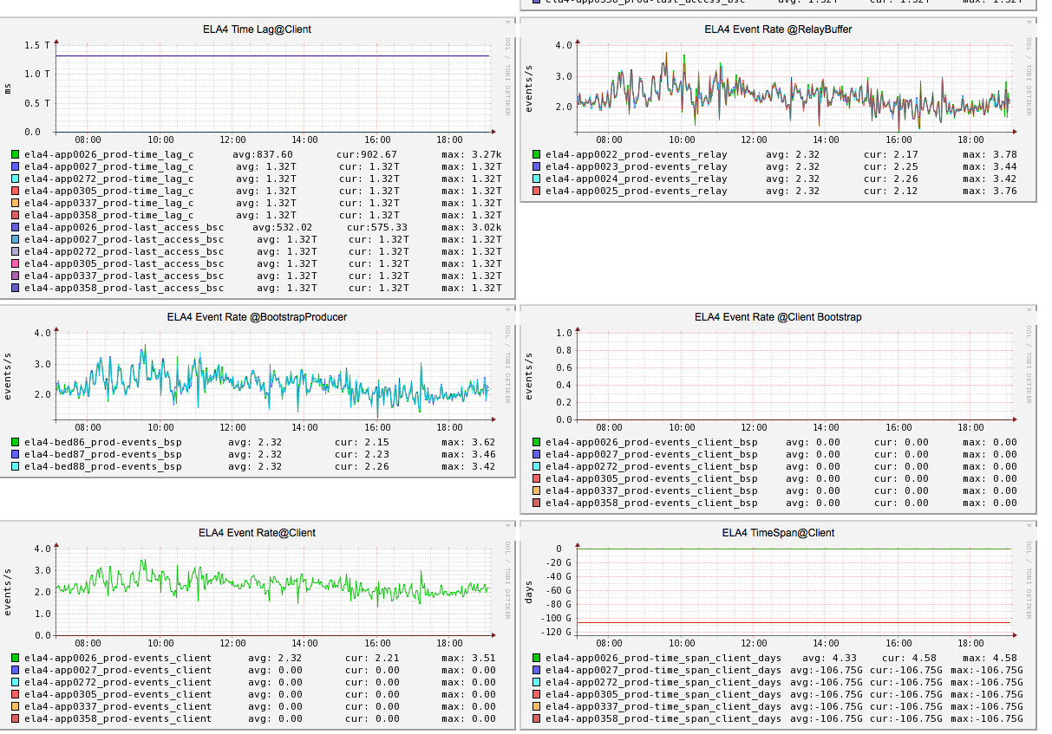
Pilot: Bizfollow Databus Consumer Monitoring

Slide 28
Work in Progress
Simple Packaging
One war stub , different configs for relays and bootstraps
Event Compression
Buffer longer durations of larger events in memory [member2]
V1 Relay as a Source
Case of overloaded DB , consume from v1 Relay
Consumer Chaining
Mimics v1 behaviour of chaining consumers
Source Discovery
Discovery of source parameters
Simplifies configuration for clients
Notes:
Team ownership of Databus infrastructur – first step toward Databus-as-a-Service

Slide 29
Important Links
Databus2 User Guide
Databus2 Consumer Development
List: databus-development@linkedin.com

Slide 30
Questions

Slide 31
Databus Consumer : Callback API Example
@Override
public ConsumerCallbackResult onDataEvent(DbusEvent e, DbusEventDecoder eventDecoder)
{
//decode the Databus Event to get Avro Record
GenericRecord decodedEvent = eventDecoder.getGenericRecord(e, null);
Integer memberId = (Integer)decodedEvent.get("memberId");
List<GenericRecord> positions = (List<GenericRecord>)decodedEvent.get("profPositions");
List<GenericRecord> educations = (List<GenericRecord>)decodedEvent.get("profEducations");
LOG.info("member: id=" + memberId + " #positions=" + positions.size() +
" #educations=" + educations.size());
return ConsumerCallbackResult.SUCCESS;
}

Slide 32
Databus Consumers: Ingraphs
Bizfollow Dashboard
LIAR Dashboard

Slide 33
Writes
Reads
Service DS
R
W
Databus V1
Consumer
Index/Store
W
DB
R
Databus V1 Stream
R
Service DS
Databus V2 Stream
R
Databus V2 Consumer
R
Index/Store
W

