Slide 1
Databus2 Migration
A System for Timeline Consistent Change Data Capture
Balaji Varadarajan , Sunil Nagaraj LinkedIn Tech Talk, 11/16/2011

Slide 2
Overview
Databus V2 Ecosystem
Why Migrate?
How to Migrate to Databus V2?
Databus V2 Client Library
Case Studies
Migration Patterns

Slide 3
DatabusV2 Eco-System
Client
M
Relays
Consumer 1
Consumer n
Databus2 Client Lib
Subscribe
rows
DB
Events in Memory
DB
events
Sources
events
DatabusV2
Event Stream
Subscribe
Works with V1 instrumentation
Client
events
Databus2 Client Lib
Consumer 1
Consumer n
Snapshot Store
Events in MySQL
Bootstrap Servers

Slide 4
Why Migrate?
Supports Common Use-Cases of Databus Consumers
Consumers seamlessly bootstrap
No load on primary Database
Custom bootstrap from warehouse not necessary
Lagging consumers automatically switch to snapshot store
No load on primary Database
No SRE intervention
Schema Evolution of Databus Events
No need to launch new relay if schema of source changes
Databus Events are represented by versioned Avro schemas
Notes:
Team ownership of Databus infrastructure – first step toward Databus-as-a-Service

Slide 5
Why Migrate?
New Ownership Model
Databus2 Event Streams are centrally managed, owned and operated
Relay and Bootstrap Server creation ,deployment and operations
Instrumentation of Primary Database (databusification) for new sources
Databus2 Consumers are provided Databus Client Library and API
Teams will only be responsible for creating and operating the services that are databus consumers
Notes:
Team ownership of Databus infrastructure – first step toward Databus-as-a-Service

Slide 6
Why Migrate?
Scalability and Operability Features
Databus Consumers support parallelism
Multiple threads of execution of consumer
Server side partitioning support
No need for consumers to filter at client
Cluster of databus client nodes with hot standby
Services can have 1 “master” databus consumer node with n “stand-by” nodes
Notes:
Team ownership of Databus infrastructure – first step toward Databus-as-a-Service

Slide 7
How To Migrate – Identify Sources
Identify Sources
Is it a new source?
Does a Databus V1 Relay exist for this source?
If not, fill out request for Databusification and give capacity estimates [link]
Get the Avro schemas for the sources
Databus Team will generate and publish schema package
Notes:
Team ownership of Databus infrastructure – first step toward Databus-as-a-Service

Slide 8
How To Migrate – Databus v2 Consumer Development
Consumers
implement
invoke
implement
Bootstrap Event Callback
API
HTTP Client API
Stream Event Callback
API
subscribe (Sources,partition)
start()
stop()
onStartConsumption()
onStartDataEventSequence(SCN)onStartSource(Source, Schema)onDataEvent(DbusEvent, Decoder)onCheckPoint(SCN)
onEndSource(Source, Schema)onEndDataEventSequence(SCN).
onEndConsumption()
onError(Throwable)
onRollback(SCN)
configure()
-source URIs
-hot standby clusters
-resource specs
-misc failure/recovery params
Notes:
Depict Client Library in the slide.

Slide 9
How To Migrate – Consumer Development
Migration Options
Convert v2 Databus Event to v1 Event
No rewrite of core application logic , merely implement a wrapper
Cannot leverage consumer parallelism support.
Develop new processing logic built around v2 API
Requires restructuring of event processing logic
Consumer can be made thread-safe to utilize parallelism
Notes:
Team ownership of Databus infrastructure – first step toward Databus-as-a-Service

Slide 10
How To Migrate – Easy Way
Wiki: https://iwww.corp.linkedin.com/wiki/cf/display/ENGS/Chapter+V+-+Migration+of+Legacy+Clients+to+Databus+2.0
Steps:
Implement V2 to V1 DTO Converter
Implement new V1 Consumer interface (to be made optional)
Register your consumer to Client Library
Use Databus V1V2 Client Startable (recommended)
DatabusEventHolder<V1> convert ( DatabusEventHolder<V2> event );
ConsumerCallbackResult onBootstrapEvent ( DatabusEventHolder<V1> event );
<entry key="liar_member_relay.databusv1.enabled" value="false" />
Notes:
Team ownership of Databus infrastructure – first step toward Databus-as-a-Service

Slide 11
How To Migrate – Implement V2 Callbacks
Wiki:
https://iwww.corp.linkedin.com/wiki/cf/display/ENGS/Chapter+IV+-+Creating+a+Simple+Databus+2.0+Client
Steps:
Implement Stream and/or Bootstrap Consumer Callback interface
Register your consumer callback to the Client Library
Call one of several start() methods or use V1V2 Client Startable (if you are migrating)
Notes:
Team ownership of Databus infrastructure – first step toward Databus-as-a-Service

Slide 12
How To Migrate – Deployment
Databus Client Library is integrated with Autometrics
Packaging
Dev Environment
One WAR stub (databus2-dev) containing all databus2 WARs provided
Consumers can bring up Databus2 artifacts ( relays, bootstrap servers) in dev using the WAR stub
Other Environments
Centrally managed EI, BETA environments for your sources
[wiki link here]
<bean id="databus2ClientSensorFactory" class="com.linkedin.databus.client.DatabusClientSensorFactory" lazy-init="false">
<constructor-arg index="0" ref="sensorRegistry" type="com.linkedin.healthcheck.pub.spring.SensorRegistry" />
<constructor-arg index="1" ref="databus2Client" type="com.linkedin.databus.client.DatabusClientRunnable" />
</bean>
Notes:
Team ownership of Databus infrastructure – first step toward Databus-as-a-Service

Slide 13
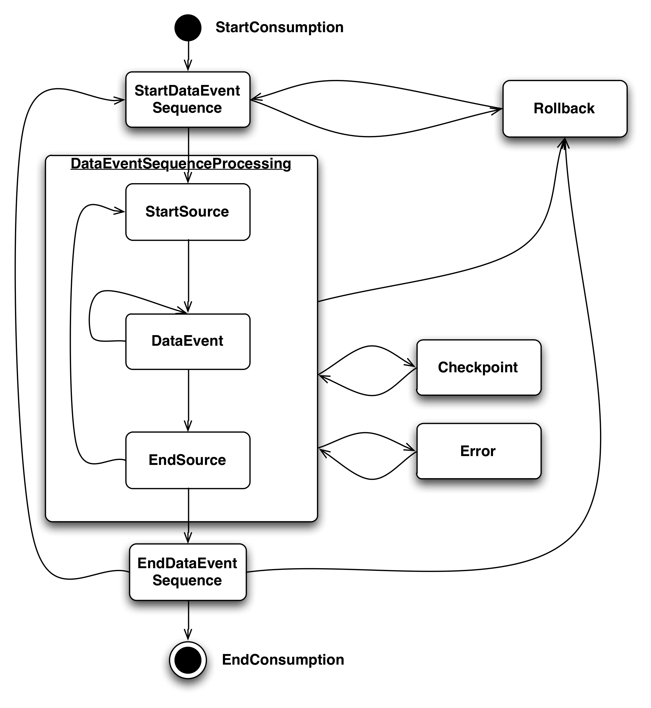
Databus Event Callback API and Execution Model
onStartConsumption()
-consumer is started (called once)
onStartDataEventSequence(SCN)
Start of an event window.
onStartSource(Source, Schema)
start of a new Databus source in a window
onDataEvent(DbusEvent, Decoder)
- A new data event
onEndSource(Source, Schema)
end of a Databus source in a window
onEndDataEventSequence(SCN)
end of an event window.
onEndConsumption()
Consumer is stopped (called once)
onError(Throwable)
- on Error encountered by databus client
onCheckPoint(SCN)
Databus wants to persist a checkpoint
onRollback(SCN)
rollback to the specified SCN
decoder.getTypedValue(event, liarJobRelayObj, LiarJobRelay.class);
Notes:
-Point out differences in v1 (parts in orange) : onCheckpoint() – useful for saving progress while processing large windows. Esp in bootstrap
-onRollback – explanation- when does this happen – an example.
-onDataEvent – example – how to use the decoder.
-is onStartConsumption called on mastership? –only on mastership – consumers are instantiated – but not invoked callbacks unless they are ‘master’ – in a hot-standby situation

Slide 14
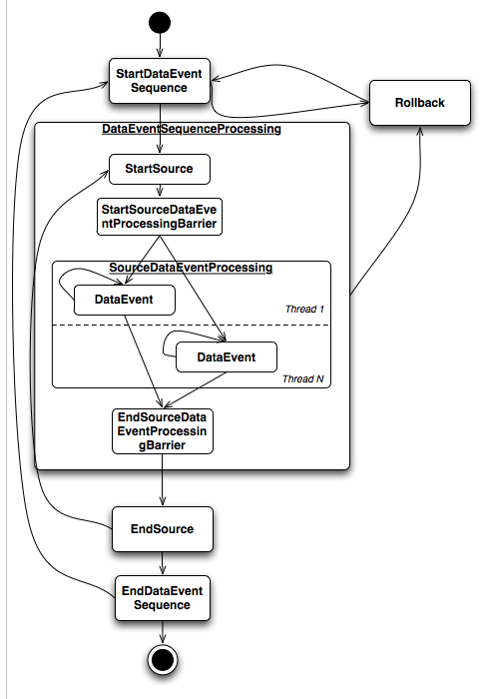
Databus Consumer - Parallelism
Consumer should be thread-safe
Multiple threads of execution of consumer
Degree of parallelism [size of threadpool] specified
Parallelism achieved when processing data events within an event window
onStartSeq,onEndSeq,onStart/onEndSource invoked for all threads
Barrier on onStart and onEndSource for all threads
Notes:
Simple Parallelism -

Slide 15
Case Studies: LIAR Member Search
Sources:
LIAR Member Relay
Services:
LIAR Member Search
Prod Statistics:
- Number Of Clients
(96 = 32 shards * 3 cluster/replica)
Number Of Rows : 100M rows
- Event Rate : 60 eps
- Average Row Size : 18 bytes
Databus v2 Feature:
Range-based Server side Filtering
Notes:
Need to make this brief.
Should we talk about all the sources and clients?

Slide 16
Server Side Filtering Use Case
Liar Member Search
(Partition 1)
[0-5M)
Oracle DB
Liar Member Relay
E1
EV 1
EV 2
EV 31
Liar Member Search
(Partition 2)
[5M-10M)
E2
E1
E2
E31
E31
…..
EVENTS
EV1 -> Member Id ( 1200 )
EV2 -> Member Id ( 5M )
EV31 -> Member Id ( 150M )
Liar Member Search
(Partition 31)
[150M-155M)

Slide 17
Work in Progress
Simple Packaging
One war stub , different configs for relays and bootstraps
Event Compression
Buffer longer durations of larger events in memory [member2]
V1 Relay as a Source
Case of overloaded DB , consume from v1 Relay
Consumer Chaining
Mimics v1 behaviour of chaining consumers
Source Discovery
Discovery of source parameters
Simplifies configuration for clients
Notes:
Team ownership of Databus infrastructur – first step toward Databus-as-a-Service

