Slide 1

Databus Overview + Testing
Sajid Topiwala
DDS Data Infrastructure Team

Slide 2
Agenda for Today
PART - I
Overview of Databus
High Level Architecture
Part - II
Challenges in Testing
Details of Testing
Notes:
Good Afternoon Thank you all for coming. This is a two part talk
Part I – Overview
Overview of Databus
High Level Architecture
Part II – Testing
Challenges in Testing
Details of Testing
Feel free to interrupt me to ask any questions. I would like to keep this interactive. Actually I function better in a QA mode rather than talking continuously.

Slide 3
PART I DATABUS OVERVIEW & ARCHITECTURE

Slide 4
Databus at LinkedIn
Overall 60+ Services use Databus at LinkedIN
Team Money
BizFollow, BizProfile, Ads, CAP ( Corporate accounts portal), Jobs/Talent Match
Core
Member2, Profile, Public Profile, EOS ( Email Ownership Service), Targeting, Member Recommendations, Member Picture, Customer Service Portal
CNC
Anet, NUS, Forums, Twitter Integration, AYN (Ask Your Network)
Security
Auth
DDS
Espresso
SNA
LIAR, People Search, Cloud, LiX, Type Ahead, LinkedIn Today
Notes:
Does anyone know how many services use Databus?
(
Mobile Team does not have any services

Slide 5

Bob’s Computer
Internet
LI Internal Services
Peter
Jack
CONNECT
REQUEST
Jill
ACCEPT
Abe
Bob
John
Jill’s Computer
Connection Graph

Slide 6
Evolution of Databus
Peter
Jack
Jill
Abe
Changes
Bob
John
DB
Job Recommendation
Poll
Recruiting Services
Ads Platform
Too much load on Database!
Company Follow
NUS feed
Search Index
Notes:
-Too much load on DB – would never work:
-Starting building databus

Slide 7
Evolution of Databus
Databus - v1
Jill
Peter
Jack
“Changes since 30 min”
Abe
Recent Changes
2 hrs
Bob
John
DB
Relay
Relay
(Memory)
Client2
….
“Changes since 6 hrs”
Client N
“Changes since beginning”
Notes:
V1 FEATURES
Have a broker between the services and the database.
Relay is a in memory store of the latest updates from a database
V1 PROBLEMS
Slow clients that do a lot of processing gradually fall behind and eventually can fall off the relay during peak traffic times
These slow clients connect to the database to catchup increasing load at database
New client has no choice but to pull updates from the Database

Slide 8
Evolution of Databus – Databus v2
Jill
Peter
Jack
“Changes since 30 min”
Recent Changes
2 hrs worth of Data
Bob
Abe
John
DB
Relay
Relay
(Memory)
Client2
….
Client N
Recent Changes
“Changes since 6 hrs”
“ 1 Time Transfer: All data”
Bootstrap +
Catch-up
(DB)
“Changes since beginning”
age of DB
Notes:
NEW V2 FEATURE : ***BOOTSTRAP DB*****
Save’s direct access of DB from slow clients and new clients
Bootstrap only has a snap shot of the data …
data is compressed….for eg. If there are multiple updates to the same key the relay stores everything but the Bootstrap will only store latest
Client does not have to specify connection to relay or bootstrap it is handled seamlessly.

Slide 9
Other Improvements from V1 to V2
No spring wiring
Schema Updates Seamless
Server Side Filtering of events
Many more changes…
Notes:
No spring wiring …services use REST over HTTP to communicate
Schema updates are seamless
If a new schema is published ( due to an extra field added to a table ) , databus can now store events with the new schema without requiring a restart of the service. So the buffer will have older events with v1 schema and newer events with v2 schema
The client is also forward compatible. So if the client has not upgraded to v2 schema it will see the events as v1 events.
Databus v2 adds server side filtering. It can partition data based on some key. This is helpful in sharding data at the client side. Multiple clients are created and they operate on specific key ranges.

Slide 10
Databus2 Architecture: Control Flow
Poll
Connection Service
Jill Creates Profile
e1
e2
Relay
Databus2 Client Lib
Bob and Jill
Make a
connection
e3
Pull
BOB Creates
Profile
Poll
Poll
Push/Pull
DB
Pull
Bootstrap Service
DB
Notes:
Relay is a giant circular buffer in Memory

Slide 11
Change Capture – An Example in Oracle
sy$sources
Consumers
Source | BitNum
Member_connections | 1
member_profile | 2
changes since scn > 1200
subscribe:
member_profile
subscribe:
Member_connections
member_profile
Member_connections
txn | . . .
95 | Bob
101 | Jill
txn | . . .
103 | Bob, Jill
1236
1234,1235
1235
1236
sy$txlog
1234
txn | scn | ts | mask
95 | 1234 |  | 10
1234,1235
1236
101 | 1235 |  | 10
changes since scn > 1200
103 | 1236 |  | 01
Notes:
Lets take a look from the perspective of a database transaction.

Slide 12
PART II TESTING DATABUS

Slide 13
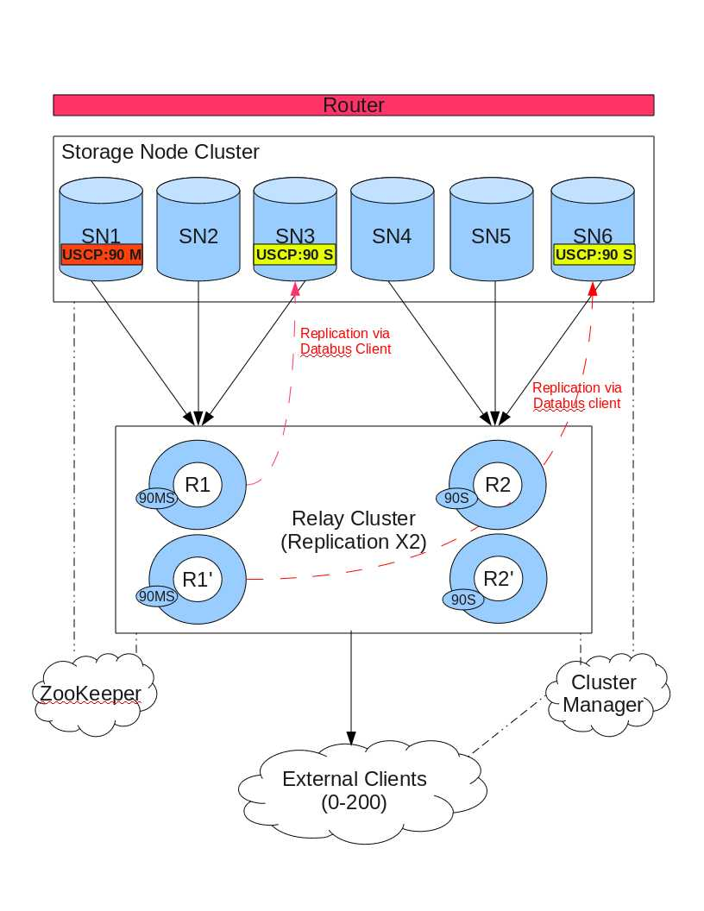
Notes:
e.g. of Complex setup. Don’t talk about this slide just show it to give context into what we mean by a complex seutp.

Slide 14
Test Challenges
Many components
Complex Setup
Many configurations
Very Hard concurrency issues
Need to have very high uptime while handling heavy loads
Verification of data is tricky
Keeping automated tests running in regression mode
Development cycles compressed and rapid feature release
Limited resources and many potential test cases
Notes:
Many Components
(relay, bootstrap, zookeeper, clients, oracle, mysql, storage nodes)
Complex Setup
(See previous slide)
Many Configurations
event buffer size, poll intervals
Tricky concurrency Issues
Keeping automated tests running in regression mode
Verification can be tricky
events may get compressed, events distributed in many relays

Slide 15
Testing Process
Write a TestPlan
Setup a Framework and build tooling
Build Mock Services ( e.g. Test Clients )
Write the Integration testcases – Single Box Tests
Make it run in regression
CHO - Multibox Dev Environment
Performance – Multibox Dev Environment
Fault Injection
Code Coverage
Releasing a Backend Service / MultiProduct
Notes:
Write a Testplan
Databus Enhancement features to support Espresso
Features are called Brews in Espresso language
Feature or Brew is not complete until all the Bugs are closed or Triaged.
Talk about the JIRA plugin

Slide 16
Goal of the test framework
Good Test Coverage
Easy to come up with new tests
Easy to extend for CHO and Perf
Deterministic regression tests
Easy to debug issues
Notes:
configurations and topologies
setup requirements (zookeeper, mysql)

Slide 17
Test Framework 40,000 foot view
Java Services
Python Driver
Shell Script
Notes:
At test case level, use shell script
Anyone should be able to easily add new tests
At driver level, use Python which more logic can be added, e.g., handle Hudson and Dev machine differences
If there are too many stuff to do in the test case level, abstract it into the driver as building blocks
The building blocks may be specific for different project (wait for bootstrap, zookeeper)
Add java level hooks to support testing
e.g., Generator functionality
Consumer control (start/pause/resume)

Slide 18
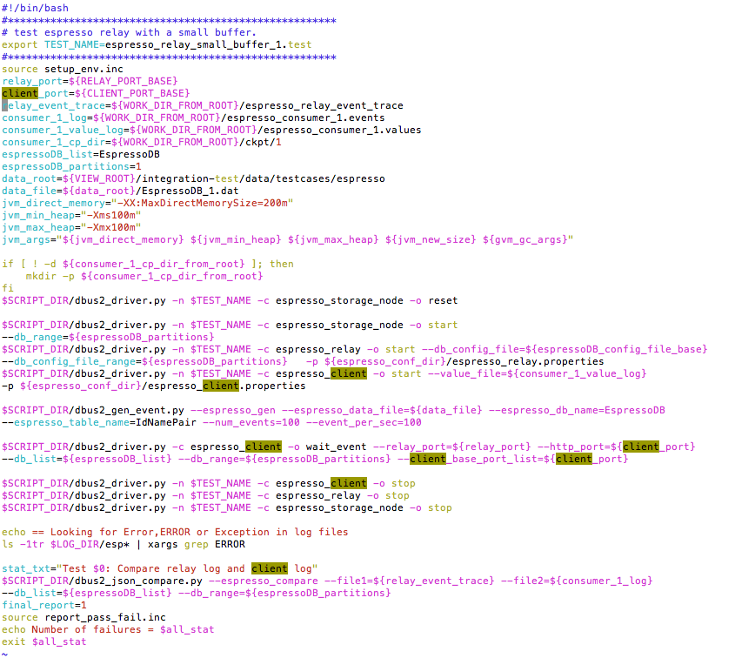
TESTNAME
TEST ENVIRONMENT VARIABLES
CLEANUP OLD DATA & STATE
START SERVICES
GENERATE DATA
VERIFY STATE
STOP SERVICES
VERIFY DATA &
EXIT WITH PASS/FAIL
Notes:
Testname : Used in Hudson to identify the test, used to identify test log folder

Slide 19
Anatomy of a Command
Pass the Test Name
Component
Invoke the Python Driver
$SCRIPT_DIR/dbus2_driver.py -n $TEST_NAME -c espresso_relay -o start --db_config_file=${file_base1} --db_config_file_range=${espressoDB_partitions} -p ${espresso_conf_dir}/espresso_relay.properties
Options
Secondary Command
Notes:
Invoke the python driver : In path SCRIPT_DIR
2. Pass the Test Name: This is important for the log files to go in the correct place
3. Component: Can also be thought of as the primary command. In this case it is a espresso relay
4. Secondary Command: What operation you want to perform on the component. Start/Stop/Pause
5. Options: e.g. Relay properties file to be passed to configure the relay

Slide 20
More Commands
STOP A SERVICE
$SCRIPT_DIR/dbus2_driver.py -n $TEST_NAME -c espresso_client -o stop
RESET A SERVICE
$SCRIPT_DIR/dbus2_driver.py -n $TEST_NAME -c espresso_storage_node -o reset
WAIT FOR SERVICE TO GET TO SOME STATE
$SCRIPT_DIR/dbus2_driver.py -c espresso_client -o wait_event --relay_port=${relay_port} --http_port=${client_port} --db_list=${espressoDB_list}

Slide 21
Yet More Commands…
GENERATE DATA
$SCRIPT_DIR/dbus2_gen_event.py --espresso_gen --espresso_data_file=${data_file} -espresso_db_name=EspressoDB
--espresso_table_name=IdNamePair --num_events=100 --event_per_sec=100
VERIFY DATA
$SCRIPT_DIR/dbus2_json_compare.py --espresso_compare --file1=${relay_event_trace} --file2=${consumer_1_log} --db_list=${espressoDB_list} --db_range=${espressoDB_partitions}

Slide 22
Test Framework ( Summary)
Shell Script - Testcase
Python Driver
Java Code
Thread Management
ENVIRONMENT SETUP
RELAY
Command Dictionary
BOOTSTRAP
SERVER
CLEANUP
Option Parser
REST Command Builder / JSON Response Parser
TEST LOGIC
BOOTSTRAP
PRODUCER
PASS/FAIL
Data Generator/Validation
Logic
CLIENT
Log Management
Notes:
Test driver (start/stop, put in background, report status)
Generator (start/resume, rate, duration)
Comparison (sorting, compression, directly select from db construct the event and compare again the databus events, check foreign key order, serialized or deserilized)
Remote deploy and performance test
Long running verification, use special data generation pattern
test cases can be run as a whole or step by step
easily turn on debug logging or attach debugger
easily run on multiple machines (not fully automated)

Slide 23
Advantages
Rapid Testcase Development
Manage Multiple Processes/Services
Readable testcases
Full advantage of UNIX commands
Very easy to modify for debugging
Easy to extend for CHO & Performance
Notes:
What are the advantages of this approach
Rapid Testcase Development: Major work done in framework development. Once all framework is setup very quickly crank out testcases. Helps also to budget time upfront
Manage Multiple Processes/Services: Something not easily done in Java
Readable Testcase: The driver hides all the complexities, testcase have very simple command structure with options
Full advantage of UNIX commands: ( curl, grep, sort, mkdir)
Easy to extend to CHO & Perf: Put a for loop around the relay start command and you can get 10 instances of the relay.
Or increase the event rate & num events in data generator code to generate 1 million events

Slide 24
Limitations
Cannot test all the permutations of configs of various components
Limited Fault Injection
Does not catch very rare hard to find bugs
Notes:
1.) So many properties for all components it is not possible to test all the permutations. Currently we manually generate the properties. A possible extension would be a auto config generator which would create 1000’s of configs and rerun a set of tests with different configurations. (We mitigate this right now by testing configs most likely to be used in production )
2.) The reason for alert in number (2) . VIP between relay and DB went down, causing relay to timeout after some retries ( another non optimum configuration )
3.) A rare bug that used to happen after some relays ran for 3-4 days. (This was caused by the lookup index getting corrupted, and would report the buffer as empty when it was full ). We did not catch it in unit testing or integration test environment, but it showed up in Dark Launches in PROD. It took several iterations for it to get fixed.

Slide 25
Future extension
Automated remote execution
Crash Monkey
Network Failure Simulator
Failure injection
API Testing
Notes:
API Based Testing : Test all permutations of the REST API

Slide 26
Resources
Testplans
https://iwww.corp.linkedin.com/wiki/cf/display/ENGS/5.3+Testplan
https://iwww.corp.linkedin.com/wiki/cf/pages/viewpage.action?pageId=46460263
Databus Repository
Path to integration tests

Slide 27
APPENDIX

Slide 28
Use Cases
Standardization
Standardization
Standardization
Standardization
Standardization
Standardization
Standardization
Standardization
MemCache Invalidates
Search Index
Graph Index
Read Replicas
Updates
Primary
DB
Data Change Events
Notes:
What do we mean when we say that Databus is LinkedIn’s data-change propagation system.
Add Es

Slide 29
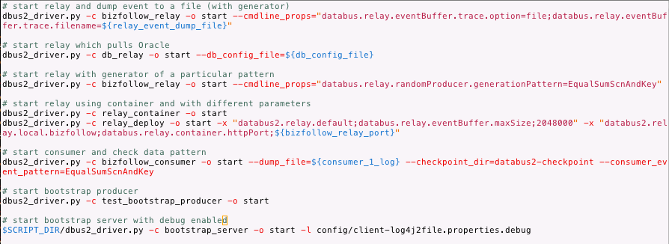
Test driver calls

Slide 30
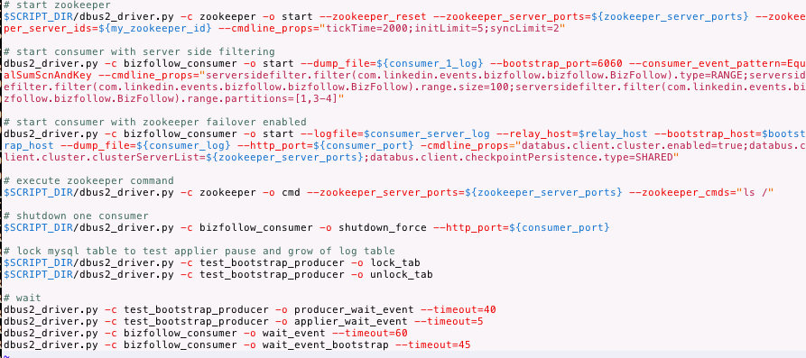
Test driver calls cont

Slide 31
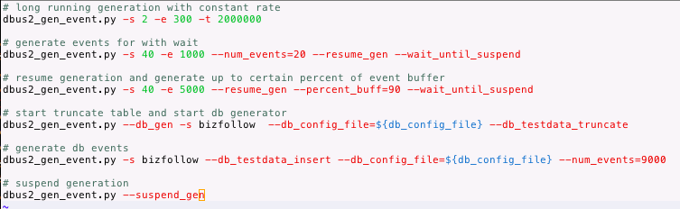
Generator calls

Slide 32
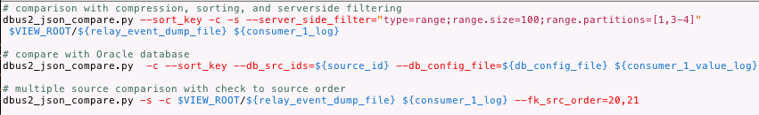
Comparison calls

Slide 33
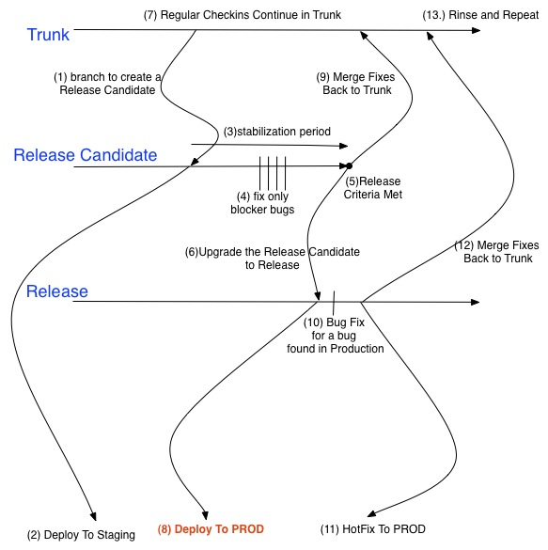
Release Process

Slide 34
Where is Databus Run?
EI ( v2 – 4 machines, v1 appx 10 )
Staging Beta ( v2 – 6 machines, v1 appx 10 )
Staging Alpha ( Phasing out )
Production (

