Slide 1
Databus Training
3/20/2012

Slide 2
Overview
Provides a stream of update events from a source database
Persistent publish/subscribe with point-in-time indicator: SCN (System Change Number)
Publish is implicit via database updates
Examples: DS inserts/updates data; DBA updates
Subscribe (conceptual): getUpdates(sinceSCN, sources, callback, timeout)
Examples: graph engine; search engines; caches; replica databases
Implemented for Oracle
Incoming support for Espresso

Slide 3
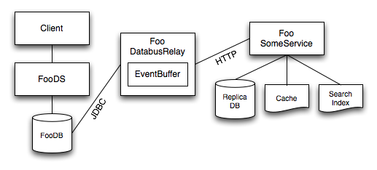
Architecture

Slide 4

How Databus Works
Search Index
Auth cache
member_profile
member_account
txn | . . .
 | Robert
txn | . . .
 | bob@gmail.com
101
101
scn>1200
101, 66
66
scn>1210
sy$txlog
txn | scn | ts | mask
101 | 1234 |  | 00101
scn>1233
101, 66
Member2
relay
66 | 1235 |  | 00100
123 | 1236 |  | 00010
123
66

Slide 5
V1 Modes of Operation
originDatabus:databus.type
http: HTTP RPC mode – client-to-relay or cascaded relays
db: relay-to-DB or client-to-DB
Chunking (originDatabus:dbDatabus.chunkedScnThreshold)
-1: No chunking
> 0: chunking is enabled
Relay proxy mode

Slide 6
Chunking
Disabled: chunkedScnThreshold == -1, useRowChunking = N/A
Row chunking: chunkedScnThreshold > 0 (e.g. 20000), useRowChunking = true (default)
rowsPerChunk - chunk size (in # of rows)
SCN chunking (legacy): chunkedScnThreshold > 0, useRowChunking = false
Use only by request from DBAs!

Slide 7
Event Buffer and SCN Persistence
Event buffer contents (and last SCN!) persisted through shutdown/restart (the databus cache)
Location /export/content/<service>/i001_caches/<service>/databusrelay.cache
Big buffers can slowdown startup/shutdown
If cache is absent, relay will start with an empty buffer and from the most recent update in the DB
Crash after long uptime – persisted state too old
Copy from a different relay
If the relay fails to load cache on startup
Cache is corrupted (e.g. a crash on shutdown)
Event schema has changed
In both cases, need to copy/remove cache

Slide 8
Logging
Location: /export/content/glu/apps/<service>/i001/logs/<service>_databus.log
Typical messages:
2011/08/17 00:00:00.458 INFO [EventBuffer] 73 updates => wt:269;db:415;cb:4=419
events => bop=178003711049 eop=178003711384 member_account_1=3 member_account_2=3 member_profile=13 member_search_profile_1=16 member_search_profile_2=16 member_setting=4 privacy_settings_102=6 privacy_settings_103=6 privacy_settings_104=6
NEW!(doGetUpdatesThread) 15 updates => wt:31648;db:76028;cb:80=76108;oqps: 0.18;dqps: 0.14
https://iwww.corp.linkedin.com/wiki/cf/display/ENGS/Databus+Logging

Slide 9
Chunking Mode
Sample log
2011/08/17 18:21:48.255 INFO [sdr_people_search_p22_6] row chunking mode: 178044770079
2011/08/17 18:21:48.561 INFO [sdr_people_search_p23_6] row chunking mode: 178044770005
2011/08/17 18:21:48.933 INFO [sdr_people_search_p24_6] row chunking mode: 178044770061
2011/08/17 18:21:49.241 INFO [sdr_people_search_p25_6] row chunking mode: 178044770009
2011/08/17 18:21:49.717 INFO [sdr_people_search_p26_6] row chunking mode: 178044770086
2011/08/17 18:21:50.570 INFO [sdr_people_search_p27_6] row chunking mode: 178044770045
2011/08/17 18:21:53.639 INFO [sdr_people_search_p28_6] row chunking mode: 178044770066
2011/08/17 18:21:54.021 INFO [sdr_people_search_p22_7] row chunking mode: 178044770079
2011/08/17 18:21:54.355 INFO [sdr_people_search_p23_7] row chunking mode: 178044770005
2011/08/17 18:21:54.721 INFO [sdr_people_search_p24_7] row chunking mode: 178044770061
2011/08/17 18:21:55.060 INFO [sdr_people_search_p25_7] row chunking mode: 178044770009
2011/08/17 18:21:55.549 INFO [sdr_people_search_p26_7] row chunking mode: 178044770086
2011/08/17 18:21:56.406 INFO [sdr_people_search_p27_7] row chunking mode: 178044770045
2011/08/17 18:21:59.468 INFO [sdr_people_search_p28_7] row chunking mode: 178044770066
2011/08/17 18:21:59.485 INFO [EventBuffer] 2046 updates => wt:621;db:11209;cb:5=11214
events => bop=178044759307 eop=178044770086 sdr_people_search_p22_6=56 sdr_people_search_p22_7=56 sdr_people_search_p23_6=48 sdr_people_search_p23_7=48 sdr_people_search_p24
_6=59 sdr_people_search_p24_7=59 sdr_people_search_p25_6=50 sdr_people_search_p25_7=50 sdr_people_search_p26_6=80 sdr_people_search_p26_7=80 sdr_people_search_p27_6=147 sdr_
people_search_p27_7=147 sdr_people_search_p28_6=583 sdr_people_search_p28_7=583
2011/08/17 18:23:58.875 INFO [EventBuffer] 26 updates => wt:5554;db:2275;cb:1=2276
events => bop=178044770086 eop=178044770147 sdr_people_search_p23_6=2 sdr_people_search_p23_7=2 sdr_people_search_p24_6=4 sdr_people_search_p24_7=4 sdr_people_search_p26_6=2
sdr_people_search_p26_7=2 sdr_people_search_p27_6=1 sdr_people_search_p27_7=1 sdr_people_search_p28_6=4 sdr_people_search_p28_7=4
2011/08/17 18:24:33.636 INFO [EventBuffer] 5176 updates => wt:2410;db:32344;cb:7=32351

Slide 10
Monitoring
InGraphs: http://ingraphs.prod.linkedin.com/dashboard/databus
Databus Sensor:
TimeSinceLastEvent: http://ingraphs.prod.linkedin.com/service/member2-databusrelay/member2-databusrelay-i001-databus-sensor---member2-eventbuffer-timesincelastevent_value?fabrics=ela4
SecondsSinceLatestEventOrigin: http://ingraphs.prod.linkedin.com/service/member2-databusrelay/member2-databusrelay-i001-eventbufferdatabus-secondssincelatesteventorigin_value?fabrics=ela4
New Autometrics: https://iwww.corp.linkedin.com/wiki/cf/display/ENGS/Databus+V1+Anatomy#DatabusV1Anatomy-AutometricsenabledSensors

Slide 11
Configuration
Sample
Type: databus.type=db
DB poll interval: dbDatabus:dbDatabus.alertDelay=250
Enable/Disable chunking: dbDatabus:chunkedScnThreshold=-1
Enable/Disable row chunking: dbDatabus:dbDatabus.useRowChunking=true
Row chunk size: dbDatabus:dbDatabus.rowsPerChunk=1000
DB query hint: dbDatabus:dbDatabus.hintsString=
Row chunking DB hint: dbDatabus:dbDatabus. rowChunkingHintsString=
Max # of proxy connections in relay: databusConnectionPool.maxConnections=3

Slide 12
Databus 2.0 Features
Wiki: Databus 2.0
Complete rewrite of Databus v1
Versioning and Serialization improvements
Convergence on schema definition, evolution and serialization with Tracker
Bootstrap DB to support efficient and seamless bootstrap
Persistent Events Log to support larger event window
Destination sharding to support horizontal scaling for consumers
Simplified creation of new Databus clients and relays
Enabling source sharding for horizontal scaling for producers

Slide 13
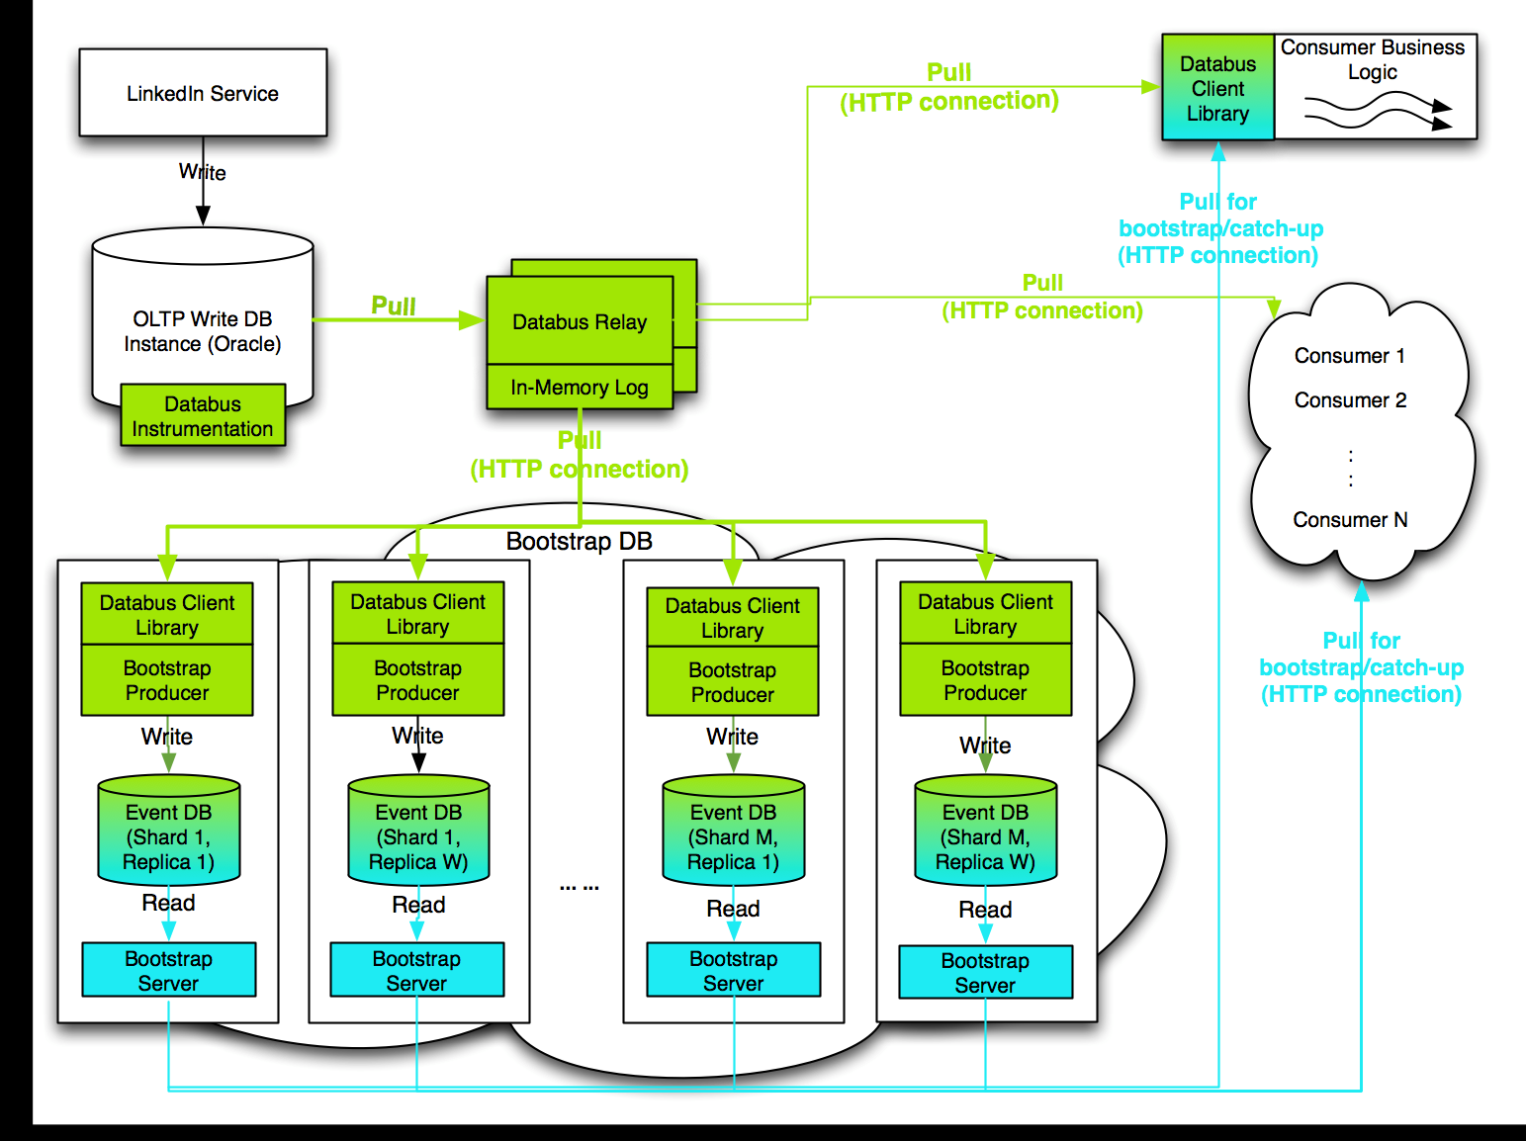
Databus v2 Architecture

Slide 14
Logging (Relays)
https://iwww.corp.linkedin.com/wiki/cf/display/ENGS/Databus+2.0+Logging
forum_relay_dbevents.log
src:com.linkedin.events.forum.CommentWithDiscussionDTO(701) #src:1 #evt:1 scn:212849782412 ms:3
src:com.linkedin.events.forum.DiscussionDTO(702) #src:1 #evt:2 scn:212849782412 ms:2
src:forum(0) #src:2 #evt:3 scn:212849782412 ms:8
forum_relay_httpin.log
2011/08/17 19:00:01.719 +3174601579 > 172.17.138.248 CONNECT /START 0 200 0.00 0.00 0
2011/08/17 19:00:01.720 +3174601580 > 172.17.138.248 GET /databus2-relay-bizfollow/admin 0 200 0.12 0.53 5
2011/08/17 19:00:01.841 +3174601701 > 172.17.138.248 CONNECT /END 0 200 0.00 0.00 5
2011/08/17 19:00:01.895 +3174601755 > 172.17.138.246 GET /stream?sources=101&checkPoint={"snapshot_offset":0,"windowScn":178046401016,"consumption_mode":"ONLINE_CONSUMPTION"
,"windowOffset":-1}&output=binary&size=102400&filters={} 0 200 0.21 0.38 0
forum_databus_relay.log – everything else

Slide 15
Logging (Clients)
liarApplication_databus.log
[LoggingConsumer] (pool-54-thread-1) bst: 1 updates => wt:534.821;cb:1.109
events => bop=212852035768 eop=212852039395 LiarJobRelay=1 (0.628 ms)

Slide 16
Logging (Bootstrap Producers)
https://iwww.corp.linkedin.com/wiki/cf/display/ENGS/Databus+2.0+Logging
liar_databus2_bootstrap_producers.log
[LoggingConsumer] (pool-9-thread-1) +1712591650 str: 21 updates => wt:612.897;cb:7.955
events => bop=212770852916 eop=212770853061 LiarMemberRelay=21 (5.270 ms)
liar_databus2_bootstrap_applier.log
2011/08/17 19:00:08.480 +2389065321 last line repeated: 4
2011/08/17 19:00:08.480 +2389065321 Applier state : 201 3 263235 178046406923
2011/08/17 19:00:08.494 +2389065335 last line repeated: 1
2011/08/17 19:00:08.494 +2389065335 Applier state : 202 240 170264 178046409282
2011/08/17 19:00:08.495 +2389065336 last line repeated: 1
2011/08/17 19:00:08.495 +2389065336 Applier state : 201 3 263244 178046409282
liar_databus2_bootstrap_producers_httpout.log
2011/08/17 19:00:02.930 +2389059771 < 172.17.154.230 GET /stream?sources=202,201&checkPoint={"snapshot_offset":0,"windowScn":178046405148,"consumption_mode":"ONLINE_CONSUMPTION","windowOffset":-1}&output=binary&size=102400&filters={} 0 200 0.88 0.89 0
2011/08/17 19:00:03.550 +2389060391 < 172.17.154.230 GET /stream?sources=202,201&checkPoint={"snapshot_offset":0,"windowScn":178046405223,"consumption_mode":"ONLINE_CONSUMPTION","windowOffset":-1}&output=binary&size=102400&filters={} 0 200 0.96 0.97 0

Slide 17
Logging (Bootstrap Server)
https://iwww.corp.linkedin.com/wiki/cf/display/ENGS/Databus+2.0+Logging
databus2_bootstrap_server.log
[BootstrapRequestProcessor] (pool-7-thread-16) +3542536 Bootstrap request received: fetchSize=101147, consumptionMode=BOOTSTRAP_CATCHUP, checkpoint={"windowOffset":561325,"snapshot_offset":-1,"windowScn":176858211457,"consumption_mode":"BOOTSTRAP_CATCHUP","bootstrap_since_scn":175768070036,"bootstrap_start_scn":176856924027,"bootstrap_target_scn":176858254095,"snapshot_source":"com.linkedin.events.bizfollow.bizfollow.BizFollow","catchup_source":"com.linkedin.events.bizfollow.bizfollow.BizFollow"}
[BootstrapConn] (pool-7-thread-16) +3542537 srcid=101 status=4
[BootstrapConn] (pool-7-thread-16) +3542537 logid for catchup:7
[BootstrapConn] (pool-7-thread-16) +3542538 logid for catchup:7
[BootstrapProcessor] (pool-7-thread-16) +3542548 Terminating batch with result: isLimitExcceed=false; processedRowCount=311
(END)
databus2_bootstrap_server_httpin.log
2011/08/17 19:56:43.520 +2392439402 > 172.17.139.247 CONNECT /START 0 200 0.00 0.00 0
2011/08/17 19:56:43.522 +2392439404 > 172.17.139.247 GET /databus2-bootstrap-server/admin 0 200 0.15 0.76 5
2011/08/17 19:56:43.632 +2392439514 > 172.17.139.247 CONNECT /END 0 200 0.00 0.00 5

Slide 18
Monitoring
http://ingraphs.prod.linkedin.com/dashboard/databus2_bizfollow_e2e
http://ingraphs.prod.linkedin.com/dashboard/databus2_e2e_conn?fabrics=ela4
https://iwww.corp.linkedin.com/wiki/cf/display/ENGS/Databus+v2.0+Monitoring#Databusv2.0Monitoring-Databus%26nbsp%3BAlerts
Autometrics contain *databus2*

Slide 19
Configuration
https://iwww.corp.linkedin.com/wiki/cf/display/ENGS/Databus+v2.0+Configuration+Properties
State
Relay
SCN directory: databus.relay.dataSources.sequenceNumbersHandler.file.scnDir
Latest read SCN: /export/content/data/databus2-relay-XXX/i001/maxScn/MaxSCN_XXX
Bootstrap producer:
Checkpoints directory: databus.bootstrap.producer.client.checkpointPersistence.fileSystem.rootDirectory
/export/content/data/databus2-bootstrap-producer-XXX/i001/checkpoints
Client
Checkpoints directory: databus.client.checkpointPersistence.fileSystem.rootDirectory

Slide 20
Databus Roadmap
Launched: Liar-App, Liar Job Recommendation, Liar Member Search, Bizfollow, Forum-search
Dark Launch: Anet, Conns, (partial) Member2, Mbrrec
Coming: CAP prospect history, news slices
Espresso
Member2

Slide 21
Links
https://iwww.corp.linkedin.com/wiki/cf/display/ENGS/Databus
Databus v1
https://iwww.corp.linkedin.com/wiki/cf/display/ENGS/Databus+Logging
Databus v2
https://iwww.corp.linkedin.com/wiki/cf/display/ENGS/Databus+2.0+Support+and+Site-Up
https://iwww.corp.linkedin.com/wiki/cf/display/ENGS/Databus+v2
https://iwww.corp.linkedin.com/wiki/cf/display/ENGS/Databus+2.0+Deployment+and+Operability+Documents

