Slide 1
Distributed Data Systems Q2 – 2011 New Hire Bootcamp
Lei Gao
Chavdar Botev

Slide 2
DDS Team
Distributed Data Systems
Infrastructure (technology projects)
Databus, message queuing, Media Server, ESPRESSO, Scheduler, Voldemort, Kafka
Working model: some projects are “standalone”, some are “embedded” with other teams/projects
Common technology model: open source plus “wrapping” with LI-specific features

Slide 3
Topics
Data Services (DS) and Data Access
Data Service Context (DSC)
Caching
Media Backend Service
Databus

Slide 4
Learning Objectives
Gain an overview of the services supported by the DDS team
Learn the common practices for data access and caching

Slide 5
Data Service and Data Access
Key Questions to be Addressed:
How does Data Service (DS) fit into the LinkedIn stack?
How do the services interact with the storage tier?
How is data access handled?

Slide 6
Data Service
DS is one of the building blocks of our SOA scheme along with others such as BPS, Frontier, etc.
The granularity of a DS is a functional application domain: member2, comm, anet, subs, etc.
Allows separation of concerns for both
Development: have a clean isolated layer for interacting with a domain’s data store
Operations: monitor and manage data-related concerns (e.g., tuning connection pools etc.)
Protects the database from app servers
E.g. prevent connection storm DDOS from hundreds of app servers

Slide 7
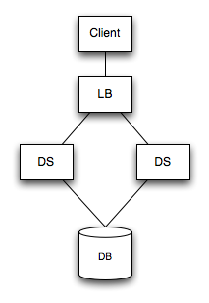
Data Service Topology
DS HA via multiple instances
DB HA via specialized hardware (storage array etc)

Slide 8
Data Stores: Oracle
We are an Oracle shop
In PROD, we have about 50 Oracle schemas running in about 20 physical Oracle instances
In DEV, we run Oracle in VMWare on our Mac towers
Each schema corresponds to a domain as discussed earlier: member2, comm, anet, subs, etc.
In the source tree: one directory per schema with schema definition and test data:
ls $LEOHOME/database

Slide 9
Data Stores: Other
The “default” is Oracle, but we do use other systems
Voldemort
Open source project founded by a LI engineer; several contributors here
Initially for offline data store (batch, analytics), now used for some online uses
MySQL (mostly deprecated)
Krati
Tesoro (in design/prototype) – next gen online datastore

Slide 10
Data Access and Transactions
util-sql module has our transaction manager and utility/integration code for data access
Wiki: Transaction Manager; Autocommit
DBExecManager
ITransactionManager, AutoCommitExecutor
execute(DBExecCallback callback)
gives you access to (pooled) db connection, JdbcTemplate, DBInterface
Recommendation: Use AutoCommit unless you have a specific need otherwise

Slide 11
Writing Data Access Code
Several approaches available
Each team/project can do as they wish
However, before introducing a new framework (iBatis or whatever) talk to DDS team
JDBC: raw JDBC + LI DBInterface
Utility methods for standard operations (getXml, isConstraintViolated, etc.)
Spring JdbcTemplate
Convenient wrapper around JDBC (PreparedStatementSetter, ResultSetExtractor, RowCallbackHandler, etc.)
Hibernate
Object/relational mapping framework

Slide 12
Data Service Context (DSC)
DSC is a token used to ensure that a reader always sees his or her own writes.
Read-own-writes: If I update my own status, it is okay if you don’t see the change for a few minutes, but I have to see it immediately
Typical LinkedIn topology uses a read/write “core” database and a set of read-only replica databases for each data domain
DSC lets us track a user’s writes so we can ensure her reads are not served by a stale replica
DSC is also used to detect and invalidate stale cache entries in “mid-tier caches” that are not actively invalidated by the data layer

Slide 13
Typical LinkedIn Stack
Frontend
Mid-tier services talk to replica data service (Rep DS)
Rep DS talks to read-only replica database (Rep DB)
Most reads can be served from the replica
All writes are forwarded to the Core DS, which writes to the Core DB.
Changes are replicated to Rep DBs asynchronously, so Rep DBs are always “a little behind” the Core DB.
If a user has a recent write which is not yet replicated to the Rep DB, then their reads are forwarded to the Core DB.
Memcache scattered throughout
Mid Tier
memcache
Rep DS
r/o
Rep DB
r/w
Core DB
Core DS
r/w

Slide 14
How DSC works
A DSC token generated by a DS each time a user does a write. It includes the database domain (MBR2, COMM, etc.) and the timestamp of the write.
Each member has her own DSC with her most recent write to each domain. It is stored in a browser cookie and in the “DSC Store” service – used by API and mobile clients which do not support cookies.
The process to ensure a reader sees her own writes is as follows:
Every read is initially routed to a random Rep DS instance. That Rep DS looks at the DSC entry for the current domain.
The DSC timestamp is compared to the timestamp for the latest event replicated to the Rep DB. If the latest Rep DB event is newer than the DSC timestamp, or if there is no DSC entry (no recent writes), then the Rep DB is sufficiently up to date to process this read.
If the RepDB is older than the DSC, then the read is forwarded to the CoreDS

Slide 15
What this means to you
Most of this is automatic, but if you ever write a data service (DS), you must:
annotate the read and write interfaces
wrap your DS in a read/write tracking proxy
update the DSC Domain Registry Wiki page
Even if you think your database is not replicated, you still need this for proper multi-datacenter behavior and cache staleness detection.
Tracking proxy is mandatory; Routing proxy is optional

Slide 16
Annotation Pattern
You can annotate methods or entire interfaces
We recommend annotating interfaces so each method you add in the future automatically gets the proper behavior
@DataReadAction
public interface FooReadDal
public FooDTO getFoo(int id);
. . .
@DataWriteAction
public interface FooDal extends FooReadDal
public void updateFoo(FooDTO foo);
. . .

Slide 17
Proxy Pattern
Example of wiring a ReadWriteTrackerProxy around your DAL implementation (from member2/rep-cmpt/components/dal.spring):
<lin:component id="rwTrackerDal" location="dal-rwtrack-proxy-cmpt"> <lin:wire bean-name="iFaces" bean-value="readWriteIFacesArray"/> <lin:wire bean-name="delegate" bean-value="**yourDalBean**"/> <lin:wire bean-name="domain" bean-value=“**yourDomainIDConstant**"/> </lin:component>

Slide 18
Caching
In-process
Java Map or similar
EHCache (with LI wrapper)
Out-of-process
memcached (with LI client)
Flip between cache impls based on config:
<lin:bean id="memrepCacheNoOpcache" class="com.linkedin.cache.impl.NoOpCache" />
<lin:component id="memrepCacheEhcache" location="cache-ehcache-cmpt" . . .
<lin:component id="memrepCacheMemcache" location="cache-memcache-cmpt" . . .
<lin:dynAlias current-bean="memrepCache${member2repreader.cache.kind}" new-bean="memrepCache"/>

Slide 19
Memcache highlights
In DEV, memcached runs in VMWare (devdb:11211)
Granularity and type of objects in cache
Cache coherence and invalidation
Watch for race between put and delete
Wiki: DAL Caching and Replication
Sharing a cache for multiple realms in the same domain
member2: acct1234 and prof1234
Wiki: Cache Key Prefixes

Slide 20
Media Backend Service
Web application that manages (store, delete, fetch) media content and its meta data
Types of media
Profile and Group pictures, Company logos
Ad media (pictures)
Stores data in two locations
Physical media on file system
Media meta data in database
Media service clients
Media frontend server, Upload server, application clients
Notes:
Media backend service is a web application that serves media files to calling applications. It basically includes storing, deleting, fetching media content and meta data. Meta data contains media Id, content type, size, creation date, and whether it is persisted in the storage.
On our website the media basically includes profile, group pics, company logos, advertising pics, etc. In future, we are planning to include video files too in media list.
Physical media content (files) are stored on network filer (file system) and media meta data is stored in backend database. These two locations are being accessed by various services for media content and its meta data.
Client services that access Media backend service include Media frontend server, upload server, SAS, etc. These services some times directly access filer for media content. For example, Media frontend server accesses filer directly to fetch media content without accessing Media backend service. It is done for optimization purpose.

Slide 21
Media Backend Service
Media Frontend Server
Upload Server
Client
Store Media
Get Meta data
Store Media
Store Media
Media Backend Service
Get Media
Store Media
Store Meta Data
Filer
DB
Notes:
This is the high level diagram of how Media backend service is involved in various media interactions.
In most of the cases, Media frontend server directly accesses the filer to get (read) media.
Media backend is responsible for storing, deleting media content in the filer and meta data in database.

Slide 22
Media Backend Service
Network module on svn – ‘media/backend-*’
Technologies used
Programming – Java, LinkedIn Spring, Build framework (Ant, ivy, etc)
File system (filer) – NetApps (NAS, RAID disks)
Database – Oracle
API
MediaService - Provides methods to access media metadata and does management of media
MediaDataService - Provides access to the actual media (put, get)
Wiki: Using medias for product features
Notes:
You will find Media backend service code in ‘media’ module on our network code base.
All the programming is done using Java and Spring (LinkeIn Spring) framework. This module is built by building a war file using our standard LinkedIn build framework (uses Ant, ivy etc). Physical media content is stored on NetApp’s Network Attached Storage (NAS) and RAID disks and media meta data is stored in Oracle database.
There are two interfaces using which Meida BE service can be accessed. While MediaService manages media and meta data, MediaDataService provides direct access to media content.
It is important to consider whether a media is required to be stored as it involves storing physical media (bytes) on the disk and storing information about the media in database. Once the media is stored, it is possible that database can be queried for multiple data related to media. It involves in lot of IO operations. As there are millions of media with our huge user base, storing and fetching media is critical and should be avoided if necessary.

Slide 23
Media Backend Service
Deployment details
Backend container (Jetty)
Media repository (NAS)
#of servers – 3
#of media files ~ 50M
Current limitation
Filer capacity
Notes:
This application is deployed in backend-container on Jetty. All the media is stored in media repository on NAS. In PROD there are three servers for Media backend service that currently serve around 50M media files.
We are growing rapidly in terms of #of user profiles, #of groups, and #of companies on our website. All these features can utilize media (mainly pictures) in their respective modules. With this, we are reaching our filer capacity faster. Per SysOps, we have to look into more capacity. Also, with lot of media requests, it is necessary that we optimize our media services (both front end backend) so that media can be served in a better, faster, and reliable manner. SysOps is looking into considering 3rd party solutions such as DataDirectNetwork’s WebObjectScaler. They haven’t decided on any specific solution.

Slide 24
Databus
Provides a stream of update events from a source database
Implemented for Oracle
Persistent publish/subscribe with point-in-time indicator: SCN (System Change Number)
Publish is implicit via database triggers
Examples: DS inserts/updates data; DBA updates
Subscribe (conceptual): getUpdates(sinceSCN, sources, callback, timeout)
Examples: graph engine; search engines; caches; replica databases

Slide 25
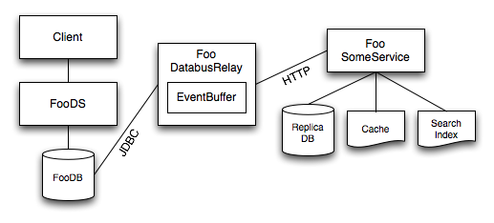
Databus Architecture

Slide 26

How Databus Works
Search Index
Auth cache
member_profile
member_account
txn | . . .
 | Robert
txn | . . .
 | bob@gmail.com
101
101
scn>1200
101, 66
66
scn>1210
sy$txlog
txn | scn | ts | mask
101 | 1234 |  | 00101
scn>1233
101, 66
Member2
relay
66 | 1235 |  | 00100
123 | 1236 |  | 00010
123
66

Slide 27
EventCallback
Databus notifies for new events using your EventCallback
Data change event into app space (vs database-specific replication technologies which are DB-to-DB only) : use it as we wish
Use cases include:
Homogeneous replication (Oracle ==> Oracle)
Hetereogeneous replication (Oracle ==> MySQL or Voldemort or ...)
Lucene-based search indexes (People Search, Job Search, etc)
Custom indexes and caches (Connection Graph, Email Lookup Service, etc)

Slide 28
EventCallback API
startEvents(long beginningOfPeriod)
startEvents(Source source)
onEvent(Event<K, V> event)
endEvents(Source source)
endEvents(EventsSummary summary)
Outermost begin/endEvents: an "event period”/"event cycle”
Only events that were committed after the previous event period
No guarantee of any ordering within an event period
Only the most recent data for a row
Sources are notified in predetermined order: e.g, member_account before member_profile

Slide 29
Using Databus
Wiki: Databus
Hard deletes not supported; use active=[‘Y’,’N’] column in base table
Make consumer event-processing idempotent
Events are guaranteed to be seen at-least-once, not exactly-once
SCN management – persist conservatively for safety
Example: replica db: update data; update SCN; commit
Example: in-memory custom index: persist to flat file at shutdown and every N updates and/or seconds
It’s OK for saved SCN to be a bit behind - but never ahead!

Slide 30
Areas for Improvement in Databus
Data transport: serialization and versioning
Custom serialization impacts operability and extensibility
Manual Bootstrapping and Catchup
Frequent occurrence in staging and prod
Enormous time commitment from Site Ops/DB Ops to babysit and resolve
Developer productivity
Setting up a new relay and client is tedious and involves lots of non-obvious Spring wiring
Scalability bottleneck
No standardized multi-threaded consumer support
No standardized multi-process consumer support
No standardized source sharding support

Slide 31
Databus 2.0 Features
Wiki: Databus 2.0
Complete rewrite of Databus v1
Versioning and Serialization improvements
Convergence on schema definition, evolution and serialization with Tracker
Bootstrap DB to support efficient and seamless bootstrap
Persistent Events Log to support larger event window
Destination sharding to support horizontal scaling for consumers
Simplified creation of new Databus clients and relays
Enabling source sharding for horizontal scaling for producers

Slide 32
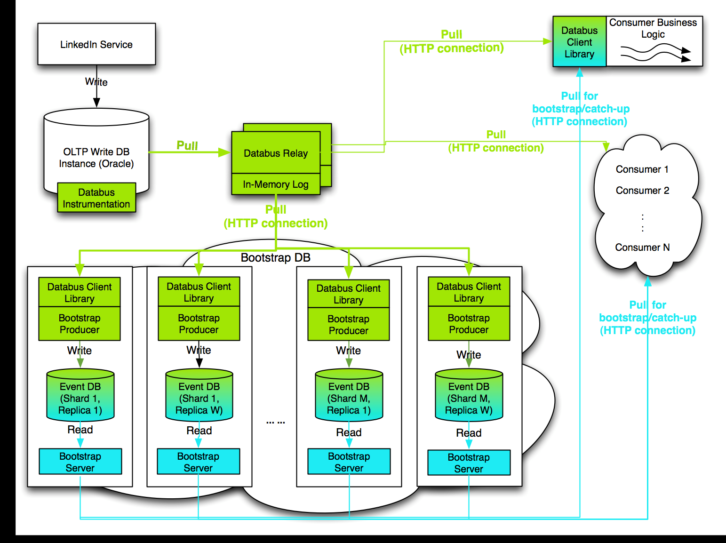
Databus v2 Architecture

Slide 33
Beyond Databus 2.0
Databus 2.1+
Push interface for MySQL Databus
MySQL binlog integration
Improvements to consumer partitioning and load balancing
Databus 3.x
Source partitioning and rebalancing
Scalability and performance tuning
Support for DR Replication

