Slide 1
Databus
2/16/2011
Mitch Stuart

Slide 2
What is databus?
A near-real-time data change event stream. A way to ask "what data has changed since point X in time?"
Typically: "what data has changed since the last time I asked?"
Examples: what new connections have been added between members? which profiles have been updated?
How "near" to real-time?
Under normal conditions, consumers should see data events less than 1 second after they are committed
Events will be delayed if the source db is overloaded, or your consumer is backlogged processing events
Guaranteed at-least-once delivery
In almost all cases: exactly-once delivery (more on this later)
Circa 1/2011 there are 103 services in the LI stack that are databus consumers

Slide 3
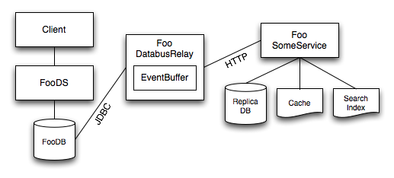
Databus Topology

Slide 4
SCN
Oracle "System Change Number" – ever-increasing long integer
When we ask "what data has changed since point X in time?" - SCN is the X "point in time" marker

Slide 5
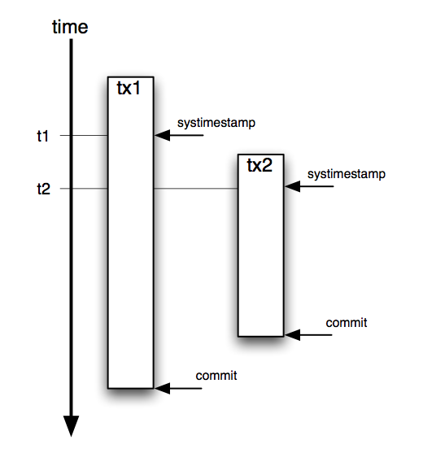
SCN vs. timestamp or sequence
SCN is assigned at the time of transaction commit, thus giving us a true ordering of events
Timestamp or sequence is assigned at the time of statement execution
Using timestamp or sequence can cause loss of events, as shown in diagram
You can try to work around this by using "padding" in the timestamp query, or by using batch jobs to find missed events – but SCN is a more reliable and real-time mechanism.
Diagram: Jean-Luc Vaillant, LinkedIn co-founder and CTO, QCon 2007

Slide 6
Transaction Log
sy$txlog table
domain table
sy$<source> view
txn | scn | ts | mask
txn | . . .
txn | key | . . .
Examples:
member_account
member_profile
sy$member_account
sy$member_profile
A row in sy$txlog represents a db transaction
The txn column holds a normal Oracle sequence number (as opposed to the "special" scn)
txn is only used for joining, not for ordering
A single sy$txlog row is associated with one or more domain rows in one or more domain tables
Example: new member joins, a row is added to both member_account and member_profile
Example: batch updates such as scheduled tasks or DBA maintenance/grandfathering
sy$txlog is occasionally pruned manually by DBAs

Slide 7
EventCallback
The way that your code receives events is by having databus invoke your EventCallback
The callback gets the data change event into app space, where we can use it as we wish - as opposed to database-specific replication technologies which are DB-to-DB only
Use cases include:
Homogeneous replication (Oracle ==> Oracle)
Hetereogeneous replication (Oracle ==> MySQL or Voldemort or ...)
Lucene-based search indexes (People Search, Job Search, etc)
Custom indexes and caches (Connection Graph, Email Lookup Service, etc)

Slide 8
EventCallback API
startEvents(long beginningOfPeriod)
startEvents(Source source)
onEvent(Event<K, V> event)
endEvents(Source source)
endEvents(EventsSummary summary)
Each outermost begin/endEvents is called an "event period" or "event cycle"
EventsSummary.getEndOfPeriod is the maximum SCN for the current period, and is used as beginningOfPeriod for the next period
You see sources in the order that you declare them in your spring file. For example, member_account and then member_profile.
Each event period is guaranteed to contain only events that were committed after the previous event period
There is no guarantee of any ordering within an event period
You are not guaranteed to see every event affecting a row - only the most recent event (i.e., the most recent data for that row). More on this later.

Slide 9
EventCallback Invocation
Databus is a pull model
DatabusConnection API:
EventsSummary getUpdates(
Timespan timeout,
EventCallback callback)
But almost all consumers use the push adapter: DatabusConnectionPushImpl
Wire in your callback via Spring, and it will be called "forever" until your process shuts down

Slide 10
Reading Databus Logs
Example: els_databus.log:
2011/02/16 00:48:44.084 INFO [Databus] 9 updates => wt:747;db:1;cb:0=1
events => bop=157524853324 eop=157524853439 member_emails=9
wt: time waiting for event to arrive
db: time to query for events
cb: time to invoke your callback
bop: starting SCN you asked for in getUpdates
eop: SCN of latest event in period
All events in the period have SCN > bop and SCN <= eop

Slide 11
How fast is databus?
"It depends"
Comparison of processing time for an event period with 9 events (on PROD, 2/16/2011)
Service | db | cb | Description
member2- databusrelay | 103 | 0 | Read from DB and write to RAM EventBuffer
member2rep | 3 | 122 | Read from relay buffer via http and write to replica database
els | 1 | 0 | Read from relay buffer via http and write to RAM data structure

Slide 12
Developer Tips 1
Manage SCN and your data store/cache conservatively
Example: replica db: update data; update SCN; commit
Example: in-memory custom index: persist to flat file at shutdown and every M updates and/or N seconds
It’s OK for saved SCN to be a bit behind - but never ahead!
If your saved/last-known-good SCN is behind, you will see events multiple times (exactly-once vs. at-least-once)
Can happen during Ops maintenance; or due to non-orderly shutdown of your consumer process; or due to transient exception when processing a batch of events
Write idempotent event handlers
In case you see an event multiple times
Do not depend on ordering within an event period
Test with databusrelay in dev
Whenever you add or change databus sources
To catch errors before Staging
For example, in ~/.override.properties set:
member2rep.databus.type=http (default in dev/qa =db stg/prod =http)

Slide 13
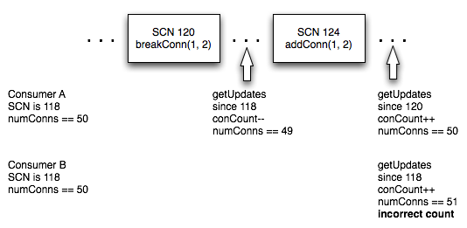
Developer Tips 2
Be aware that events in a period are coalesced
In each event cycle, you see a maximum of one event per key, per source – you see the latest state of that domain object. You are not guaranteed to see every state transition.
Imagine that you are counting member connections, and as of SCN 118, member 1 has 50 connections

Slide 14
Databus Limitations
Hard deletes not supported; use active=[‘Y’,’N’] column in base table
Boilerplate copy/paste for db schema (procs, triggers) and spring wiring (databus pre-dates LI Spring, and was never properly componentized)
Only supports Oracle (not MySQL, Voldemort, ...)
Brittle data marshalling (AnnoMarshaller)
Bootstrapping: need DBA help or custom bootstrap app
No early filtering of events (e.g., for index sharding)
Databus v2 is under active development!

Slide 15
Databus DB Internals 1 (simplified)
Producer: databus trigger calls PL/SQL sync_core.getTxn:
insert into sy$txlog(txn, scn, mask) values(currentTxn, infinity, currentMask);
Maintainer: scheduled coalesce_log proc does:
update sy$txlog set scn=ora_rowscn where scn=infinity;
Why: ora_rowscn is a pseudocolumn that cannot be indexed – it is slow to query. So we query against scn column.

Slide 16
Databus DB Internals 2 (simplified)
Consumer: databus query does:
select
sync_core.getScn(tx.scn, tx.ora_rowscn) scn,
tx.ts event_timestamp,
src.*
from
sy$<source> src, sy$txlog tx
where
src.txn=tx.txn and
tx.scn > ? and
tx.ora_rowscn > ?

Slide 17
Wiki Pages
Databus
HowTo Databus
Databus Logging
Databus Bootstrapping
SCN Velocity
HowTo AnnoMarshaller
Databus v2.0

Slide 18
Questions?

