Slide 1
Databus v2 Migration
Balaji Varadarajan , Sunil Nagaraj LinkedIn Tech Talk, 11/16/2011

Slide 2
Overview
Databus V2 System
Why Migrate
How to Migrate
Client Development
Migration Patterns
Pilots

Slide 3
DatabusV2 System
Application
Databus Client
Databus Client Lib
Databus
Consumer
Databus
Consumer
Databus
Consumer
M
Subscribe to sources
DB
Events in Memory
DB
rows
events
Relays
events
table
view
Application
table
view
Snapshot Store
Snapshot Store
Databus Client
events
Sources
Databus Client Lib
Databus
Consumer
Databus
Consumer
Subscribe
to sources
Databus
Consumer
Bootstrap Service
DatabusV2
Event Stream
Notes:
- All components in blue are databus2 owned/developed
- Source instrumentation : nothing changes
Differentiate : Client and Consumer
- Databus Client Library : Defines Callback API and provides functionality to get event stream from databus2 event stream.
-Databus Client : Refers to the instance of Databus Client Library with registered consumers
- Many Databus Clients on a single machine.
-Consumer Callback is process logic for the change eventts. It implements callbacks exposed by databus client library.
-- Many consumers per databus client.

Slide 4
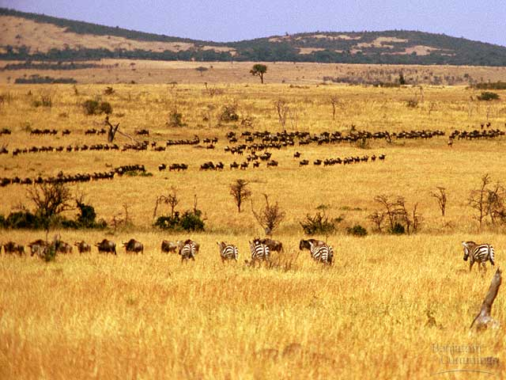
Why Migrate?

Slide 5
Why Migrate?
Supports Common Use Cases of Databus Consumers
Consumers seamlessly bootstrap
No load on primary Database
Custom bootstrap from warehouse not necessary
Lagging consumers automatically switch to snapshot store
No load on primary Database
No SRE intervention
Gracefully handles schema changes of sources
No need to launch new stream at Relay for schema changes
Sources described by Avro schemas, change events are Avro objects
Notes:
- Although databus consumers are fairly diverse, some unhandled common use-cases are addressed.
Schema Evolution:
Schema of source changes (in a backward compatible way) .
-- Databus 2 event stream always has the object of the latest schema.
-- Databus Client Library contains decoder to convert the latest object to that of an older version.
-- Databus v1 – requires a new stream that contains objects of diff versions of objects.

Slide 6
Why Migrate?
New Ownership Model
Databus2 Event Streams are centrally managed, owned and operated
Relay and Bootstrap Server creation ,deployment and operations
Instrumentation of Primary Database (databusification) for new sources
Databus2 Consumers are provided Databus Client Library
Teams will only be responsible for creating and operating the databus clients
Path to network branch independence

Slide 7
Why Migrate?
Scalability and Operability Features
Support for consumer parallelism
Multiple threads of execution of consumer
Enables faster processing , especially during bootstrap
Server side partitioning
Partitioning key of source should be numeric
No need for consumers to apply filters at the consumer
Consumers define partition type
Range [partition_size, partition_number]
Mod [num_buckets, partition_number]
“Hot Standby” cluster
Services will have one active and n “stand-by” databus clients
Improves fault tolerance
Notes:
Wherever, databus clients write to a secondary store/index , usually, only one instance writes . Should that instance go down, manual/config change required to make one of the other nodes of the service active databus writer.

Slide 8
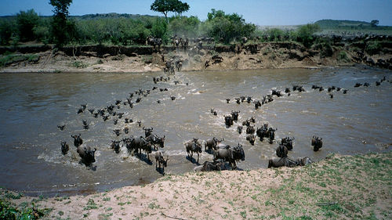
How to Migrate?

Slide 9
How To Migrate
Approximate Timeline
Databus Team
Partner (YOU)
Notify Databus Team ( with capacity estimates if new source)
Day 0
1 – 3 days
Publish Schema
Start Coding Client
1 – 3 days
Publish Dev WARs
2-10 weeks
Test in Dev Env
4-12 weeks
Setup Relay and Bootstrap in EI,Stg
Test in Stg Env
Setup Relay and Bootstrap in Prod
Launch in Prod Env

Slide 10
How To Migrate – Client Library
Databus Client
EEEEEvent Processor
Consumers
Consumers
implement
Databus Client Library
Stream Event Callback
API
Bootstrap Event Callback
API
Client API
register(consumers, sources , filter)
start() ,startAsync()
shutdown(), awaitShutdown()
onDataEvent(DbusEvent, Decoder)
…
…
Notes:
Depict Client Library in the slide.

Slide 11
How To Migrate – Use V1 Callbacks
Steps:
Implement V2 to V1 DTO Converter
Register your consumer to Client Library in code or through spring
Use Databus V1V2 Client Startable (recommended)
Pros:
Few and isolated code changes to migrate
Cons:
Overhead in converting V2 to V1 object
Cannot leverage on Parallel Consumption feature
Wiki:https://iwww.corp.linkedin.com/wiki/cf/display/ENGS/Chapter+V+-+Migration+of+Legacy+Clients+to+Databus+2.0
Notes:
Team ownership of Databus infrastructure – first step toward Databus-as-a-Service

Slide 12
How to Migrate: Databus V2 to V1 Converter
1. /*
2. * Converts Databus V2 to V1 Event object.
3. * LiarEntityUpdateEvent : Databus V1 DTO, LiarMemberRelay : Databus V2 Event Object
4. */
5. public DatabusEventHolder<LiarEntityUpdateEvent> convert
6. ( DatabusEventHolder<LiarMemberRelay> v2EventHolder)
7. {
8. LiarMemberRelay v2Event = v2EventHolder.getEvent();
9. Integer id = (Integer)(v2Event.get(2));
10. String isDeleteStr = v2Event.get(3).toString();
11.
12. boolean isDelete = false;
13. if ( isDeleteStr.startsWith("Y") || (isDeleteStr.startsWith("y")))
14. isDelete = true;
15.
16. LiarEntityUpdateEvent memberEvent = new LiarEntityUpdateEvent(id, MEMBER, isDelete);
17. DatabusEventHolder<LiarEntityUpdateEvent> evtHolder =
18. new DatabusEventHolder<LiarEntityUpdateEvent>();
19. evtHolder.setScn(v2EventHolder.getScn());
20. evtHolder.setEvent(memberEvent);
21. return evtHolder;
22. }

Slide 13
How to Migrate: Databus V1V2ClientStarter
Example:
<lin:bean id="DatabusV1V2Starter"
class="com.linkedin.databus.client.generic.DatabusV1V2ClientStarter">
<property name="v1" ref="databusConnectionPush" />
<property name="v2" ref="databus2LiarClient" />
<property name="v1Enabled" value="${liar_member_relay.databusv1.enabled}" />
</lin:bean>
Databus V1 Client
Databus V2 Client
<entry key="liar_member_relay.databusv1.enabled" value="false" />
In main.spring
<lin:bean id="startables" class="org.xeril.util.CompositeStartable">
<property name="startables">
<list>
<ref bean="DatabusV1V2Starter"/>
</list>
</property>
</lin:bean>

Slide 14
How To Migrate – Using V2 Callbacks
Steps:
Implement Databus V2 Consumer Callback for Stream and bootstrap consumption.
Register your consumer to Client Library in code or through spring
Use Databus V2 Startables to bring up your databus v2 client
Pros:
Can leverage on parallel consumption feature.
Schema Evolution . No need to change V1 DTO
No additional overhead of conversion
Cons:
Requires restructuring of event processing logic
Wiki: https://iwww.corp.linkedin.com/wiki/cf/display/ENGS/Chapter+IV+-+Creating+a+Simple+Databus+2.0+Client
Notes:
Team ownership of Databus infrastructure – first step toward Databus-as-a-Service

Slide 15
How To Migrate – Monitoring
Databus Client Library is integrated with Autometrics
<bean id="databus2ClientSensorFactory" class="com.linkedin.databus.client.DatabusClientSensorFactory" lazy-init="false">
<constructor-arg index="0" ref="sensorRegistry" type="com.linkedin.healthcheck.pub.spring.SensorRegistry" />
<constructor-arg index="1" ref="databus2Client" type="com.linkedin.databus.client.DatabusClientRunnable" />
</bean>
Notes:
Team ownership of Databus infrastructure – first step toward Databus-as-a-Service

Slide 16
How To Migrate – Client Library
Databus Client
Databus Client Library
Stream Event Callback
API
Bootstrap Event Callback
API
Client API
Notes:
Depict Client Library in the slide.

Slide 17
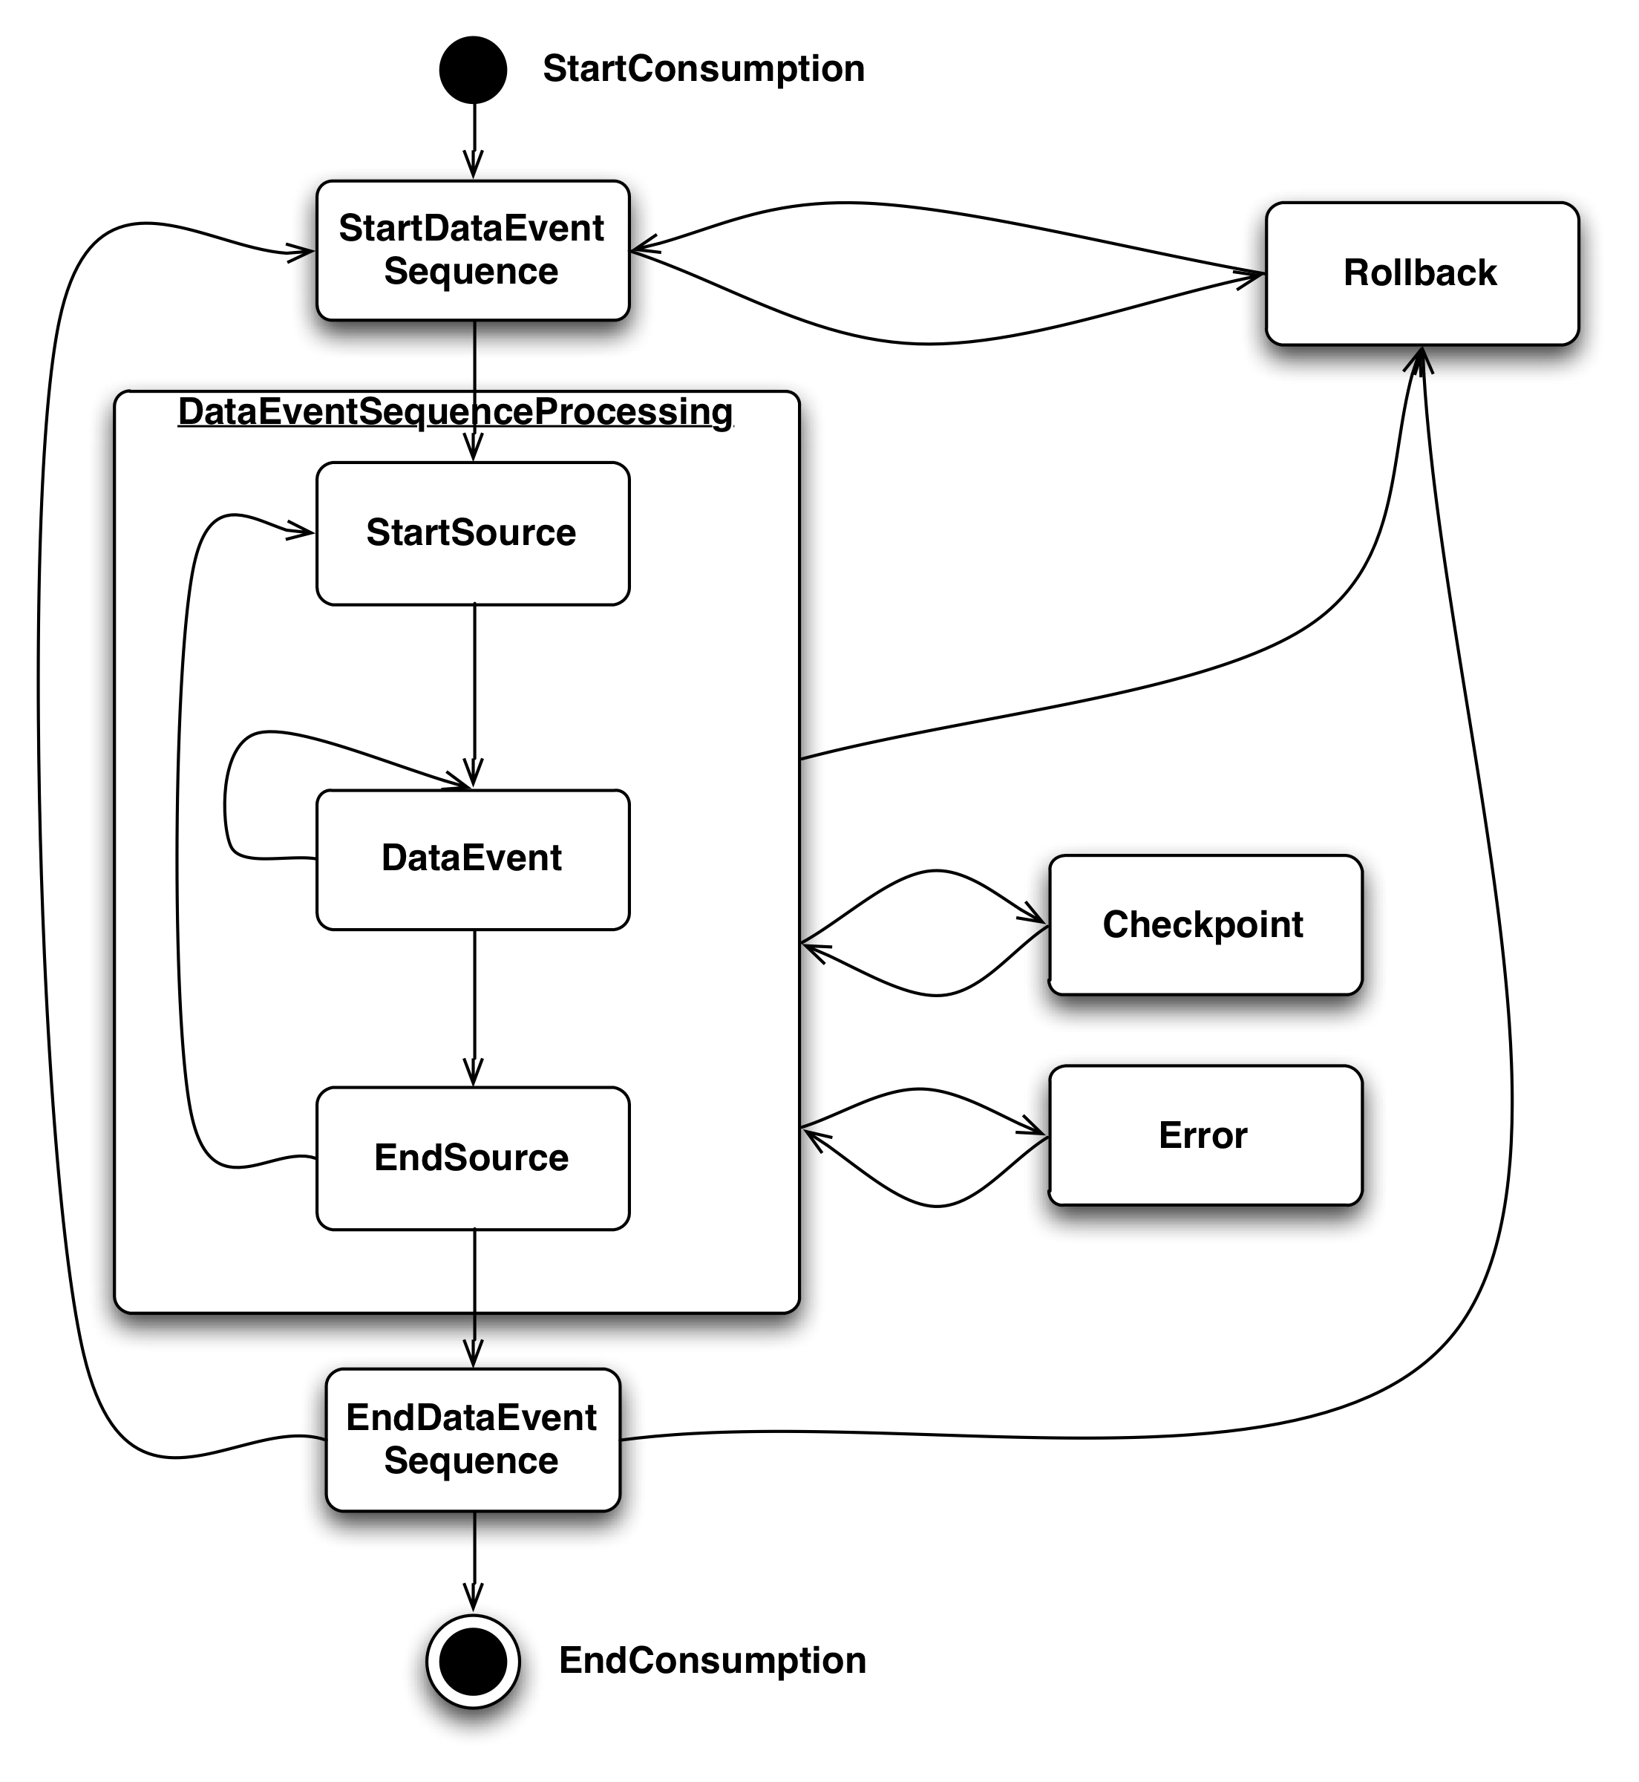
Databus Client Library: Event Callback API
onStartConsumption()
-consumer is started (called once)
onStartDataEventSequence(SCN)
Start of an event window.
onStartSource(Source, Schema)
start of a new Databus source in a window
onDataEvent(DbusEvent, Decoder)
- A new data event
onEndSource(Source, Schema)
end of a Databus source in a window
onEndDataEventSequence(SCN)
end of an event window.
onEndConsumption()
Consumer is stopped (called once)
onCheckPoint(SCN)
Databus wants to persist a checkpoint
onError(Throwable)
- on Error encountered by databus client
onRollback(SCN)
rollback to the specified SCN
Notes:
-Point out differences in v1 (parts in orange) : onCheckpoint() – useful for saving progress while processing large windows. Esp in bootstrap
-onRollback – explanation- when does this happen – an example.
-onDataEvent – example – how to use the decoder.
-is onStartConsumption called on mastership? –only on mastership – consumers are instantiated – but not invoked callbacks unless they are ‘master’ – in a hot-standby situation

Slide 18
Using Decoder : Example 1
1. /*
2. * Process Dbus Event
3. */
4. public ConsumerCallbackResult onDataEvent( DbusEvent e,
5. DbusEventDecoder eventDecoder)
6. {
7. //get avro deserialized object representation of changed-row
8. // BizFollow is the type represented by Avro schema [available in a package]
9. BizFollow event = eventDecoder.getTypedValue(e,
10. (BizFollow)null,
11. BizFollow.class);
…….
…….
15. return ConsumerCallbackResult.SUCCESS;
16. }

Slide 19
Using Decoder : Example 2
1. /*
2. * Process Dbus Event
3. */
4. public ConsumerCallbackResult onDataEvent( DbusEvent e,
5. DbusEventDecoder eventDecoder)
6. {
7. //decode the Databus Event to get Avro Record
8. GenericRecord decodedEvent = eventDecoder.getGenericRecord(e, null);
9.
10. Integer memberId = (Integer)decodedEvent.get("memberId");
11. List<GenericRecord> positions = (List<GenericRecord>)
12. decodedEvent.get("profPositions");
13. …….
14. …….
15. return ConsumerCallbackResult.SUCCESS;
16. }

Slide 20
How To Migrate – Client Library
Databus Client
Databus Client Library
Stream Event Callback
API
Bootstrap Event Callback
API
Client API
Notes:
Depict Client Library in the slide.

Slide 21
Databus Client Library : Client API
register(Consumers, Sources)
Subscribe to source and provide pointer to processing logic
register(Consumers, Filters, Sources)
Subscribe , but defines filters on partitioning key at source
start() , startAsynchronously()
Starts the http client , connects to relevant databus2 event stream
shutdown() , awaitShutdown()
Stops the consumer and client, wait until all processing stops
Configuration Params
checkpoint type : Progress saved on file or centrally in zookeeper
checkpoint freq : For large windows, save progress periodically
optional bootstrap : Don’t rely on bootstrap at all !
hot standby cluster : Part of a “one-active , n-standby” group
consumer parallelism : number of concurrent executions of data event processing

Slide 22
Databus Consumer : Parallelism
Consumer Multi-threading
Consumers have to be threadsafe
Same instance of consumer called in parallel
Ex: Degree of parallelism : 3
Consumer Groups
Consumers have to be threadsafe
Data events distributed amongst
group members
Decreases contention
ex: Degree of parallelism : 3
Databus Client Lib
Databus Client Lib
Consumer1
Consumer1
Consumer1’

Slide 23
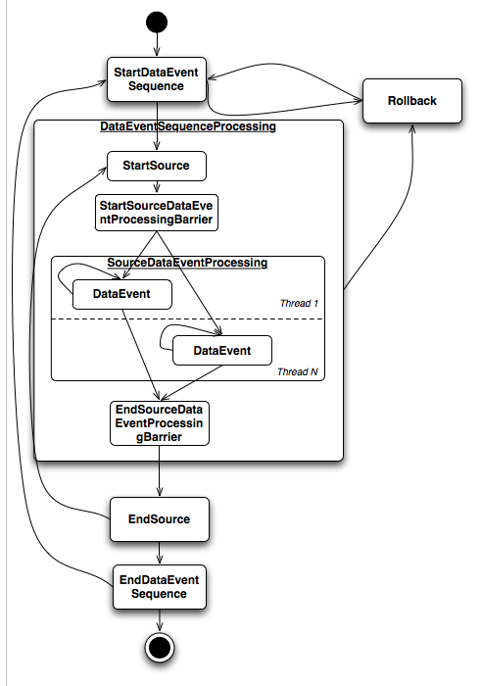
Databus Consumer : Consumer Multi-threading
Consumer should be thread-safe
Multiple threads of execution of consumer
Degree of parallelism [size of threadpool] specified
Parallelism achieved when processing data events within an event window
onStartSeq,onEndSeq,onStart/onEndSource invoked for all threads
Barrier on onStart and onEndSource for all threads
Notes:
Simple Parallelism -

Slide 24
Databus Consumer: Execution Model : Example
Application
Databus Client
Databus Client Lib
C5
DB
{S2}
Databus2 Relay
S1
C4
S2
E11
E12
E21
E22
{S1}
CG 1
C2
C3
S1 : { E11, E12 }
S2 : { E21, E22 }
{S1, S2}
C1
Notes:
- All components in blue are databus2 owned/developed
- Source instrumentation : nothing changes
Differentiate : Client and Consumer
- Databus Client Library : Defines Callback API and provides functionality to get event stream from databus2 event stream.
-Databus Client : Refers to the instance of Databus Client Library with registered consumers
- Many Databus Clients on a single machine.
-Consumer Callback is process logic for the change eventts. It implements callbacks exposed by databus client library.
-- Many consumers per databus client.

Slide 25

Databus Consumer: Execution Model - Example
StartSeq(123)
StartSrc(S1)
Event(e11)
Event(e12)
EndSrc(S1)
StartSrc(S2)
Event(e21)
Event(e22)
EndSrc(S2)
EndSeq(123)
Consumer Group 1 { S1, S2 }
C4
{ S1 }
C5
{ S2 }
C1
C2
C3
StartSeq(123)
StartSeq(123)
StartSeq(123)
StartSeq(123)
StartSeq(123)
StartSrc(S1)
StartSrc(S1)
StartSrc(S1)
StartSrc(S1)
Event(e11)
Event(e12)
Event(e11)
Event(e12)
EndSrc(S1)
EndSrc(S1)
EndSrc(S1)
EndSrc(S1)
StartSrc(S2)
StartSrc(S2)
StartSrc(S2)
StartSrc(S2)
Event(e22)
Event(e21)
Event(e21)
Event(e22)
EndSrc(S2)
EndSrc(S2)
EndSrc(S2)
EndSrc(S2)
EndSeq(123)
EndSeq(123)
EndSeq(123)
EndSeq(123)
EndSeq(123)

Slide 26
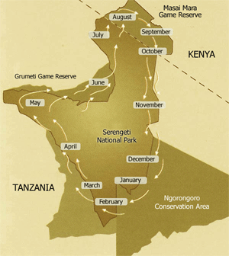
Databus Consumer Migration Patterns

Slide 27
Migration Patterns: Databus Usage
W
R
Service1 DS
Service3 DS
R
Source
W
Index/Store
Service2 DS
Databus Stream
Databus V2 Stream
R
Databus
Client
Databus V2 Client
W
R

Slide 28
Consumer Migration Patterns – In Place Switchover
Stop Databus V1 writes to store/index
Start Databus v2 writes to store/index
No bootstrap required for V2
Reads occur from original store through the switch.
Callers can live with stale data for a small amount of time
More risk , less capacity requirements from both application and databus

Slide 29
Consumer Migration Patterns – The V2 Replica
Bootstrap new store using Databus V2
Prove V2 store is equivalent to V1 store
Switch read traffic to V2 store
Disable and decommission V1 store
Less risk, more capacity needs, effort to validate

Slide 30
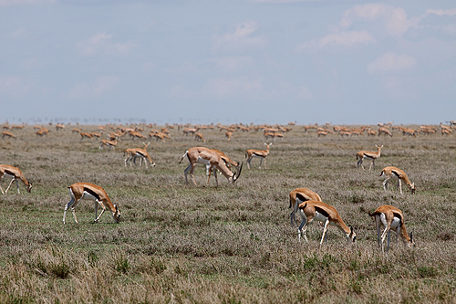
Pilot Program : The early adopters
Bizfollow
Liar

Slide 31
Pilot : BizFollow Migration
Company-follows
(writes)
reads
Peak: 1000 ev/sec
company-bizfollow DS
Peak: 10 events/sec
R
W
Databus V1
Client
bizfollow
Vdmt
W
R
Databus V1 Stream
R
Peak: 10 events/sec
100 M Rows
Event Size: 200 bytes
Size: 200 G
Significant number of rows , low update rate
Only one DS instance has an active databus client at a given time

Slide 32
Pilot : BizFollow Migration
Consumer Development: V2 Event “converted” to v1
Migration Pattern: “v2 Replica” method chosen
“Hot standby” picks active databus client improving fault tolerance
company-bizfollow
-
R
Databus V2 Client
DatabusV1
Client
Vdmt
V1
W
W
bizfollow
R
Databus V1 Stream
R
company-bizfollow
Databus V2 Stream
R
R
Databus V2 Client
R
Vdmt
V2
W

Slide 33
Pilot: LIAR - Server Side Filtering
Liar Member
Search - #1
Databus Client
memberId=1-5M
Partition key: memberID
liar
member
Liar Member
Search - #2
Databus V2 Stream
Databus Client
Apply filter
memberId=5M -10M
Databus Clients specify filter: [partition_id=n, partition_size=5M, partition_type=range ]
Filter is applied at databus relay and bootstrap
Can dynamically grow the number of partitions as number of members grow
Liar Member
Search #31
Databus Client
memberId=150M-155M

Slide 34
Pilot :Lessons Learnt
Debugging
Long running bootstrap uncovered failure recovery issues
Operability improvements were found by experimenting with various configs such as timeouts , retries , batch size
Capacity Planning
Realized that the type of migration (v2 Replica) requires good capacity assessment of the client application
For large sources, bootstrap DB hardware planning will be key
Dev Testability
Understood /network reasonably well when databus2 had to be testable end to end

Slide 35
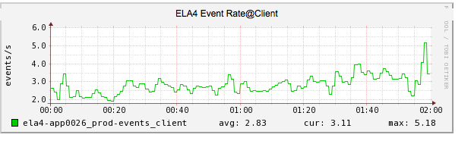
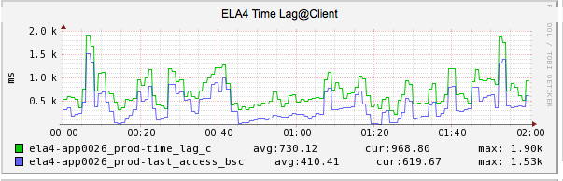
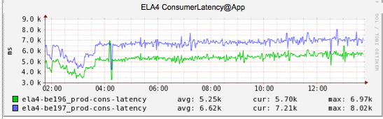
Pilot: Databus Client Monitoring
Event rate measure at client
Time since ‘birthtime’ (@source) of last event seen
Time since receiving any event from databus2 event stream
Consumer stats available .
Measures time spent in processing events at Consumer

Slide 36
Current Work - Migrations
Completed
LIAR Member Search , LIAR Job , Liar App
Bizfollow
In Progress
Cloud (Superblock as part of Inversion 2.0 )
Forum Search
Notes:
Team ownership of Databus infrastructur – first step toward Databus-as-a-Service

Slide 37
Future Work
Features
Event Compression
Buffer longer durations of larger events in memory [member2]
V1 Relay as a Source
Workaround for overloaded DB , consume from v1 Relay
Databus V2 As A Service
Source Discovery
Discovery of source parameters
Simplifies configuration for clients
Improved Capacity Model
Automated source provisioning
Notes:
Team ownership of Databus infrastructur – first step toward Databus-as-a-Service

Slide 38
Acknowledgements
Team LIAR (Anmol Bhasin, Adil Aijaz, Ethan Zhang )
Team Money (Carleton Miyamoto , Bhaskaran Devarajan, Bhaskar Hariharan )
QA (John Fung, Ashish Mantri )
SRE Partners (Zach White , Alex Schwartz , Kevin Krawez )
Team Voldemort (Brendan Harris, Lei Gao)
Notes:
Team ownership of Databus infrastructur – first step toward Databus-as-a-Service

Slide 39
Important Links
Databus2 User Guide
Databus2 Consumer Development
Databus2 Sources
List (for migration) : databus2-migration@linkedin.com
List: (all databus2) : databus-development@linkedin.com

Slide 40
Questions

Slide 41
Appendix

Slide 42
Databus Consumers: Ingraphs
Bizfollow Dashboard
LIAR Dashboard

Slide 43
LIAR: Server Side Filtering
Liar Member Search
(Partition 1)
[0-5M)
Liar Member
Liar Relay
E1
EV 1
EV 2
EV 31
Liar Member Search
(Partition 2)
[5M-10M)
E2
partition key: memberId
E1
E2
E31
E31
…..
Liar Member Search
(Partition 31)
[150M-155M)
Consumers define ‘range partition’ [partition-size, partition_num]

