Slide 1
Databus
LinkedIn’s Data-Change Propagation System
Chavdar Botev LinkedIn Tech Talk, 09/21/2011

Slide 2
Agenda
What is Databus?
Why Databus V2?
How to Databus V2?
Where next for Databus?
Conclusion
Notes:
In this presentation, we are going to answer 4 questions:
What is Databus for those who are unfamiliar
Why did rewrite Databus V1 to V2
How one can use and migrate to the new version
* Where we are going next with Databus?

Slide 3

What is Databus?
LinkedIn’s Data-Change Propagation System
sdr
cloud
mem2rep
member_id=1234
+ position: linkedin
+ position: google
Databus
member_id=1234, position: linkedin
position: google
Notes:
What do we mean when we say that Databus is LinkedIn’s data-change propagation system.
Let’s say a user updates their profile. The change is reflected to the primary database (Member2 in this case) by changing rows in one ore more tables as part of the same transaction. External services like SDR, cloud and member2rep are interested in those changes to update their internal state, the search index, the graph index or a Member2 replica.
Databus is the system that propagates the data row changes from the primary store (Member2) to those external services.

Slide 4
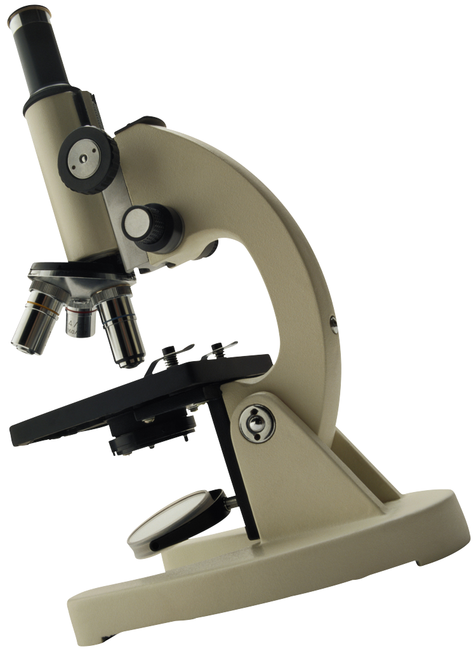
Dissection
Transport independent of data source
Oracle, MySQL, …
Broker for messages (relay)
Publish/subscribe model
Event Semantics Guarantees
Consistency preservation
At-least-once delivery
System Guarantees
Durability (provided by the data store)
Reliability
Low latency
Notes:
Let’s look deeper into Databus. First, Databus is independent from the source. V1 supports Oracle, in V2 we are adding support for MySQL and it can be extended for other data stores too.
Databus uses a Publish/subscribe model
Publish happens on transaction commit
Subscribers communicate with a broker (the Databus relay)
Topics: changes to a table/view
Databus provides Strong Consistency
At least once delivery for the data changes records (aka Databus events)
Transaction boundaries if the primary store supports them.
Event ordering in and across topics: determined by the source database commit order (external clock)
Consistency across topics (preserving FK constraints)
Databus is as durable as the primary store since Databus uses the store as the source of truth of events. Luckily, Oracle and MySQL are robust products with strong durability. As a result, relay failures do not cause loss of events.
Reliability – Everything is easily replicated since we have a single timeline/order of events (determined by the source database). All relays see the same event timeline.
Databus can deliver events in the order of milliseconds to hundreds of milliseconds depending on the configuration.

Slide 5
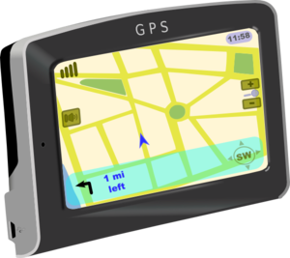
Related Systems
Databus
Strong consistency guarantees
Durability provided by data store
Commit ordering for events
ActiveMQ
Weaker consistency guarantees
Exactly-once/at-most-once
Heavy-weight
Kafka
Weaker consistency guarantees
At least-once delivery
Durability provided by broker
Broker determines ordering of events
Notes:
As discussed in the previous slide, Databus provide strong consistency guarantees with durability and ordering provided by the primary data store.
AMQ is a JMS implementation that provides somehow weaker consistency semantics: there are transaction boundaries but those are point-to-point, rather than end-to-end.
Image: http://www.clker.com/clipart-gps-reciever-no-brand.html

Slide 6

Why Databus V2?
Motivation
Architecture
New features
Notes:
Databus is already fairly widely used in LinkedIn.
So, Why did we build Databus v2?
http://www.freeclipartnow.com/people/men/puzzled.jpg.html

Slide 7
Motivation
Address V1 issues (V2.0):
Event serialization and versioning
Bootstrapping and catchup
Performance and scalability bottlenecks
Developer and operations productivity
Espresso requirement (V2+)
MySQL integration
Internal data change propagation for replication and index updates
Source-side scalability
Dynamic discovery
Notes:
Event serialization and versioning – avoid tedious creation of DTOs for table schema version and improve handling of schema migration
Address issues with clients falling behind the relay and triggering a catch-up for many events which can cause significant performance degradation. A similar issue is the bootstrapping of clients with no previous state. V2 also addresses various other performance and scalability issues in V1. Address also issues with difficulties of using Databus by developers and siteops.
We also targeted a number of new features which a targeted for use in Espresso.

Slide 8
Databus V2 at a Glance
Complete rewrite of Databus v1
New features
Efficient event transport
Automatic bootstrapping/catch-up with arbitrary look-back
Scalability improvements
Operability
Team ownership of Databus infrastructure
Greatly improved monitoring and transparency
Development
Simplified creation of new Databus clients and relays
Notes:
Team ownership of Databus infrastructure – first step toward Databus-as-a-Service

Slide 9
Architecture: Data Flow
DB
Client
Relay
“Recent”
Changes
Databus2 Client Lib
Consumer 1
Consumer n
 |  |  | Memory
Changes
Changes
Client
Bootstrap Service
‘”Older” Data
Databus2 Client Lib
Consumer 1
Consumer n
DB

Slide 10
Architecture: Control Flow
DB
Client
Relay
Databus2 Client Lib
Callback 1
Callback n
 |  |  | Memory
Pull
Push/Pull
Pull
Pull
Client
Bootstrap Service
Databus2 Client Lib
Callback 1
Callback n
Pull
DB

Slide 11
Efficient Event Representation
Generic event serialization with Avro
Versioned Avro schemata
Lower memory footprint at relays
Versioned + Binary Fmt
Relay
DB
 |  |  | Memory
Changes
Notes:
Generic event serialization with Avro
* No more need to write DTOs
* Map-based or Java class access
Versioned Avro schemata
Automatic handling of backward compatible schema changes; For example, in v1 adding a new field necessitates the creation of a new Databus stream not to break backwards compatibility. The reason is that the change breaks DTOs. In v2, relay always stores the latest schema version and client library may convert to the version used by the client.
Better memory management and utilization at relays
Uniform blob storage in ByteBuffers
Store only the latest version

Slide 12
Scalability
@ Relay
Huge event buffers with no GC
Scalability to hundreds of clients per relay
@ Client
Multi-threaded consumption
Efficient stream consumption: relay-side filtering
@ Data Source
Sharded data source with one logical stream
Data sources can scale independently from consumers
Notes:
Efficient stream consumption: partitioning through server-side filtering

Slide 13
Streaming Performance

Slide 14
Relay Performance

Slide 15
Bootstrapping and Catch-up
Automatic
Primary DB unaffected
Optimized store for bootstrap and catch-up queries (no expensive joins)
Chunking for guaranteed progress
Notes:
Bootstrapping is the process of generating initial state of the client consistent as a particular point in the source database.
Catch-up is replaying events to the client that happened after the last successful event processed.

Slide 16
Bootstrap Performance Test
Notes:
Single-threaded consumer

Slide 17
Developer and Operations Productivity
No Spring required
Create a new client in 10 lines of Java code
Hassle-free Databus source provisioning
Databus team creates and maintains relays/bootstrap servers
Spring

Slide 18
Databus v2 Operational Metrics
Freshness
Time elapsed since receiving last change event
Time lag from source
Throughput
Number of events processed
Capacity
Time span of change events available in memory
Latency
Time taken for change event to reach the consumer
Exceptions
Number of change requests not available in Relays

Slide 19

How to Databus V2?
Play
Migrate
Create
Notes:
curl with flexible checkpoint
curl with with a checkpoint for a given SCN

Slide 20
Play
Relays in STG-BETA
liar, bizfollow, member2
Coming soon: anet, connections, nus, and others
Coming soon:
dtail – command-line tool to stream events
Sample Databus v2 client code to use STG-BETA relays
Notes:
HTTP interface to the relay and bootstrap

Slide 21
Migrate an Existing Consumer
Wiki: Chapter V – Migration of Legacy Clients to Databus 2.0
Few and isolated changes
Steps
Implement a converter for V2 Avro Event objects to V1 DTOs
Optionally: implement differentiated handling of events during normal streaming or bootsrapping
Register consumer callback with Databus V2 client library
Recommended: use V1/V2 client starter for easy switch between the two
Notes:
We will have a separate talk where we will discuss this in greater detail and share our experiences from migrating the pilot clients – Liar and Bizfollow.

Slide 22
Create a New Consumer
class MyConsumer
extends AbstractDatabusStreamConsumer
implements DatabusStreamConsumer {
ConsumerCallbackResult onDataEvent(DbusEvent e,
DbusEventDecoder d){
//use map-like Avro GenericRecord
GenericRecord g = d.getGenericRecord(e, null);
//or use a POJO from the event Avro schema
MyEvent e = d.getTypedValue(e, null,
MyEvent.class);
…
return ConsumerCallbackResult.SUCCESS;
}
}

Slide 23
Create a New Consumer
public void main(String[]) {
//configure
DatabusHttpClientImpl.Config configBuilder =
new DatabusHttpClientImpl.Config();
clientConfig.loadFromFile(“mydbus”, “mdbus.props”);
DatabusHttpClientImpl client =
new DatabusHttpClientImpl();
//register callback
MyConsumer callback = new MyConsumer();
client.registerDatabusStreamListener(callback,
null, "com.linkedin.events.member2.MemberProfile”);
//start client library
client.startAndBlock();
}
https://iwww.corp.linkedin.com/wiki/cf/display/ENGS/Chapter+IV+-+Creating+a+Simple+Databus+2.0+Client

Slide 24
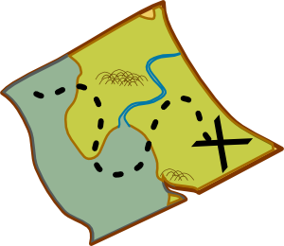
Where next for Databus?
Migrations
Databus-as-a-Service
Databus for Espresso
Hadoop bridge

Slide 25
Migrations
No new V1 relays
Wrap up Databus v2 reference migrations of BizFollow and Liar (R1136)
Further migrations – exact timeline is TBD
Databus v2 for Member2 and ConnectionsDB (Q1/2012)
All Databus v1 relays migrated to Databus v2 (End of Q1/2012)
Announce V1 EOL Date
V1 EOL (Q2/2012)
Simple client migration from Databus v2 and Oracle to Espresso
Notes:
If you want to create a new Databus source and new relays, please come talk to us so we create v2 relays directly.

Slide 26
Databus as a Service
Sources
M
Client
Relays
O
Databus2 Client Lib
Consumer 1
Consumer n
Subscribe
Bootstrap Servers
Client
Databus2 Client Lib
Consumer 1
Consumer n
Managed Service

Slide 27
Databus as a Service
Simplify Databus v2 usage , operations and adoption
Elastic cluster of multi-tenant relays and bootstrap servers
Automatic publisher discovery for clients
New sources
100% coverage for Espresso sources
Streamlined process to add new Oracle sources
Standard consumer solutions
Integration with DSC
Caching

Slide 28
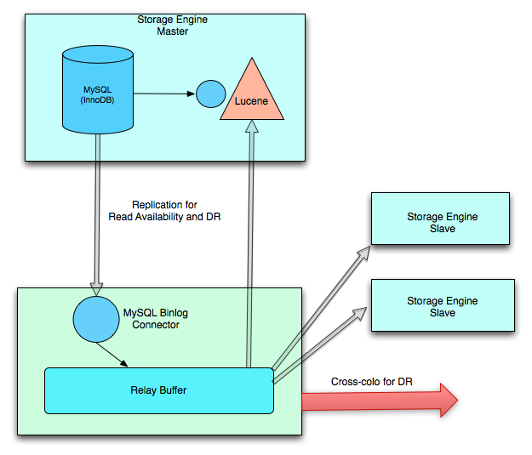
Databus for Espresso

Slide 29
Databus for Espresso
Integration with MySQL and Espresso
Used for both replication and external consumers
Captures all updates (including deletes!)
Very low latency (<10ms)
No need for “databusification”
Intra- and cross-colo
Managed service

Slide 30
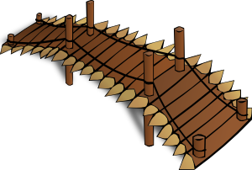

Hadoop Bridge
Bulk export to Hadoop
Everything (since SCN 0)
Changes since SCN N
Export to: CSV, JSON, Avro

Slide 31
Conclusion
LinkedIn’s Data-Change Propagation System
Efficient event transport
Automatic bootstrapping/catch-up
Scalability improvements
DaaS: Databus as a Service
Key component for Espresso

Slide 32
Shout-outs
Databus v2 Alumni: Kapil Surlaker, Shirshanka Das, Lei Gao, Jemiah Westerman, David Zhang, Shivani Gupta, Vincent Kwong
Our partners
Bizfollow: Carleton Miyamoto, Ganesh Hariharan, Bhaskaran Devaraj
“Liar” : Adil Aijaz, Anmol Bhasin, Alex Schwartz
Espresso: Lin Qiao, Jason Zhang
Cluster Manager: Kishore Gopalakrishna, Shi Lu
Tools: Jarek Rudzinski, Haiping Han, Hideyuki Inada
SRE: Zachary White, Erik Bourget, Brunno Connelly
DBA: Nishant Vyas, Neil Pinto, Agila Devi

Slide 33
Wikis etc
User Guide: Databus 2.0 User Guide
Main Wiki: Databus, Databus v2
Email lists:
databus-development@
ask_databus@
Team contacts:
Sunil Nagaraj snagaraj@linkedin.com
Balaji Varadarajan bvaradarajan@linkedin.com
Boris Shkolnik bshkolnik@linkedin.com
Chavdar Botev cbotev@linkedin.com
Phanindra Ganti pganti@linkedin.com
Sajid Topiwala stopiwal@linkedin.com
Location: 2029 second floor, DDS area, next to the stairs to the main lobby

Slide 34
Databus Comparison Matrix
 | V1 | V2 | V2+
Data Stores | Oracle | Oracle | Oracle/MySQL/Espresso
Serialization | Custom (DTOs) | Avro | Avro
Versioning | Independent streams | Single stream w/ automatic conversion | Single stream w/ automatic conversion
Bootstrapping/Catch-up | Manual/Automatic (sometimes) | Automatic / Automatic | Automatic / Automatic
Source scalability | Single instance | Single instance | Support for sharding
Consumer scalability | Single-threaded, all or nothing | Multi-threaded, stream partitioning | Multi-threaded, stream partitioning
Setup | Springhetti | No Spring required | No Spring required
Operating model | DIY Kit | Client library + team-operated | Client library + Elastic service
Multi-tenancy | No | Partial support | Full support

