Slide 1
Statistical Analysis
Bobga-herman Gwanvoma
DSC 530

Slide 2
Statistical Question/Hypothesis
"Does the number of hours spent studying per week affect college students' final exam scores, considering their class attendance, participation in extracurricular activities, amount of sleep, and socioeconomic background?"

Slide 3
Variables
Study Hours per Week (continuous): Number of hours a student spends studying weekly.
Final Exam Score (continuous): Final exam score in percentage.
Class Attendance (ordinal): Frequency of class attendance (Never, Rarely, Occasionally, Frequently).
Extracurricular Participation (categorical): Participation in extracurricular activities (Yes/No).
Sleep Hours per Night (continuous): Average number of hours slept per night.
Socioeconomic Status (ordinal): Socioeconomic status categorized as Low, Medium, High.

Slide 4
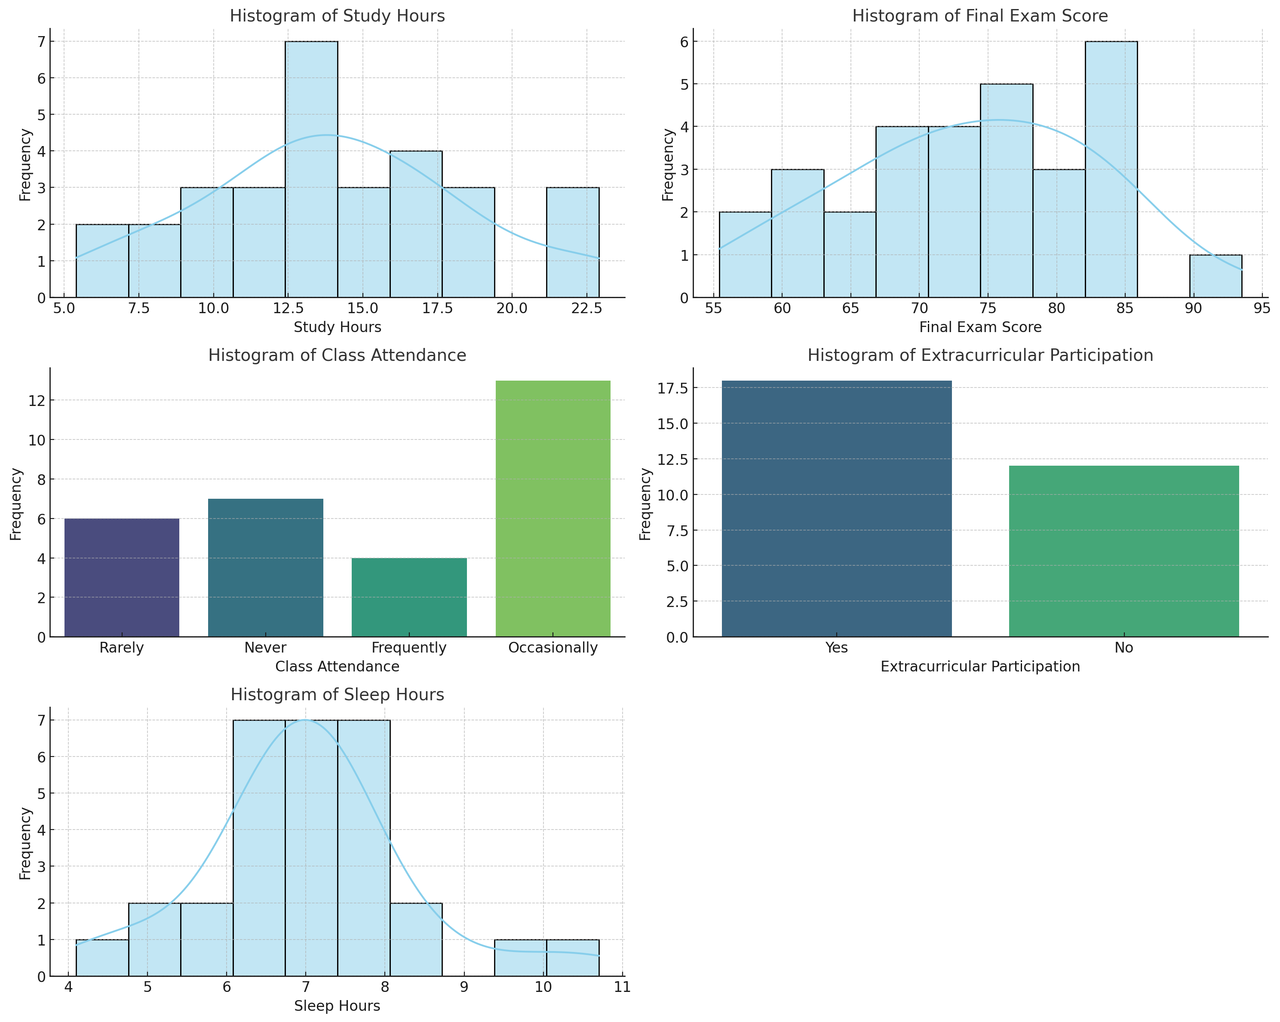
Histograms

Slide 5
Descriptive Statistics Summary
1. Study Hours per Week
Mean: 14.06 hours
Mode: 12.7 hours
Standard Deviation: 4.50 hours
Skewness: 0.14 (slightly skewed to the right)
Kurtosis: -0.36 (light tails, indicating fewer extreme values)
2. Final Exam Score
Mean: 73.78%
Mode: 55.4%
Standard Deviation: 9.31%
Skewness: -0.10 (approximately symmetric)
Kurtosis: -0.61 (light tails, suggesting fewer extreme scores)
3. Class Attendance
Mode: "Occasionally"
4. Extracurricular Participation
Mode: "Yes"
5. Sleep Hours per Night
Mean: 7.0 hours
Mode: 7.4 hours
Standard Deviation: 1.32 hours
Skewness: 0.48 (moderately skewed to the right)
Kurtosis: 1.46 (heavier tails, suggesting more extreme sleep hours)

Slide 6
Analysis
Study Hours per Week:The distribution is nearly symmetric with a slight right skew. There are no significant outliers, indicating that the majority of students have a similar study pattern.
Final Exam Score:The distribution is also approximately symmetric. The histogram shows one mode at 55.4%, but this isn't necessarily an outlier, as the distribution does not show any extreme deviations.
Class Attendance:The most common attendance frequency is "Occasionally." There are no numerical outliers as this is categorical data.
Extracurricular Participation:Most students participate in extracurricular activities. As this is categorical, no outliers are present.
Sleep Hours per Night:The distribution shows a moderate right skew with some students sleeping significantly more than others (e.g., 10.7 hours). These might be considered outliers, especially if they deviate greatly from the rest of the data. Handling these could involve investigating if these values are errors or if they represent valid but unusual cases.

Slide 7
Handling Outliers
For the variables that are continuous (Study Hours, Final Exam Score, Sleep Hours), outliers could be examined more closely to understand if they represent data entry errors or valid extreme cases. If they are valid, they can be retained; if not, they could be corrected or excluded from further analysis.

Slide 8
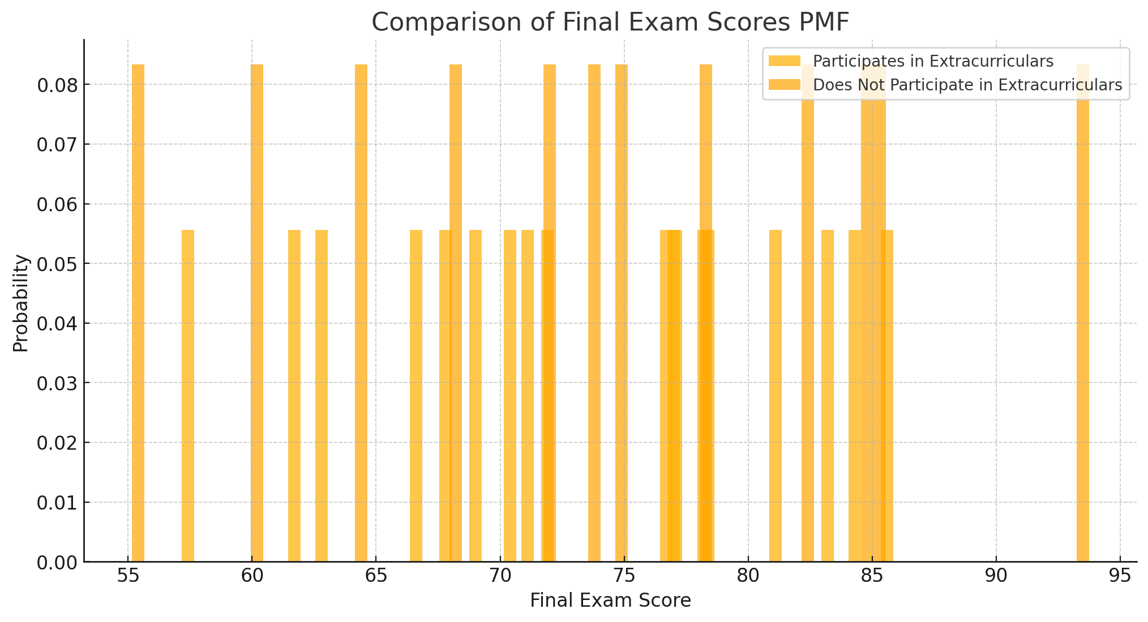
PMF Comparison

Slide 9
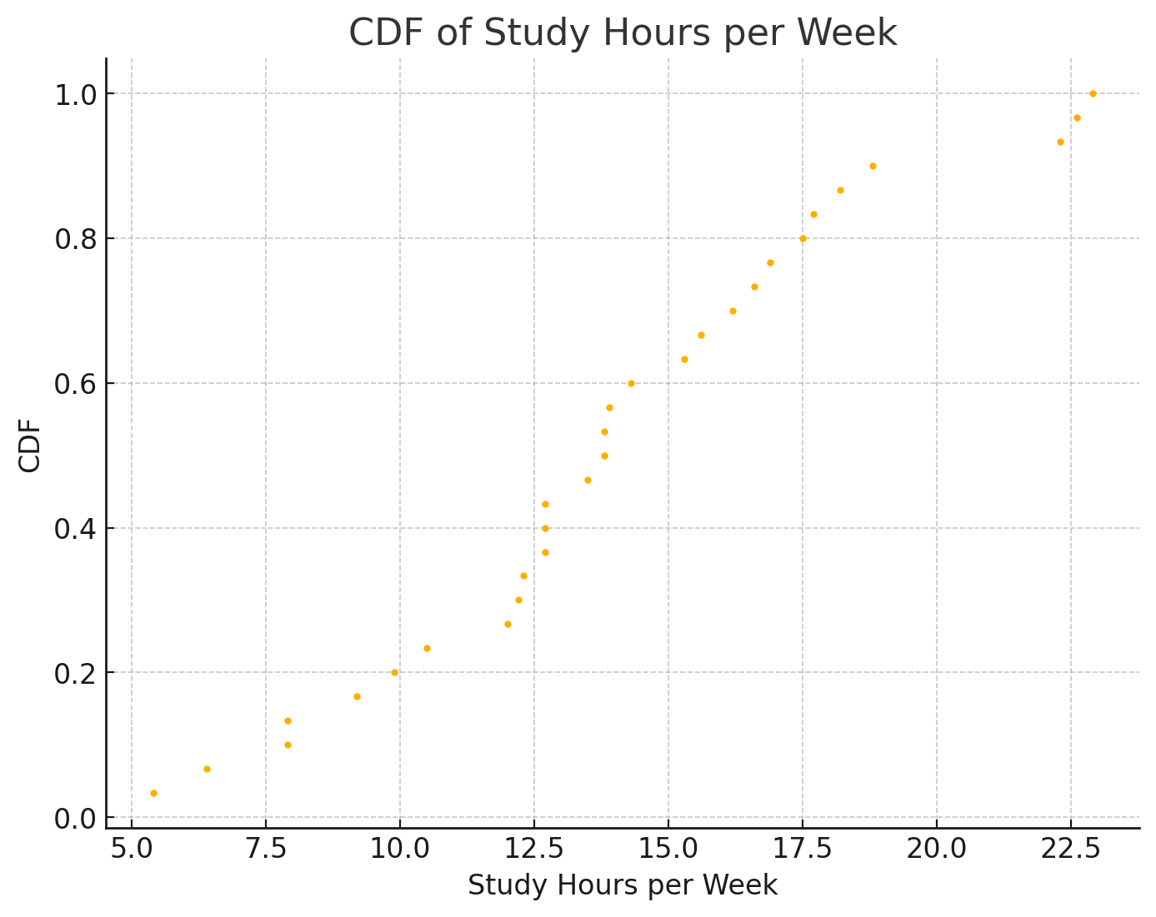
CDF Analysis

Slide 10
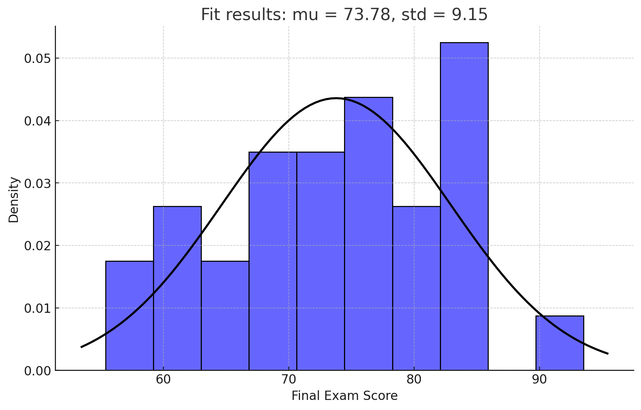
Analytical Distribution

Slide 11
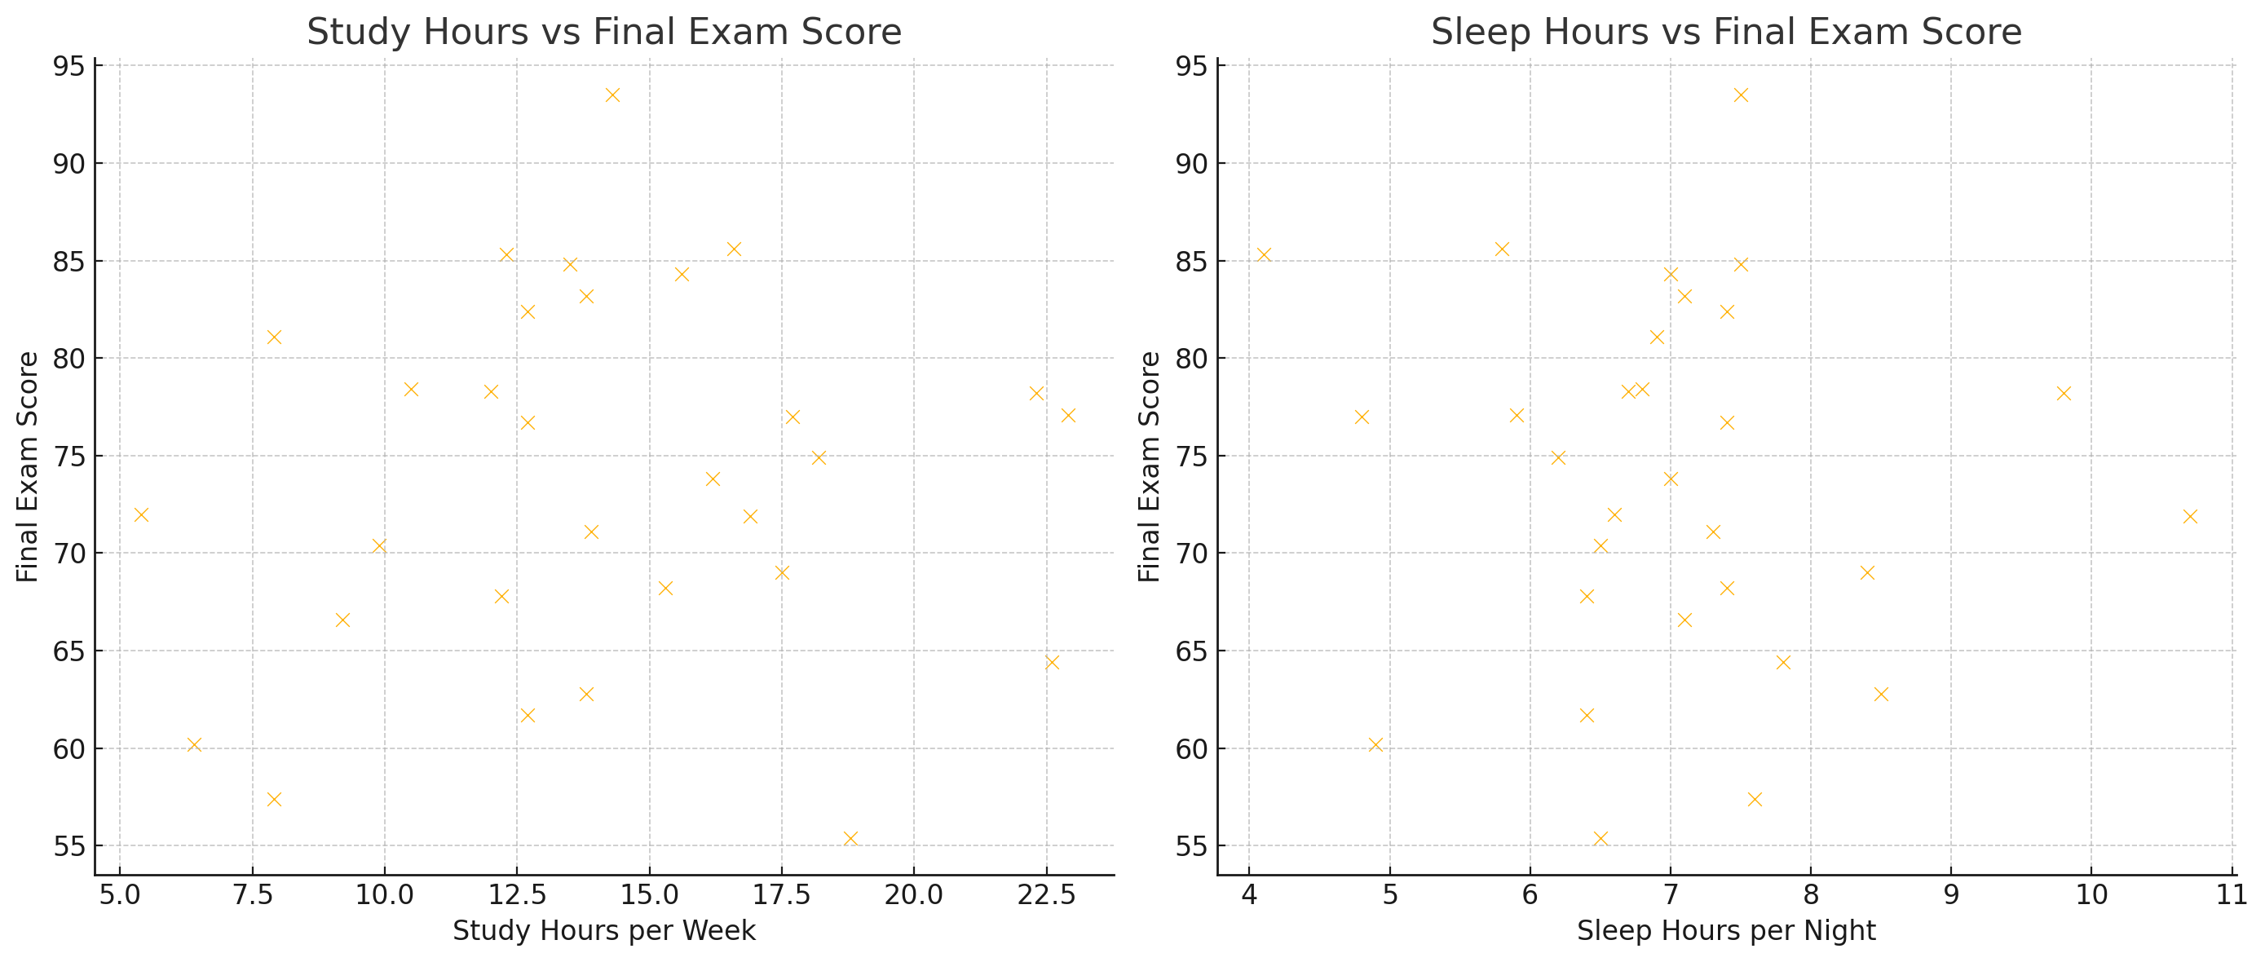
Scatter Plots & Correlation Analysis
Notes:
Study Hours vs Final Exam Score: This plot examines the relationship between the number of hours students study each week and their scores on the final exam.Sleep Hours vs Final Exam Score: This plot explores the potential correlation between how many hours students sleep each night and their exam performance.

Slide 12
Regression Analysis
Key Findings
Coefficients
R-squared: 0.125, indicating that the model explains approximately 12.5% of the variance in the final exam scores.
Significant Variables: None of the explanatory variables showed a statistically significant relationship with the final exam score (all p-values > 0.05).
Study Hours: Positive but not statistically significant.
Sleep Hours: Positive but not statistically significant.
Class Attendance: Negative coefficients for "Never," "Occasionally," and "Rarely," but none are statistically significant.
Extracurricular Participation (Yes): Slightly negative but not statistically significant.
Socioeconomic Status: Positive for "Low" and negative for "Medium," but neither is statistically significant.
Notes:
Dependent Variable: Final Exam Score
Explanatory Variables: Study Hours, Class Attendance, Extracurricular Participation, Sleep Hours, Socioeconomic Status

Slide 13
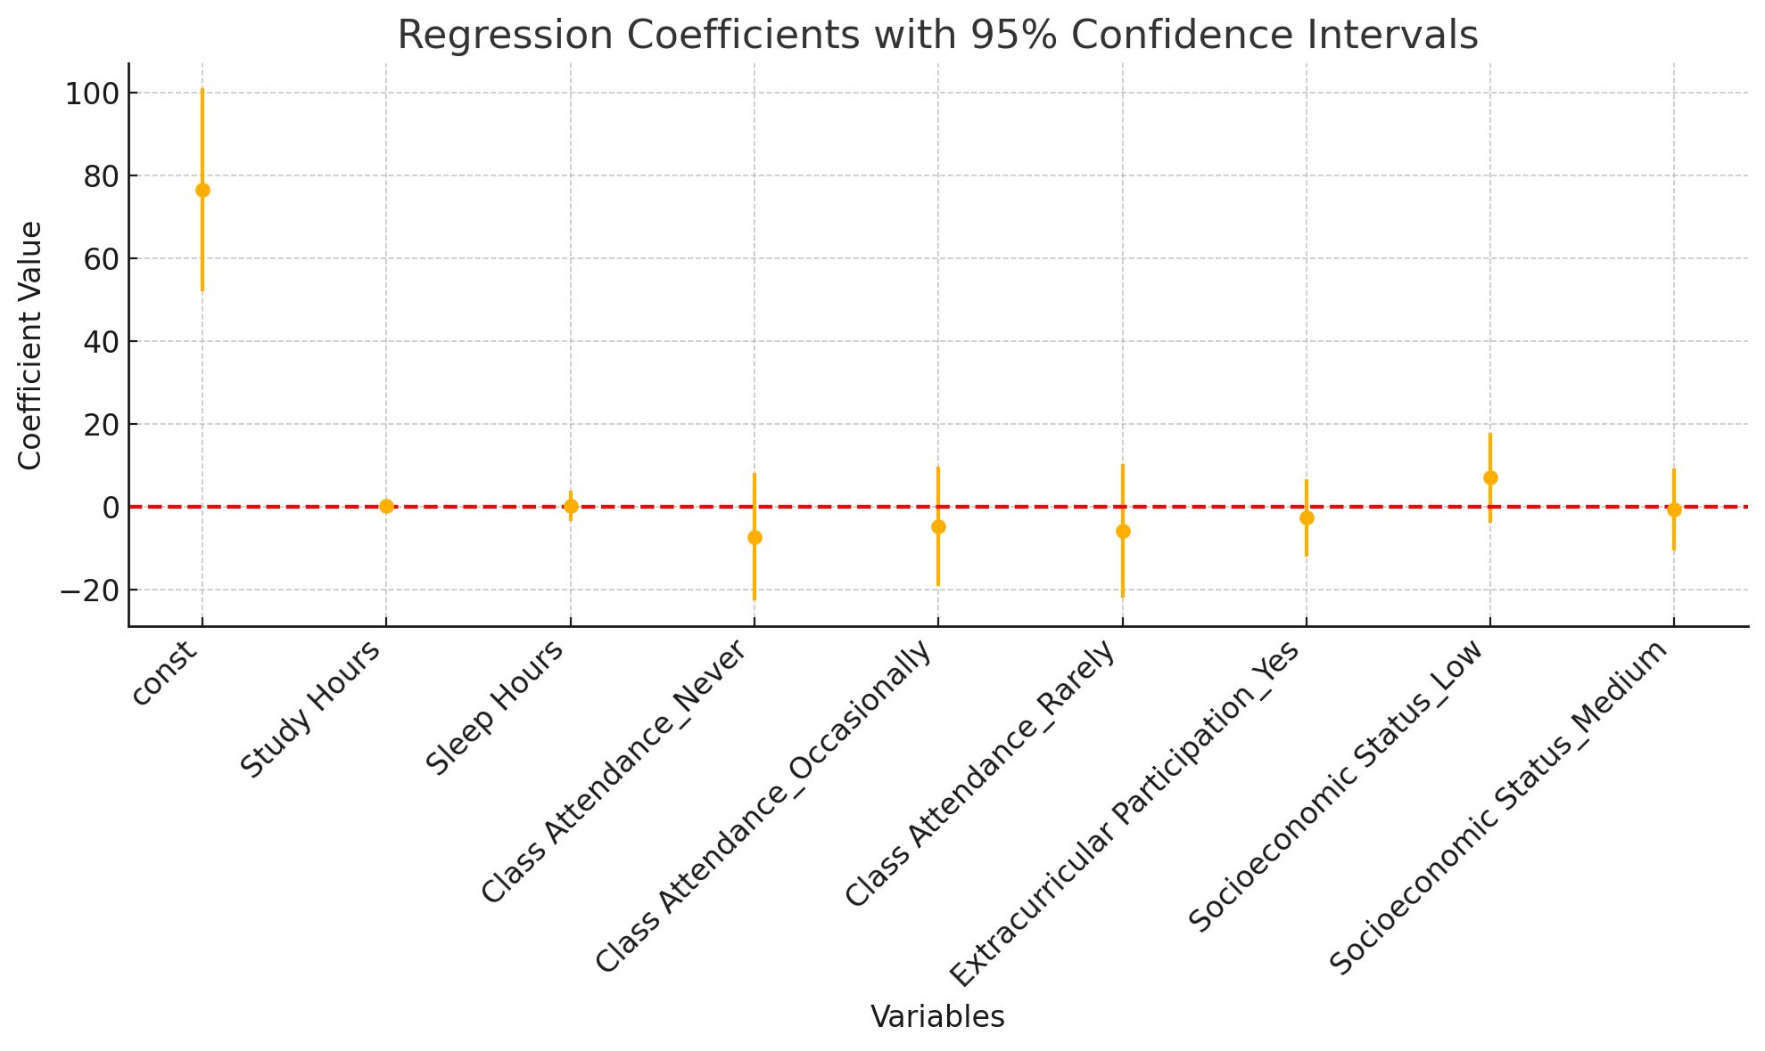
Notes:
plot of the regression coefficients along with their 95% confidence intervals. The red dashed line at zero indicates no effect. If a coefficient's confidence interval crosses this line, it suggests that the variable's effect is not statistically significant.

Slide 14
Hypothesis Testing
ANOVA test results
Interpretation
F-statistic: 0.29
P-value: 0.832
The high p-value (greater than 0.05) indicates that there is no statistically significant difference in final exam scores based on class attendance. In other words, the variation in final exam scores is not strongly associated with differences in class attendance among the groups.

