Slide 1
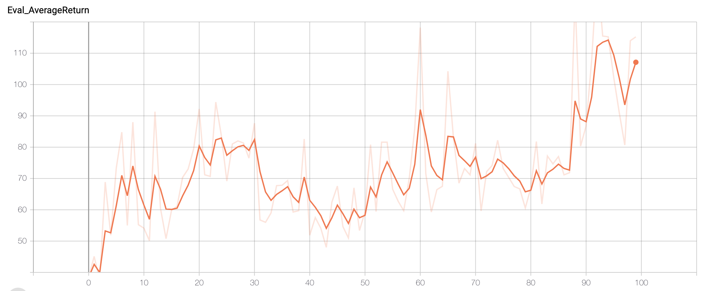
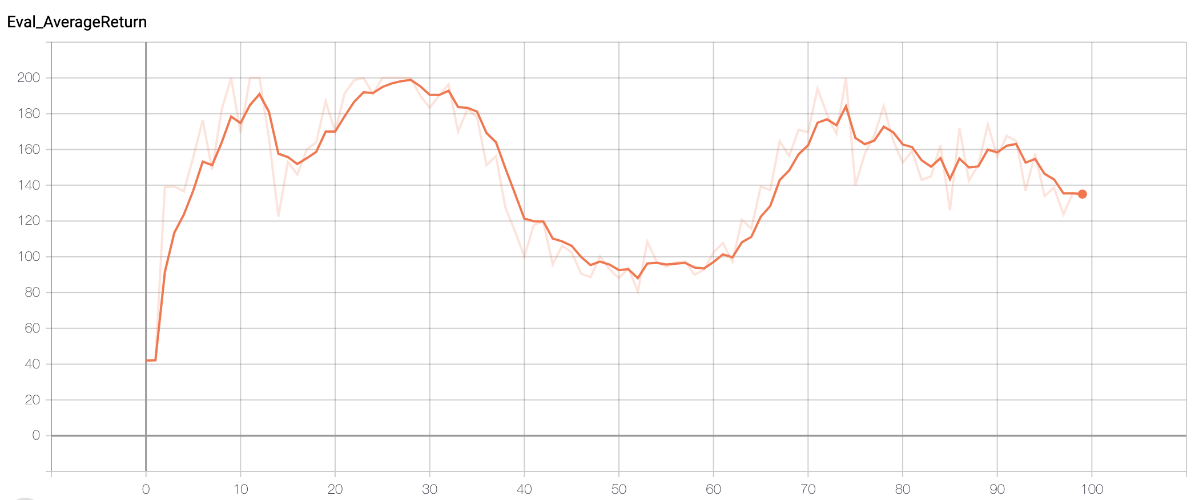
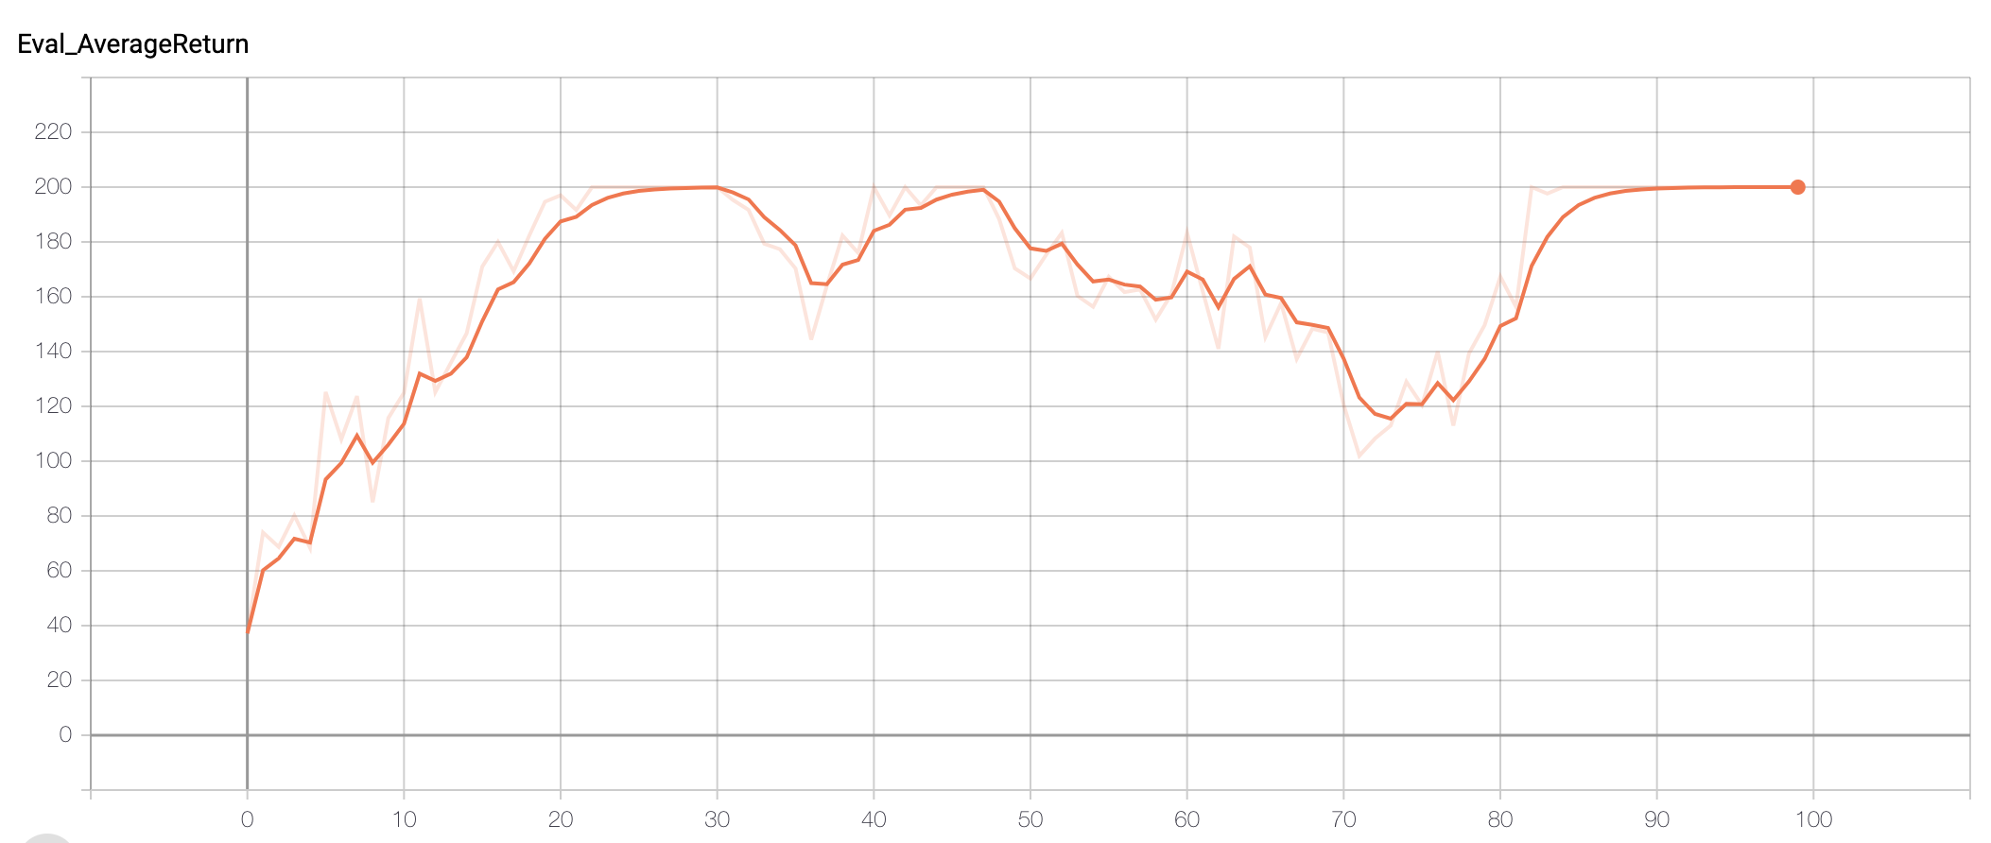
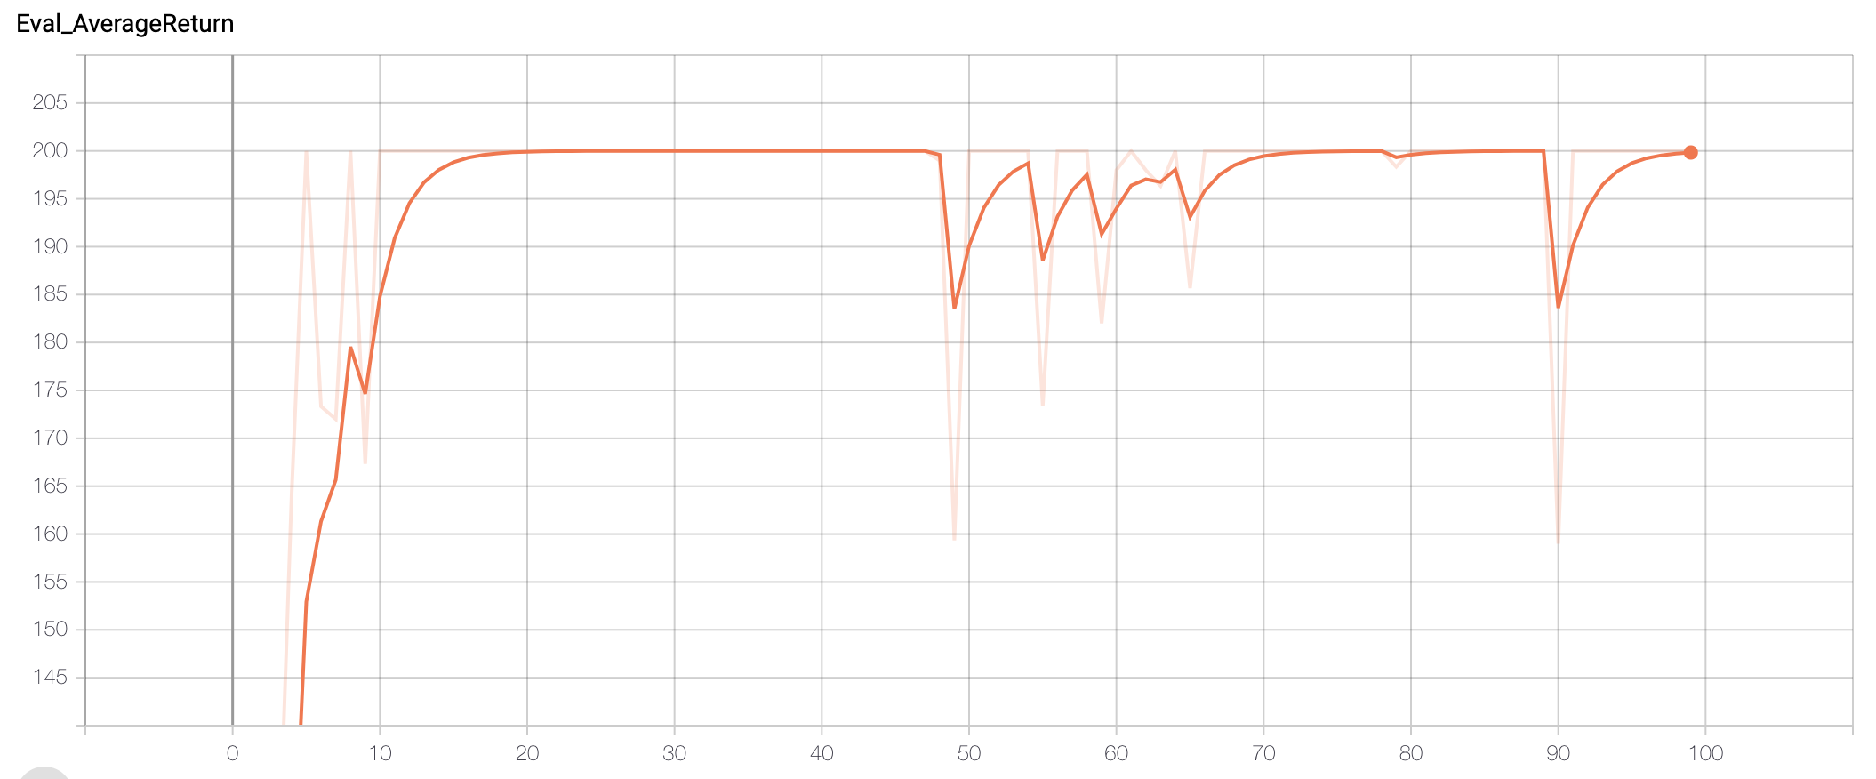
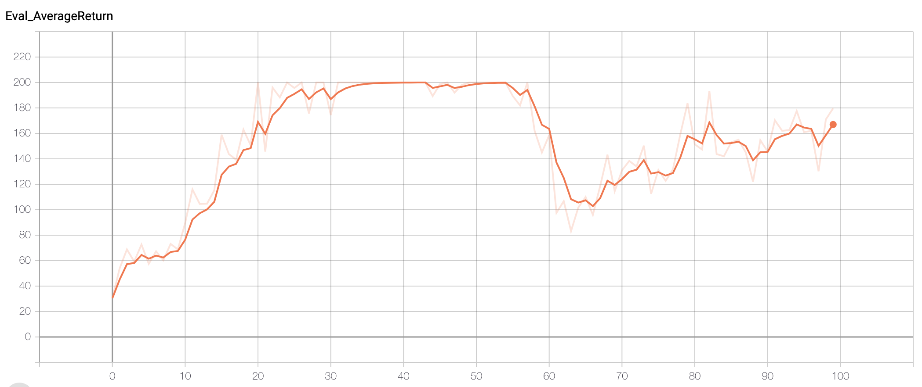
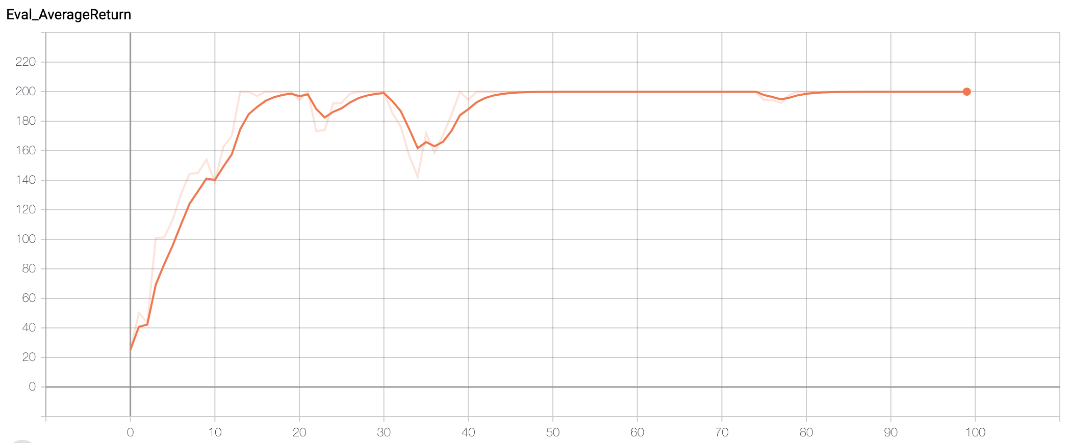
Batch: 5000, reward-to-go: False,
Standardize_advantages: False
Batch: 1000, reward-to-go: False,
Standardize_advantages: False
Batch: 5000, reward-to-go: True,
Standardize_advantages: False
Batch: 1000, reward-to-go: True,
Standardize_advantages: False
Batch: 1000, reward-to-go: True,
Standardize_advantages: True
Batch: 5000, reward-to-go: True,
Standardize_advantages: True

