Slide 1




Improve your Software Security posture with SAMM 2.0 Dashboard
Tuesday, June 16, 2020

Slide 2
Sathish Ashwin
Head of Research and Operations – National Cyber Defence Research Centre, India.
Working with leading MNC’s on building cyber security strategy.
Founder – The Cyber School, an NGO that serves less-privileged children by teaching them latest technology, programming skills, artificial intelligence, cyber security etc., and help them shape their personality and career.
Worked and Trained – State and Central Governments, Legal and Law enforcements agencies.
Speaker at many National and Inter National Conferences.
Mentored 20+ Startups.
Help individuals on overcoming their cyber security issues and digital psychological issues.
Master’s in Cyber Security, Criminology and Psychology.
Pursuing Phd in Neural Networks and Digital Psychology.
Authored and co-authored 100+ international articles and 10+ books.

Slide 3



What is SAMM?
Measurable
Defined maturity levels across business practices
The Software Assurance Maturity Model (SAMM) is an open framework that provides an eﬀective and measurable way for all types of organizations to analyze and improve their software security posture.
owaspsamm.org
Actionable
Clear pathways for improving maturity levels
Versatile
Technology, process, and organization agnostic

Slide 4
SAMM 2.0
Governance
Design
Implementation
Verification
Operations
Strategy & Metrics
Threat Assessment
Architecture Assessment
Incident Management
Secure Build
Policy & Compliance
Security Requirements
Secure Deployment
Requirements- driven Testing
Environment Management
Education & Guidance
Secure Architecture
Defect Management
Operational Management
Security Testing

Slide 5
SAMM Maturity Levels and Scoring
Transparent view over diﬀerent levels
Fine-grained improvements are visible
Maturity levels |  | Assessment scores
3 | Comprehensive mastery at scale | 1 | Most
2 | Increased eﬀiciency and eﬀectiveness | 0.5 | At least half
1 | Ad-hoc provision | 0.2 | Some
0 | Practice unfulfilled | 0 | None

Slide 6
Governance
Design
Implementation
Verification
Operations
Strategy & Metrics
Threat Assessment
Architecture Assessment
Incident Management
Secure Build
Create & promote
Measure & improve
App risk profile
Threat model
Build process
Architecture validation
Architecture compliance
Incident detection
Incident response
Dependencies
Policy & Compliance
Security Requirements
Secure Deployment
Requirements- driven Testing
Environment Management
Policy & standards
Compliance mgmt
Software reqmts
Supplier security
Deployment process
Control verification
Misuse/abuse testing
Config hardening
Patch & update
Secret mgmt
Education & Guidance
Secure Architecture
Defect Management
Operational Management
Security
Architecture
Security Testing
Training & awareness
Org & culture
Architecture design
Technology mgmt
Defect tracking
Metrics & feedback
Scalable baseline
Deep understanding
Data protection
Legacy mgmt
Stream A
Stream B
Stream A
Stream B
Stream A
Stream B
Stream A
Stream B
Stream A
Stream B

Slide 7
What was missing?
Different dashboards Types of report It was always difficult in transferring data between multiple stakeholders. Instant notifications Integrating with your existing security roadmap. Large amount of time consumption to validate the artifacts submitted by the respective stakeholders. Provide review feedbacks for the artifacts submitted. CONVENCING THE ENTIRE TEAM AND MANAGEMENT

Slide 8
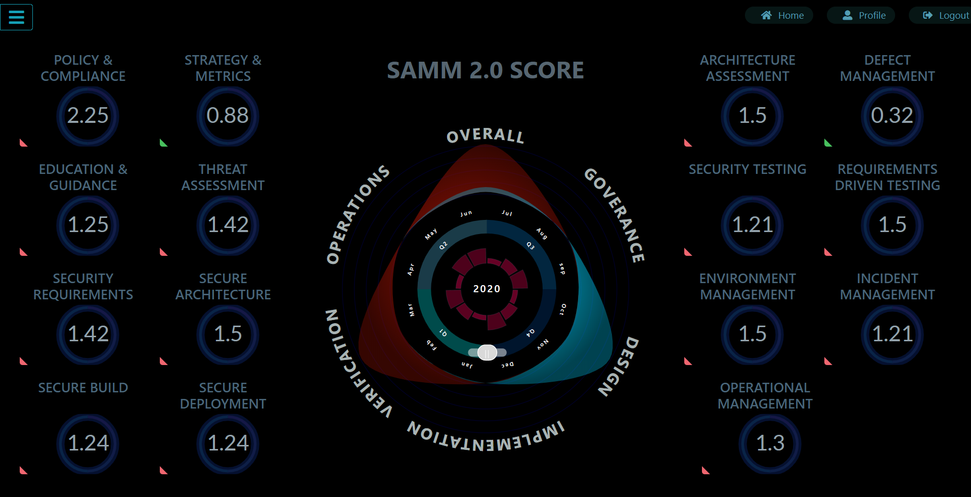
Critical Success Factors with SAMM 2.0 Dashboard

Slide 9
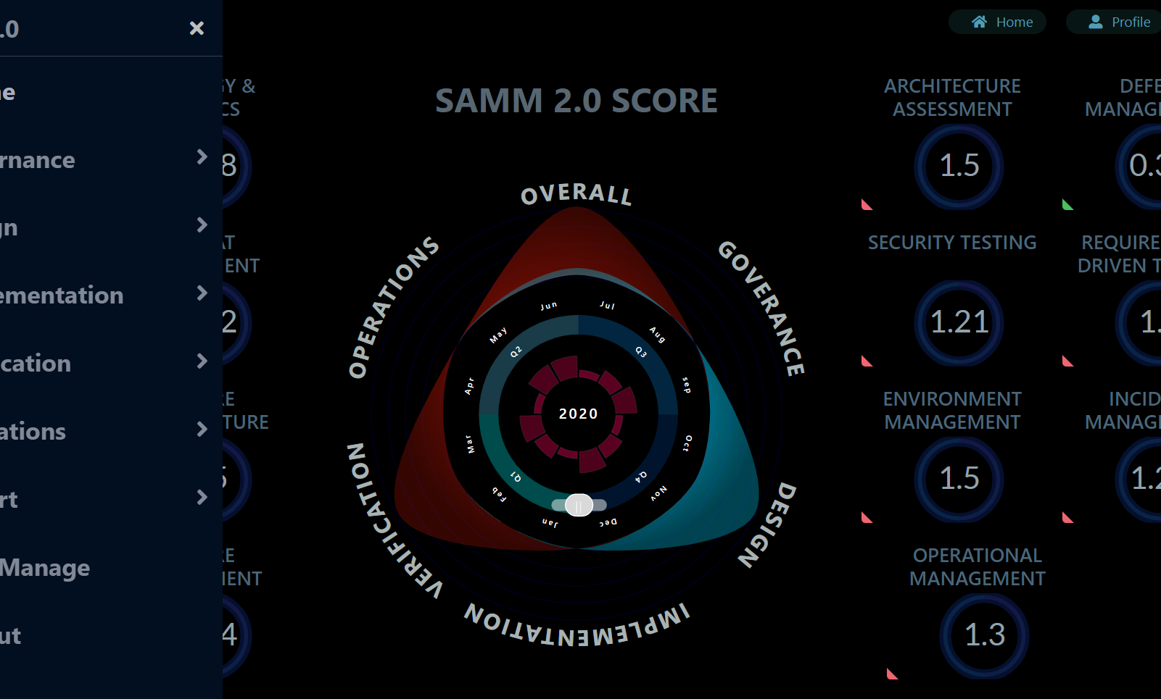
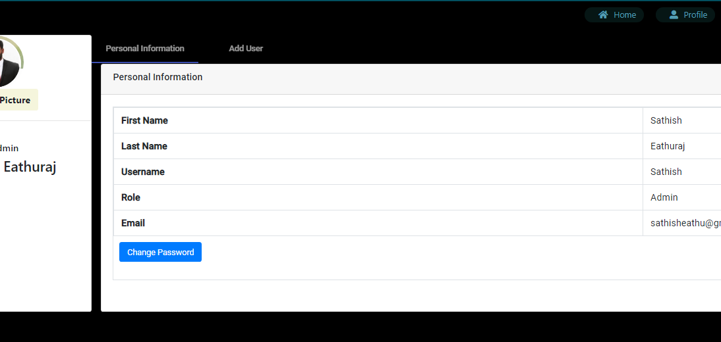
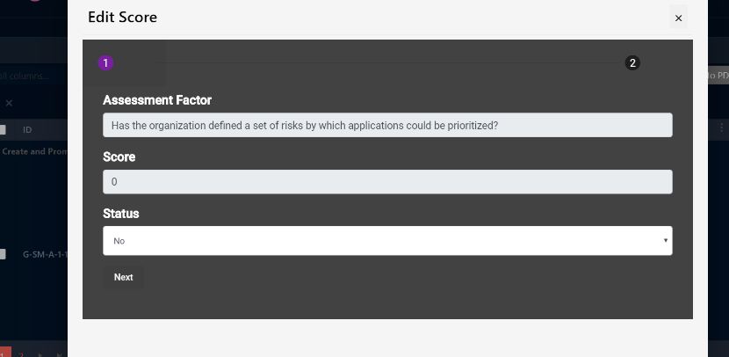
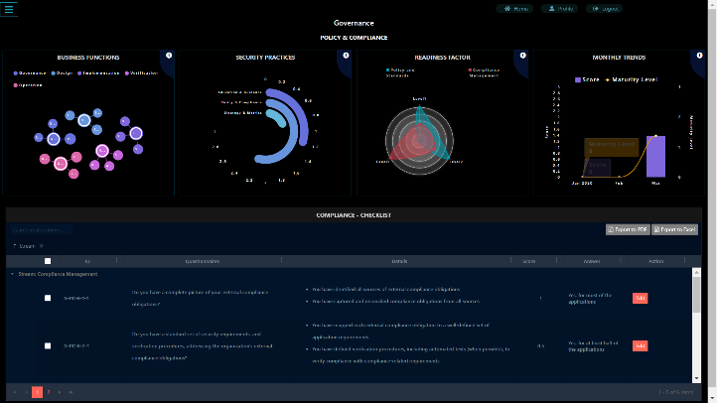
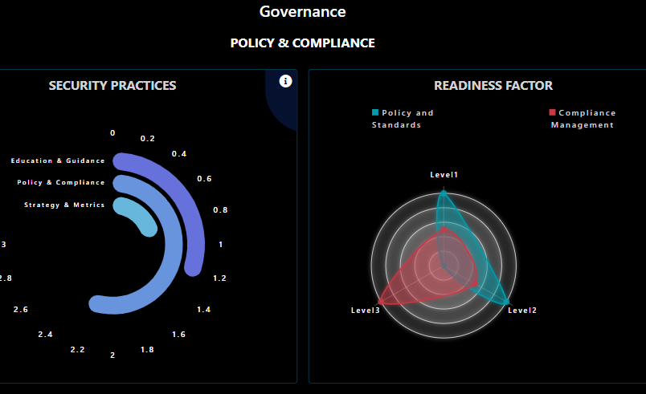
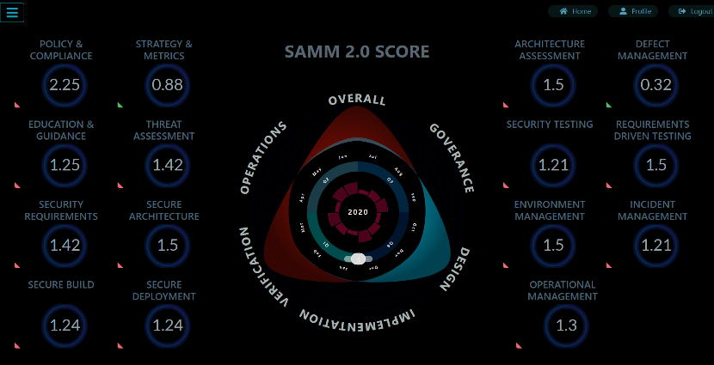

Slide 10
Automated Interviews, Task and Report Transfer
Maturity scores can be produced by any users once onboarded to the portal and the reviewer will verify the artifacts submitted by the user and confirm the maturity score. Reports can be transferred to any number of users specified by the organization through mail automatically rather than downloading the reports manually. This enhances the ease of transferring data between multiple stakeholders.

Slide 11
Automated Scoring Mechanism
Documents can be evaluated automatically and scorings can be provided based on the artifacts submitted by the respective stakeholders. Automated evaluation of strategies employed by integration SAMM to the existing security road map that it performs evaluation automatically on each of the phases of strategy been employed and gets updated automatically in the SAMM Software. Enormous time consumption to perform audit on the documents been evaluated. An AI mechanism will be used to perform automated audit on the factors once the artifacts have been evaluated.

Slide 12
Users, Dashboard and Reporting
Create different types of users such as administrator, auditor, users. A Detailed Comparison Report can be generated on the documents been uploaded for Analysis and for Audit-support Document for future Reference and Analysis. Dashboard with multi-view and different maturity scores.

Slide 13

Would you like to contribute?
Remediate the existing vulnerabilities and upgrade the dependency libraries.
Roadmap features.
Notification feature.
Integration with existing SDLC.
Customized reporting.
Artifacts review and automated scoring
github.com/OWASP/samm

Slide 14
Questions? Feedback?

Slide 15
Thank you!
Google – SathIsh AshwIn
sath9600@gmail.com
satihsh.ashwin@ncdrc.co.in
contact@thecyberschool.org
https://thecyberschool.org

