Slide 1

OWASP SAMM:
Tools of the Trade
SAMM User Day
June 16th, 2020

Slide 2


John Ellingsworth
United States Resident
Temple University (BA), Drexel University (MS)
20+ years cybersecurity & web technology experience:
Startups (1996-2000), Higher Education (1999-2009), Corporate (2009-Present): Software Development / Architecture / Security / Management
OWASP: Maine Chapter lead, SAMM Project
Infragard, ASCP
johnellingsworth.com

Slide 3
Tools of the Trade
OWASP SAMM Toolkit - MS Excel
SAMM 2.0 Calculator by Concord USA
OWASP SAMM App by SathIsh AshwIn
OWASP SAMM Toolkit - GDocs version
OWASP SAMM Assessment - Google Forms & Data Studio

Slide 4
SAMM v2 Question Format
GOVERNANCE
Stream | Level | Strategy and metrics
Create and promote | 1 | Do you understand the enterprise-wide risk appetite for your applications?
 |  | You have captured the risk appetite of your organization’s executive leadership The organization’s leadership have vetted and approved risks You have identified the main business and technical threats to your organization’s assets and data Risks are documented and accessible to relevant stakeholders
https://github.com/OWASP/samm/tree/master/Supporting%20Resources/v2.0/toolbox

Slide 5
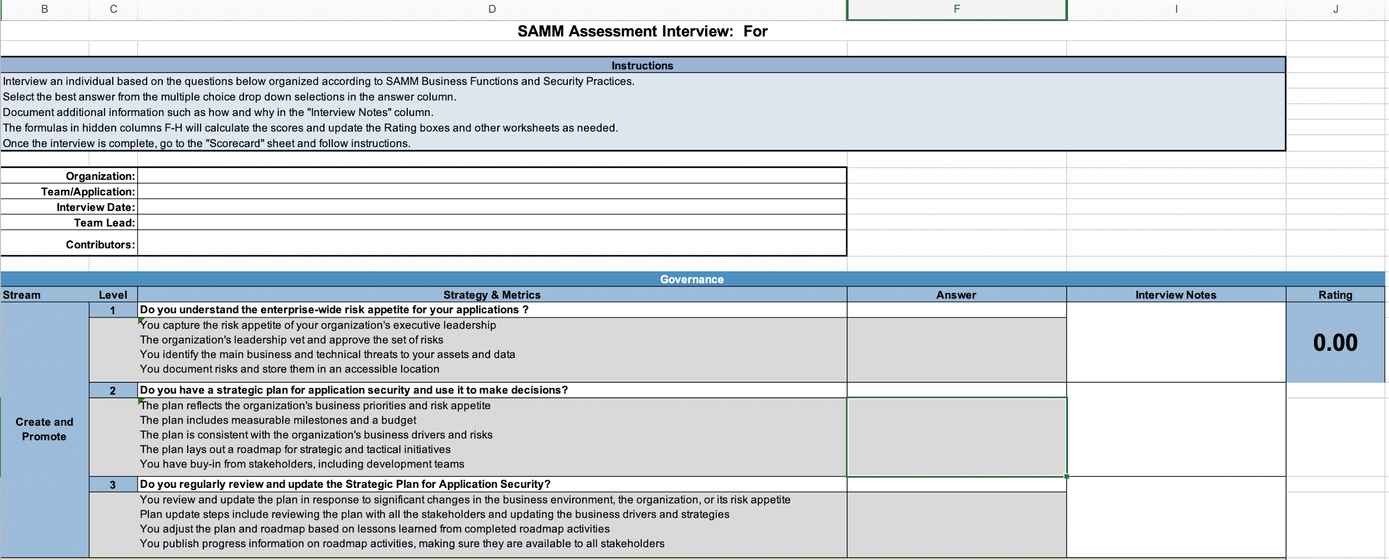
OWASP SAMM Toolkit - MS Excel
Components:
90 Question Interview
Scorecard & Roadmap for visualizing Maturity
Roadmap for Maturity goal planning
Microsoft Excel-Based Tool
Ready to use!
https://github.com/OWASP/samm/tree/master/Supporting%20Resources/v2.0/toolbox
Notes:
Cannot save data

Slide 6
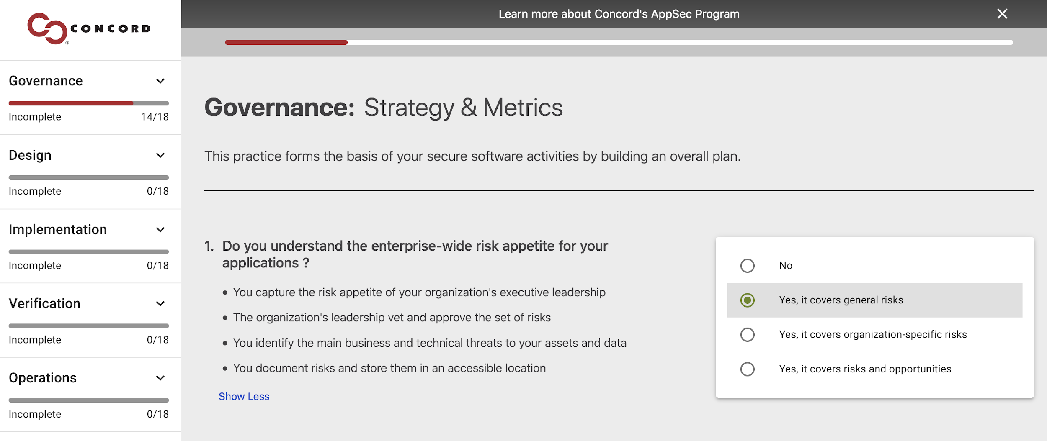
SAMM 2.0 Calculator: ConcordUSA
Components:
Self-guided assessment
Function/Practice Breakdown
Function Maturity Breakdown
SaaS Web-Based Tool
Progress Bar
Industry Benchmark Comparison
Ready to use!
https://concordusa.com/SAMM/
Notes:
Cannot save data

Slide 7
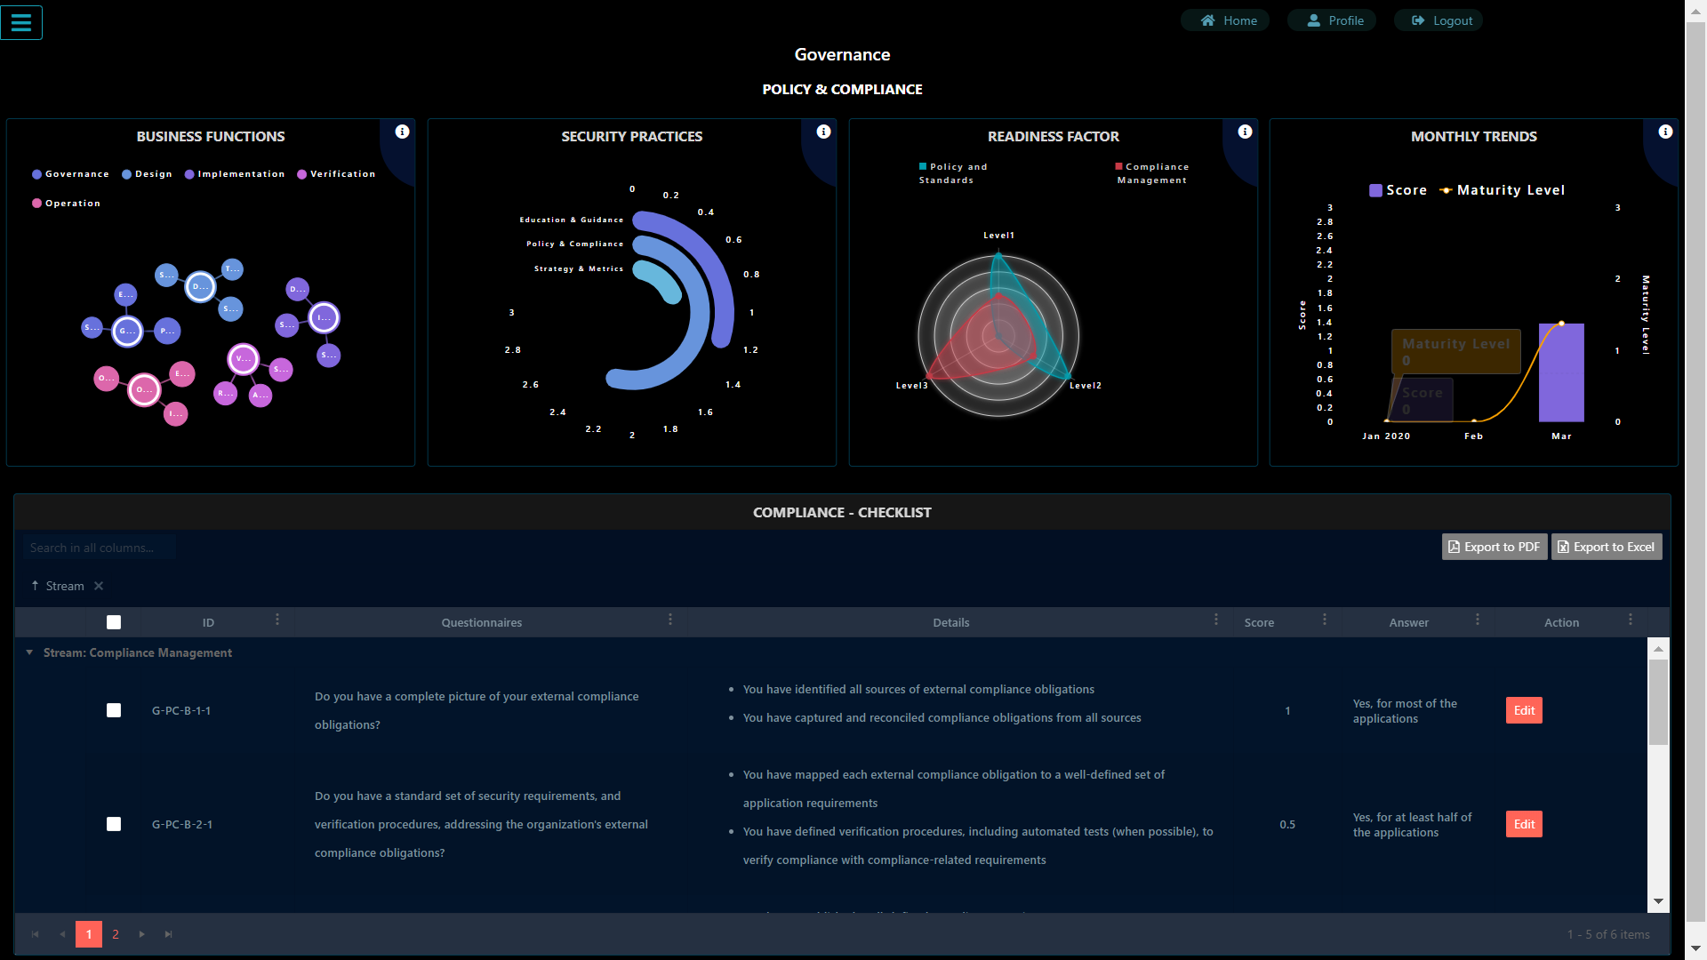
OWASP SAMM App: SathIsh AshwIn
Components:
Login protected
Role Based Access Control
Practice Trending
Angular project on Github
PDF/Excel Report Generation
Self-Hosted Solution
Ready to use!
https://github.com/OWASP/samm/tree/master/Supporting%20Resources/app

Slide 8
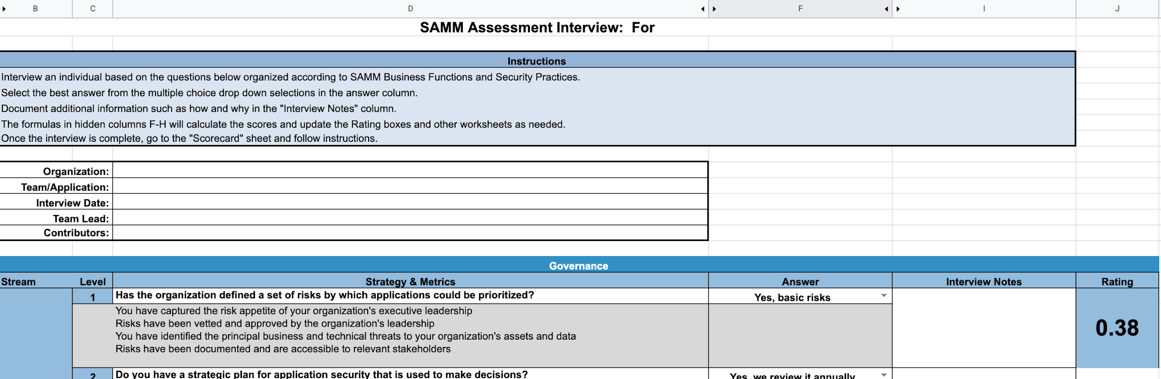
Google Sheets
Google Sheets Version of Excel Toolkit
Can be exported to reporting tools and shared with others
Currently being validated!
https://docs.google.com/spreadsheets/d/1uBoiaHcY3UpdZim1zGuKkVwSxhmCHCnaq5nawnfglsY/edit?usp=sharing

Slide 9
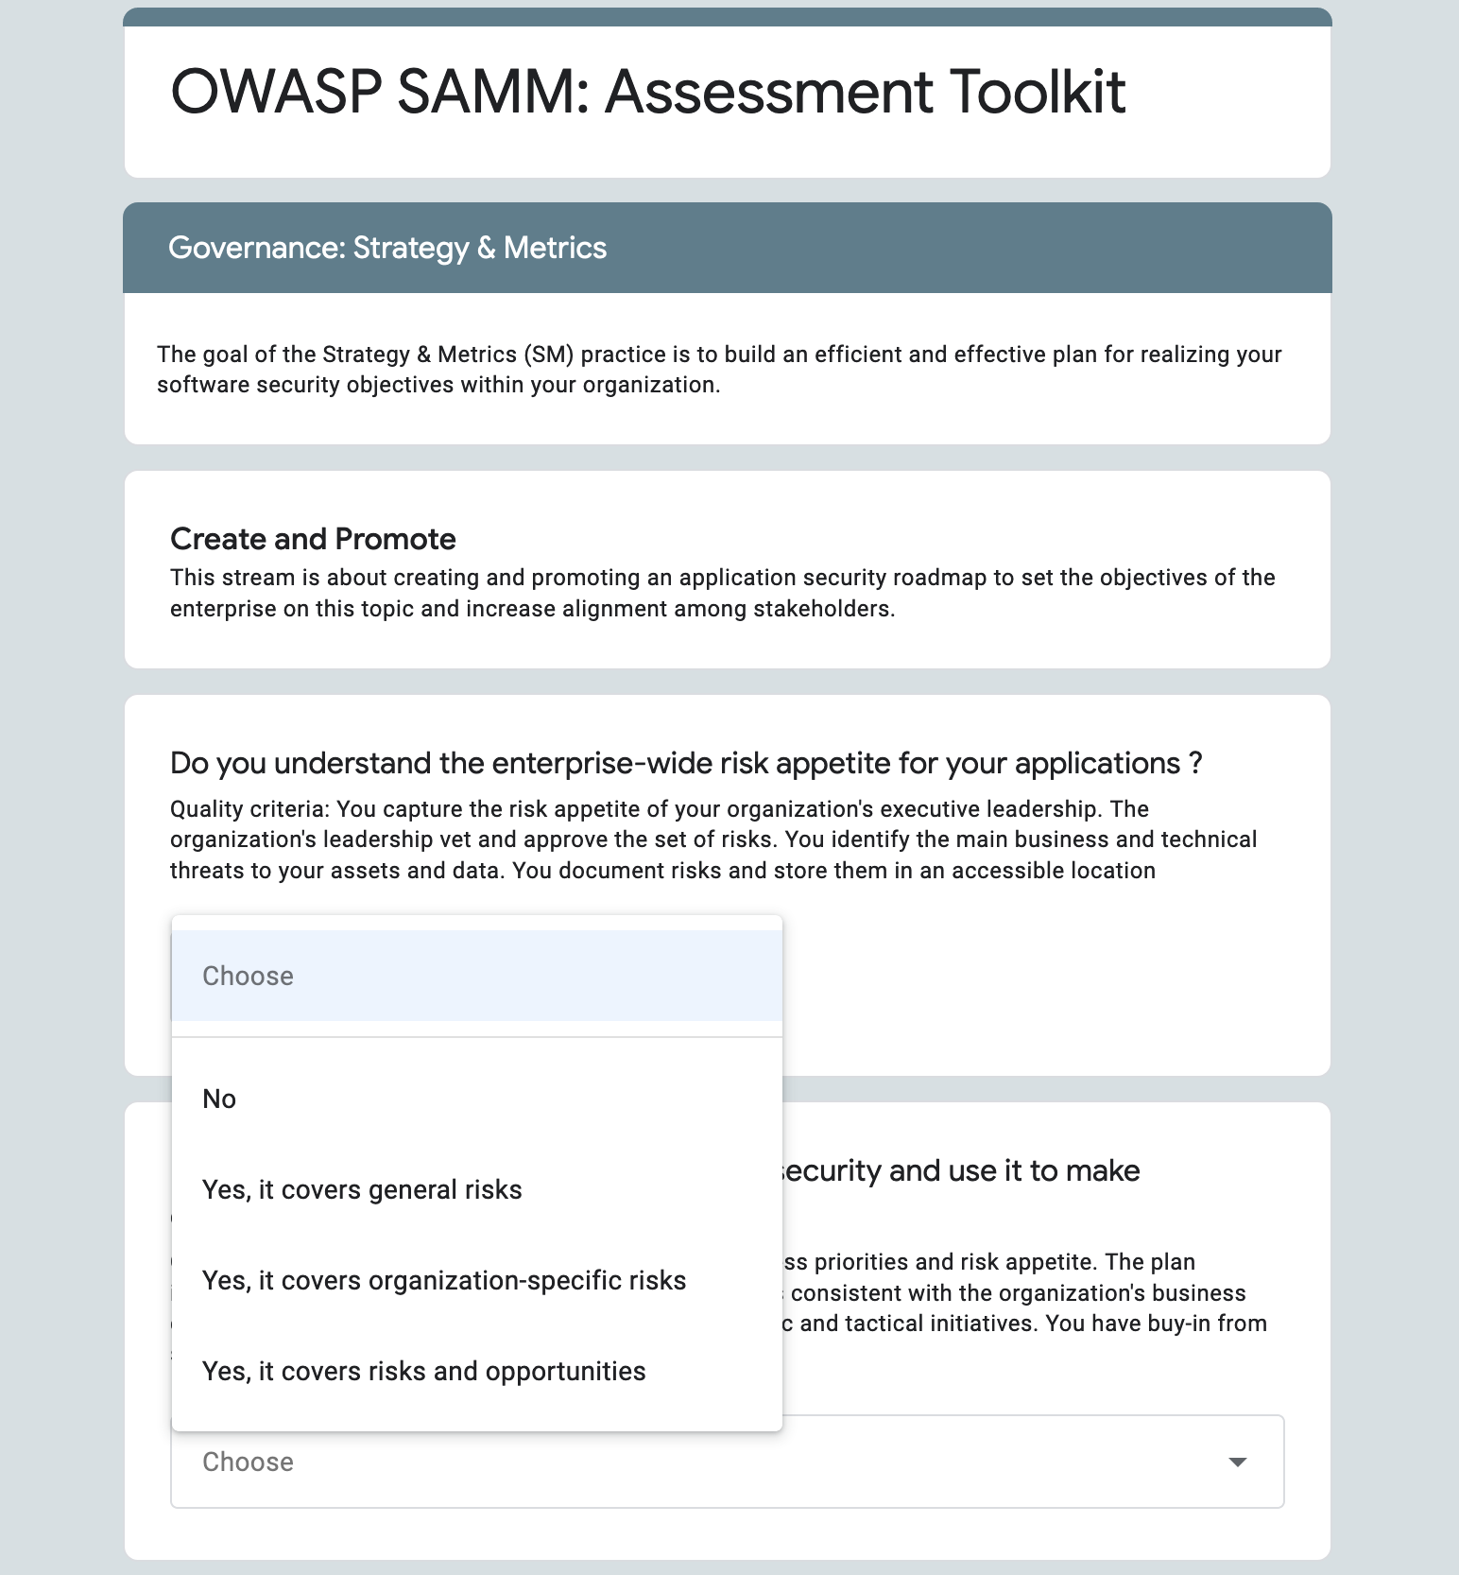
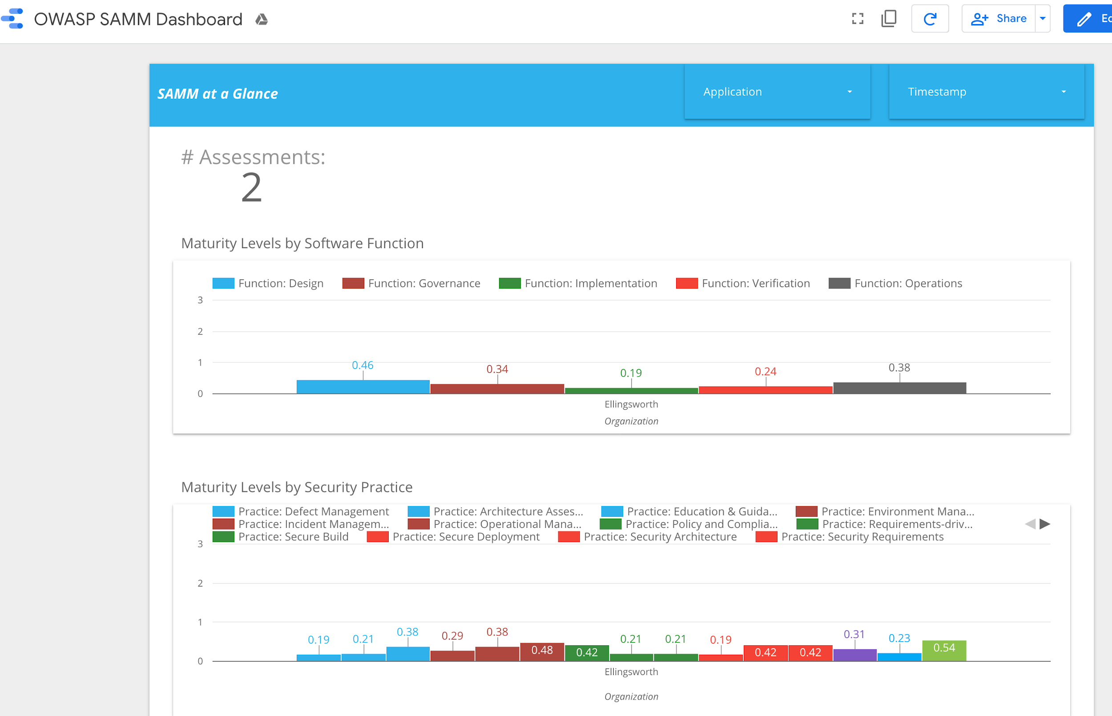
Google Forms & Data Studio
/
Google Sheets/Forms based assessment
Data is stored in Google Sheets
Easy Self-service Form
Responses can be edited
Can be exported to reporting tools
Google Data Studio
Currently being validated!
https://forms.gle/ufT6N79WFtoh2Bj66

Slide 10
Assessment Toolbox Roadmap
What features would you like to see in OWASP SAMM assessment tools? Let us know!
Feature Request:
https://forms.gle/eMH2LqVQ8jz51h8U7
Drop us a line:
https://owaspsamm.org/contact/

