Slide 1

The Seven Deadly Sins of SAMM
SAMM User Day
June 16th, 2020

Slide 2

John D Wood
Fortify
Cigital
Checkmarx
Europe
USA
Middle East and Africa
China
Notes:
Why I care about SAMM?
I was there at the beginning at Fortify – BSA became SSA became OpenSAMM became SAMM
Personal motivation – Way too many AppSec programmes fail.

Slide 3
The Importance of SAMM
“Without doubt, the single determining factor in the success of a impactful Application Security Project is the use of SAMM”

Slide 4
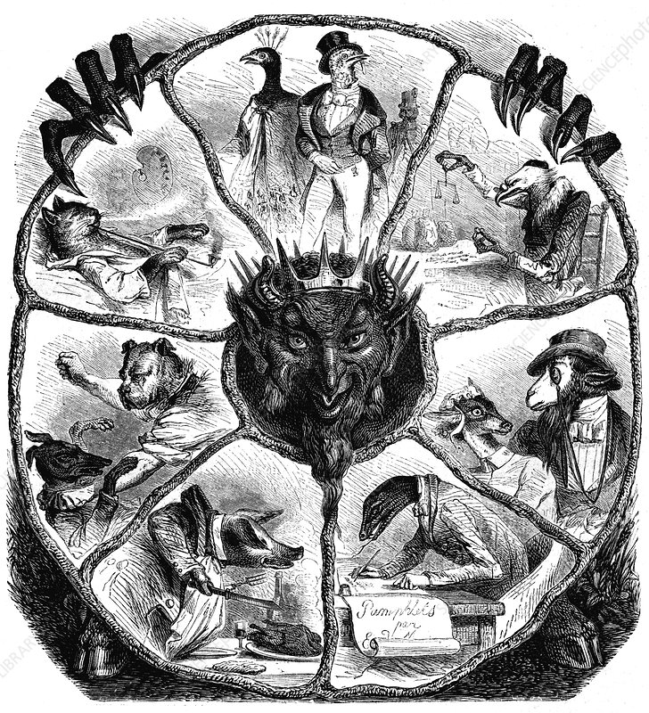
The Seven Deadly Sins
Notes:
The seven deadly sins are derived from Western Christian theology , they are a collection of Vices
These are stories about how lust, gluttony, greed, sloth, wrath, envy, and pride may be undermining your latest AppSec project as we speak. The seven deadly sins we speak of are
Lust
Gluttony
Greed
Sloth
Wrath
Envy
Pride

Slide 5
Lust
Lust is an immoral desire yet we know that Passion is morally accepted

Slide 6
Gluttony
Gluttony is the over consumption and indulgence of food but also associated with wealth items

Slide 7
Greed
Greed is an inordinate desire to acquire or possess more than one needs
Notes:
This is one for the Static Analysis Vendors, The Pen Testers and the Threat Modellers. I am talking about the Greed of

Slide 8
Sloth
Sloth is the absence of interest.

Slide 9
Wrath
Wrath is the strong uncomfortable and hostile response to a perceived provocation, hurt or threat

Slide 10
Envy
Envy as pain at the sight of another’s good fortune, stirred by “those who have what we ought to have.”
Envy is one of the most potent causes of unhappiness
Notes:
This slide is about comparing yourself to other Maturity Models…

Slide 11
Pride
Placing one's own desires, urges, wants, and whims before the welfare of others

Slide 12
Questions
john.wood@checkmarx.com

