Slide 1

USING OWASP SAMM TO KICKSTART THE SSDLC LESSONS LEARNED FROM REAL-WORLD PROJECTS
SAMM User Day
June 16th, 2020

Slide 2

DI Thomas Kerbl, MSc.
SEC Consult Unternehmensberatung GmbH
Principal Security Consultant / Teamleader
ISTQA, ISAQB, CPSSE, PCiIAA
E t.kerbl@sec-consult.com
T https://twitter.com/dementophobia
L https://at.linkedin.com/in/thomas-kerbl-2ab81648

Slide 3
Topics
Security requirements are the backbone of the SSDLC
Security Champions can carry you a long way
Use the benefits of your development methodology
Big bang approach vs. steady improvements over time
Q&A

Slide 4
Security requirements are the backbone of the SSDLC
Not all security activities are born equal
Consider your security requirements in all stages of development
Invest in proper security requirements now and reap the benefits later
Use your traceability matrix for root cause analysis
Let’s take a look at some examples next!

Slide 5
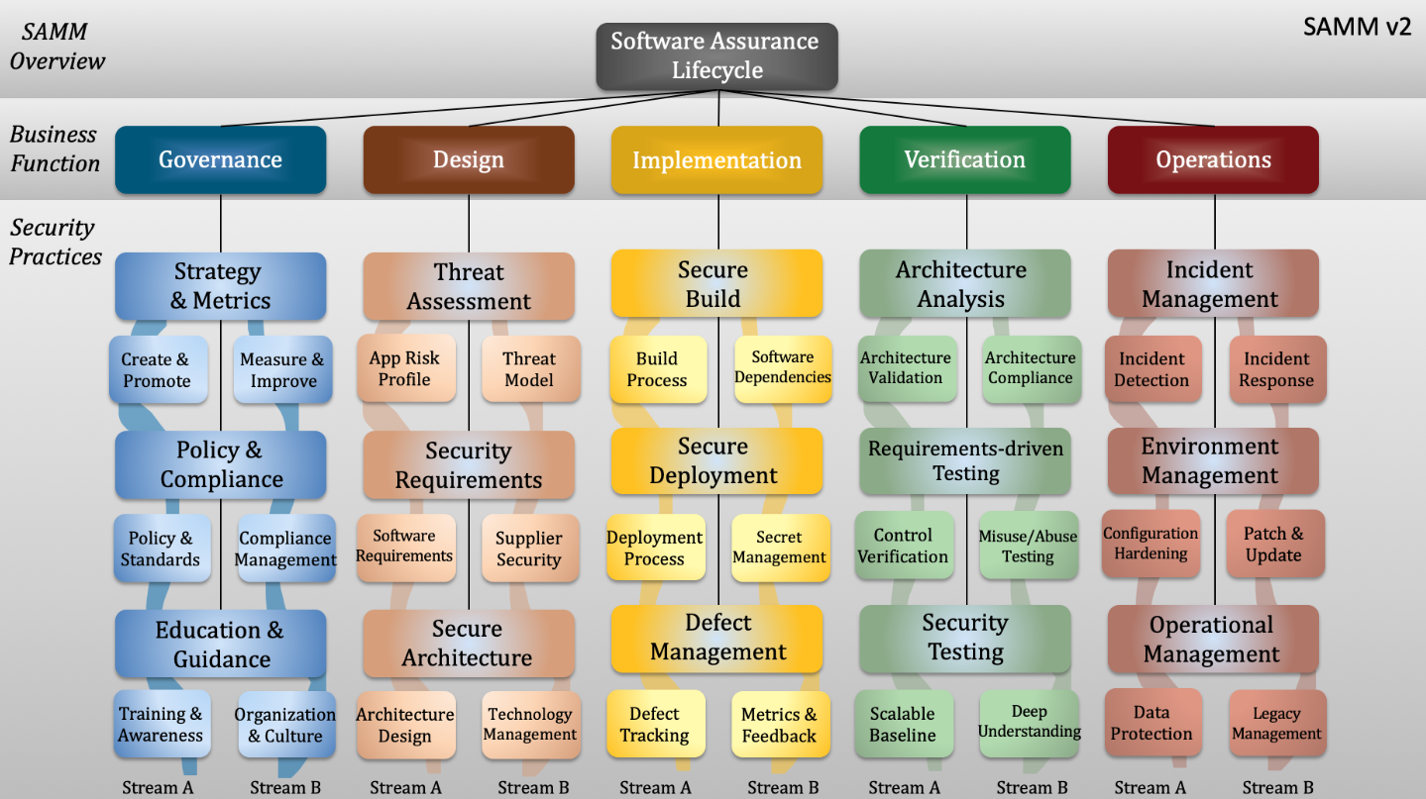

Slide 6
Security requirements are the backbone of the SSDLC
Tips, Tricks, and Quick Wins:
Use the OWASP ASVS as shortcut for technical requirements
Implement a Quality Gate to verify security requirements early on

Slide 7
Security Champions can carry you a long way
Educate and enable your security champions
Create room for those who want to contribute
Getting the buy-in from everyone involved is crucial
Working on Security must be enjoyable

Slide 8
Security Champions can carry you a long way
Tips, Tricks, and Quick Wins:
Make your security champions visible and effective
Build a great security culture

Slide 9
Use the benefits of your development methodology
OWASP SAMM is process and technology agnostic
There are no one-size-fits-all security solutions
Get the most out of the strong areas of your SDLC
Find ways to address the weak spots

Slide 10
Use the benefits of your development methodology
Tips, Tricks, and Quick Wins:
Adapt your test methods for fast paced environments (DevOps)
Integrate manual testing early to compensate for short test windows
Leverage test automation through integration in the CI/CD pipeline

Slide 11
Big bang approach vs. steady improvements over time
It depends on team size and agility
The big bang can work, but usually you want to do it step by step
Take time to evaluate different approaches before you settle
Establish the fundamentals before you aim for mastery

Slide 12
Big bang approach vs. steady improvements over time
Tips, Tricks, and Quick Wins:
Plan your roadmap to utilize synergies
Measure your progress and celebrate successes
Share your achievements with stakeholders

Slide 13
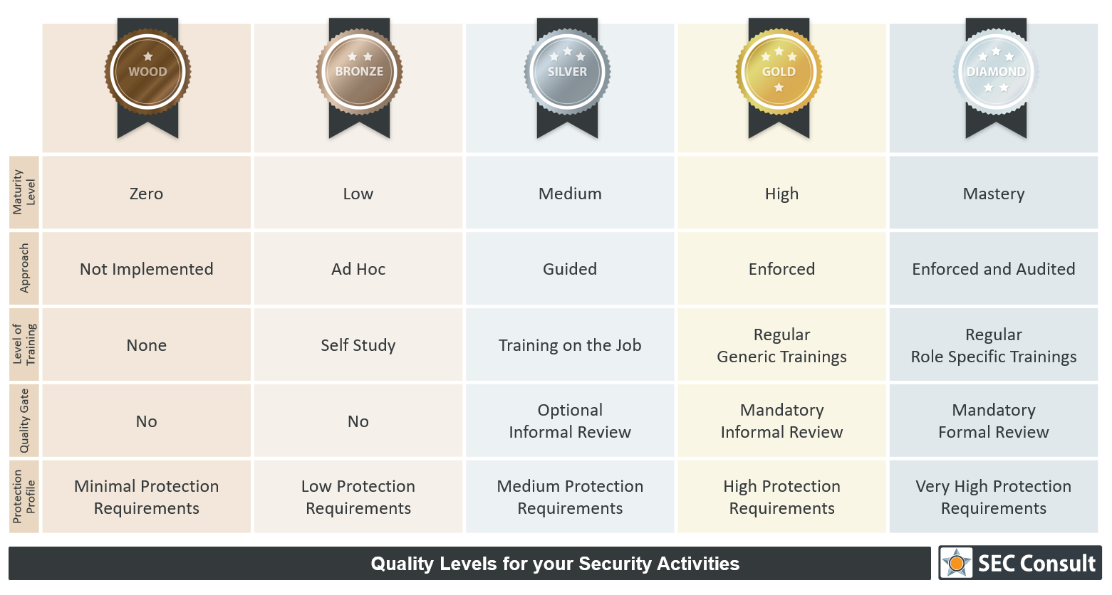
Recommended Reading
“A deep dive into Secure Software Development based on OWASP SAMM”
https://r.sec-consult.com/SSDLC
Follow me on Twitter for Updates!

