Slide 1
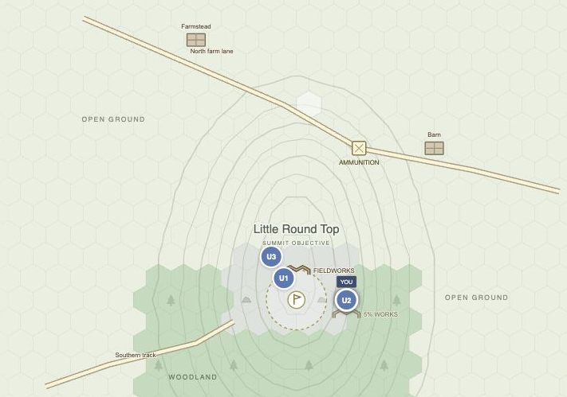
battle
Can you hold
Little Round Top?
Command three Union detachments against a computer-led Confederate advance. Hold the summit until 5 p.m.
GETTYSBURG, PENNSYLVANIA / JULY 2, 1863
Notes:
Playable local experiment. The setting is historical. The terrain layout, forces and victory conditions were authored for the prototype. Source: apps/poc/README.md and apps/poc/artifacts/battle-map-features.png.

Slide 2
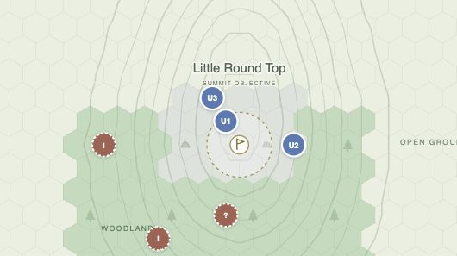
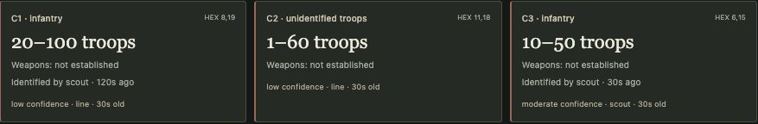
What has reached headquarters?
You ride with detachment U2. Nearby troops can speak to you. A runner carries orders and reports across longer distances.
A scout reports infantry, perhaps 10 to 50 troops. Another sighting gives a range of 1 to 60. Their troop type is still unknown.
Notes:
The enemy contact cards and map are from the same captured state. See apps/poc/artifacts/battle-reconnaissance.jpg and docs/research/20-reconnaissance-and-standing-reactions.md. Reports carry observation and receipt times. Estimates depend on the observer and can grow stale.

Slide 3
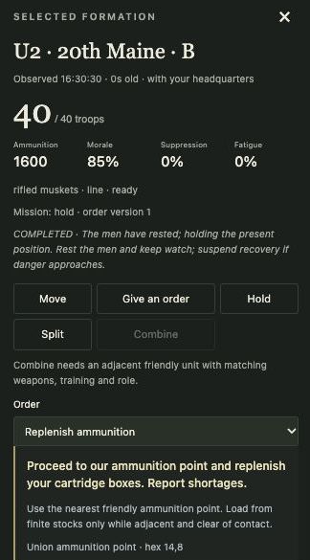
What orders will you give?
Click a friendly unit to inspect its strength, morale, ammunition and fatigue before committing it.
On contact
Standing orders guide the unit while a runner is on the road. Under fire it can take cover, return fire or withdraw.
Send it to a hex, call it back, or order a rest or resupply. A detachment can also split or combine when conditions permit.
An ammunition order sends the men to a supply point. They load what the stockpile can spare.
Notes:
Source: apps/poc/artifacts/battle-common-orders.png, docs/research/22-unit-panel-and-formation-actions.md, docs/research/23-common-order-templates.md and docs/research/26-standing-orders-and-troop-analysis.md.

Slide 4
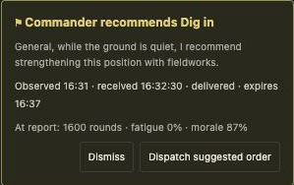
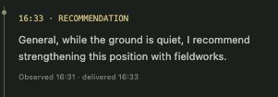
A commander asks to dig in
At 16:31, the commander of U1 sees a lull. He asks to build fieldworks. The recommendation reaches headquarters at 16:32:30.
You can send the order or dismiss it. If it arrives while the ground is still quiet, the men can start digging. Incoming fire can interrupt the work.
Notes:
Screenshot: apps/poc/artifacts/battle-commander-recommendations.png. The recommendation panel gives the exact receipt time. The feed displays the recommendation under its rounded display time. Fields and behavior: docs/research/24-map-features-and-digging-in.md and 25-commander-recommendations.md.

Slide 5

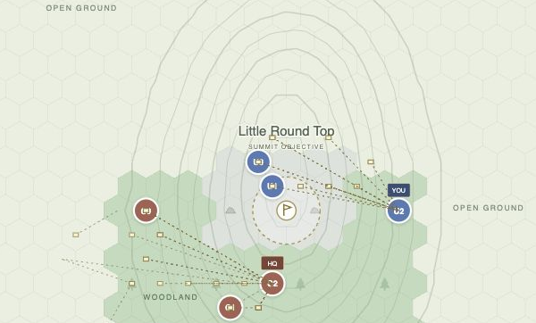
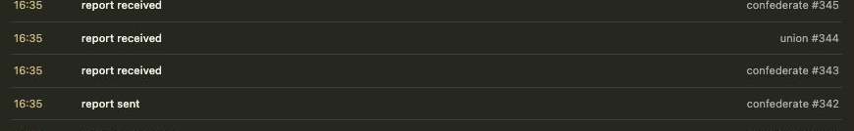
Follow the battle on one clock
Start, pause or change speed while you play. Replay uses the decisions already recorded, so you can trace what led to an outcome.
Switch on God Mode to see both forces. Orders are disabled in this view, and commanders keep their own fog of war.
Notes:
Sources: apps/poc/artifacts/battle-calendar-header.png and battle-god-mode.jpg, docs/research/18-simulation-clock-and-replay.md, docs/research/21-god-mode-and-command-location.md. The observer image and commander clock come from different saved moments.

Slide 6
Holding the summit had a cost
Three runs began with 120 troops on each side. Only the Union plan changed.
Union plan | Orders | Summit | Union troops left
Reposition the detachments | 5 | Held until 17:00 | 80
Keep the starting missions | 0 | Held until 17:00 | 98
Pull back to rear positions | 3 | Lost at 16:35 | 120
Leaving commanders to carry out their original missions held the hill with 18 more Union troops surviving than the repositioning plan.
These are simulation results for one authored scenario. Historical calibration is a separate test.
Notes:
Source: docs/research/30-design-scale-assessment.md, table “What the playable experiment establishes”. Remaining Confederate strength in order: 82, 95, 120. The same Confederate scripted policy responded to each Union policy. These are deterministic results, not historical casualty estimates.

