Slide 1
HCI in a Nutshell
Usability & Accessibility

Slide 2
but first... Term Project Review

Slide 3
Term Project (review)
Term Project provides an opportunity for student groups to design and mock-up a web application. The application can serve any purpose, real or imagined, in the present or the future.
The web application is not intended to be fully functional, but should adhere to the following guidelines:
Each group must write a description of what the application does, who it serves, and place it in the context of existing applications.
Each group must make a case for their application's value: how does it distinguish itself? Is there perceived demand for the application, or does it fill a void not taken by another service?
Each group must document a reasonably full information architecture, explaining the application's structure, navigation, and key user interface elements.

Slide 4
Term Project (review)
Each group should mock up their web application's user interface, and will be given points on competence in five areas. Of these five areas, each group must pick two around which to focus their efforts: a primary area and a secondary area. The project should strive for excellence in the first and proficiency in the second.
Area 1: HTML, CSS, and graphics for page layout and design
Area 2: Javascript interactivity to improve user experience (e.g. from simple to more complex: mouse hovers, form validation, hide/show, auto-completion, drag and drop, etc)
Area 3: Pull static data from a data file, e.g. JSON or XML (or both)
Area 4: Pull real data from a database
Area 5: Put real data in a database, cookie, session storage, or local storage

Slide 5
Prototyping Your Project (review)
Think about your users, and the tasks they perform
Build a low-fi, paper prototype and/or storyboard
Build a medium fidelity, electronic prototype
Perform Heuristic Evaluation
Build a high-fidelity prototype

Slide 6
Term Project (review)
Teams of 3 persons have been randomly assigned
Teams submit proposal for Term Project Problem and Scope by Thursday Oct 11
Teams submit Term Project Plan by Oct 31
Teams make Term Project Presentations on Dec 1, 5, and Dec 8
Teams submit Term Project Final Report on Dec 8

Slide 7
HCI

Slide 8
What is HCI?
Human-Computer Interaction
HCI is a discipline, not a methodology
Like Computer Science or IT, it encompasses a broad range of techniques and best practices
HCI professionals examine, evaluate, and improve the ways in which humans interact with computer interfaces
Not just desktop computer interfaces, but ATMs, mobile devices, fighter planes, control panels, etc.
Both hardware and software

Slide 9
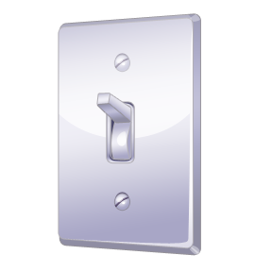
What is Usability?
Usability is a dimension of quality: how easy an interface is to use
Jakob Nielsen, the well-known usability expert, splits usability into five components...
Nielsen, Jakob. (2010). Usability 101: Introduction to Usability.
In Jakob Nielsen's Alertbox. Retrieved from http://www.useit.com/alertbox/20030825.html

Slide 10
Dimensions of Usability
Learnability
How quickly can a user learn to perform tasks the first time?
Efficiency
Once learned, how quickly can a user perform tasks?
Memorability
How well can a user remember how to perform tasks?
Errors
How many errors do users make? Can they recover quickly?
Satisfaction
How pleasant is the user interface to use?

Slide 11
What is Accessibility?
Accessibility allows people with disabilities to “perceive, understand, navigate, and interact” with your web site or application Henry, Shawn Lawton, Ed. (2005). Introduction to Web Accessibility. In W3C’s Web Accessibility Initiative. Retrieved from http://www.w3.org/WAI/intro/accessibility
Public web sites / applications can be tested:
Section 508 compliance (Amendment to the Rehabilitation act of 1973)
WCAG compliance (Web Content Accessibility Guidelines by the W3C)
The web developer toolbar has links for both
Uses the “Cynthia Says” website http://www.cynthiasays.com/

Slide 12
Why do we care?
Improve the overall experience for end users
Users can work more efficiently with less frustration
System can communicate clearly to users
Advantages
Save money during development
Encourages us to correct mistakes early on
Save money after development
Fewer calls for technical support
A more satisfying user experience leads to stronger customer loyalty

Slide 13
Usability is Necessary
Take the web (or an application):
“If a website is difficult to use, people leave. If the homepage fails to clearly state what a company offers and what users can do on the site, people leave. If users get lost on a website, they leave. If a website's information is hard to read or doesn't answer users' key questions, they leave. Note a pattern here?”
Nielsen, Jakob. (2010). Usability 101: Introduction to Usability. In Jakob Nielsen's Alertbox.
Retrieved from http://www.useit.com/alertbox/20030825.html

Slide 14
HCI is multidisciplinary
Computer Science, “Hard” IT Disciplines
How do we construct the interface?
What are the technical limitations?
Psychology/Sociology
What is the user thinking?
How do we make the interaction intuitive?
Visual Design
How do I best communicate important information?
How do I make the interface easy-to-use?

Slide 15
User-centered design (UCD)
Who are your primary users?
Is your design centered on them?
E.g. if you design a site for kids, then you need to consider a kid’s point of view (and probably their parent’s).
Practice empathy. Put yourself in the user’s shoes.
Don’t rely on your smarts alone: You are a sample size of one. Get your design in front of users!

Slide 16
User-centered design
Interfaces are built in iterative cycles
Study, Design/Build, Test
We gather information based on certain assumptions...
Then we apply the information, and build a prototype of the interface...
We then test our prototype to see if it lives up to our and the user's expectations
We test by observing (...not coaching)
We repeat the cycle as many times as time, need, and funding allow

Slide 17
Usability Testing Roadmap:
Study users and the tasks they perform
Build a low-fi, paper prototype and/or storyboard
Walk through storyboards/prototype with user
Review user feedback
Build a medium fidelity, electronic prototype
Perform Heuristic Evaluation
Study/Evaluate results
Build a high-fidelity prototype
User Testing
Repeat as necessary

Slide 18
Usability Testing Roadmap:
Study users and the tasks they perform
Build a low-fi, paper prototype and/or storyboard
Walk through storyboards/prototype with user
Review user feedback
Build a medium fidelity, electronic prototype
Perform Heuristic Evaluation
Study/Evaluate results
Build a high-fidelity prototype
User Testing
Repeat as necessary

Slide 19
Usability Testing Roadmap:
Study users and the tasks they perform
Build a low-fi, paper prototype and/or storyboard
Walk through storyboards/prototype with user
Review user feedback
Build a medium fidelity, electronic prototype
Perform Heuristic Evaluation
Study/Evaluate results
Build a high-fidelity prototype
User Testing
Repeat as necessary

Slide 20
Studying users and tasks
A very important first step!
There are a number of things we need to take into account
Demographics – characteristics of user groups
Psychographics – how these groups think
Surrounding environment
User desires, needs, and constraints

Slide 21
How do we study users?
One way is user profiling or Personas
Create profiles of “mock users,” who represent your target audiences
These mock users aren't real people…
But you collect information about real people to create these profiles!
An excellent source of information for creating personas is the Fluid Project:
http://wiki.fluidproject.org/display/fluid/Personas

Slide 22
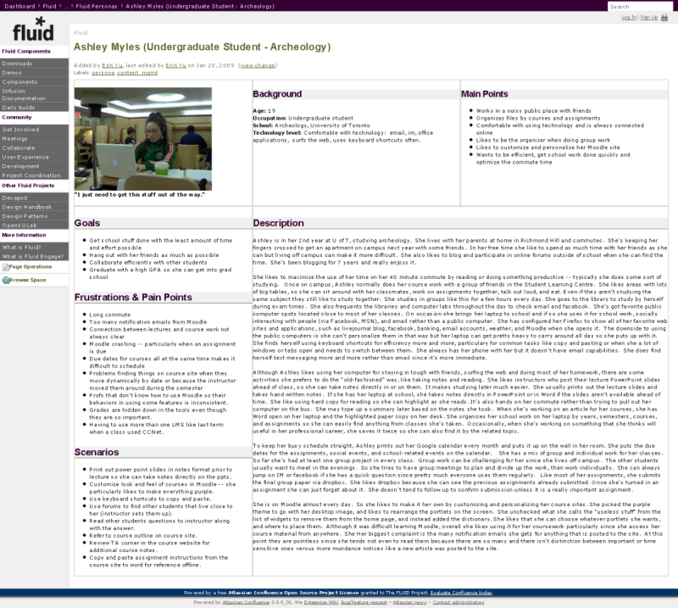

Slide 23
Why personas?
As you develop your project, ask yourself:
Does my interface fit the needs of my target audiences? ← These are your personas.
Is the portrait I painted of “Ashley” (users similar to Ashley) accurate?
This keeps the project requirements on track!

Slide 24
Studying Tasks 1 of 2
We must determine what users need to do
There are a number of ways to do this
Your own thoughts on the matter
Direct interaction with a user
“Innocent bystander” approach, non-interactive
“Master/Apprentice” approach, you are the apprentice and the user is the master, you observe and ask questions while tasks are performed.
Others...

Slide 25
Studying Tasks 2 of 2
If you are designing something that doesn’t exist,
you must rely on your own mind and
study apps & interfaces that have similar characteristics...
Pull ideas from different paradigms, including the non-technical.
other engineering and sciences
history
science fiction
Philosophy
Remember – you are trying to define a solution that solves the problem – not the symptom – Listen, Observe, Empathize
Users will often describe a symptom of a larger need

Slide 26
Usability Testing Roadmap:
Study users and the tasks they perform
Build a low-fi, paper prototype and/or storyboard
Walk through storyboards/prototype with user
Review user feedback
Build a medium fidelity, electronic prototype
Perform Heuristic Evaluation
Study/Evaluate results
Build a high-fidelity prototype
User Testing
Repeat as necessary

Slide 27
Low-fi Prototype
All of this information leads to your “first draft”
Should be done on paper
Inexpensive to correct
Fewer design decisions to make
Emphasis on the interface, not aesthetics
Storyboarding
Sketches of each component of the interface
May have descriptive text
Paper computer - Facilitator, Computer, Recorder

Slide 28
Paper Computer
“Interactive storyboard” used to walk through a new interface with users
User is asked to complete a series of tasks using the interface, and describes how they would like to interact with it
Group members shift/replace/write on the storyboard to illustrate how the system would respond
This kind of testing is known as “Wizard-of-Oz Paradigm” (“Pay no attention to the man behind the curtain!”)

Slide 29
Facilitator, Computer, Recorder, User
The Facilitator explains what is going on in the user test, and is the only one talking to the user
Encourage the user to think out loud
Don't help them with the interface!
The Computer (a person) is the one updating the paper interface when the user acts on it.
Recorders take copious notes
Errors, near-errors, time taken
When the user hesitates
What the user says aloud, etc.

Slide 30
The next step?
Odds are, you found a lot of problems with your paper prototype
Screens you didn't draw ahead of time
User acted in a way you didn't expect
User thought they completed a task, but didn't
That's great!
The next version won't have those problems, right?
Study your results, and use them to build another prototype

Slide 31
Usability Testing Roadmap:
Study users and the tasks they perform
Build a low-fi, paper prototype and/or storyboard
Walk through storyboards/prototype with user
Review user feedback
Build a medium fidelity, electronic prototype
Perform Heuristic Evaluation
Study/Evaluate results
Build a high-fidelity prototype
User Testing
Repeat as necessary

Slide 32
Medium-fi Prototype
At this point, you should be making some visual design decisions
Create an electronic version
e.g. a browser-based mock-up, or a Photoshop or other bitmap representation (even PowerPoint can work!)
This means we must touch on the basics of graphic design, and we’ll start with the big four...

Slide 33
C.A.R.P.
Contrast
Alignment
Repetition
Proximity
We help our design decisions by keeping these four basic concepts in mind.
Want to make this easier to remember? Switch the "R" and the "A".

Slide 34
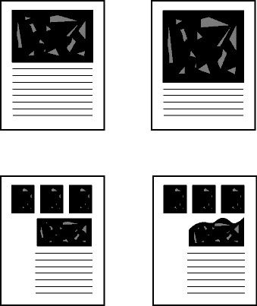
Contrast
Use contrast to call special attention to important information
If it is important, it should stand out
The eye is very good at discerning anything that is different or out-of-place
Contrast isn't restricted to font weight, or even color: shape, size, any other quality we can perceive
But note: if everything is bold, nothing is bold

Slide 35
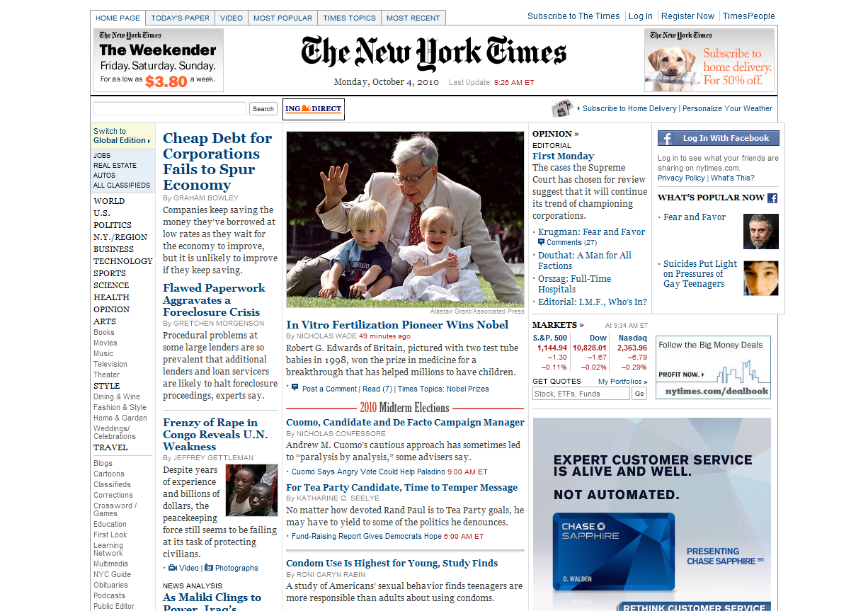

Slide 36
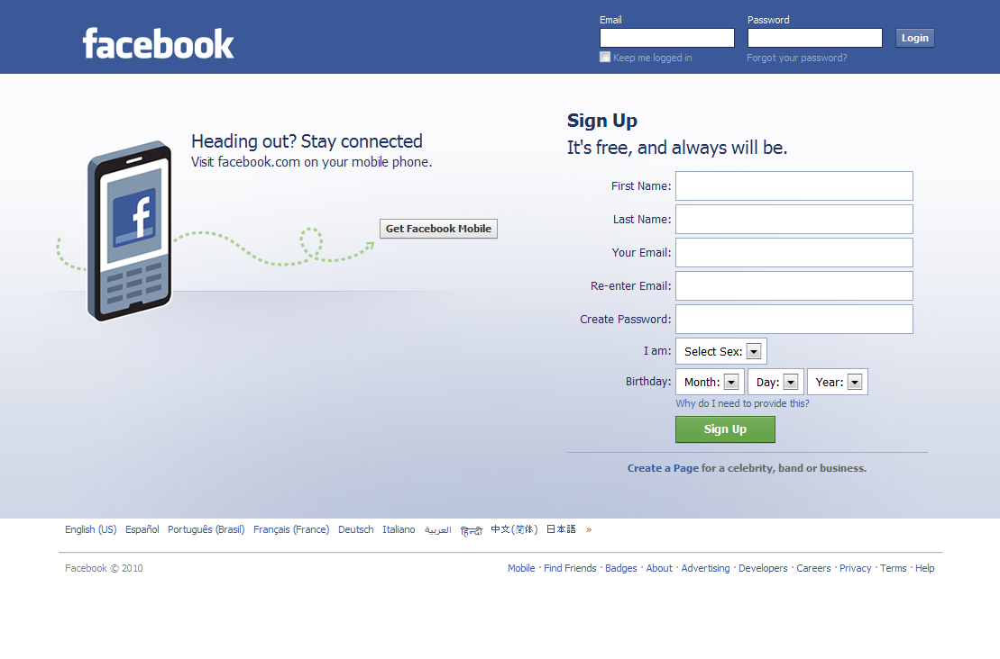

Slide 37
Alignment
Used to maintain a logical ordering and cohesion of elements
Every element on the page should be visually connected to another
Left-aligned is good for most content
Improves readability
You can use indentation to show that one item is logically grouped under another

Slide 38
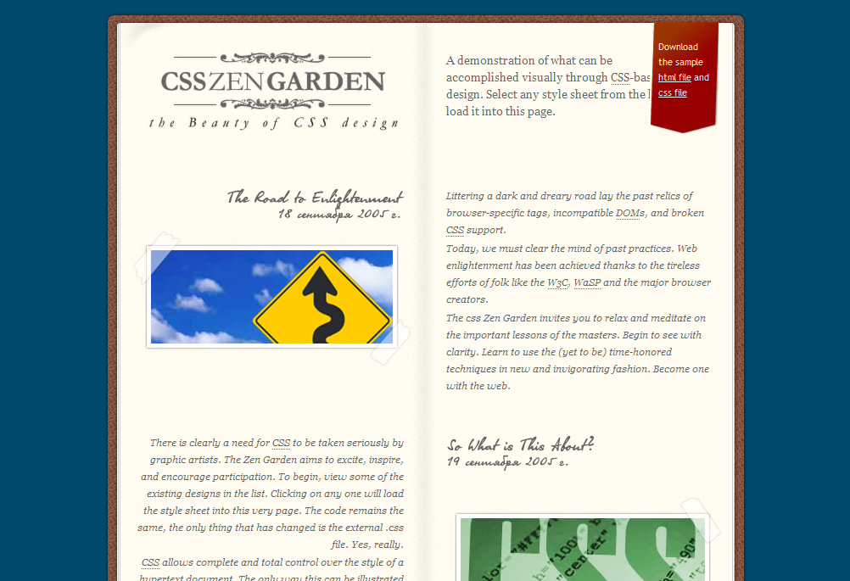

Slide 39
Repetition
Repetition of interface elements creates unity & visual continuity
headlines
page layout
order of menu items
color, shape, texture, size
Include visual breaks, white space, and contrast to avoid monotony!

Slide 40
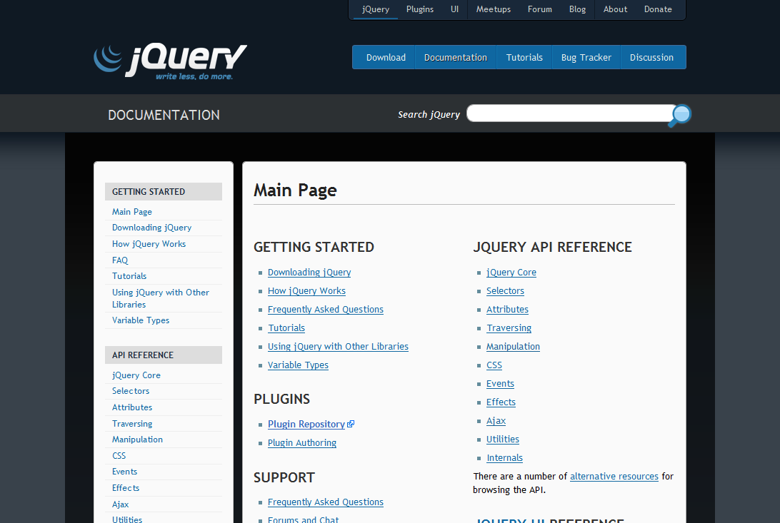

Slide 41
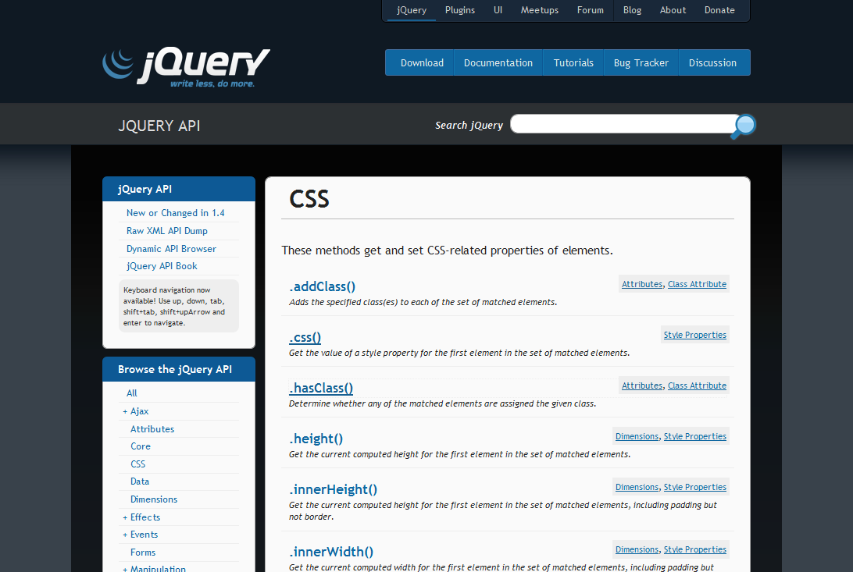

Slide 42
Proximity
Elements that are close together are connected
Let's consider this bulleted list
These items share alignment and are close together
You can conclude that they're related...
And they are: I'm using them all to make the same point
Elements that are further apart differ
This new block makes the counter example

Slide 44
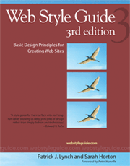
Web Style Guide
http://webstyleguide.com/

Slide 45
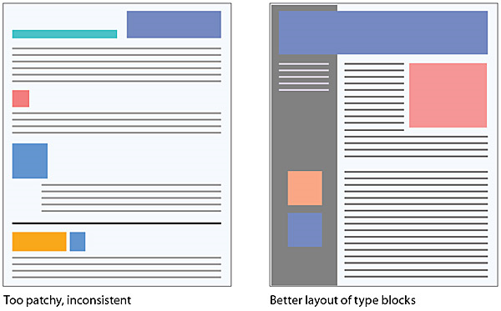
Grids and Layout
[Figure 8.5 — Use contrast and logic to create meaningful repeating patterns of contrast to help the reader quickly make sense of your page layouts.] Retrieved October 1, 2010 from http://webstyleguide.com/wsg3/8-typography/3-legibility.html

Slide 46
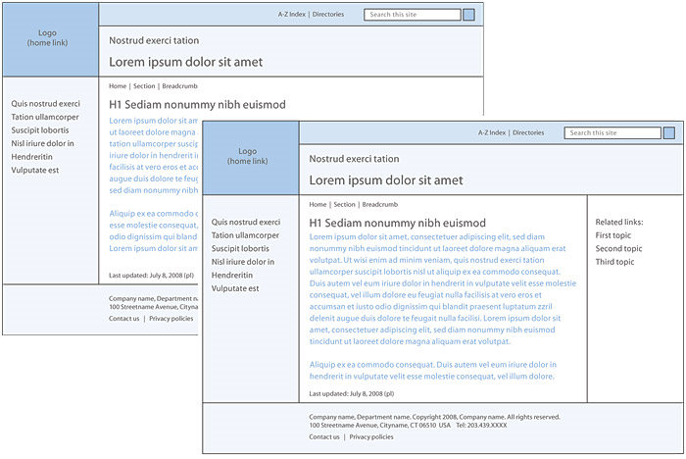
Grids and Layout
[Figure 3.17 — Always consider web conventions and user expectations as you develop the basic structure of page designs.] Retrieved October 1, 2010 from http://webstyleguide.com/wsg3/3-information-architecture/4-presenting-information.html

Slide 47
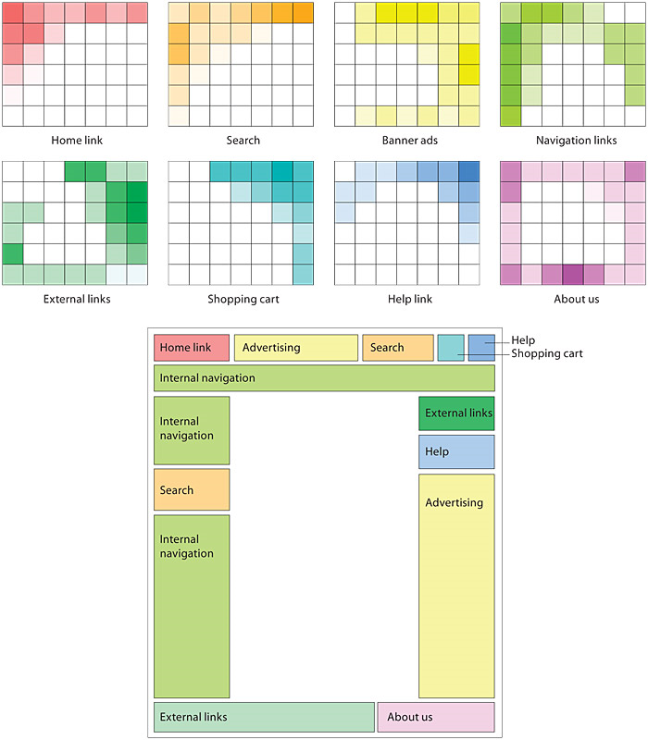
User’s Visual Expectations
[Figure 3.16 — Users have developed clear expectations about where common content and interface elements are likely to appear. Violate these expectations at your peril. Bitmap.] Retrieved October 1, 2010 from http://webstyleguide.com/wsg3/3-information-architecture/4-presenting-information.html

Slide 48
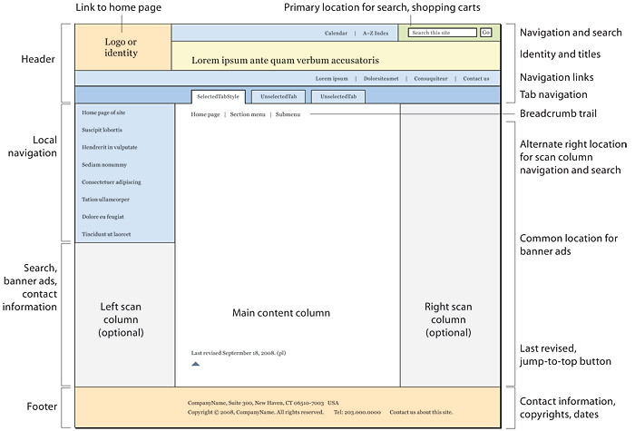
[Figure 6.1 — A canonical page design and major page elements.] Retrieved October 1, 2010 from http://webstyleguide.com/wsg3/6-page-structure/3-site-design.html

Slide 49
The next step
We’ve spent some time on the computer designing our medium-fidelity mock-up
How do we ensure our design is up to our standards before we let users test it?

Slide 50
Usability Testing Roadmap:
Study users and the tasks they perform
Build a low-fi, paper prototype and/or storyboard
Walk through storyboards/prototype with user
Review user feedback
Build a medium fidelity, electronic prototype
Perform Heuristic Evaluation
Study/Evaluate results
Build a high-fidelity prototype
User Testing
Repeat as necessary

Slide 51
Heuristic Evaluation
We run through the interface ourselves guided by a set of principals defining what a good interface should be.
For example, we can use Nielsen’s Heuristics: http://www.useit.com/papers/heuristic/heuristic_list.html
There are only ten, and they are fairly simple.
This process is trial-and-error testing – we learn for ourselves what works and doesn’t work.

Slide 52
Heuristic Evaluation
As you go through the system, note where a heuristic is violated
Where specifically in the interface
How it was violated
How severe the problem is, typically on a 0-4 scale
0 – Not an issue, safe to leave as is
4 – Catastrophic, must be fixed
All team members should do this separately, and combine the results at the end
This way, you don't skew each other's findings

Slide 53
Heuristic Evaluation
For the final project, we do not expect every topic covered by Nielsen’s heuristics to be fully fleshed out.
Where one is less relevant (e.g. contextual help), provide a brief example of where and how it would be used in your interface.

Slide 54
The next step
With your heuristic evaluation results, you should be ready to make more improvements
Use the severity of each heuristic violation as a guideline for what to fix first
These fixes will add up to your next prototype

Slide 55
Usability Testing Roadmap:
Study users and the tasks they perform
Build a low-fi, paper prototype and/or storyboard
Walk through storyboards/prototype with user
Review user feedback
Build a medium fidelity, electronic prototype
Perform Heuristic Evaluation
Study/Evaluate results
Build a high-fidelity prototype
User Testing
Repeat as necessary

Slide 56
Hi-Fidelity Prototype
This is your final “mock-up”
It should work within the confines of the project areas you committed to in your proposal.

Slide 57
User Testing
User testing occurs much like it does with the paper prototype examples
Series of tasks, multiple people taking notes, one facilitating
At this point, an actual computer is doing the work behind the interface.

Slide 58
User Testing
Make sure the environment is as close to the user's real-world environment as possible.
Don't interfere! Let the user make mistakes.
Assure them that the interface is being tested, not the user.
At this point, the goal is to adhere to the “Law of Least Astonishment”
The system always behaves in the way that astonishes the user the least

Slide 59
And in the end...
You will get a highly usable design
You will be confident in your product
You will know where the remaining pain points are and can make cost/benefit decisions from an informed position
But what if I don’t have time for this???
Do as much as you can – and keep these principals in mind as you go. Guerilla usability testing is a great tool when in need.

Slide 60
And most importantly...
LISTEN
You will not always like what you hear.
(But you’re tough. You can take it.)
Don’t treat all feedback equally (good or bad): if you hear the same complaint (or kudo) several times, pay closer attention.
Try not to influence your testers. Just listen to them!

Slide 61
Prototyping Your Project (review)
Think about your users, and the tasks they perform
Build a low-fi, paper prototype and/or storyboard
Build a medium fidelity, electronic prototype
Perform Heuristic Evaluation
Build a high-fidelity prototype

Slide 62
Works Cited
Nielsen, Jakob. (2010). Usability 101: Introduction to Usability. In Jakob Nielsen's Alertbox. Retrieved from http://www.useit.com/alertbox/20030825.html
[Screenshot of Ashley Miles persona]. Retrieved September 29, 2010 from http://wiki.fluidproject.org/display/fluid/Ashley+Myles+%28Undergraduate+Student+-+Archeology%29
Lynch, Patrick J. and Sarah Horton (2008). Web Style Guide, 3rd edition: Basic Design Principles for Creating Web Sites. Retrieved from http://webstyleguide.com/index.html

