Slide 1
AJAX
Asynchronous JavaScript and XML

Slide 2
AJAX
Asynchronous JavaScript and XML
(or JSON, perhaps)

Slide 3
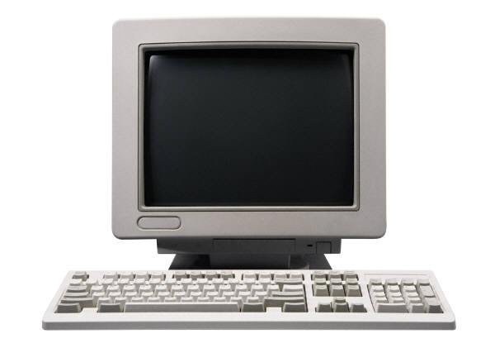

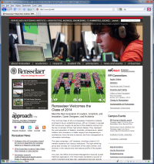
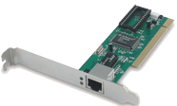


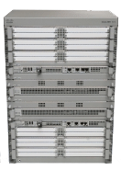

Typical HTTP GET
A browser requests a web page and a full request-response
cycle is initiated. The entire page is loaded, and requests
are made for all other resources
contained on the page.
Application
client
server
Application
apache web server
HTTP GET Request
HTTP Response
Transport
Transport
:80
TCP
ESTABLISHED
ESTABLISHED
TCP
Network
Network
IP
IP
Link
Link
MAC
MAC

Slide 4
AJAX
Asynchronous JavaScript and XML
Allows a browser to request data from a server "behind the scenes" without reloading the entire page
Built on XMLHttpRequest (XHR)
An API introduced by Microsoft in 1999-2000 to help support their development of Outlook Web Access
Picked up by all major browsers shortly thereafter
Popularized by Google with Google Maps and Gmail
W3C picked it up as a working draft in 2006
It is currently a W3C Candidate Recommendation

Slide 5
AJAX Concepts
Asynchronous
during a synchronous request, all scripting and other activities on a web page wait until the full request/response cycle is complete
an asynchronous request happens behind the scenes – a user can continue interacting with a web page, scripts can run, all while waiting for the response
JavaScript
the engine that provides the XMLHttpRequest API
And XML
or not ... can be other formats too, e.g. JSON (very popular)
Notes:
Synchronous - existing or occurring at the same time.
Asynchronous - of or requiring a form of computer control timing protocol in which a specific operation begins upon receipt of an indication (signal) that the preceding operation has been completed.

Slide 6
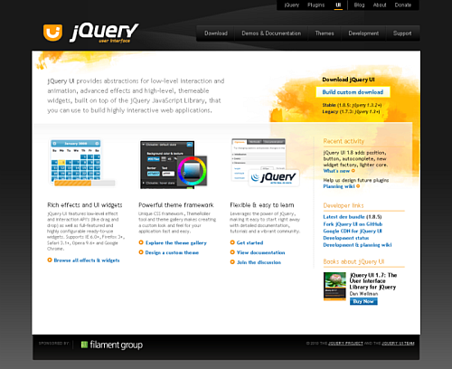
<aside> jQuery

Slide 7
jQuery & AJAX
jQuery provides a number of high-level AJAX methods that handle cross-browser support and simplify the use of XMLHttpRequest
load(), $.getJson(), $.getScript(), $.get(), $.post() For an introduction to these techniques, see: http://net.tutsplus.com/tutorials/javascript-ajax/5-ways-to-make-ajax-calls-with-jquery/
often use the most fundamental & flexible method, jQuery's low-level AJAX implementation: $.ajax()
See: http://api.jquery.com/jQuery.ajax/
http://api.jquery.com/jQuery.getJSON/

Slide 8
Same Origin Policy (SOP)
The same origin policy is a security constraint that prevents scripts from one site accessing methods or properties in scripts from another.
It allows web pages to execute only those methods in scripts with the same scheme, host, and port.
What does that mean to you practically?
Cookies and web pages from different sites are isolated one from another (this is a good thing)
XMLHttpRequest won't work cross-domain
You will want to cache data locally (e.g. json)
You may sometimes want to use special tricks (e.g. jsonp) to dynamically load a remote script (caching is often better)
We'll touch on some of these topics more when we discuss security.
HTML 5 specifies a means of passing simple messages between windows of different origins (see https://developer.mozilla.org/en/DOM/window.postMessage )
Notes:
https://github.com/mrdoob/three.js/wiki/How-to-run-things-locally

Slide 9
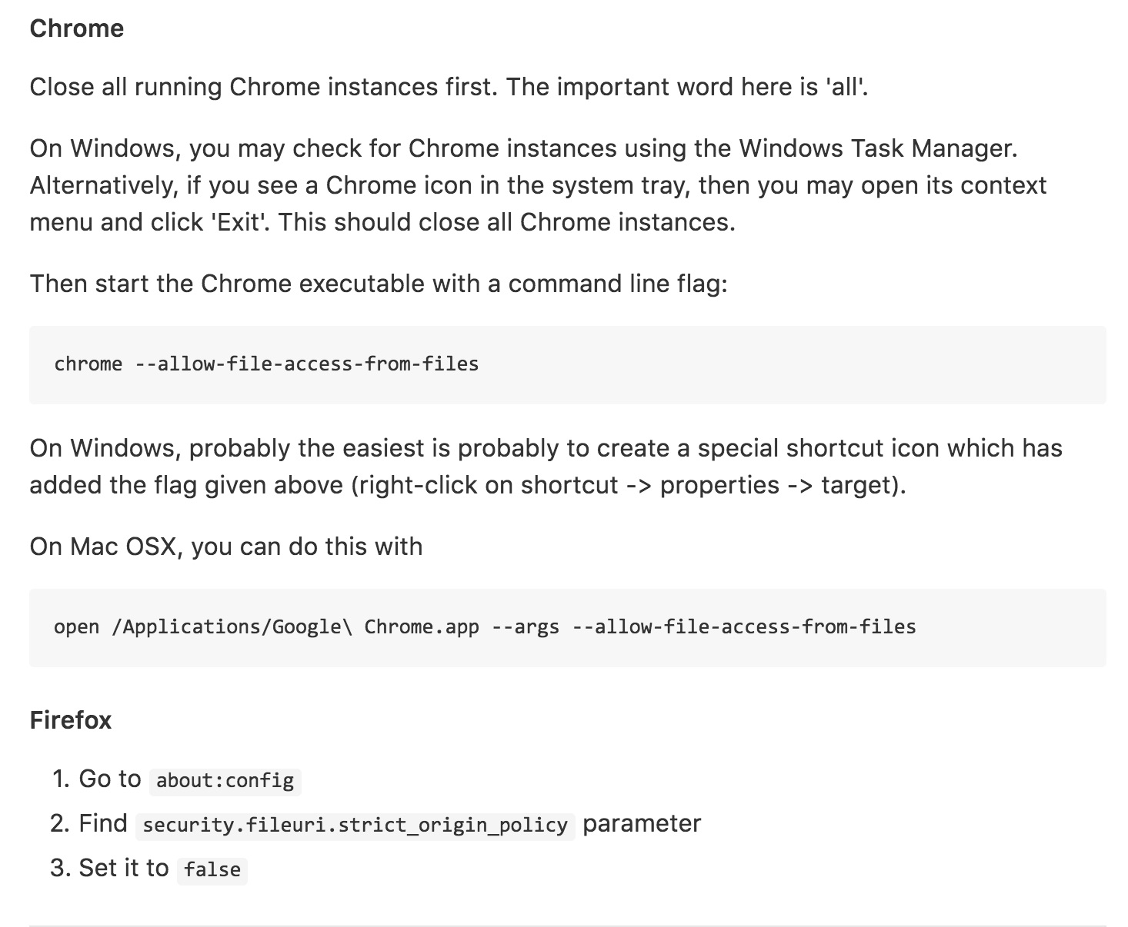
How to deal with SOP when programming?
Use local server
User editor like Brackets
Use AFS server or other host
Start browser with security disabled
Notes:
https://github.com/mrdoob/three.js/wiki/How-to-run-things-locally

Slide 10
Example
Old Lab 7: jQuery & AJAX
Download Lab7 from LMS
Lets look at the code in the Oldlab7 directory
We are going to read from external files into our pages
We will output feeds from two locations:
A json feed from Flickr: http://api.flickr.com/services/feeds/photos_public.gne?format=json&nojsoncallback=1
An rss feed from the New York Times Homepage: http://www.nytimes.com/services/xml/rss/nyt/HomePage.xml

Slide 11
Lab 7
Open lab7instructions.html
We are going to create a JSON file
We are going to create a dynamic menu by reading the contents of that file and using the data for our projects menu on our websites from Lab 3+
We will work on this in class
Lab 7 is due Thursday 10/31 – end of day.

