Slide 1
D3.js, Intro to Web Based Data Visualization
Presented by Bob Monteverde,
Senior Data Visualization Engineer @ Chegg

Slide 2
Overview
Web Standards (no specific to browser code)
Bind arbitrary data to the DOM (Document Object Model)
Capable of generating and manipulating HTML, SVG, CSS and technically more (including canvas).
If you have the data, and you can describe a visualization in 2 dimensions, you can build it with d3.

Slide 3
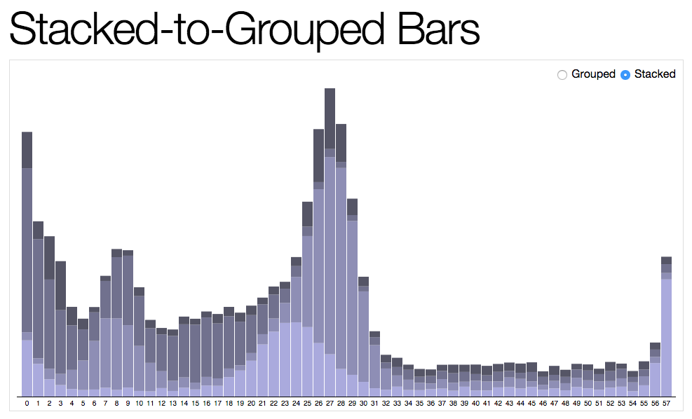
Examples

Slide 4
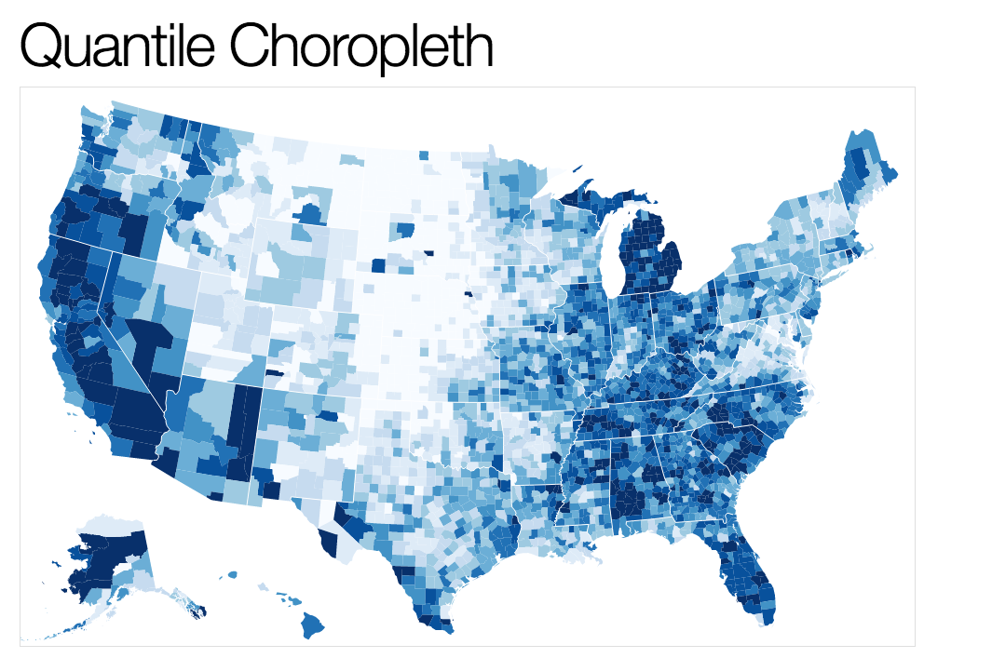
Examples

Slide 5
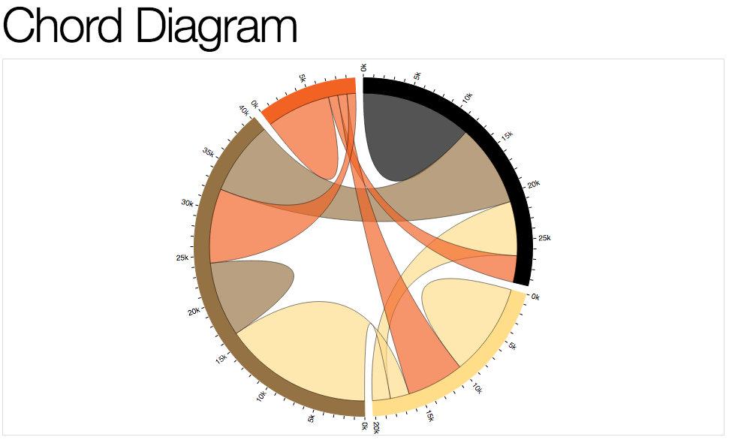
Examples

Slide 6
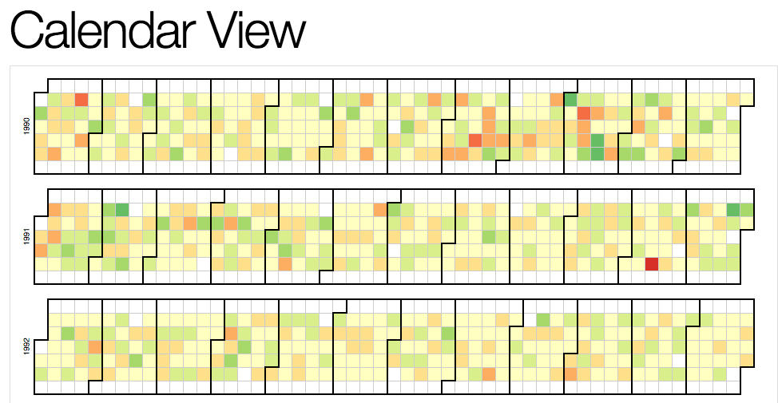
Examples

Slide 7
SELECTIONS
Single Element select: d3.select(‘#css-selector’)
Multi Element: d3.selectAll(‘.css-selector’)

Slide 8
Dynamic properties
d3.selectAll(“p”).style(“color”, “#eee”);
d3.selectAll(“p”).style(“color”, function(d, i) { return i % 2 ? “#fff” : “#eee”; });
d3.selectAll(“circle”) .transition().duration(1000) .delay(function(d,i) { return i * 10; }) .attr(”r”, function(d) { return d.size * 2 })

Slide 9
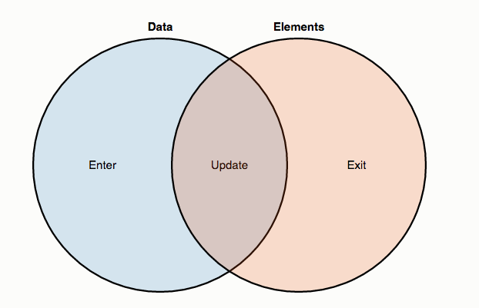
DATA JOINS

Slide 10
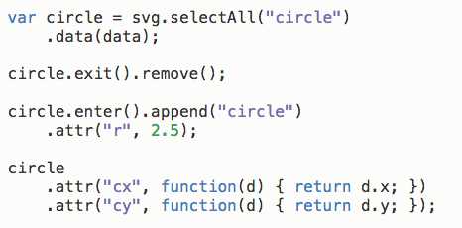
DATA JOINS

Slide 11
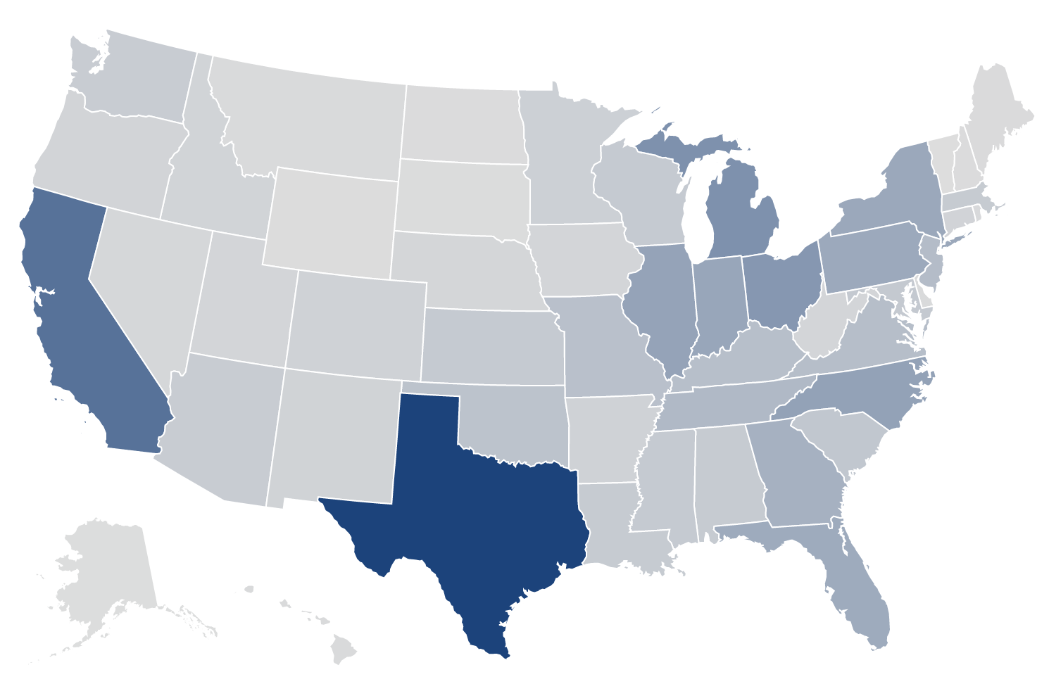
Lets build a map

Slide 12
STEP 1
Setup HTML and JS Templates

Slide 13
STEP 2
Build a US Map with TopoJSON data

Slide 14
STEP 3
Get your Data Ready to Visualize

Slide 15
STEP 4
Show your data by adding color to the states

Slide 16
STEP 5
Lets Animate this Map over time

Slide 17
QUESTIONS?

