Slide 1
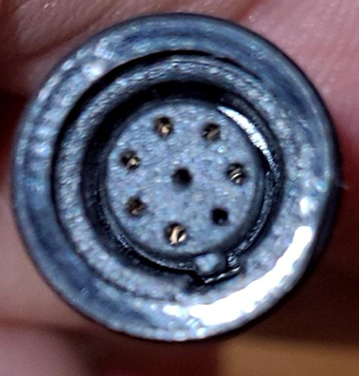
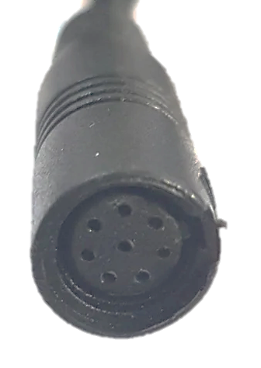
28V
CAN H
?
Brown
Orange
GND
Black
CAN L
Green
Red
5V OUT
?
?
Female

