Slide 1


Slide 2


NOTICE

Slide 3
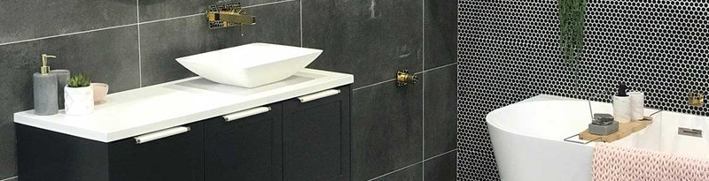
BATHROOM

Slide 4

DAILY SUPPLIES
BATHROOM

Slide 5

BATHROOM
ELECTRONICS

Slide 6

ELECTRONICS
INTERIOR

Slide 7
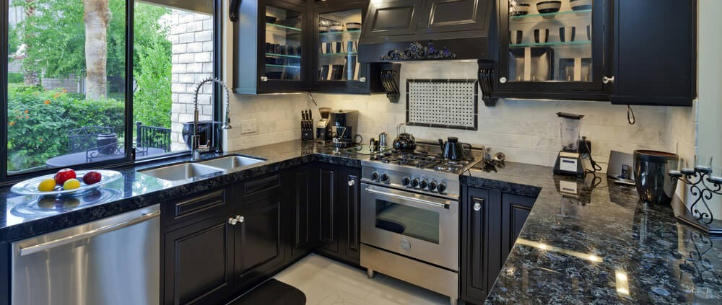
INTERIOR
KITCHEN

Slide 8

KITCHEN
OFFICE SUPPLIES

Slide 9

KNUNIVERSE

