Slide 1
RV32I (no CSR &no iFence) Core
Tarun Govind Kesavamurthi
North Carolina State University
tkesava@ncsu.edu

Slide 2
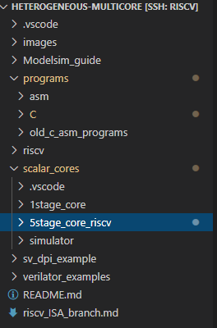
Core - source code Source - https://github.ncsu.edu/tkesava/Heterogeneous-multicore.git
riscv_ISA branch contains RV32i sources.
Scalar_cores:
1stage_core – single cycle core
5stage_core_riscv – 5 stage scalar core
Simulator – functional simulator for verification (in progress)
riscv: Contains riscv ISA spec and RV32i supported instructions list xls
Programs:
C : riscv_test – riscv ISA compliance tests
Common:
Boot assembly file - init.s
Linker script – link.ld
Init c source file (vector table)– init1.cc
Custom lib file – myClib
Median
Multiply
Qsort
Spmv
* Additional riscv_tests to be ported*
ASM : Assembly level tests

Slide 3
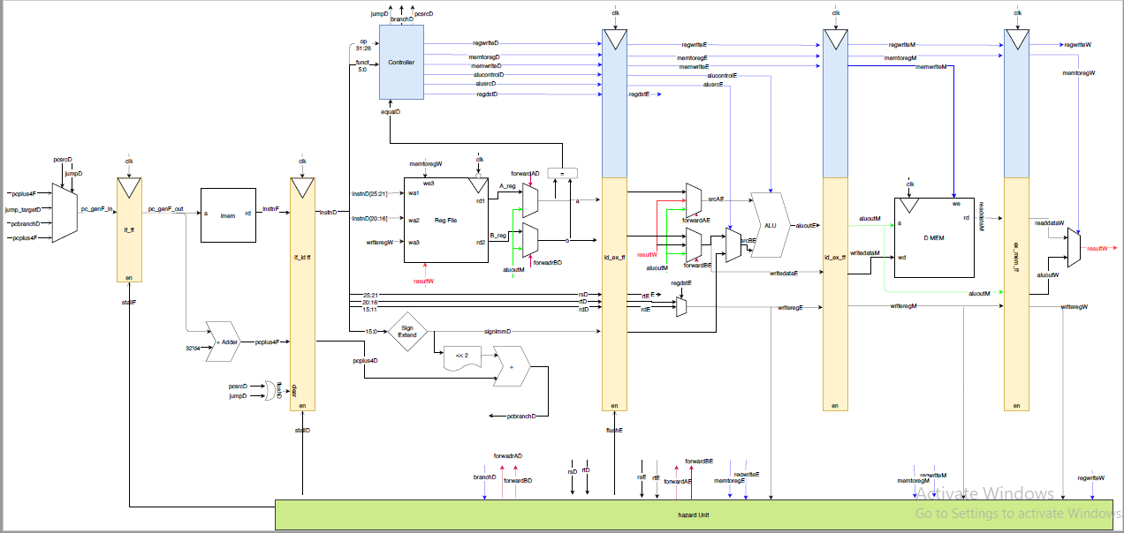
5 Stage riscv core – base

Slide 4
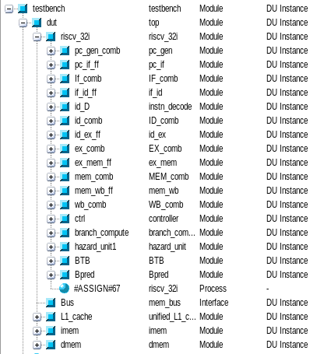
Module hierarchy – As mentioned
debug_headerfile.svh – All config params of the core
+EXEC – argument for memory file
Verilator_tb
Recent updates – Optional (bimodal) branch predictor and BTB with parameterizable structure sizes

Slide 5
Software hardware interface
CONSOLE_ADDR – “32’d65540”: address treated as console address to check the results
Linker sections
Text : program instructions (including the bootloader instns)
Vector : Contains static global readonly vector table
Data : Initialized global and static data variables in the program
Bss : Uninitialized global data variables in the program
Start of a section is stored in the symbol _s*section_name* (Eg: _stext)
End of a section is stored in the symbol _e*section_name* (Eg: _etext)

Slide 6
Custom C library – myClib
Limited functionality: only focused to generate print statements
Methods provided in myClib (as on 09/23/2020) –
atoi
write_string
write_char
See source in programs/common/myClib for the args

Slide 7

Thread migration and 3D physical design (current work)
Idea: Migrate threads between cores like Jimmy Page playing double neck guitar.
Action plans: Create two 5-stage scalar cores and swap the threads dynamically with a thread swap controller
Putfalls:
Polluted BTB and Branch Predictor
A series of cache misses after thread swap

Slide 8
Thread Migration Controller
Thread migration controller:
Timer in thread migration controller, which keep track of the switching time
Swap all in-flight instructions in the pipeline stages
Cache misses caused by thread migration?
Branch miss predicts caused by thread migration?
Switch the entire front end of the pipeline (fetch and decode) with a central mux.
IF
ID
EX
MEM
WB
Thread migration controller
IF
ID
EX
MEM
WB

Slide 9
Thread Migration – HMP (with out of order super scalar cores)
iMEM
Decoder
iMEM
Decoder
ARF & RMT
RS
FU
ARF & RMT
RS
FU
ROB
ROB
FU
FU
Thread Swap Controller

Slide 10
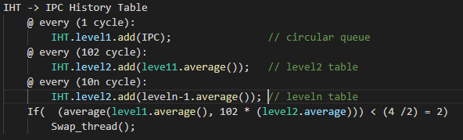
Thread Migration Controller
Monitor the IPC of both cores
Fill the history table recording the IPC for n instruction cycles
Compute and compare the weighted average IPC recorded and make a decision
Level 1
Level 2
Average Compute & Compare
Swap_threads

Slide 11
Improvements and Future plans
Core:
Use SOC standard interface with the core (wishbone or AMBA – AHB etc)
Port all riscv_tests
Add base 18 CSR registers, CSR instructions and fence instruction support (additional 10 instructions)
Physical Design:
720 like Physical design and the 3D methodology flow for the core (Scalar heterogenous version)
Out of order heterogenous core development

