Slide 1
Service Mesh & Observability for Microservices
MeshMart: Resiliency, Traffic Control, and Telemetry in a Kubernetes Cluster
Distributed Systems Course Project | Presentation Deck

Slide 2
The Monolith to Microservices Paradox
- Dynamic Business Split: Monolith decomposition creates isolated scaling domains but introduces network dependencies.
- Network Boundary Failures: Internal function calls are replaced by HTTP network hops that can lag, drop, or fail.
- Operational Blindspots: Difficult to trace request latency or isolate failure locations across many backend microservices.
- Code Clutter: Implementing retry, timeout, and circuit breaker logic in business code leads to duplication and complexity.
- Infrastructure Solution: Moving communication policies to the platform layer keeps service microservices clean.

Slide 3
MeshMart Scope & Service Boundaries
- frontend: Nginx container serving the storefront web UI and proxying endpoints.
- product-service: FastAPI app managing database catalog, reviews, and stock locks.
- order-service: FastAPI app acting as the transactional Saga orchestrator and transaction logger.
- payment-service: FastAPI app simulating bank approvals, declines, and processor delays.
- notification-service: FastAPI app simulating SMS or email alerts to consumers post-checkout.

Slide 4
API Endpoints & Service Contracts
- GET /products ➔ Returns catalog products list.
- POST /products/{id}/reviews ➔ Submits customer review details.
- POST /orders ➔ Initiates order checklist flow (supports Idempotency-Key headers).
- POST /inventory/reserve ➔ Locks product inventory in database.
- POST /inventory/commit ➔ Confirms permanent inventory decrement on payment success.
- POST /payments ➔ Simulates transaction billing.
- POST /notifications ➔ Sends alert result directly.

Slide 5
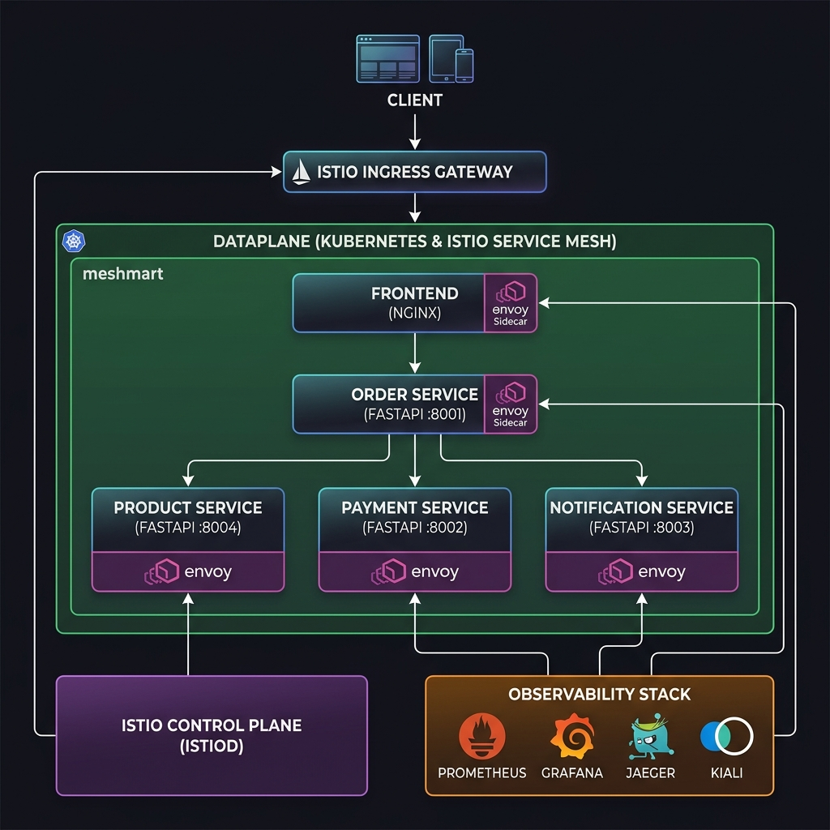
System Deployment Architecture
- Ingress Gateway: Public traffic enters via the Istio Ingress Gateway and maps routes by URL path.
- Envoy Interception: Each application container is paired with an Envoy sidecar proxy (istio-proxy) injected in the meshmart namespace.
- Control Plane (istiod): Translates high-level YAML policies into xDS config updates for proxies.
- Observability Pipeline: Sidecar Envoy proxies automatically collect and emit performance telemetry to metrics stores.

Slide 6
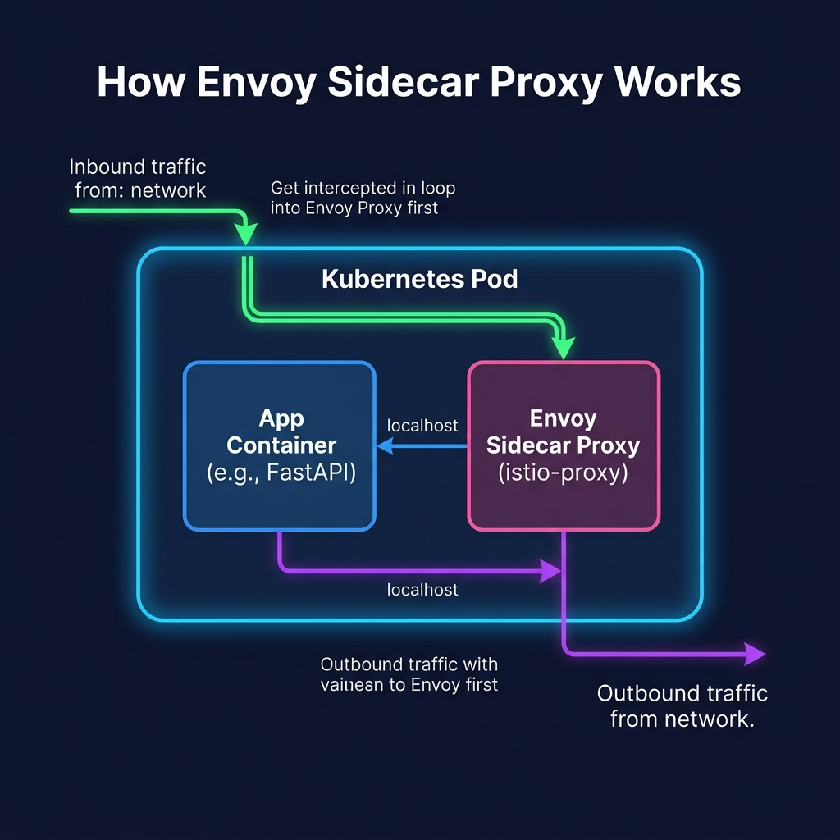
Network Interception: How Envoy Works
- iptables Redirection: All traffic entering or leaving a pod is transparently redirected to local Envoy proxies.
- Inbound Traffic: Ingress calls are intercepted by Envoy, checked for security policies, and forwarded via localhost.
- Outbound Traffic: App outbound calls are intercepted by Envoy to apply timeouts, retries, and trace headers.
- Zero App Intrusion: FastAPI applications operate without modifying code to interact with network rules.

Slide 7
Distributed Transactions (Saga Pattern)
- Isolation Limits: Traditional database locks cannot span network boundaries safely in microservices.
- Saga Orchestration: order-service manages the checkout steps sequentially.
- Eventual Consistency: Each microservice processes its local transaction and reports state back.
- Dynamic Rollback: If payment declines, the orchestrator triggers compensation calls to rollback stock.

Slide 8
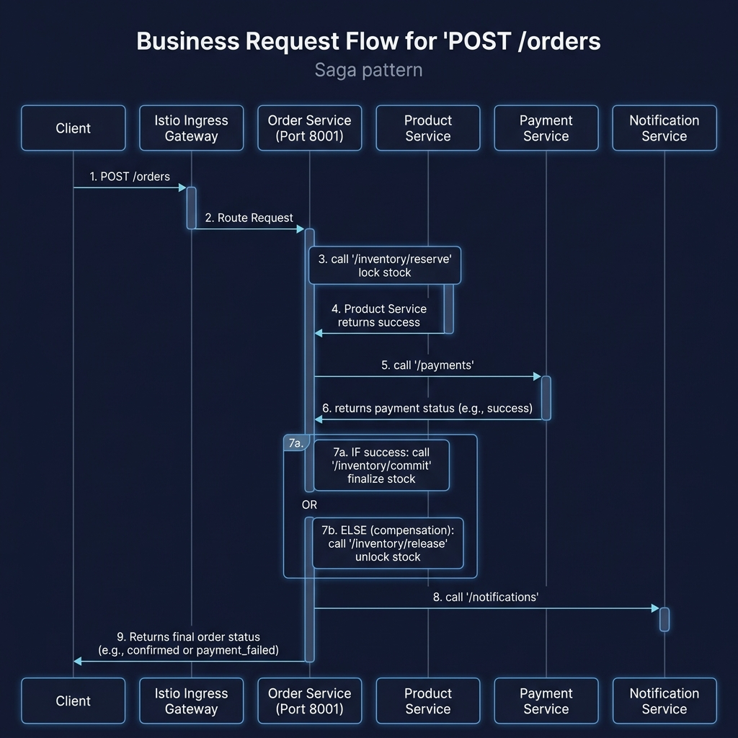
Saga Transaction Success Flow
- Check Idempotency: Checks database key to prevent double checkout processing.
- Step 1 (Reserve): order-service requests /inventory/reserve to lock catalog stock.
- Step 2 (Billing): order-service queries payment-service (/payments).
- Step 3 (Commit): On payment success, order-service calls /inventory/commit to complete stock reduction.
- Step 4 (Alert): order-service notifies user via notification-service.

Slide 9
Saga Rollback & Stock Compensation
- Problem: Stock lock succeeded, but credit card transaction failed or timed out.
- Inconsistent State: Products cannot remain locked if payment failed.
- Step 1 (Release): order-service catches payment failure and calls /inventory/release.
- Step 2 (Restore): product-service restores in-memory stock values.
- Result: Avoids database drift or stock locking issues during billing failures.

Slide 10
Idempotency Key Guard
- Network Disconnection Risk: A client billing request succeeds, but connection drops before response is received.
- The Double Click Problem: Users click 'Checkout' twice, executing duplicate payments.
- Idempotency Cache: order-service caches Idempotency-Key headers with responses.
- Fingerprint Verification: Verifies order contents match the original payload.
- Conflict handling: Returns active processing errors (409) or cached order logs immediately.

Slide 11
Ingress Path-Based Routing
- Gateway Configuration: Single public host/port receives external client calls.
- Path Prefixes (virtual-service): Matches endpoints to backend services.
- Route mappings: / ➔ frontend, /products ➔ product-service, /orders ➔ order-service.
- Decoupled Architecture: Public URLs are clean and decoupled from target cluster ports.

Slide 12
Resilience: Timeouts & Retries
- Timeouts: Aborts lagging calls at proxy levels (orders: 8s, product: 4s, payments: 3s).
- Protects thread pools: Prevent slow downstream dependencies from locking server queues.
- Retries: 2 retry attempts configured in VirtualServices.
- Transient Failures: Envoy transparently handles socket glitches before reporting errors to app.

Slide 13
Chaos Engineering: Fault Injection
- Testing resilience: Injecting failures into live staging environments without changing code.
- Istio Fault policy: Configured in payment-fault-injection.yaml.
- Settings: 30% of requests to payment-service receive a 2-second delay.
- Validation: Confirms order-service handles timeout limits gracefully.

Slide 14
DestinationRules: Connection Pools
- Traffic Policy Settings: Caps max TCP/HTTP connection resources in destination-rule.yaml.
- Port Protection: Prevents microservices from crash failures during high traffic surges.
- Configured Limits: payment-service: 20 max connections, product-service: 50, order-service: 100.
- Client queueing: Envoy queues overflow requests until downstream resources clear.

Slide 15
Outlier Detection (Circuit Breaking)
- Self-Healing Mesh: Monitors and ejects bad replica pods automatically.
- Trigger settings: 3 consecutive 5xx errors in a 10s interval.
- Ejection Rule: Bypasses the bad pod for 30 seconds, forwarding traffic to healthy replicas.
- Cascade Protection: Stops failing nodes from crashing other dependencies.

Slide 16
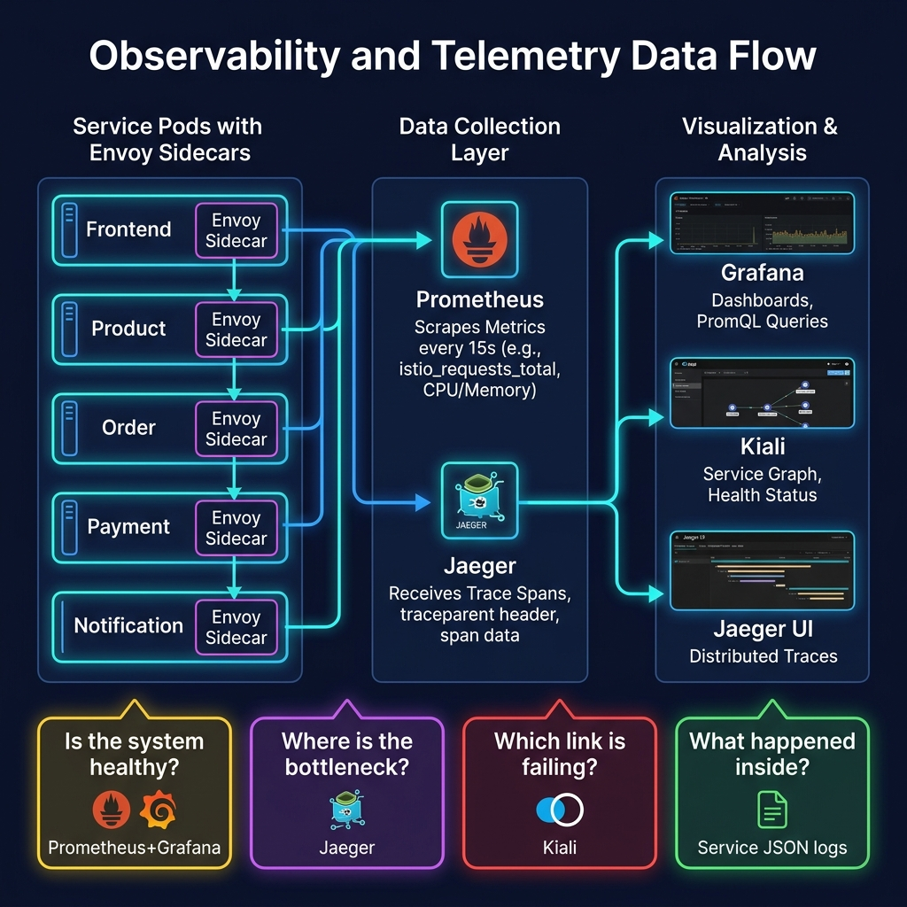
Observability & Telemetry Pipeline
- Prometheus Scraper: Gathers HTTP request metrics directly from sidecars every 15s.
- Jaeger Collector: Receives span spans to trace requests across microservice hops.
- Kiali Graph: Consumes metrics and configs to draw a live dependency graph.
- Grafana: Queries metrics and displays dashboards (Latency percentiles, Traffic, Error Rates).

Slide 17
Outage Diagnostics & Evidence
- Step 1 (Alert): Grafana dashboards show a spike in p90 response latencies.
- Step 2 (Isolate): Kiali mesh graph highlights the failing service edge in red.
- Step 3 (Pinpoint): Jaeger tracing isolates the exact slow/failed downstream span.
- Step 4 (Inspect): Query application logs with the request_id to find trace details.
- Evidence-based: Diagnostics are backed by actual telemetry graphs.

Slide 18
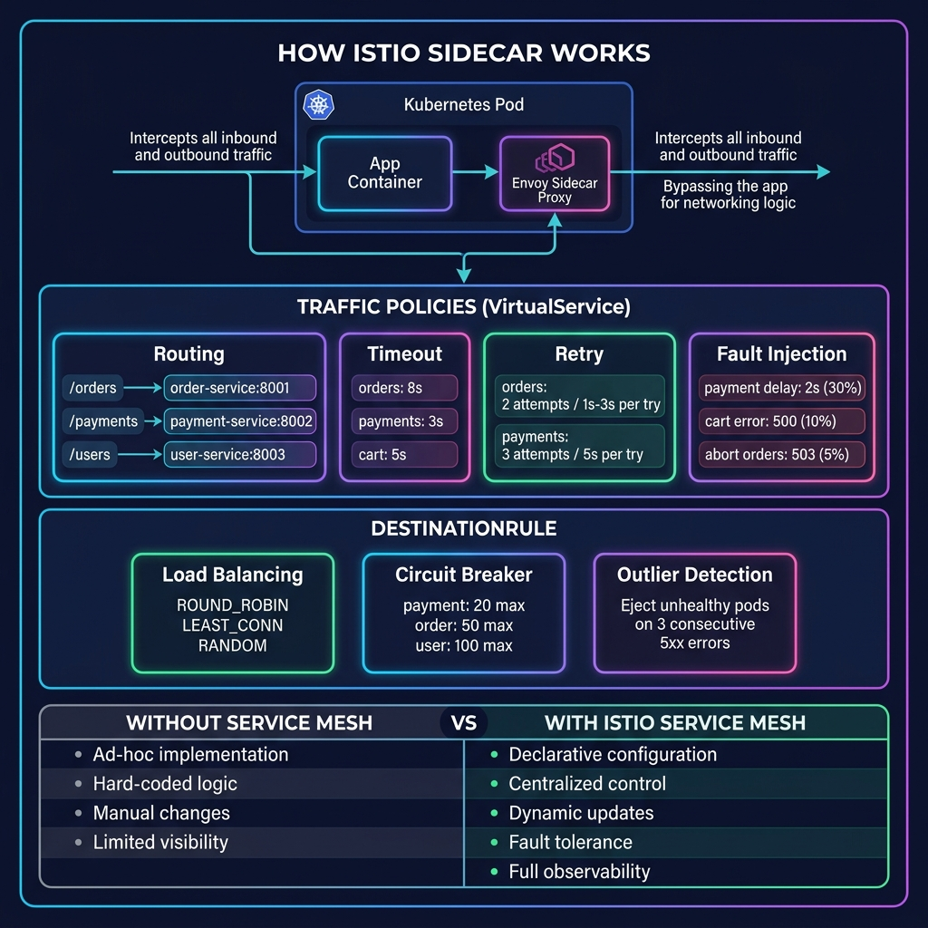
Workload Scaling & Capacity
- Resource Profiles: Pod configurations enforce CPU/Memory limits to prevent starvations.
- Horizontal Pod Autoscaler (HPA): Spawns replica pods dynamically based on CPU request loads.
- Pod Disruption Budget (PDB): Guarantees at least 1 active pod during cluster maintenance.
- Stress Testing: Ran k6 load scripts to trace HPA performance under load.

Slide 19
Limitations & Production Roadmap
- Persistent Database Integration: Migrate current in-memory lists to PostgreSQL instances.
- Shared Idempotency Cache: Migrate local dict stores to a shared Redis cluster.
- Zero-Trust Security: Enable strict mutual TLS (mTLS) policies and authorization header tokens.
- Automated Alerting: Define Prometheus alert rules with PagerDuty webhook destinations.

Slide 20
Key Technical Takeaways
- Separation of Concerns: Communication policies are managed by Istio, keeping code lightweight.
- Actionable Telemetry: Combining metrics, traces, and logs is mandatory for operating microservices.
- Resilient Transactions: Distributed systems must adopt Saga rollbacks and idempotency guards.
- Operation Mindset: MeshMart demonstrates how modern services are observed, secured, and scaled.

