Slide 1
HW#5A EKF Localization with Known Landmarks
Out：2019/05/01
Due: 2019/05/15

Slide 2
Task
Task: Localize your robot correctly using EKF while it circles around
Landmarks correspondences are known
Positions are given
Motion model & sensor model are perturbed
Randomly but the variances are given
Utilize MATLAB to implement the algorithm and visualize the results.
Hand in MATLAB script(s) which allows TA’s to verify your result by just one click.

Slide 3
Prewritten Vehicle Model and Sensor Model for Physical World Modeling
X_t = VehicleModel(v, w, X_t-1)
v : Forward speed
w : Rotation speed
X_t-1 : Previous state [X, Y, Theta]
X_t : Current state (This information is for validation purposes. Don’t use it in your algorithm!!)
Data = SensorModel(X_t)
X_t : Actual state [X, Y, Theta]
Data : Sensor readings [Flag, Distance, Relative angle]
If landmark is in cart’s left hand side, Relative angle > 0

Slide 4
For better explanation…
Actuator uncertainty
c1, c2, c3, c4
VehicleModel(v, w)
Localization
Algorithm
State : X predict
Emulated world
with landmarks
State : X
Sensor uncertainty
Q
SensorModel ([X_t])

Slide 5

Self check list & tips
Can you handle landmark’s’ simultaneously?
Does it works stably at each run?
Visualize your results
Direction of robot’s heading
Variance of states
Use different color before & after filtering
About 2~4 hours work
Seek for help if longer than expected

Slide 6
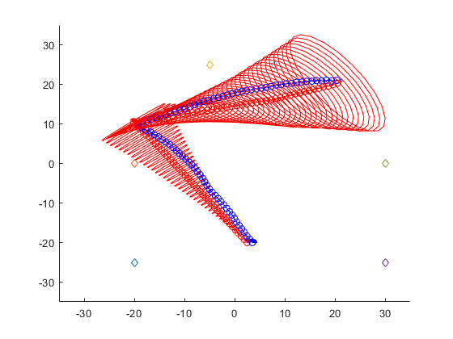
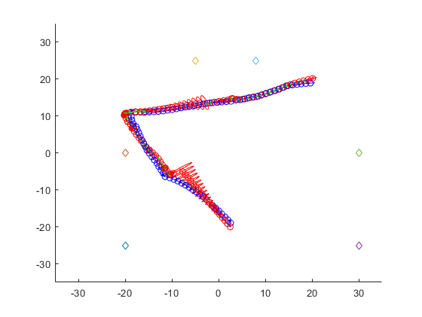
As reference…
Without sensor
With sensor
Red: predicted
Green: updated
Blue: actual

Slide 7
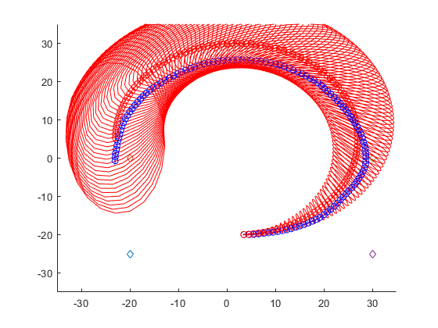
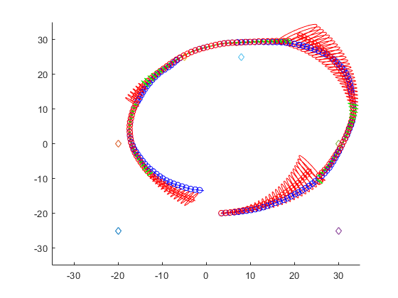
As reference…
Without sensor
With sensor
Red: predicted
Green: updated
Blue: actual

