Slide 1


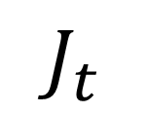
jump
jump
$$J_{t}$$
$$J_{1}$$
$$J_{2}$$

