Slide 1
Machine Learning Fundamentals Final Project
Bob Patton
bobpatton3@gmail.com

Slide 2
Overview
I started by duplicating the efforts discussed in the Capstone Instructions document.
I then moved on to exploring various Regressions that I expected to bear fruit. Bottom line: none of them did!
So I started looking at Classification models and had much greater results specifically with a Naïve Bayes model based on language used in the essays.

Slide 3
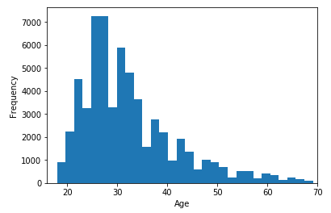
Columns Added
I added the drinks_code, drugs_code, smokes_code, essay_len, word_len, and I_me_counts columns as suggested.
Subsequent investigations led me to add:
sex_code: 0 for male and 1 for female
education_code: my attempt to rationalize these into some sort of hierarchy was probably mis-guided
age_decade: are they in their 20’s, 30’s, 40’s, etc.
age_stage: are they 35 or younger vs older than 35. That age was driven by a combination of wanting to compare “younger” folks against “older” folks but also trying to ensure there was a reasonable amount of data on the “older” side since the users are so heavily skewed to the younger side as seen in the histogram:

Slide 4
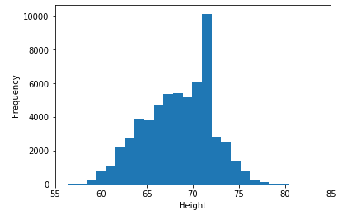
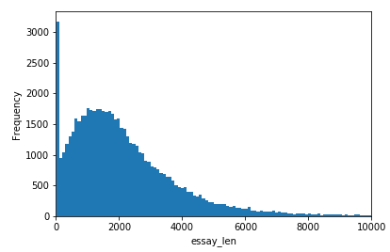
Beginnings
In attempts just to understand the data I graphed the following histograms and the two-variable correlation scatter plots on the following page.

Slide 5
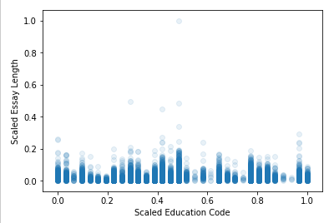
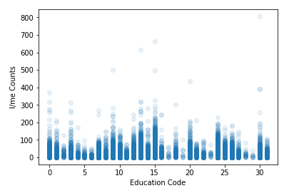
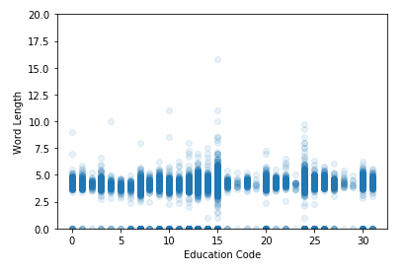
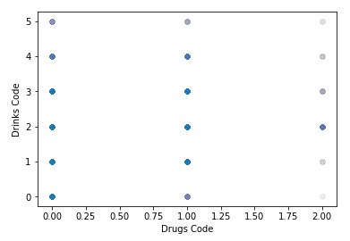
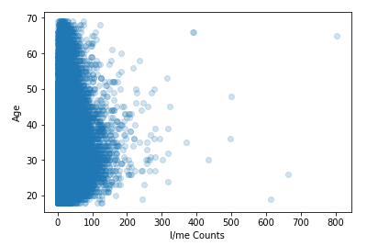
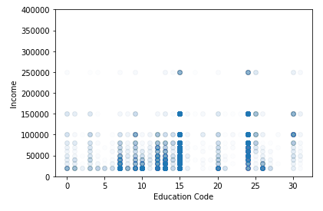
Assorted Explorations

Slide 6
Scatter-plot Analysis
The top three don’t show much hope for any correlation but that could easily land with my attempts to apply a rational ordering or hierarchy to the selections available for the education column.
Just on the basis of visual inspection of the bottom three plots, one is left with the impression that there are relationships between these variables. Clearly not simple linear relationships but maybe in conjunction with the correct set of features a multiple linear regression might find some correlations.

Slide 7
Data Issues
Turns out about 80% of the income data is -1 … which I can only assume means that they declined to answer. But that makes it difficult to do much with it. Obvious questions to ask would be:
How well does income correlate with gender, age, education?
Could gender, age, education, and possibly some additional features be used in a linear regression that could have some success at predicting income?
But this missing data drastically limits our chances of answering these questions with any confidence.
Note that the data choices are also increasingly coarse. Even for a good model, regression prediction scores would suffer from this on the high end with increasing variances from the allowed values.

Slide 8
Early Models 1
Despite the income data issues, I tried first to do a LinearRegression model with the features smokes_code, drinks_code, drugs_code, essay_len, word_len, I_me_counts, and education_code to see if those could predict income.
I had not first done a test-train split as I should have but the prediction score even on the whole training dataset was so bad (0.018) that there was no reason to go back and correct that.
I kept up this potentially bad habit of not splitting the dataset, only going back and doing the test-train split when I finally found a model (much much later) that was worth the time.

Slide 9
Early Models 2
I decided I should try to reproduce the zodiac sign results as described in the project document. I ran a KNeighborsClassifier with n_neighbors = 45 and got results similar to those reported in the document: 0.096
There are 48 distinct possible responses in the “sign” data. The recall values for the entries varied between 0 and 0.167. The zeros seemed to be for those values that had so few counts in the data that they would never end up being selected out of an n=48 nearest neighbor model.
The values for precision similarly varied between 0 and 0.126
Nothing worth writing home about.

Slide 10
A Flurry of Regression Attempts
A flurry of regression models followed (linear unless stated):
essay_len and word_len to predict income: 0.001 (worse than before)
I_me_counts to predict age: 0.002
essay_len, word_len, I_me_counts predicting age: 0.017 Much better! But still lousy. RMSE shows I am averaging about a decade off.
Throw in education_code and up it to 0.042. Still improving… still lousy!
How about a KNeighborsRegressor instead with n_neighbors = 200: 0.146 and RMSE of 8.6 years. A 3.4X improvement over the LinearRegression!
sex_code and education_code to predict income: 0.003
All-in-all, nothing to get excited about.

Slide 11
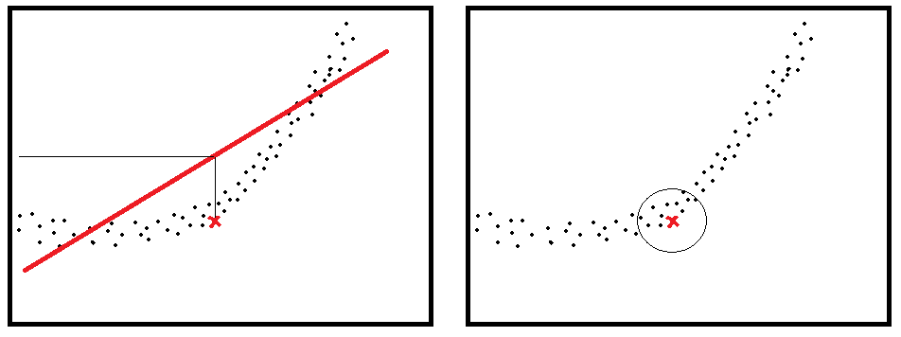
Pondering the KNeighborsRegressor vs. LinearRegression difference
I wondered why there was such a big difference between the attempt to predict age using a LinearRegression model vs that using a KNeighborsRegressor model. It seems to me that if there was data that was correlated but not in a linear way then it would be possible for this to happen. In this situation the KNeighborsRegressor could act, in broad terms, almost like the tangent lines to curves in calculus:

Slide 12
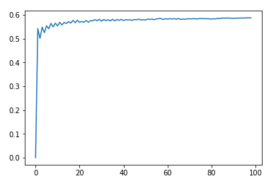
Classification Models
I decided to try the KNeighborsClassifier using essay_len, word_len, I_me_counts, and income to predict sex. I ran it in a loop on the number of neighbors and ended up with the following:
So we only get slightly better than half or, in other words ,not much better than flipping a coin!
The recall is 0.26 for “f” and 0.80 for “m” while precision is 0.47 for “f” and 0.61 for “m” which, since there are more males, could easily
Happen with a confusion matrix like:
It seems it is getting some of its “accuracy” by predicting males rather often since there are more males in the system.
 | m | f
Predicted m | 32 | 20
Predicted f | 8 | 7

Slide 13
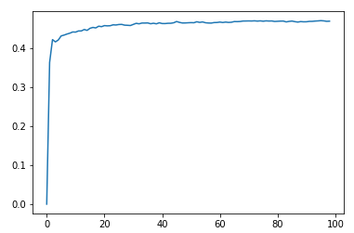
Classification Models
I wondered if these same features could do a better job of predicting age. But that has too many labels so this is when I decided to create the age_decade column. I ran the loop on the number of neighbors and obtained:
That yields an accuracy of 0.46 for 50 neighbors which doesn’t sound terrible since there are 6 main decades represented in the data.
However, when you look at the recall and precision the values are 0.0 for decades 1, 5, and 6 and the recall value for decade 4 is near zero. So a good chunk of its accuracy is just in always predicting the decades that are most common in the data. So if it is almost always choosing decade 2 or 3 which is 80% of the test data then flipping a coin would get you to 0.4 – so, once again, not much predictive value here.

Slide 14
Naïve Bayes and Vocabulary
My significant lack of success up to this point led me to consider trying a different tack. What about looking at active vocabulary? That can often vary by education and definitely seems in general experience to have differences between generations.
So I added another column to the data that I called essays_long_words but by “long” all I meant was at least 5 characters. This was to shorten the list of words used and filter out typical pronouns, prepositions, conjunctions and such. Nonetheless that resulted in 135,314 unique words! Much more than I was expecting.

Slide 15
Naïve Bayes and Vocabulary - gender
I attempted using a MultinomialNB model with the counts of the items in essays_long_words to predict gender. Accuracy came out to 0.73 – the best I had obtained so far! Recall and precision were as follows:
The data are 60-40 male to female so properly weighted random choosing would result in an accuracy of 0.52 and:
If I had time to investigate further it seems possible that there might be some subset of words that would deliver better results.
 | f | m
Recall | 0.84 | 0.66
Precision | 0.62 | 0.86
 | f | m
Recall | 0.40 | 0.60
Precision | 0.40 | 0.60

Slide 16
Naïve Bayes and Vocabulary – young or old?
The next question was could MultinomialNB and essays_long_words predict if a subject was under or over 35 years old. Accuracy came out to 0.82! Recall and precision were as follows:
The data is 72% “young” so weighted random choosing would result in an accuracy of 0.597 and precision and recall both being 0.72 for young and 0.28 for old. So this model is pretty decent!
Again, it seems feasible that a more strategically selected vocabulary could deliver better results.
 | young | old
Recall | 0.88 | 0.68
Precision | 0.87 | 0.70

Slide 17
Naïve Bayes and Vocabulary – misc
I tried a handful of other classifications using vocabulary with less impressive results:
education
job
age_decade
religion
I also tried splitting religion into its base (Buddhism, Christianity, etc.) and its modifier (“not too seirous about it”, etc.)

Slide 18
Naïve Bayes and Religion
It occurred to me I could treat the text in the religion column and run the CountVectorizer on that focusing on the words agnosticism, atheism, other, too, very, somewhat, laughing to see if those could predict drug usage (with apologies to atheists and agnostics for my assumptions here). Initial results looked great with an accuracy of 0.81!
But when you look at the recall and precision you see that the model was just always predicting “never”:
…because 80% of the 31K people who entered a response to this question answered “never”.
I encountered the exact same situation trying to predict drinks and the model predicted “socially” 100% of the time and so was correct 71% of the time!
 | never | sometimes | often
Recall | 1 | 0 | 0
Precision | 0.81 | 0 | 0

Slide 19
Next Steps
Doing a bit of reverse-engineering to improve the Naïve Bayes models by exploring vocabulary differences between genders and ages could be interesting and illuminating.
It would be nice to have more and more specific income data. The categories get much broader at higher values which has implications for how the accuracy is calculated. Given time I would have written a custom accuracy calculator that translated, for example, a predicted income of $123,456.78 down to $100,000 which is what a person with that income would have chosen from the list.

Slide 20
Conclusions
It probably shouldn’t have been but it was none-the-less surprising to me how many attempts resulted in models that had no predictive value.
I had no luck with linear regression models.
The KNeighborsRegressor performed better but still not the kind of result I would hope for.
Using essay vocabulary and a Naïve Bayes model had the best predictive results of anything I tried.

